Slide 1
Tanks
Matthew Goldstein, Savanah Many, and Joseph Chouinard

Slide 2
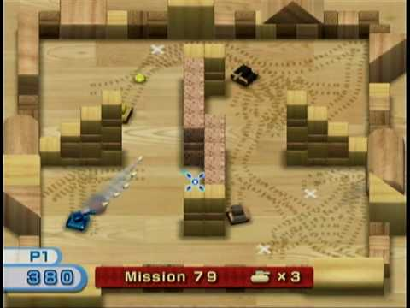
The Game - Tanks
A Windows rendition of the WiiPlay game “Tanks”

Slide 3
Controls
W – move forward
A – rotate left
S – move backward
D – rotate right
P – pause / un-pause
R - restart
Space – place mine
Move mouse – aim gun
Mouse Left Click – fire gun

Slide 4
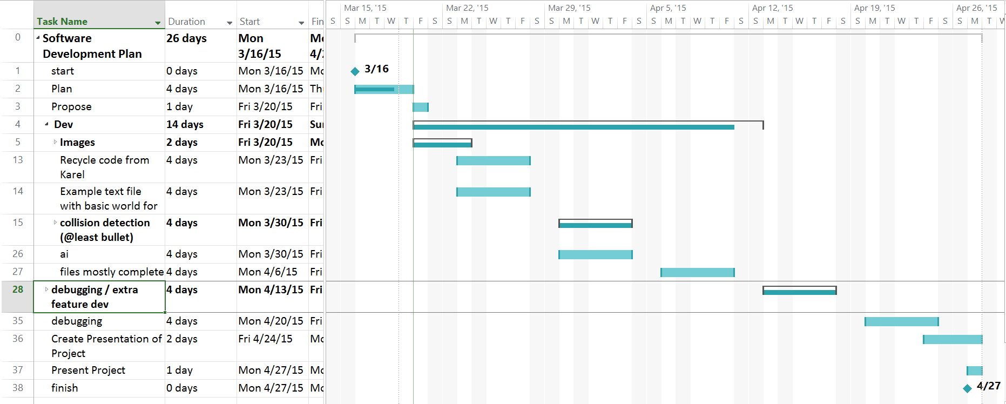
Project Management
Microsoft Project Gantt Chart

Slide 5
Work Breakdown
Joe – World Management / Drawing objects, Walls, & Collision Detection
Matt – AI, ReadFile, TanksObject, & Collision Detection
Savanah – Tanks, Bullets, & Mines
All - Images

Slide 6
Structure
Arrows
Show Inheritance

Slide 7






We Aren’t Graphic Designers

Slide 8
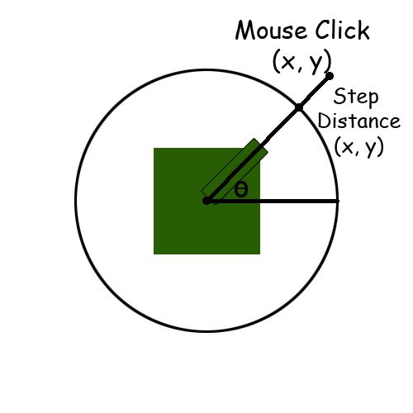
Bullet Mechanics

Slide 10
Set-backs
Collision Detection
ReadFile not properly opening a file
Rotating Images
Can’t use custom pointer because it breaks ReadFile (Windows.h)
Can’t return template arrays

Slide 11
Things We’ve Learned
Matt hates making games
Learned the logic behind collision detection
Planning ahead helped us keep on track (mostly)
Nothing goes as well as you plan

Slide 12
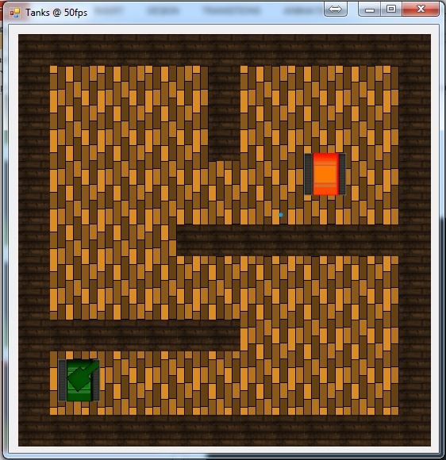
Screenshots

Slide 17
Game Demonstration

Slide 18
Any Questions?

