Slide 1
TPC-C: The OLTP Benchmark
June 2002
Prof. Sang Ho Lee
Soongsil University
shlee@computing.ssu.ac.kr

Slide 2
What is the TPC?
TPC = Transaction Processing Performance Council
Founded in Aug/88 by Omri Serlin and 8 vendors.
Membership of 40-45 for last several years
    Everybody who’s anybody in software & hardware
De facto industry standards body for OLTP performance
Administered by:
Shanley Public Relations ph: (408) 295-8894
777 N. First St., Suite 600 fax: (408) 295-9768
San Jose, CA 95112-6311 email: td@tpc.org
Most TPC specs, info, results are on the web page:
http://www.tpc.org

Slide 3
TPC-C Overview
Moderately complex OLTP
The result of 2+ years of development by the TPC
Application models a wholesale supplier managing orders.
Order-entry provides a conceptual model for the benchmark; underlying components are typical of any OLTP system.
Workload consists of five transaction types.
Users and database scale linearly with throughput.
Spec defines full-screen end-user interface.
Metrics are new-order transaction rate (tpmC) and price/performance ($/tpmC)
Specification was approved July 23, 1992.
Current version: 5.0 (Feb. 2001)

Slide 4

Wholesale Supplier Schema
company
Warehouse-1
………………..…
Warehouse-N
District-1
.……
District-10
………………..…
Customer-1
.….
Customer-3k
………………..…

Slide 5
TPC-C Database Schema
Warehouse
W
Stock
W*100K
Item
100K (fixed)
100K
W
10
Legend
Table Name
<cardinality>
District
W*10
one-to-many
relationship
secondary index
3K
Customer
W*30K
Order
W*30K+
New-Order
W*5K
1+
0-1
1+
10-15
History
W*30K+
Order-Line
W*300K+

Slide 6
TPC-C’s Five Transactions
OLTP transactions:
  New-order: enter a new order from a customer
  Payment: update customer balance to reflect a payment
  Delivery: deliver orders (done as a batch transaction)
  Order-status: retrieve status of customer’s most recent order
  Stock-level: monitor warehouse inventory
Transactions operate against a database of nine tables.
Transactions do update, insert, delete, and abort;
primary and secondary key access.

Slide 7
Response Time Restriction
Transaction Type
New-Order
Payment
Order-Status
Delivery
Stock-Level
90th Percentile
Response Time
5 sec
5 sec
5 sec
5 sec
20 sec
Minimum
Keying Time
18 sec
3 sec
2 sec
2 sec
2 sec
Minimum Mean
of Think Time
12 sec
12 sec
10 sec
5 sec
5 sec

Slide 8
Transaction Mixing
The terminal population must maintain a minimum percentage of mix for each transaction type
Transaction Type
New-Order
Payment
Order-Status
Delivery
Stock-Level
Minimum % of mix
N/A
43.0
4.0
4.0
4.0

Slide 9

TPC-C Workflow
1
Select txn from menu:
1. New-Order 45%
2. Payment 43%
3. Order-Status 4%
4. Delivery 4%
5. Stock-Level 4%
Cycle Time Decomposition
(typical values, in seconds,
for weighted average txn)
Menu = 0.3
Keying = 9.6
Txn RT = 2.1
Think = 11.4
Average cycle time = 23.4
2
Measure menu Response Time
Input screen
Keying time
3
Measure txn Response Time
Output screen
Think time
Go back to 1

Slide 10
Data Skew
NURand - Non Uniform Random
  NURand(A,x,y) = (((random(0,A) | random(x,y)) + C) % (y-x+1)) + x
    Customer Last Name: NURand(255, 0, 999)
    Customer ID: NURand(1023, 1, 3000)
    Item ID: NURand(8191, 1, 100000)
  bitwise OR of two random values
  skews distribution toward values with more bits on
    75% chance that a given bit is one (1 - ½ * ½)

Slide 11
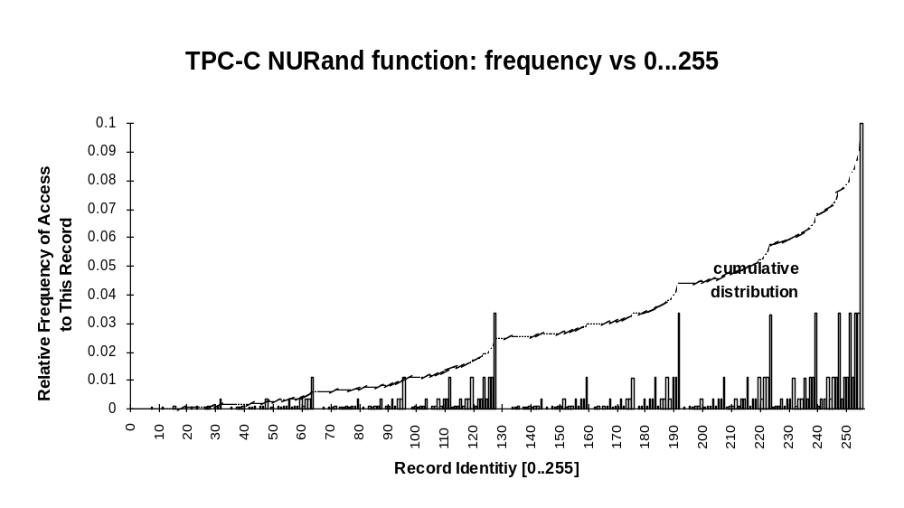
NURand Distribution

Slide 12
ACID Tests
TPC-C requires transactions be ACID.
Tests included to demonstrate ACID properties met.
Atomicity
  Verify that all changes within a transaction commit or abort.
Consistency
Isolation
  ANSI Repeatable reads for all but Stock-Level transactions.
  Committed reads for Stock-Level.
Durability
  Must demonstrate recovery from
    Loss of power
    Loss of memory
    Loss of media (e.g., disk crash)

Slide 13
Transparency
TPC-C requires that all data partitioning be fully transparent to the application code. (See TPC-C Clause 1.6)
  Both horizontal and vertical partitioning is allowed
  All partitioning must be hidden from the application
    Most DBMS’s do this today for single-node horizontal partitioning.
    Much harder: multiple-node transparency.
  For example, in a two-node cluster:
Any DML operation must be
able to operate against the
entire database, regardless of
physical location.
Node A
select *
from warehouse
where W_ID = 150
Node B
select *
from warehouse
where W_ID = 77
Warehouses:
1-100
101-200

Slide 14
Transparency (cont.)
How does transparency affect TPC-C?
  Payment txn: 15% of Customer table records are non-local to the home warehouse.
  New-order txn: 1% of Stock table records are non-local to the home warehouse.
In a distributed cluster, the cross warehouse traffic causes cross node traffic and either 2 phase commit, distributed lock management, or both.
For example, with distributed txns:
Number of nodes % Network Txns
1 0
2 5.5
3 7.3
n → ∞10.9

Slide 15
Measurement (1)
Ramp-up time
  Time for reaching steady state in executing benchmark
Measurement interval
  Steady state period during the execution of the benchmark for which the test sponsor is reporting a throughput rating
  Must be lasting during 20 minutes
Ramp-down time
  Time after measurement interval in executing benchmark

Slide 16
Measurement (2)
Measurement method
  Calculate the number of new-order transactions completed in a measurement interval
    Completed transaction: transaction that committed and displayed output data to screen or succeeded in an intentional rollback
Database scaling
  Satisfy 9 tpmC per warehouse
  Satisfy the all response restrictions

Slide 17
TPC-C Rules of Thumb
1.2 tpmC per User/terminal (maximum)
10 terminals per warehouse (fixed)
65-70 MB/tpmC priced disk capacity (minimum)
~ 0.5 physical IOs/sec/tpmC (typical)
250-700 KB main memory/tpmC (how much $ do you have?)
So use rules of thumb to size 10,000 tpmC system:
  How many terminals?
  How many warehouses?
  How much memory?
  How much disk capacity?
  How many spindles?
» 8340 = 10000 / 1.2
» 834 = 8340 / 10
» 2.5 - 7 GB
» 650 GB = 10000 * 65
» Depends on MB capacity vs. physical IO. Capacity: 650 / 8 = 82 spindles
IO: 10000*.5 / 82 = 61 IO/sec TOO HOT!

Slide 18
Typical TPC-C Configuration (Conceptual)
Emulated User Load
Presentation Services
Database Functions
Term.
LAN
C/S
LAN
Database
Server
Driver System
Client
Hardware
...
Response Time
measured here
RTE, e.g.:
Empower
preVue
LoadRunner
TPC-C application +
Txn Monitor and/or
database RPC library
e.g., Tuxedo, ODBC
TPC-C application
(stored procedures) +
Database engine +
Txn Monitor
e.g., SQL Server, Tuxedo
Software

Slide 19
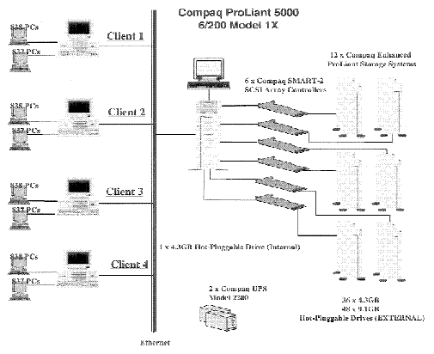
Competitive Configuration as of 1997
8070 tpmC; $57.66/tpmC; 5-yr COO= 465 K$
2 GB memory, disks: 37 x 4GB + 48 x 9.1GB (560 GB total)
6,700 users

Slide 20
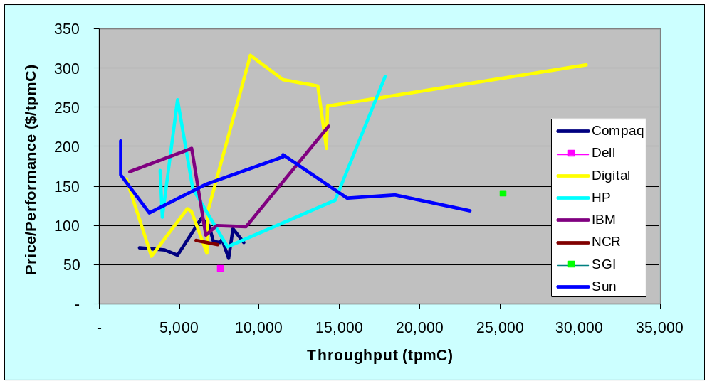
TPC-C Current Results
Best Performance is 30,390 tpmC @ $305/tpmC (Digital)
Best Price/Perf. is 7,693 tpmC @ $42.53/tpmC (Dell)
TPC-C results as of 5/9/97

Slide 21
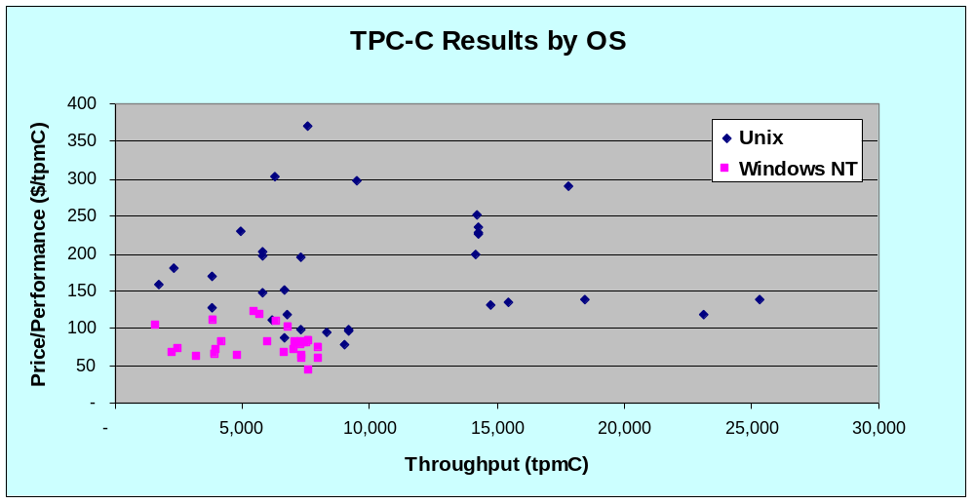
TPC-C Results (by OS)
TPC-C results as of 5/9/97

Slide 22
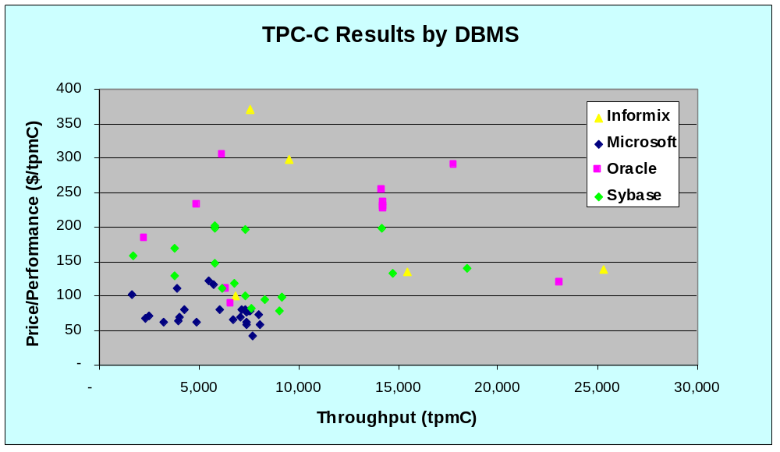
TPC-C Results (by DBMS)
TPC-C results as of 5/9/97

Slide 23
Analysis from 30,000 ft.
Unix results are 2-3x more expensive than NT.
  Doesn’t matter which DBMS
Unix results are more scalable
  Unix: 10, 12, 16, 24 way SMPs
  NT: 4-way SMP w/ Intel & 8-way SMP on Digital Alpha
Highest performance is on clusters
  only a few results (trophy numbers?)

Slide 24
TPC-C Summary
Balanced, representative OLTP mix
  Five transaction types
  Database intensive; substantial IO and cache load
  Scaleable workload
  Complex data: data attributes, size, skew
Requires Transparency and ACID
Full screen presentation services
De facto standard for OLTP performance

Slide 25
Reference Material
TPC Web site: www.tpc.org
TPC Results Database: www.microsoft.com/sql/tpc
IDEAS web site: www.ideasinternational.com
Jim Gray, The Benchmark Handbook for Database and Transaction Processing Systems, Morgan Kaufmann, San Mateo, CA, 1991.
Raj Jain, The Art of Computer Systems Performance Analysis: Techniques for Experimental Design, Measurement, Simulation, and Modeling, John Wiley & Sons, New York, 1991.
William Highleyman, Performance Analysis of Transaction Processing Systems, Prentice Hall, Englewood Cliffs, NJ, 1988

