Slide 1
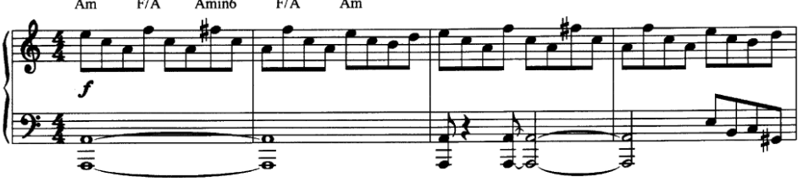
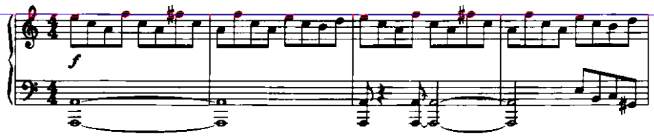
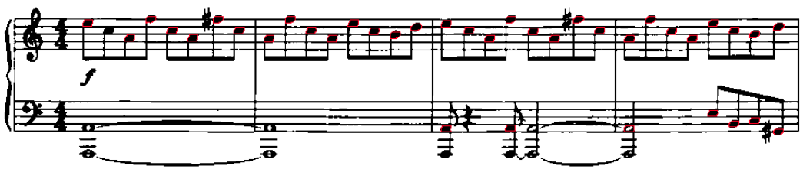
Procedure
(1) Line Detection
(2) Contour tracing
(3) Classification

Slide 2
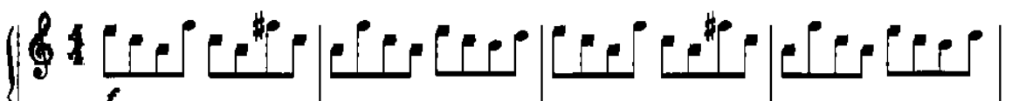
Contour Tracing
(1) Trace contours around the lines with boundary
(2) Remove the lines BTW
(3) Trace contours within the spaces between two lines

Slide 3



Contour Tracing (To be Improved)
#1 Notes with hole could be broken when removing the lines
Broken
Solution: not removing tiny segment of lines
#2 Easy to be confused with parts of the bigger shapes
Solution: trace contours w/o boundary
#3 If trace w/o boundary, needs to remove the vertical line as well.

