Slide 1


ASP.NET Core 1.0
(formerly ASP.NET 5) Lean .NET stack for building modern web apps
Muhammad Afzal Qureshi
Software Architect
@goldytech
http://goldytech.wordpress.com
Visual Studio 2015 and ASP.NET

Slide 2

Agenda
What is new ASP.NET Core ?
How does it work ?
Getting familiar with the new project structure
MVC 6
Questions

Slide 3
What is new Asp.net Core
Lean .NET stack for building modern web apps
Built from the ground up
Cross platform (Windows, OSX and Linux)
Unified programming model that combines MVC, Web API, and Web Pages
Consists of modular components with minimal overhead.
Middleware based and built in IoC
Utilizes modern tooling like Bower,Gulp,Grunt and NPM
Every request is served under DNX context.
Cloud optimized.
Open source in GitHub from the beginning https://github.com/aspnet/Mvc
Easy install from http://get.asp.net

Slide 4
How it works
System.web assembly no more exists
You choose to whatever you plan to use by registering middleware.
public void Configure(IApplicationBuilder app, IHostingEnvironment env, ILoggerFactory loggerfactory)
{
app.UseErrorHandler("/Home/Error");
app.UseStaticFiles();
app.UseIdentity();
app.UseMvc(routes => ...)
}

Slide 5
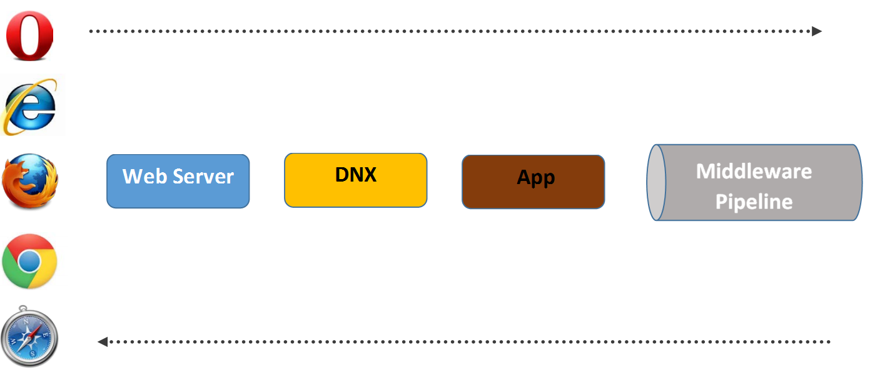
The complete picture

Slide 6
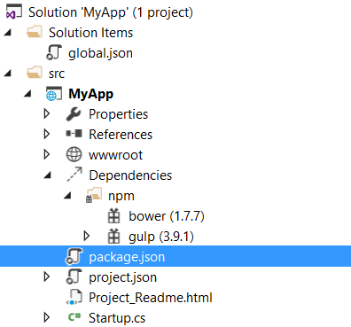
Demo: New Project Structure

Slide 7
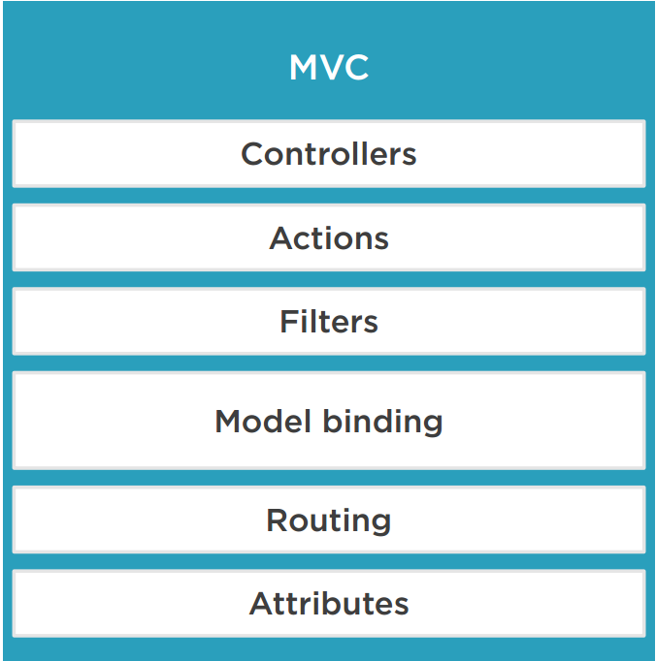
Web API in ASP.NET MVC 6
MVC, Web API, and Web Pages are merged into a single framework called MVC 6
Tag Helpers
Razor syntax : @Html.EditorFor(m => m.Name)
Tag Helpers :<input asp-for=“Name”></input>

Slide 8
View Components
Similar to partial views, but much more powerful
Something like mini-controller
Responsible for rendering a chunk
Some examples for view components usage:
Dynamic navigation menus
Tag cloud
Login panel
Recently published articles
Sidebar

Slide 9



Environments
Staging
Production
Development

Slide 10
Software and Useful Links
Visual Studio 2015
https://www.visualstudio.com/en-us/downloads/download-visual-studio-vs.aspx
Documentation and Roslyn source code
https://github.com/aspnet/Home
https://github.com/aspnet/Home/wiki
https://github.com/aspnet/mvc
Demo code available in GitHub:
https://github.com/goldytech/IPLAnalytics

Slide 11
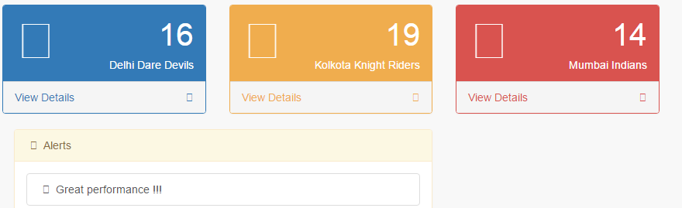
Demo: Asp.net in action

Slide 12
Thank you

