Slide 1

WEB DEVELOPMENT INTERN AT InternPe Pvt. Ltd.
Name : Maitreya Awad
Roll no : 33205
Class : TE-10
Internship Guide: Dr. Shweta C. Dharmadhikari
Reviewer:
Mr. Abhinay G. Dhamankar

Slide 2
Contents
Introduction
Result
About the company
Conclusion
Objectives
Scope
Tech Stack

Slide 3

Introduction
As a part of curriculum internship, I have completed a 1-month internship at InternPe Pvt. Ltd.
The internship duration was from 27th Feb 2023 to 26th March 2023.
The nature of internship was virtual (work from home).
The role assigned was Web development intern.

Slide 4

About Company
InternPe Ltd is a software and product development company delivering innovative business IT solutions and mainly web design solution to customers across the globe.
It is known for maintenance of websites of other firms / creation of multimedia presentations for other firms etc.

Slide 5
Objectives
To understand the basic foundations for building a web app.
To design and develop a system with enhanced features and scalability.
To learn about MERN stack and how to build projects using it.
To understand how frontend and backend are integrated with each other.

Slide 6
Scope
Exploring different web technologies. Also using them to solve real world problems and to gain knowledge of MERN stack.
Understand how to integrate Front-end with Back-end. Also to learn about API’s and how data fetching is done on the server side

Slide 7
Tech Stack
HTML
CSS
JAVASCRIPT
MONGODB
EXPRESS JS
REACT JS
NODE JS
SOCKET IO

Slide 8
RESULT (SCREENSHOTS)

Slide 9
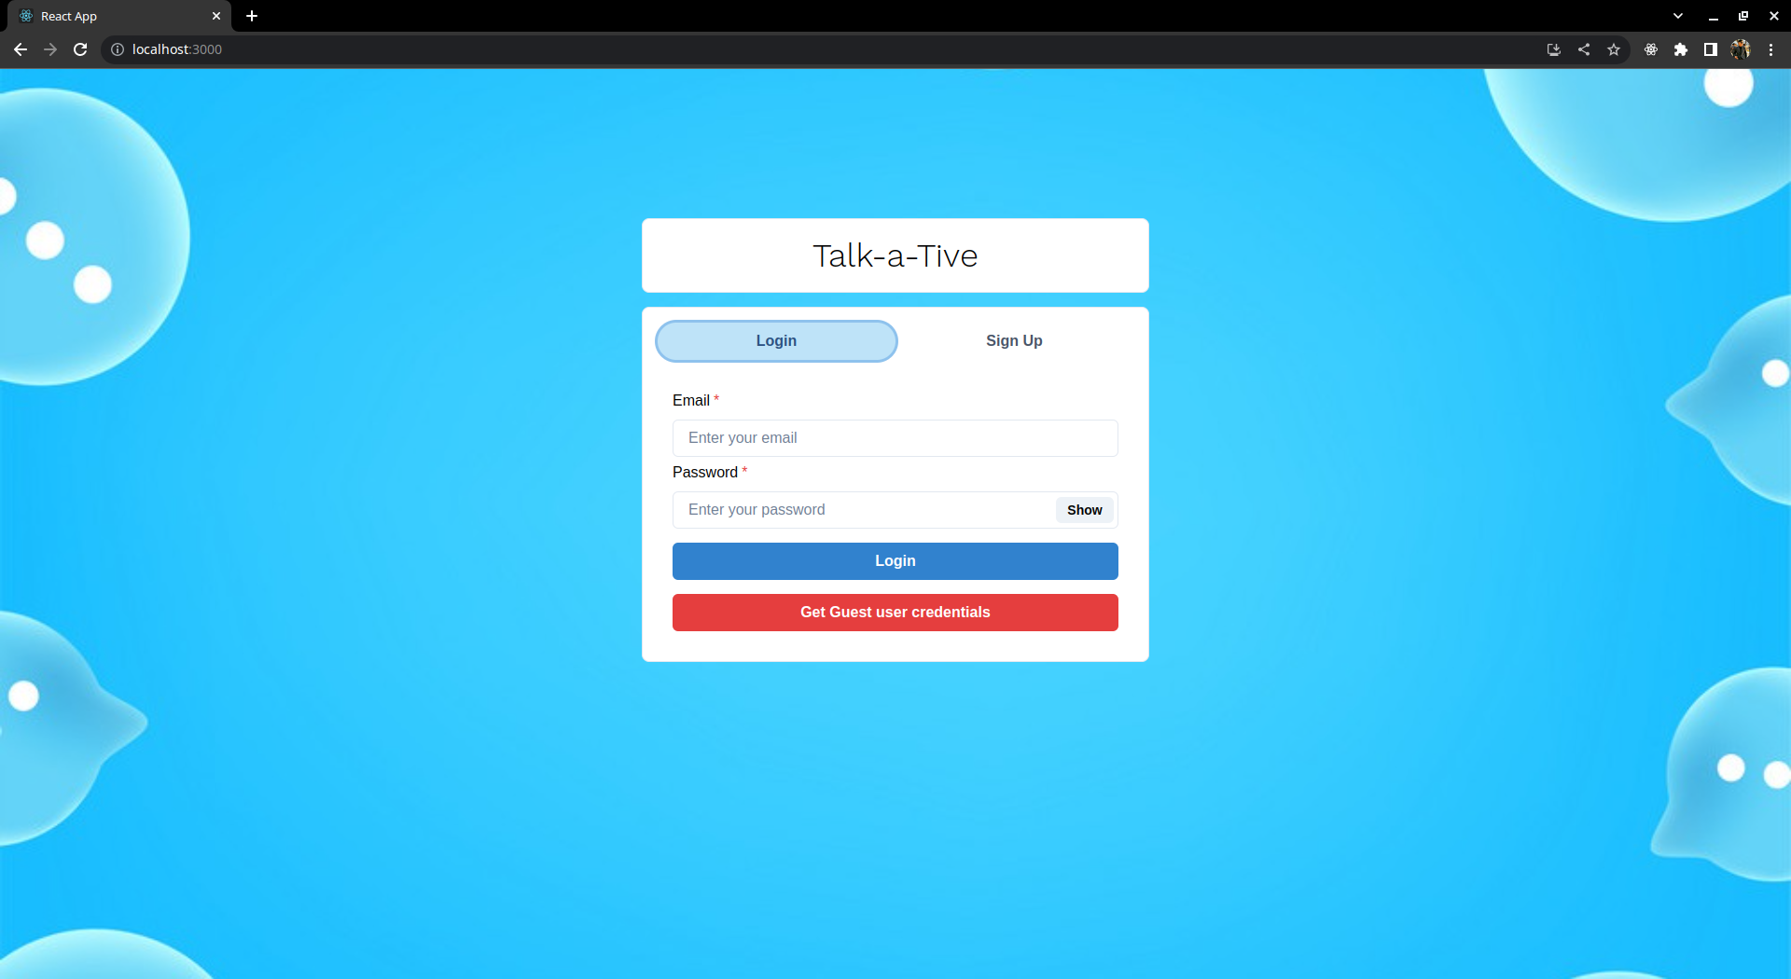

Slide 10
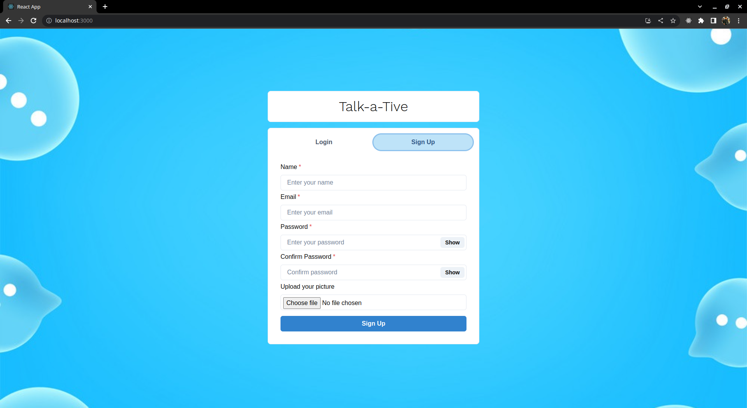

Slide 11
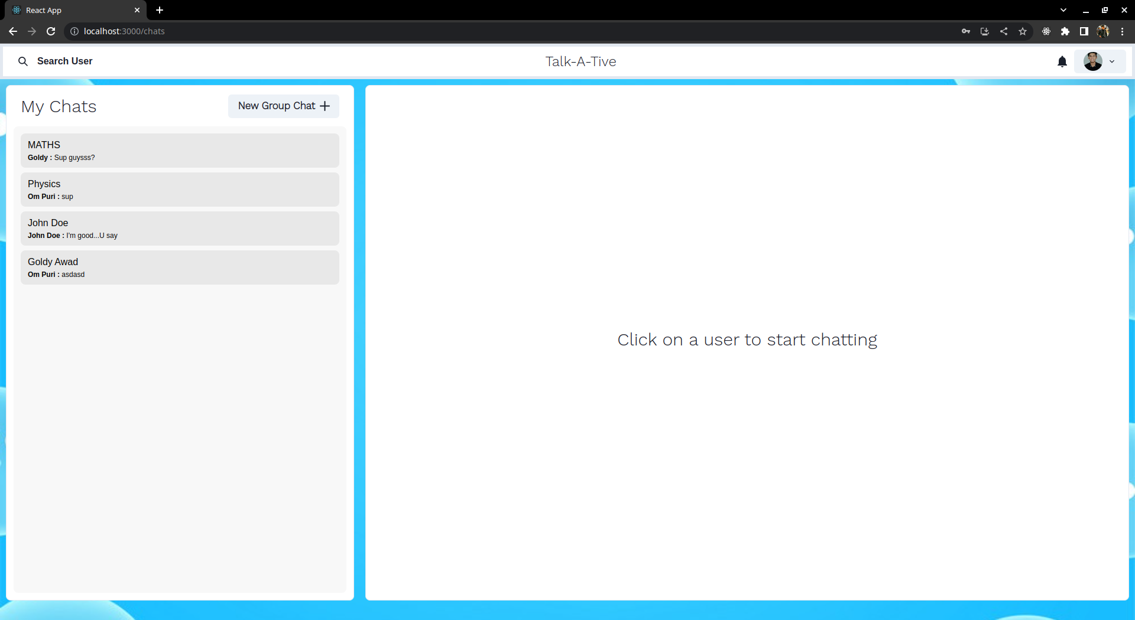

Slide 12
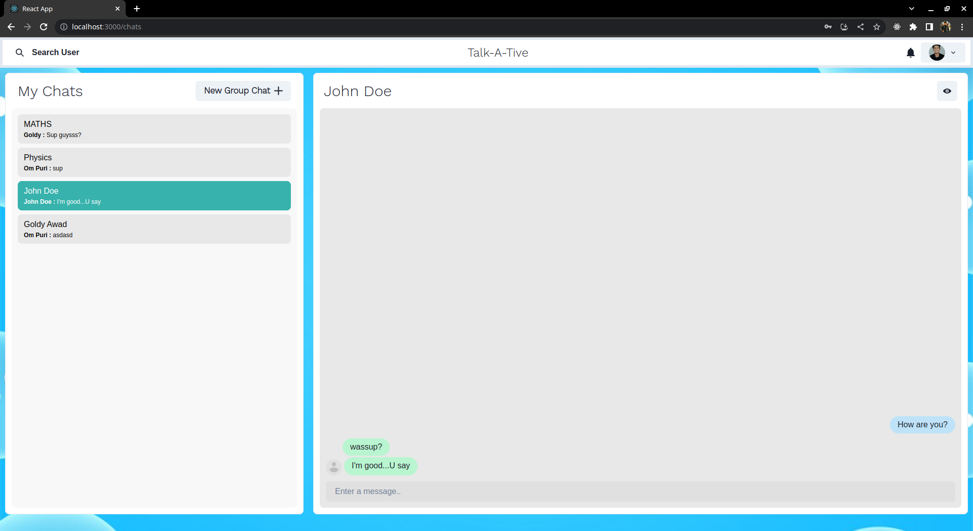

Slide 13
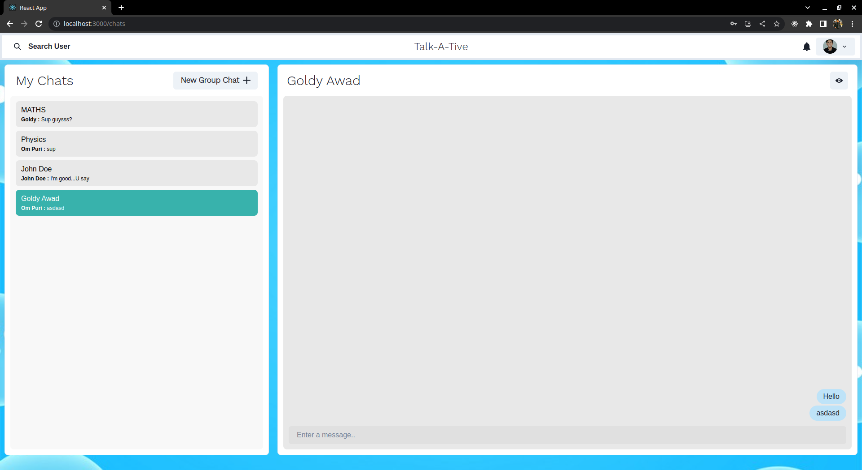

Slide 14
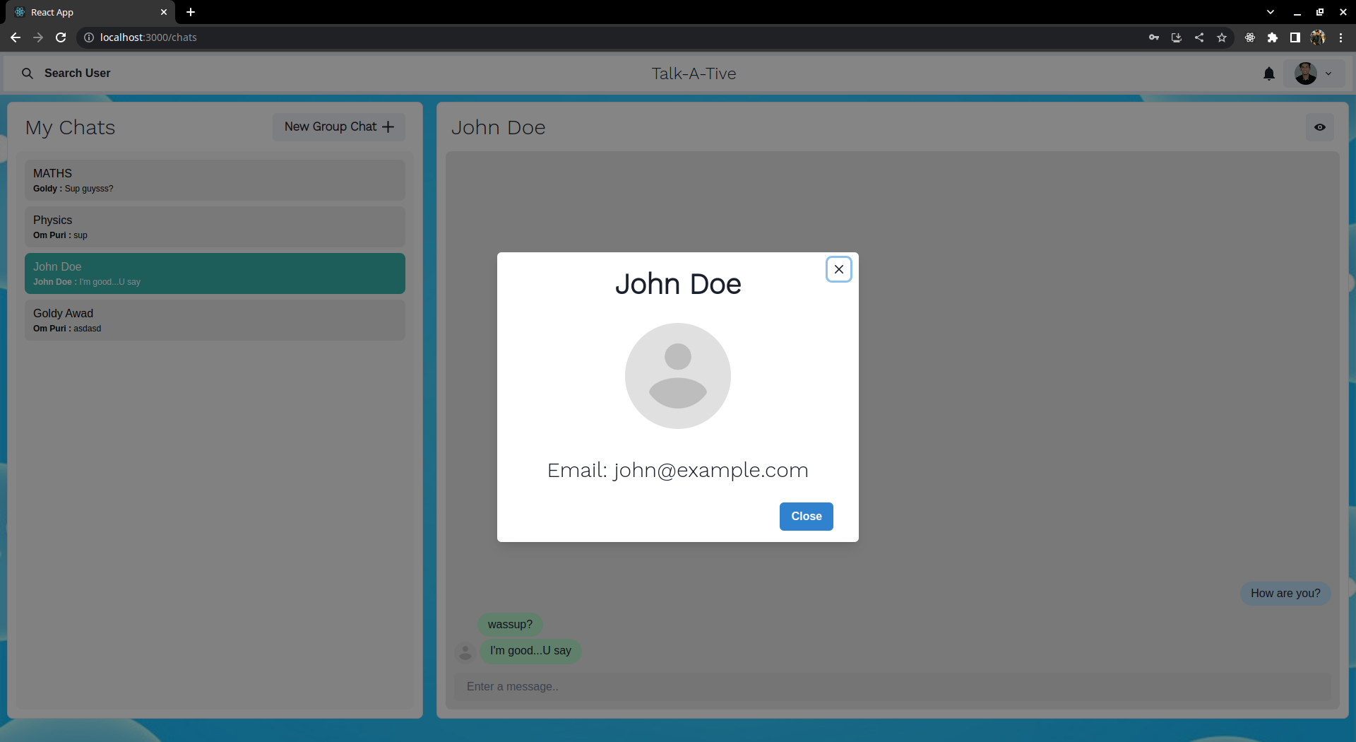

Slide 15
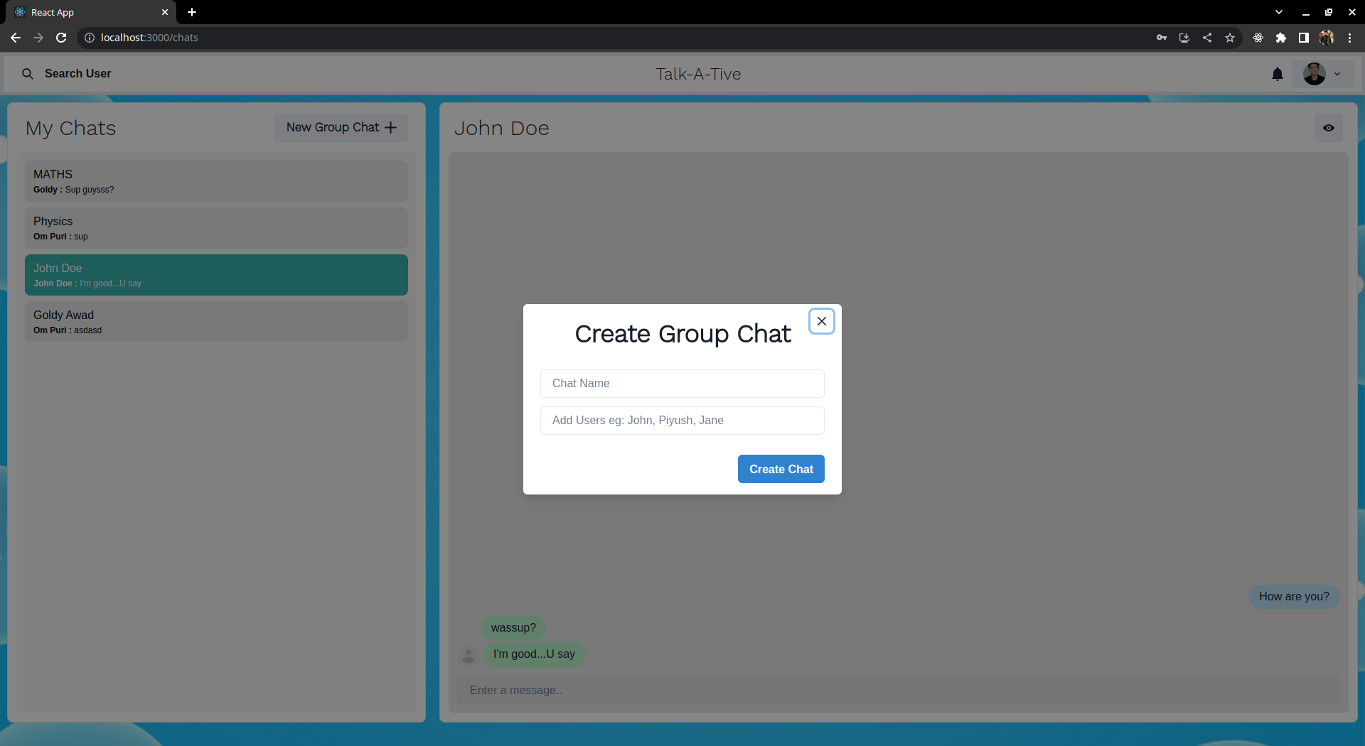

Slide 16
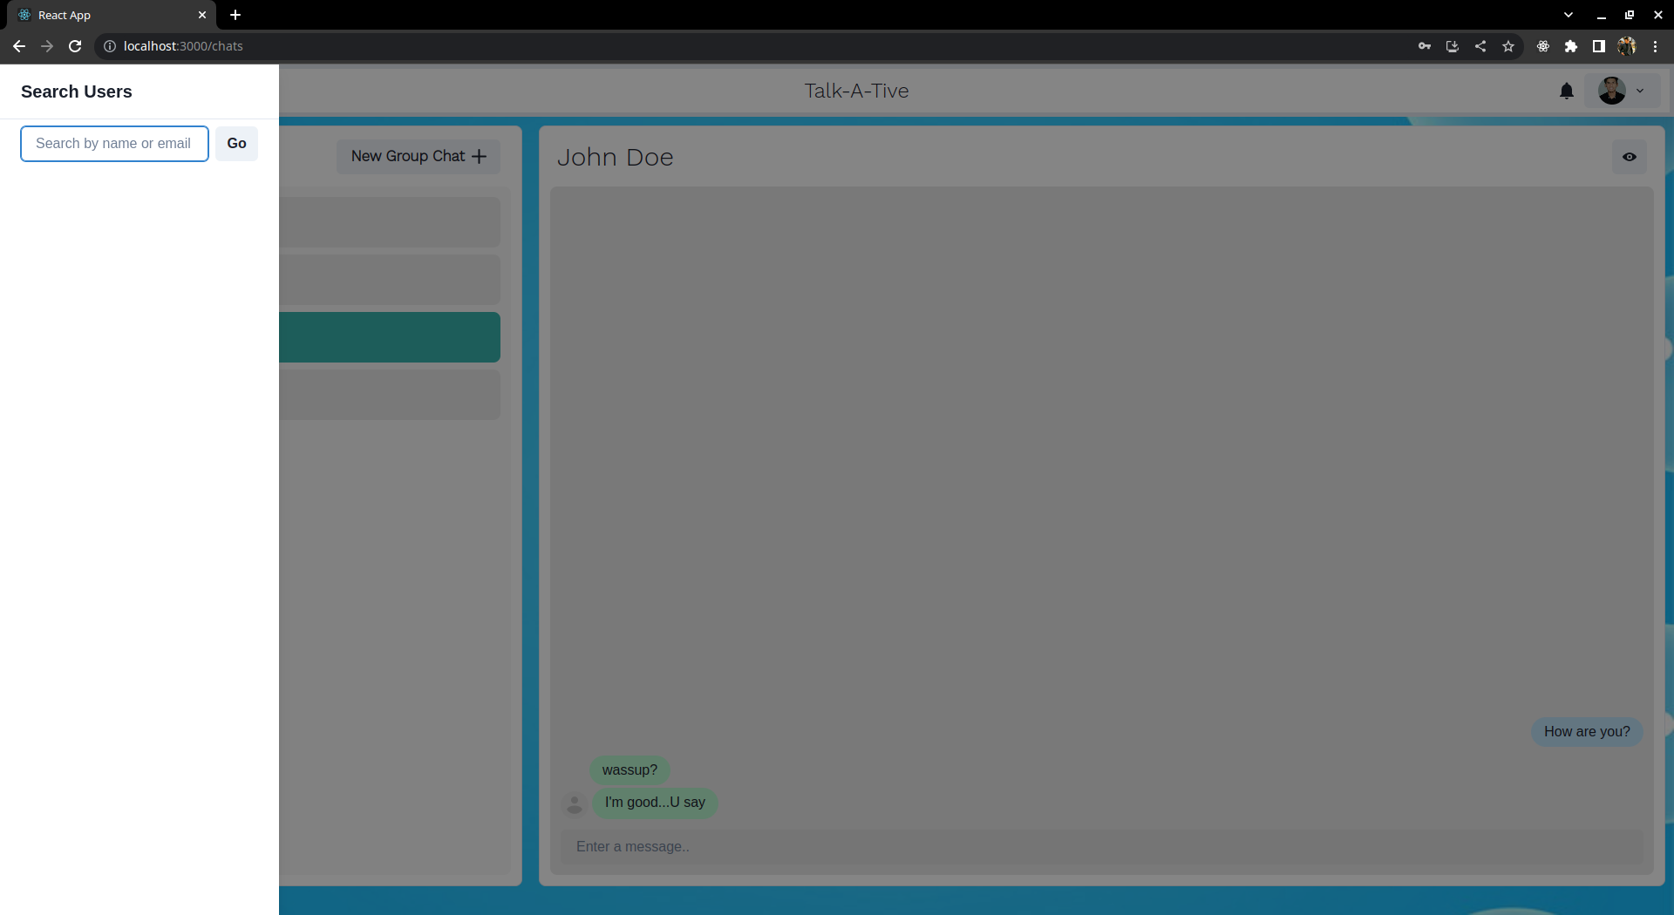

Slide 17
CONCLUSION
Learnt the basics of frontend and backend design.
Gained deeper understanding of web design and how it can be implemented in real-life solutions.
Was able to develop a online chat web application using MERN stack and Socket.io for real time messaging service.

Slide 18
Thank you!

