Slide 1
COVID-19 Research Data Pipeline
By Abhishek Gole

Slide 2
Project Details
Dataset: The dataset for this project will consist of the CORD-19 dataset, which includes the following information:
paper_id: Unique identifier for each paper.
title: Title of the paper.
abstract: Abstract of the paper.
authors: Authors of the paper.

Slide 3
Outcomes
Task 1: Ingest the COVID-19 research data into Hadoop using Apache Nifi, process it using Apache Spark, and store the results in Hive.
Task 2: Spark code and SQL queries to analyze the COVID-19 research data.
Task 3: Data Visualization Outcome: Create visualizations of the research trends and gaps using a tool like Apache Superset, Tableau, or Power BI.

Slide 4
Index
Architecture flow
Use tools like Apache Nifi for batch data ingestion.
Spark code and SQL queries to analyze the COVID-19 research data
Connection between hive and power BI
Data Visualization

Slide 5





Data Pipeline

Slide 6
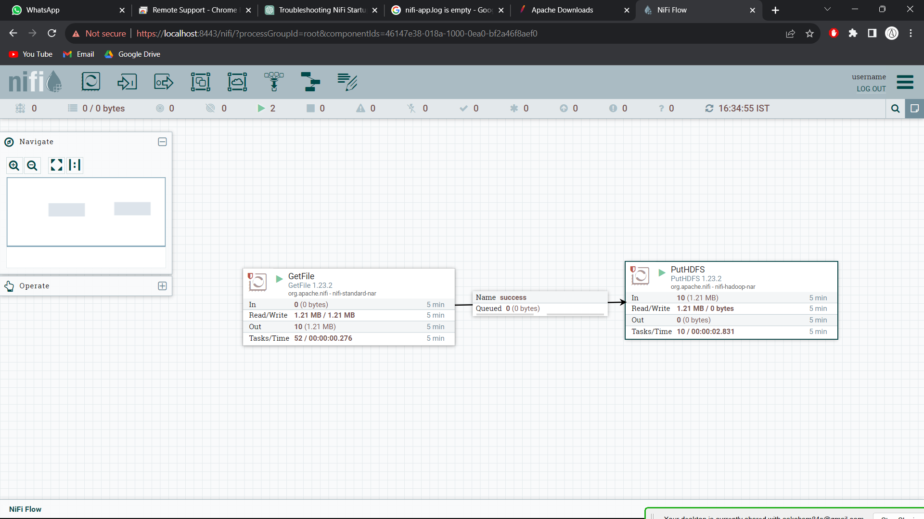
Outcome 1 :

Slide 7
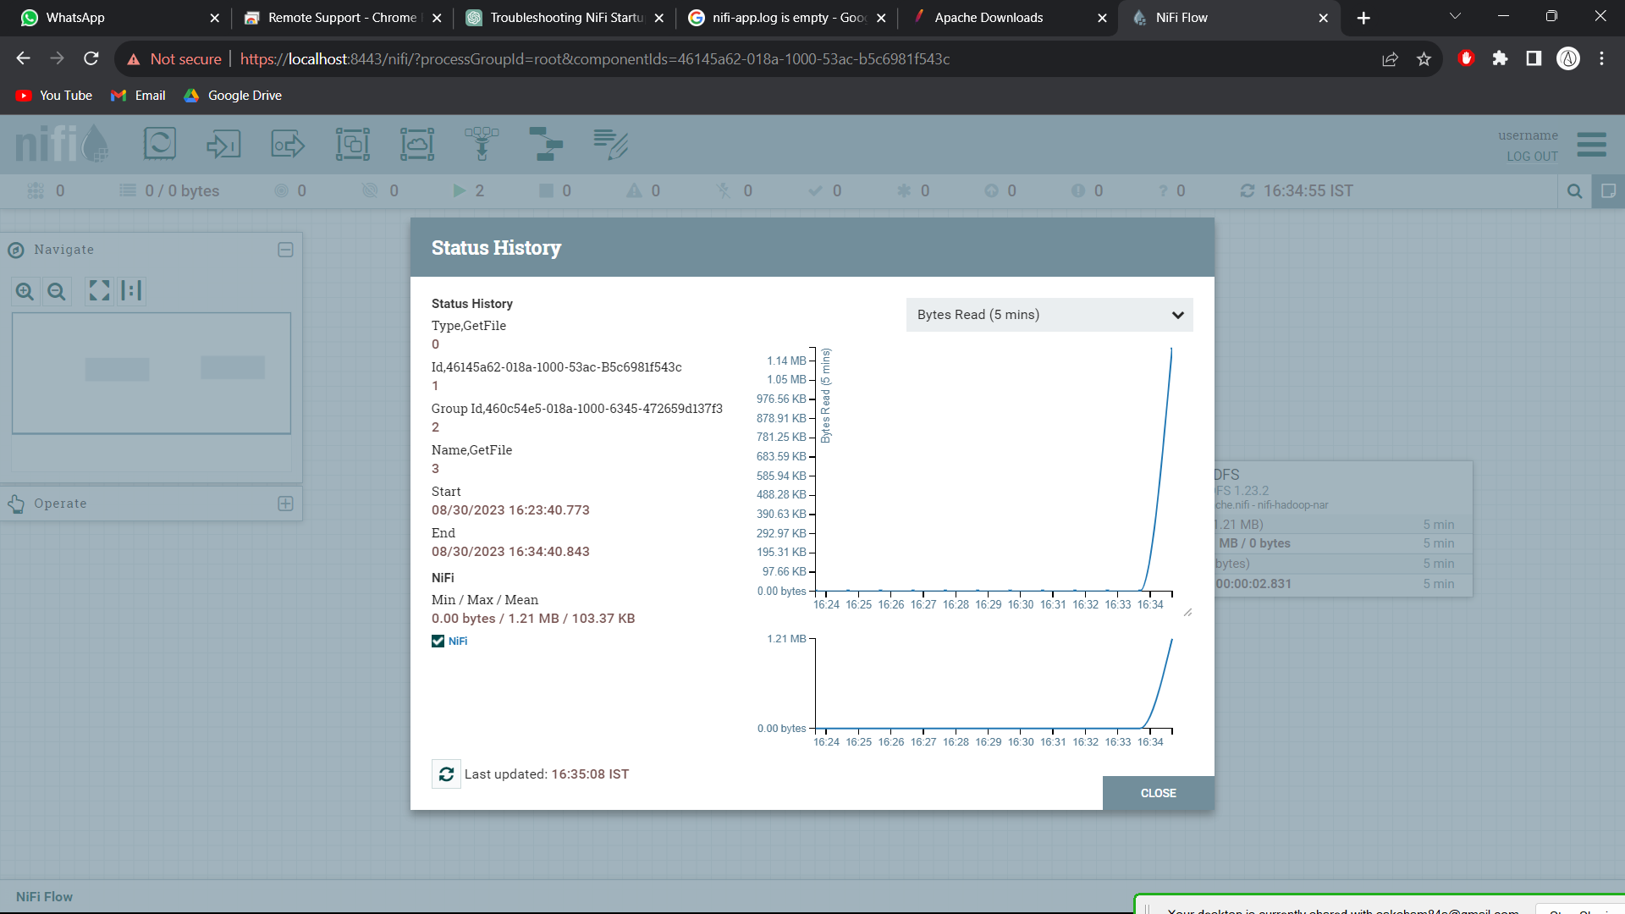
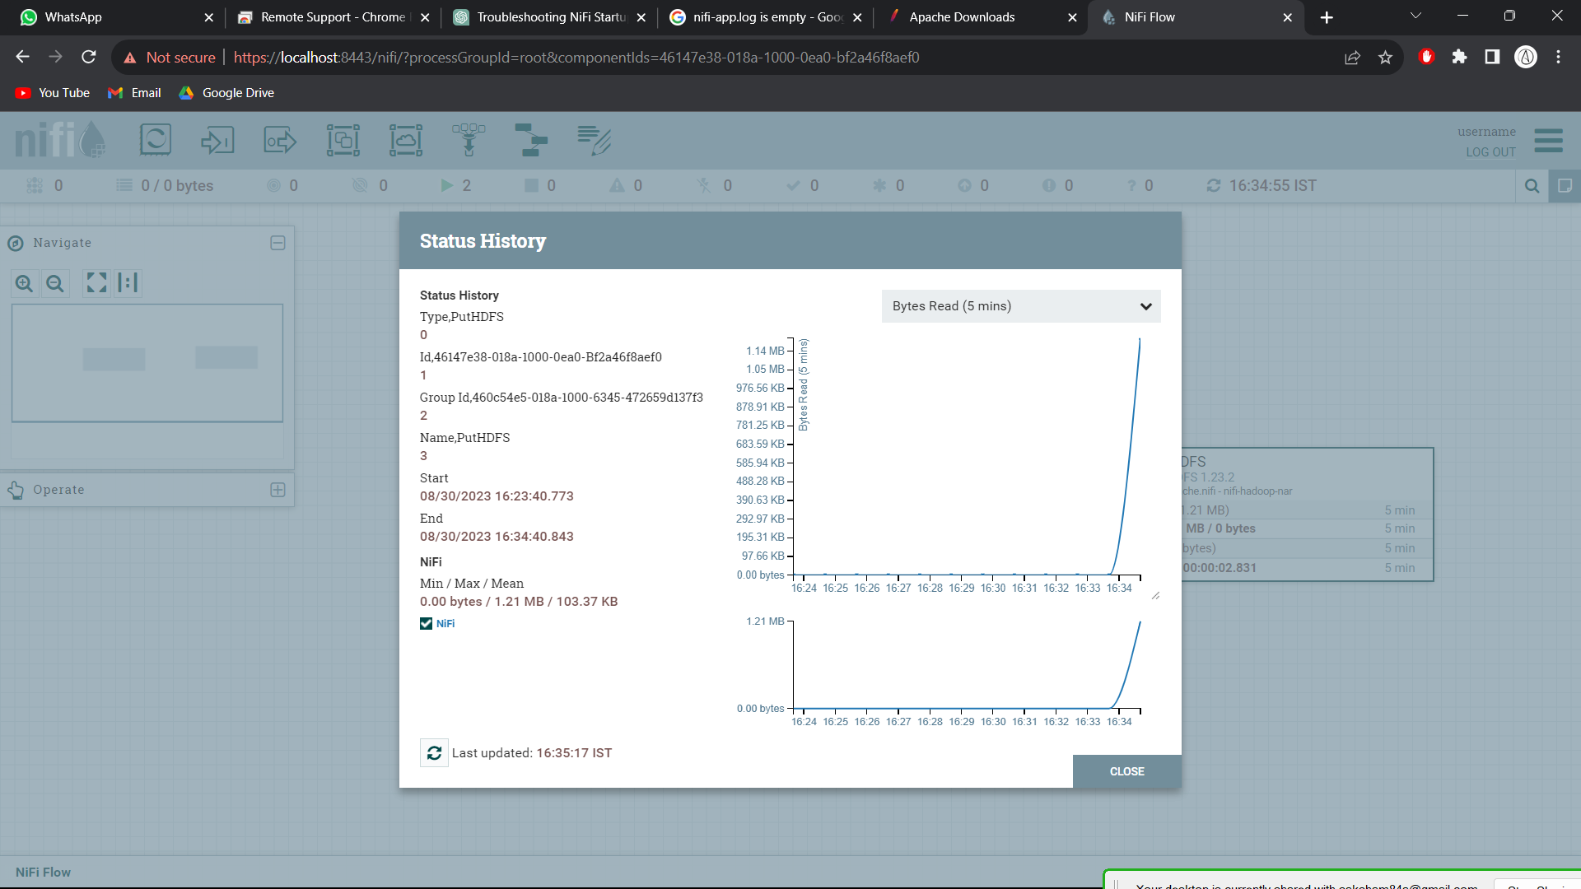
Outcome 1 : data transfer status history
Status History of getfile processor
Status History of puthdfs processor

Slide 8
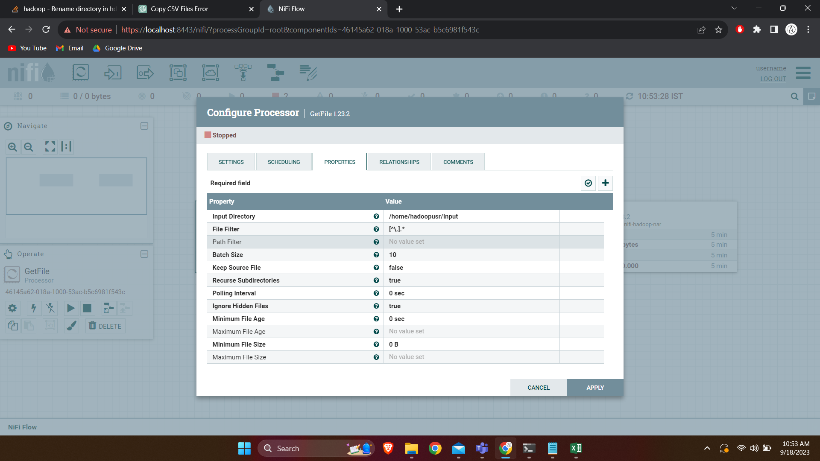
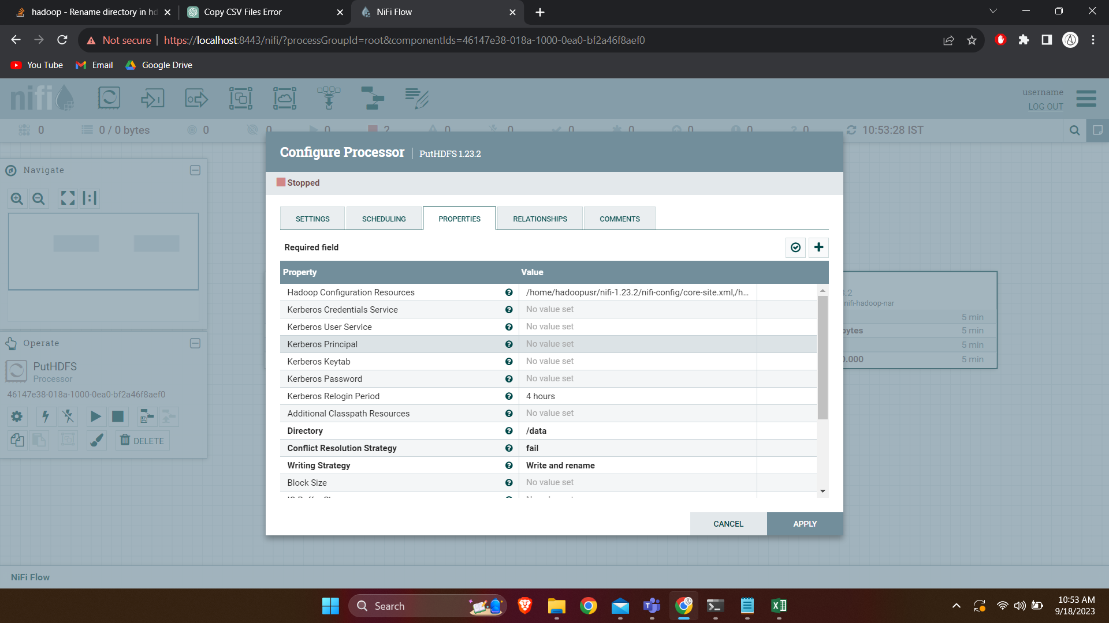
Outcomes 1: Getfile and puthdfs processor
Property and directory of getfile processor
Property and directory of getfile processor

Slide 9
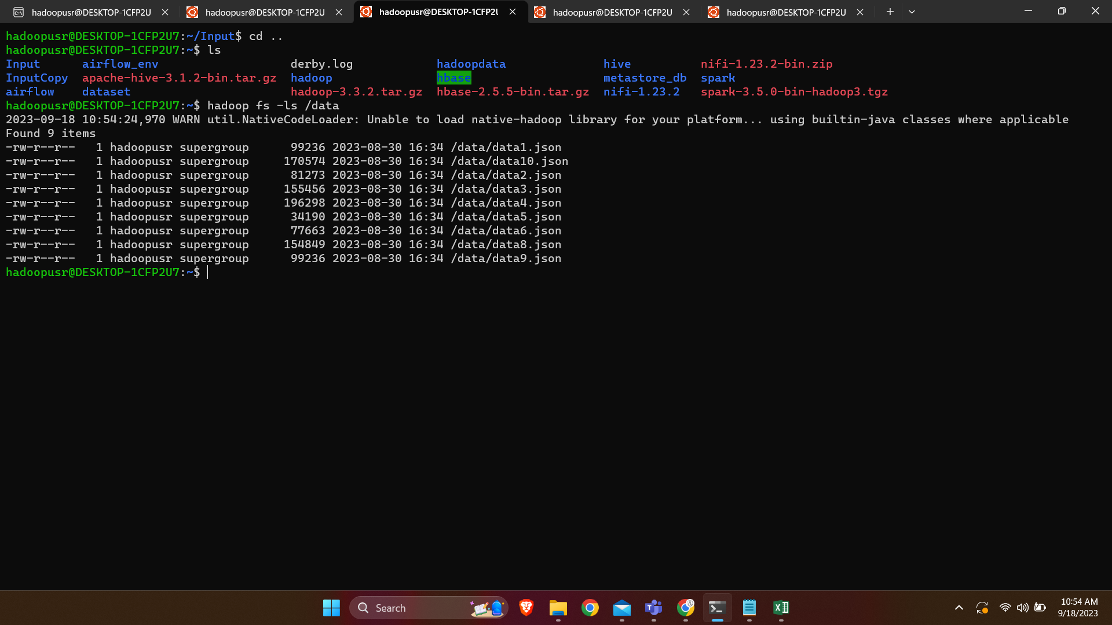
Output 1: Data in HDFS
Property and directory
Data in /data directory in hdfs

Slide 10
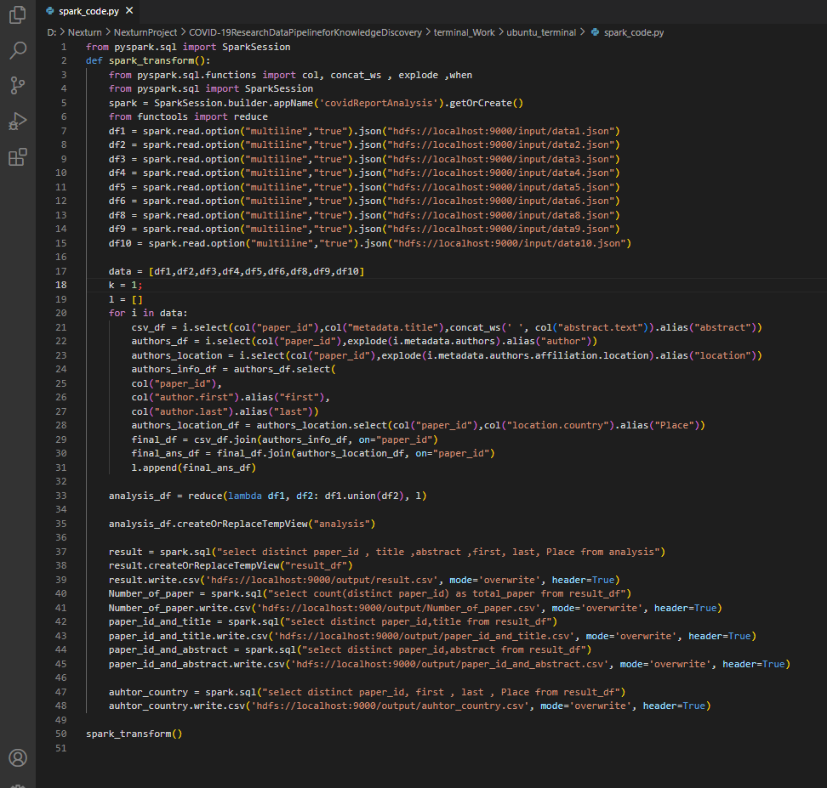
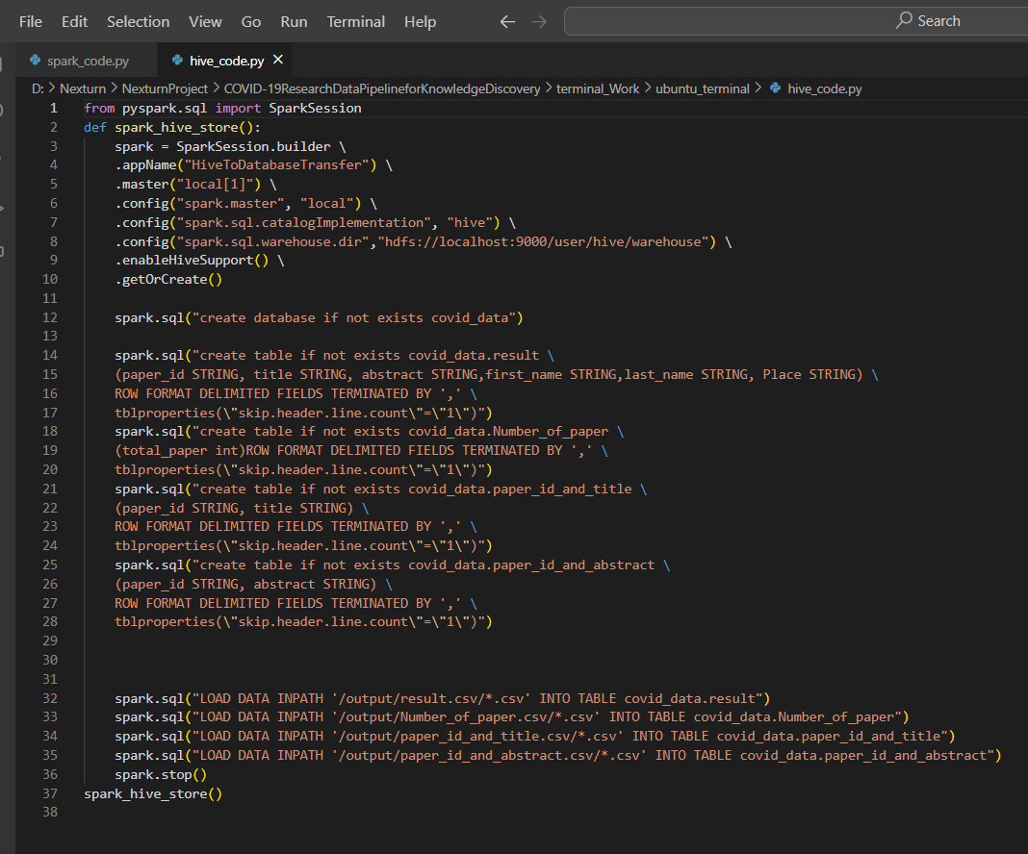
Spark and Hive Code
Spark Code
Hive Code

Slide 11
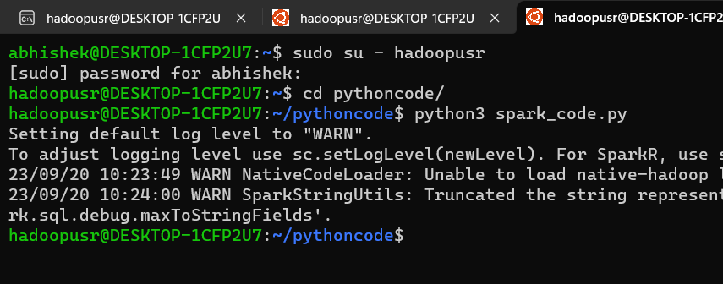
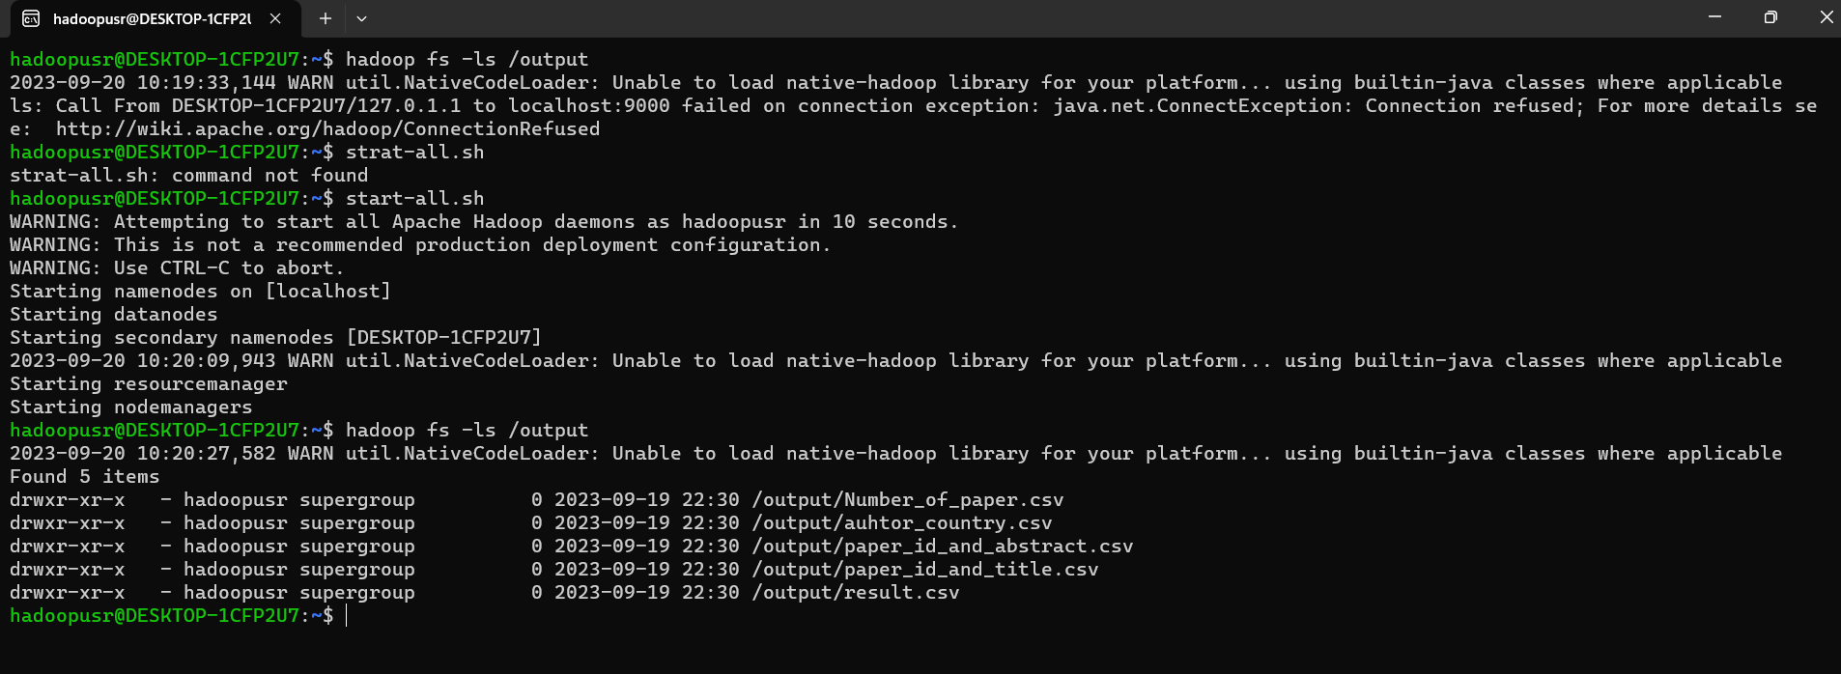
Outcomes of spark code
Commands for running python code
Spark Code output

Slide 12
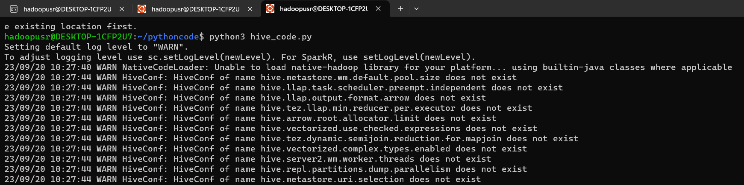
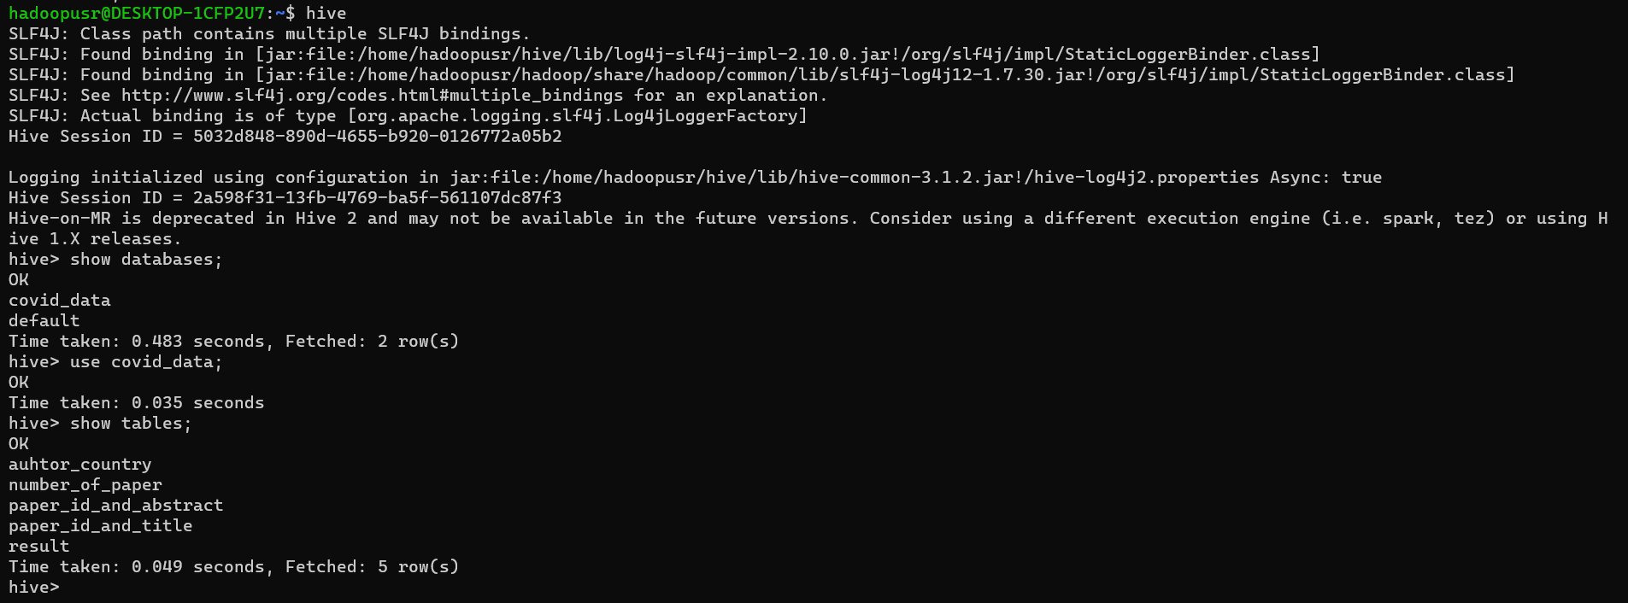
Outcomes of Hive Code
Commands for running python code
Hive code Output

Slide 13
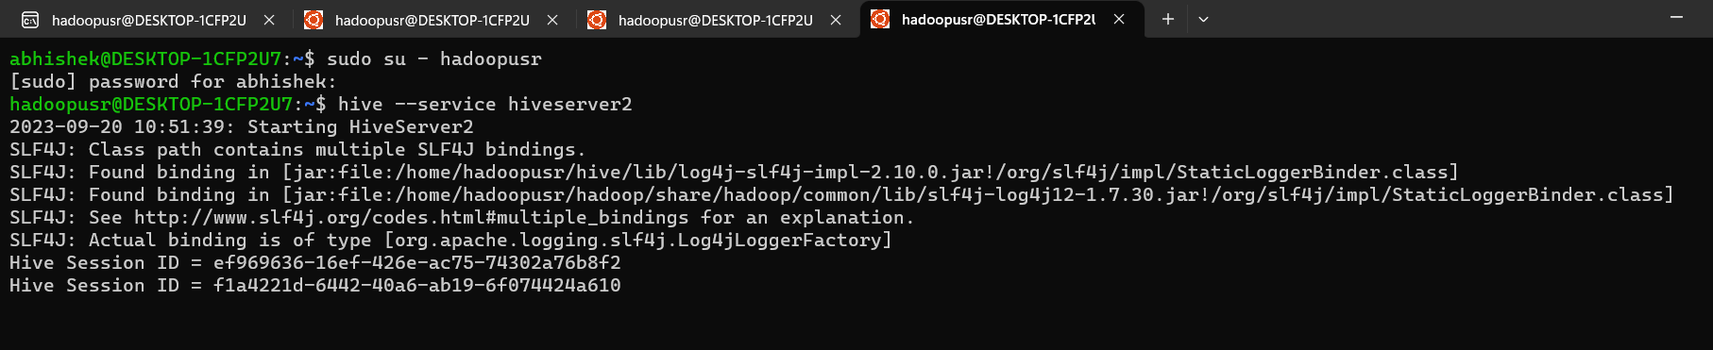
Connection between hive and power BI
For connection between hive and power BI we have to start hiveserver2 : hive --service hiveserver2
Start power bi go to Get Data section and select odbc connector and select sample cloudera hive dsn and press enter after that loading the databases from hive start and go to covid_data databases and select all table and load the table in power bi

Slide 14
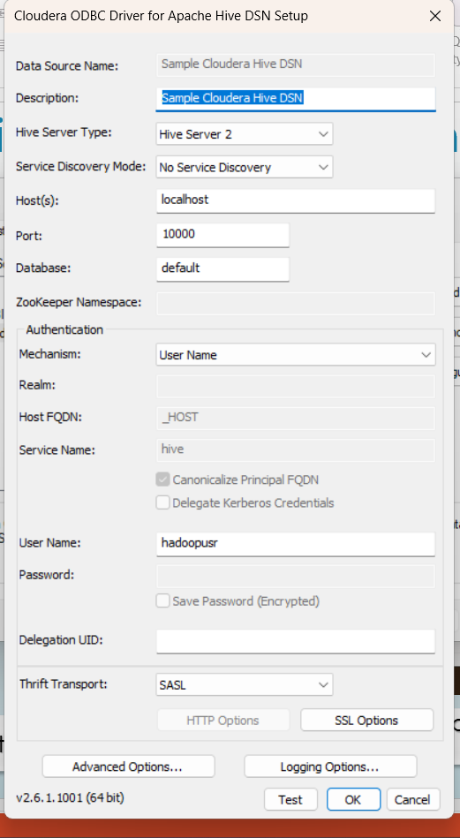
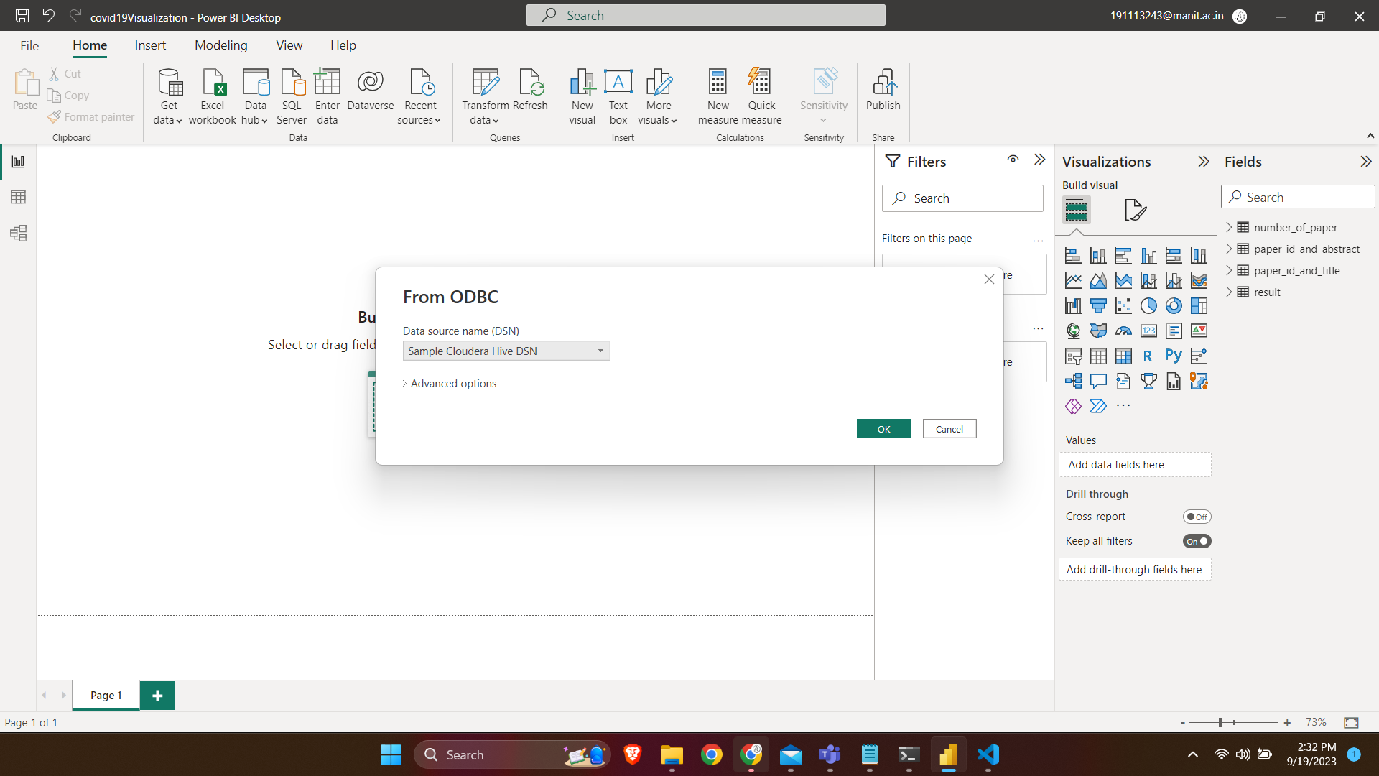
Connection between hive and power BI
Set host and port for connection in odbc
Select sample cloudera hive dsn

Slide 15
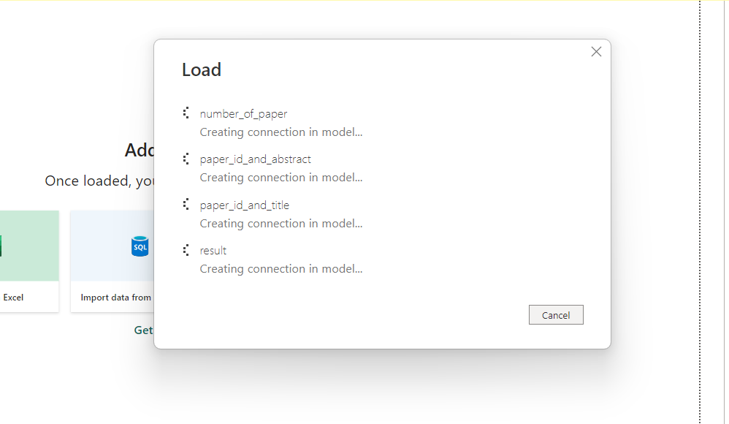
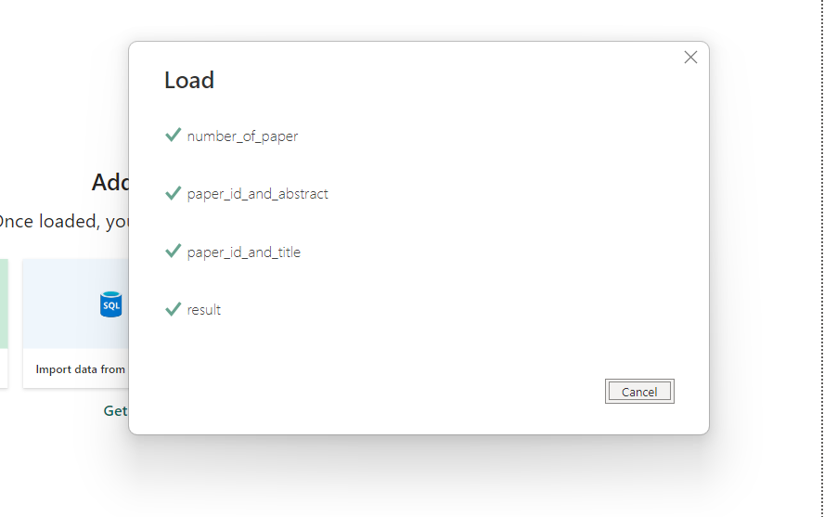
Connection between hive and power BI
Load the data

Slide 16
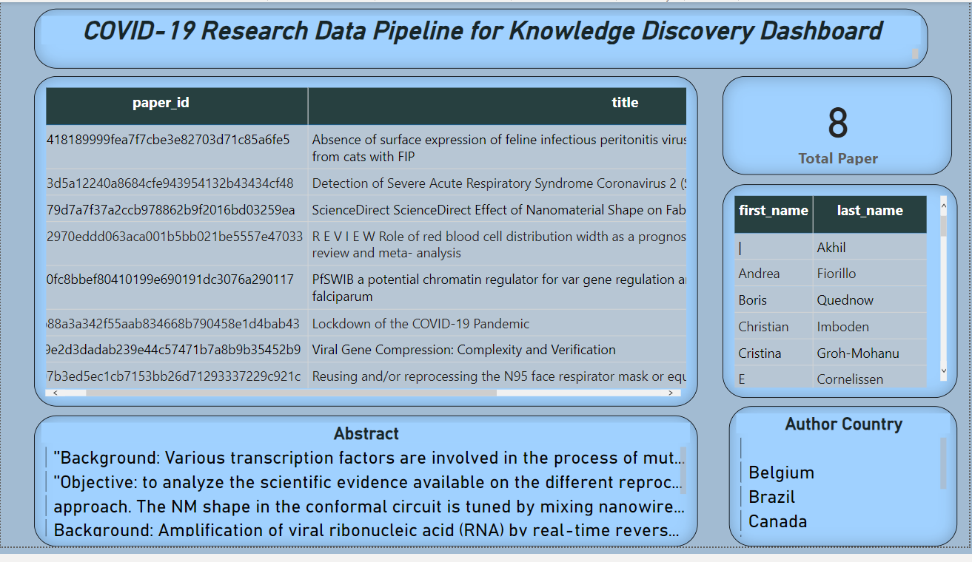
Power BI Visualization

Slide 17
Thank you

