Slide 1
Presentation
Internship at XP Link Co., Ltd.
By
Mr.Worachart Chaithong

Slide 2

XPLink Company Limited was founded in 2003.
XPLink provide service like Project Solution, Software Development Consulting, Outsourcing, and Training.
XPLink have extensive experience in EAI (Enterprise Application Integration),Web services, Web application.
Integration with Java.

Slide 3


Slide 4
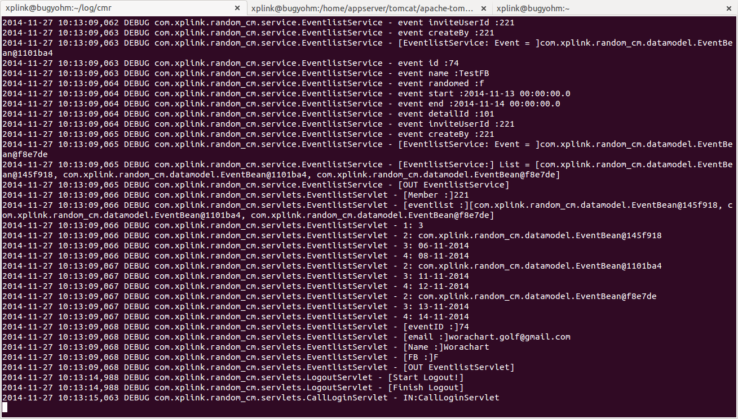
Command-line

Slide 5


Slide 6
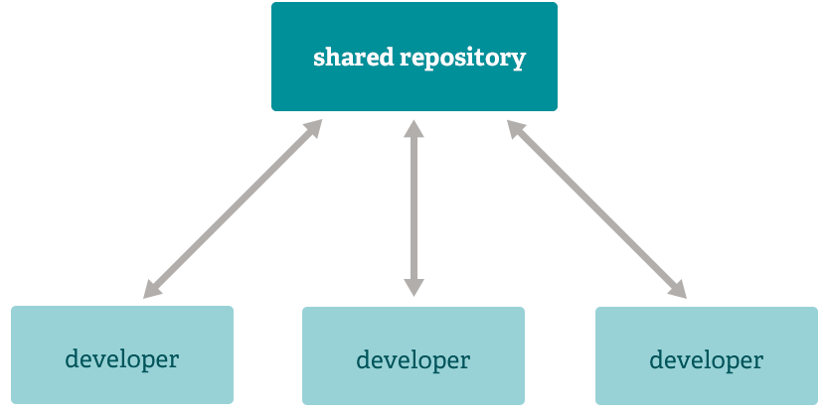
Git

Slide 7

Git

Slide 8
Video (Git)
/home/golf/Golf/Git-2014-11-27_12.30.26.mkv

Slide 9
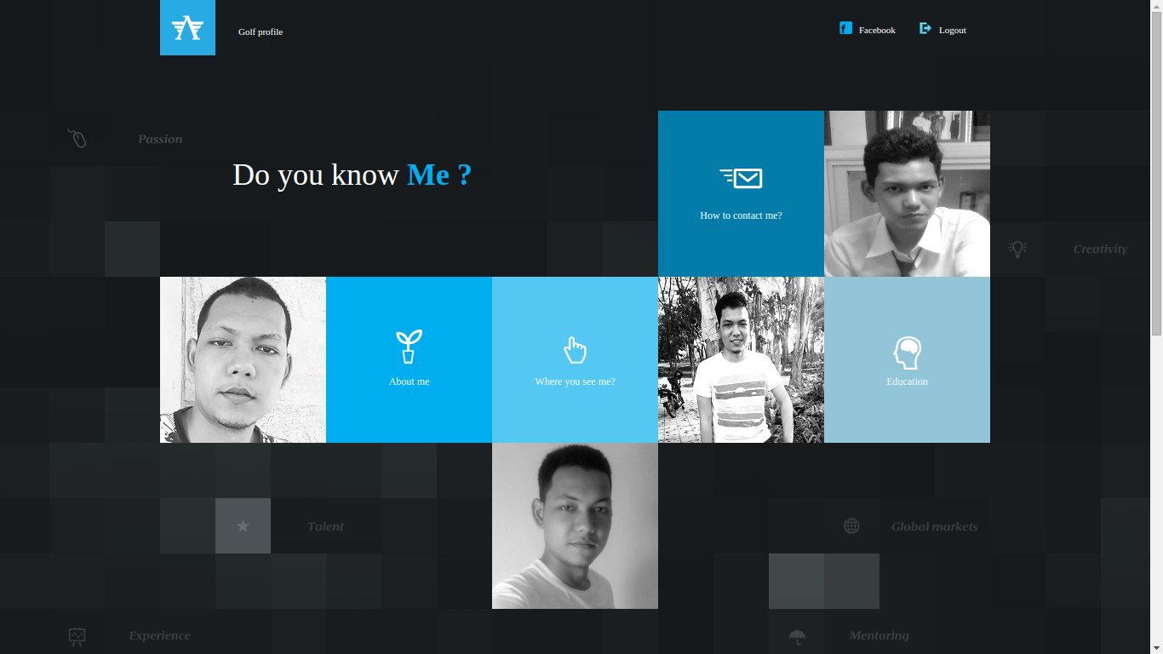
First task (My Profile)

Slide 10

Knowledge

Slide 11
Video (Profile)
/home/golf/Golf/Profile-2014-11-27_12.07.28.mkv

Slide 12
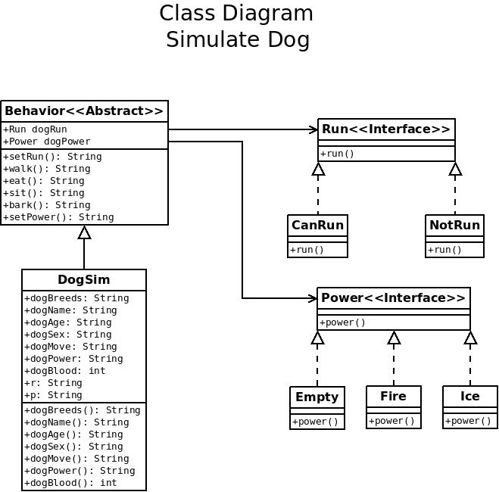
Second task (Function in Java-OO)

Slide 13



Knowledge

Slide 14
Video (Java-OO)
/home/golf/Golf/Dog-2014-11-27_14.11.02.mkv

Slide 15

Third task (Profile Spring MVC)
Integration of first task and second task.

Slide 16






Knowledge

Slide 17
Video (Profile Spring MVC)
/home/golf/Golf/Spring-2014-11-27_14.33.35.mkv

Slide 18
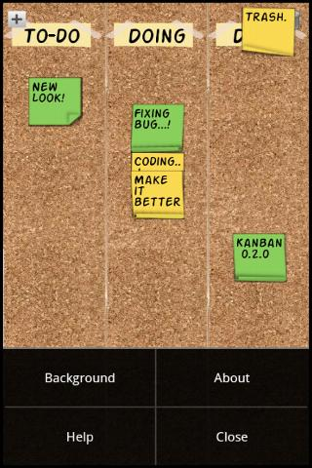
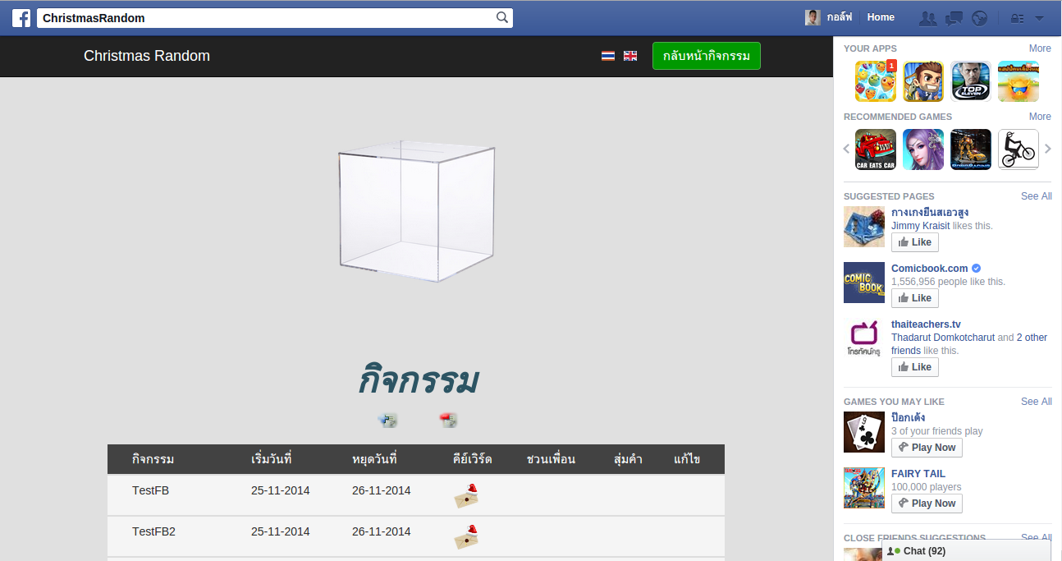
Fourth task (Create Diagram)
Christmas Random
Kanban-board

Slide 19

Task list
Class diagram
ER diagram
Usecase diagram
Activity diagram
Sequence diagram

Slide 20
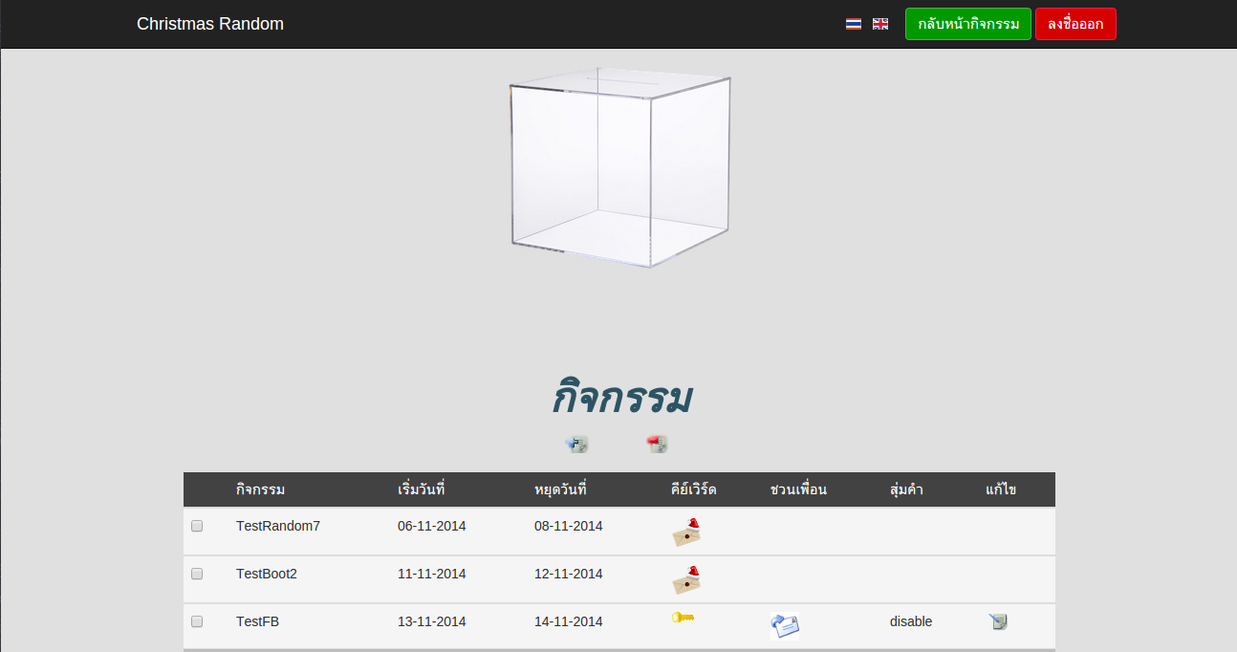
Fifth task (Update project CMR)

Slide 21
Task list
Update function Login & Register (WebApp & FacebookApp)
Update function Invite (Email & Facebook)
Update database.
Create controller for access (WebApp or FacebookApp)
Add Bootstrap (Responsive page)

Slide 22



Knowledge

Slide 23
Video (CMR WebApp)
/home/golf/Golf/WebCMR-2014-11-27_15.21.46.mkv

Slide 24
Video (CMR FacebookApp)
/home/golf/Golf/FBCMR-2014-11-27_15.36.32.mkv

Slide 25


