Slide 1
Rails framework

Slide 2
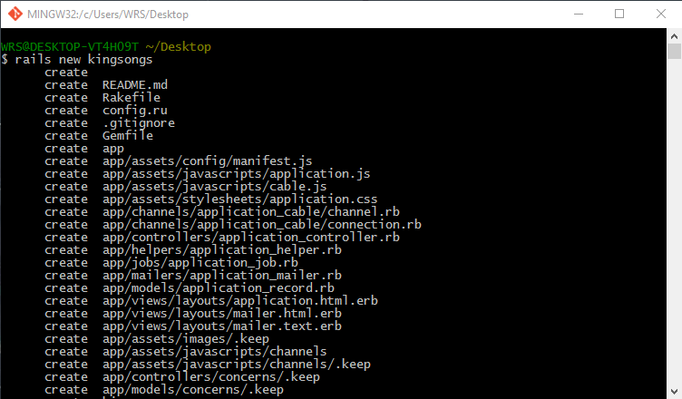

rails new kingsong

Slide 3
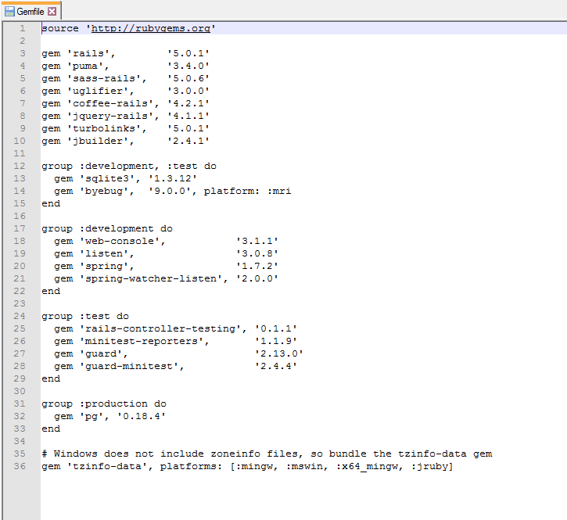
change Gemfile

Slide 4
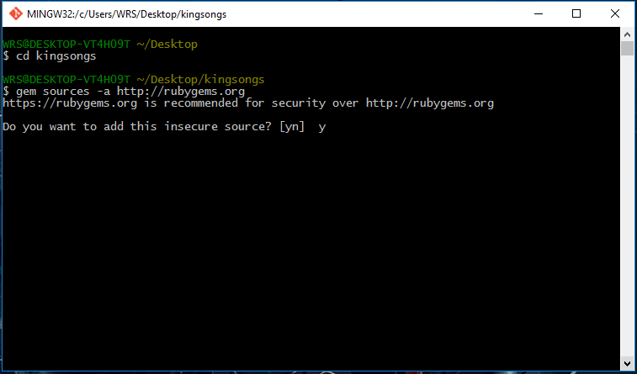
cd kingsong gem sources –a http://rubygems.org ตอบ y

Slide 5
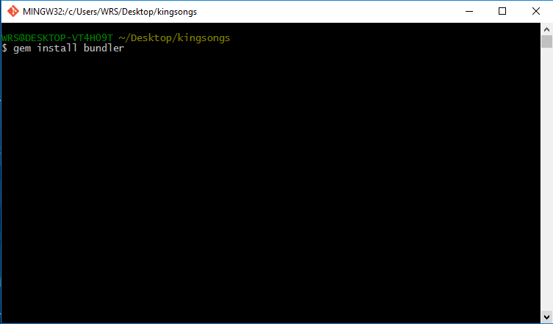
gem install bundler

Slide 6
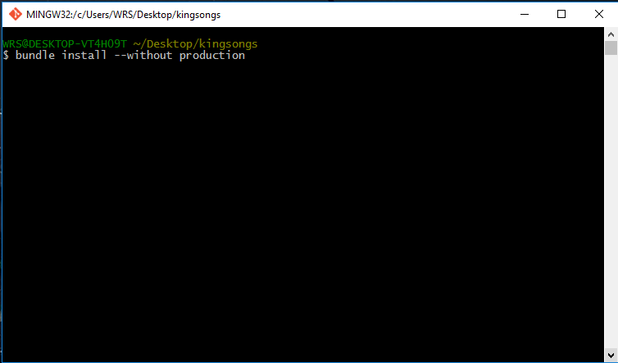
bundle install --without production

Slide 7
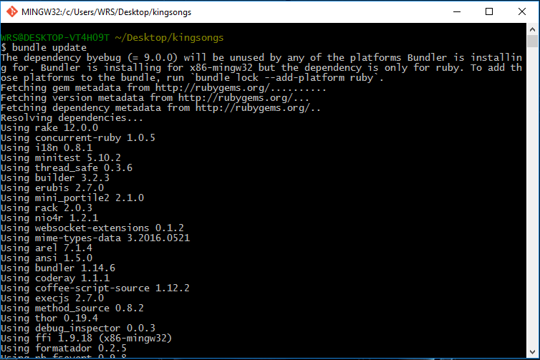
bundle show bundle update

Slide 8
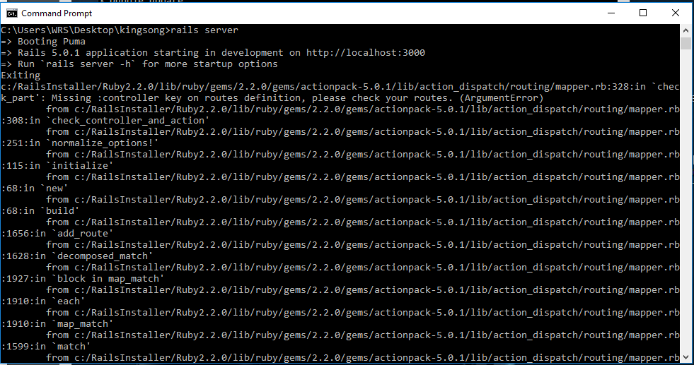
run rails server บน cmd

Slide 9
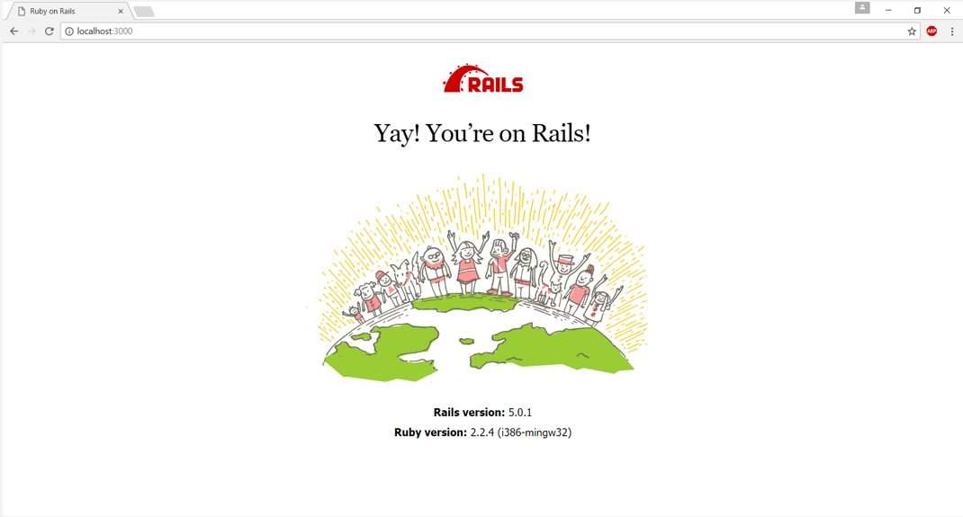
localhost:3000

Slide 10
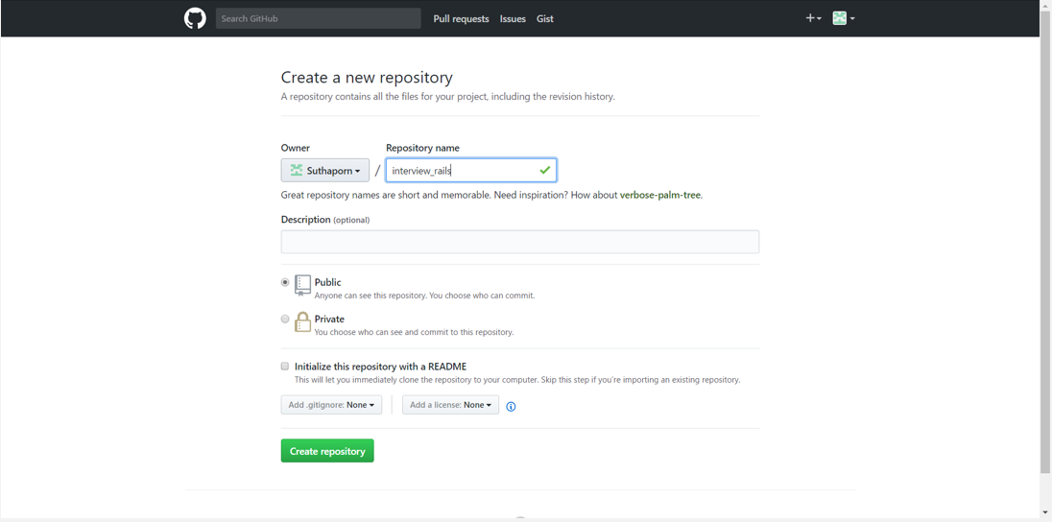
สร้าง repo บน Github

Slide 11

git config --global user.name "your username" git config --global user.email "your email"

Slide 12
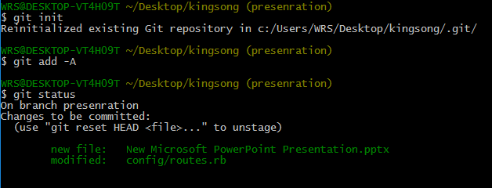
git init git add –A git status

Slide 13

git commit –m “create project kingsong”

Slide 14
git remote add origin “git repo”
git push -u origin master

Slide 15

heroku login

Slide 16
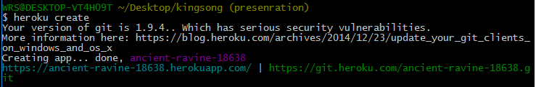
heroku create

Slide 17
git push heroku master

Slide 18
git checkout -b static-pages

Slide 19
rails generate controller StaticPages home kingsong1 kingsong2 kingsong3

Slide 20
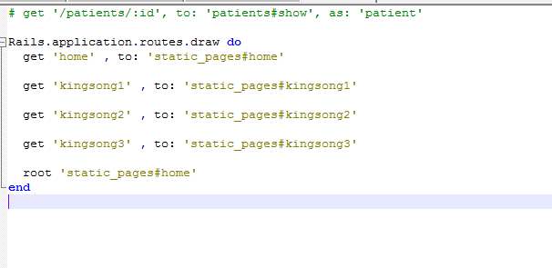
edit config/routes

Slide 21
localhost:3000

Slide 22
Edit app/views/static_pages/home.html.erb Edit app/views/static_pages/kingsong1.html.erb Edit app/views/static_pages/ kingsong2.html.erb Edit app/views/static_pages/ kingsong3.html.erb Edit Readme

Slide 23


git add –A git commit -m "Finish static pages“ git checkout master

Slide 24

git merge static-pages

Slide 25


git push git push heroku

Slide 26
git checkout –b presentation

Slide 27
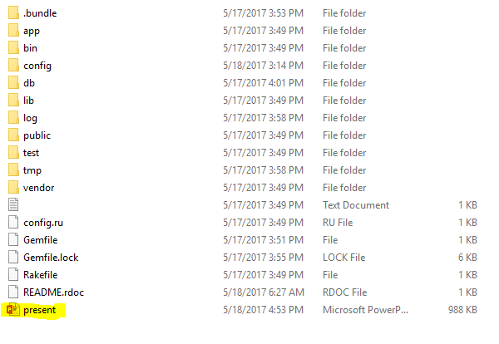
touch ชื่อไฟล์นำเสนอ แก้ไขและบันทึกไฟล์

Slide 28
git add –A git commit -m "Finish presentation“ git checkout master git merge presentation git push

