Slide 1
How to use MasterHands API from Java
2023/09/08 - 1
Rintaro Saito

Slide 2
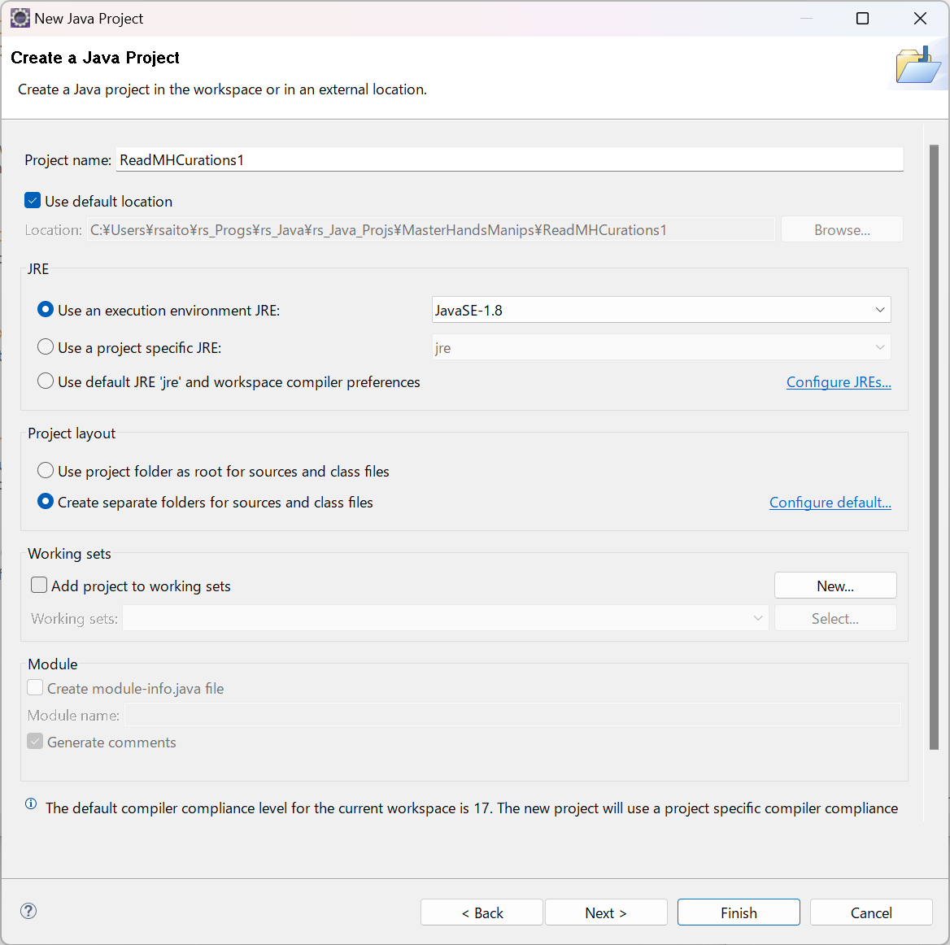
Creating new Java project

Slide 3
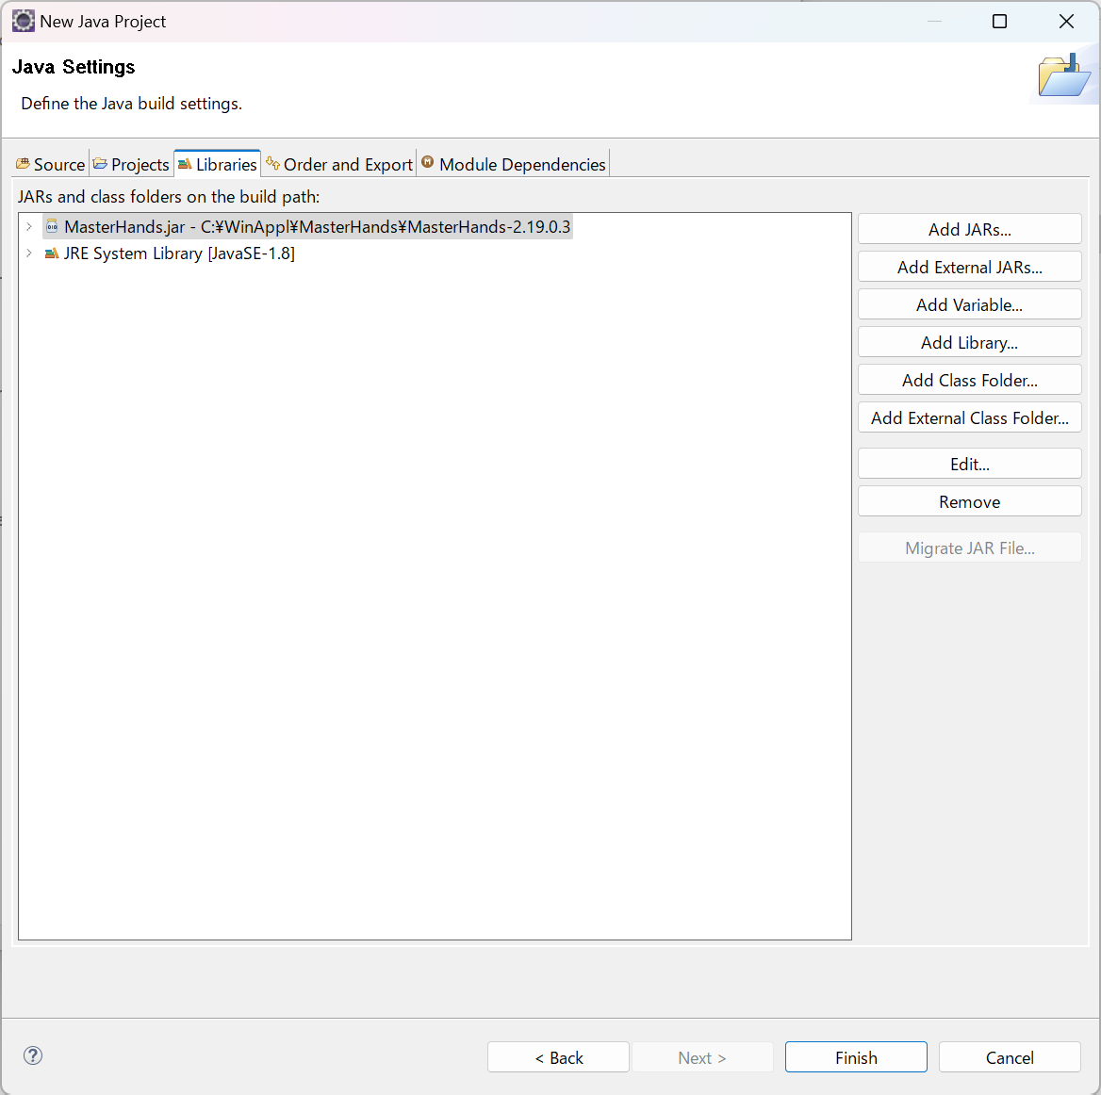
Adding MasterHands.jar as external Jar

Slide 4
Compiling and executing program
Example of compiling:
javac -classpath C:\WinAppl\MasterHands\MasterHands-2.20.0.2\MasterHands.jar Test_invoke1.java
Example of executing via Command prompt:
java -classpath C:\WinAppl\MasterHands\MasterHands-2.20.0.2\MasterHands.jar; Test_invoke1
(You need a space between ";" and "Test_invoke1“)
Example of executing via Windows PowerShell:
java -classpath "C:\WinAppl\MasterHands\MasterHands-2.20.0.2\MasterHands.jar;" Test_invoke1
Example of executing program compiled by Eclipse via Windows PowerShell:
cd C:\Users\rsaito\rs_Progs\rs_Java\rs_Java_Projs\MasterHandsManips\ReadMHCurations1\bin
java -classpath "C:\WinAppl\MasterHands\MasterHands-2.19.0.3\MasterHands.jar;" Test.Test_MHCurBase1_2
# Make sure that you have license file installed.

