Slide 1
How to use MasterHands API from Java
2023/09/08 - 1
Rintaro Saito

Slide 2
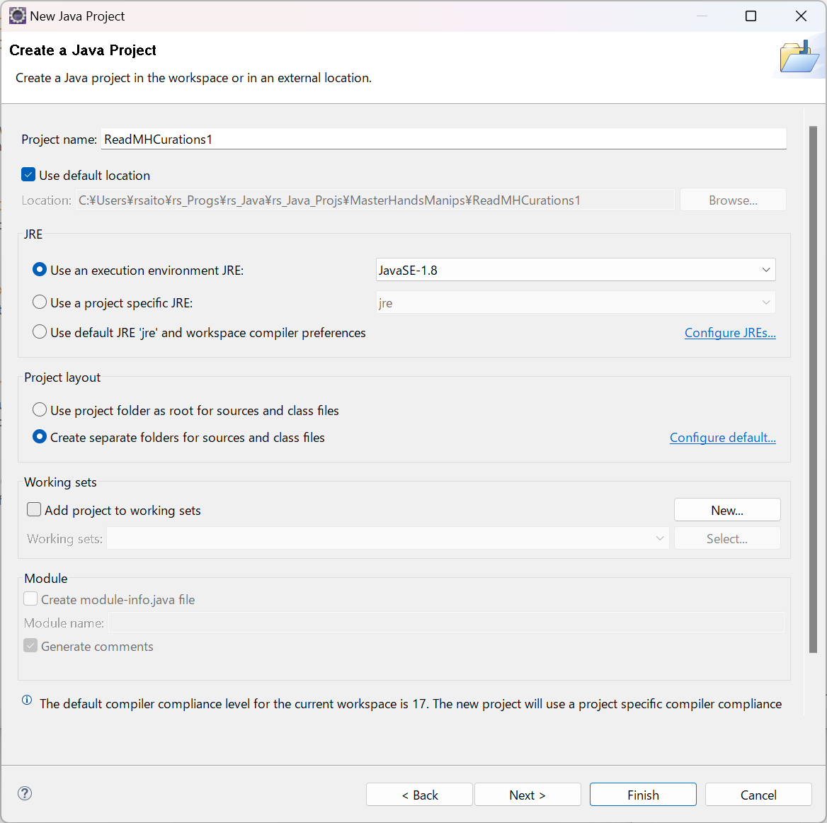
Creating new Java project

Slide 3
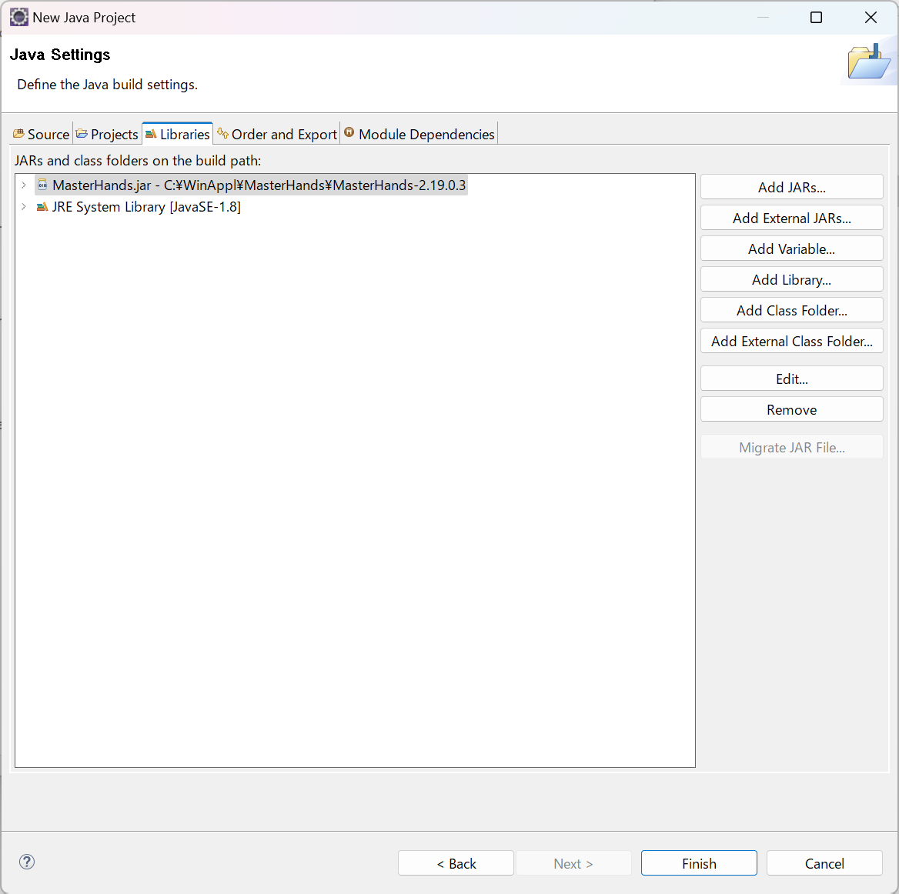
Adding MasterHands.jar as external Jar

Slide 4
Compiling and executing program
Changing to source folder:
cd C:\Users\rsaito\rs_Progs\rs_Java\rs_Java_Projs\MasterHandsManips\ReadMHCurations1\src
Example of compiling via Command Prompt:
javac -classpath C:\WinAppl\MasterHands\MasterHands-2.19.0.3\MasterHands.jar;. .\Test\Test_MHCurBase1_2.java
Example of compiling via Windows PowerShell:
javac -classpath "C:\WinAppl\MasterHands\MasterHands-2.19.0.3\MasterHands.jar;." .\Test\Test_MHCurBase1_2.java
Example of executing via Command prompt:
java -classpath C:\WinAppl\MasterHands\MasterHands-2.19.0.3\MasterHands.jar; Test.Test_MHCurBase1_2
(You need a space between ";" and "Test_invoke1“)
Example of executing via Windows PowerShell:
java -classpath "C:\WinAppl\MasterHands\MasterHands-2.19.0.3\MasterHands.jar;" Test.Test_MHCurBase1_2
Example of executing program compiled by Eclipse via Windows PowerShell:
cd C:\Users\rsaito\rs_Progs\rs_Java\rs_Java_Projs\MasterHandsManips\ReadMHCurations1\bin
java -classpath "C:\WinAppl\MasterHands\MasterHands-2.19.0.3\MasterHands.jar;" Test.Test_MHCurBase1_2
# Make sure that you have license file installed.

