Slide 1

Wireframe
-By Savita Golher

Slide 2
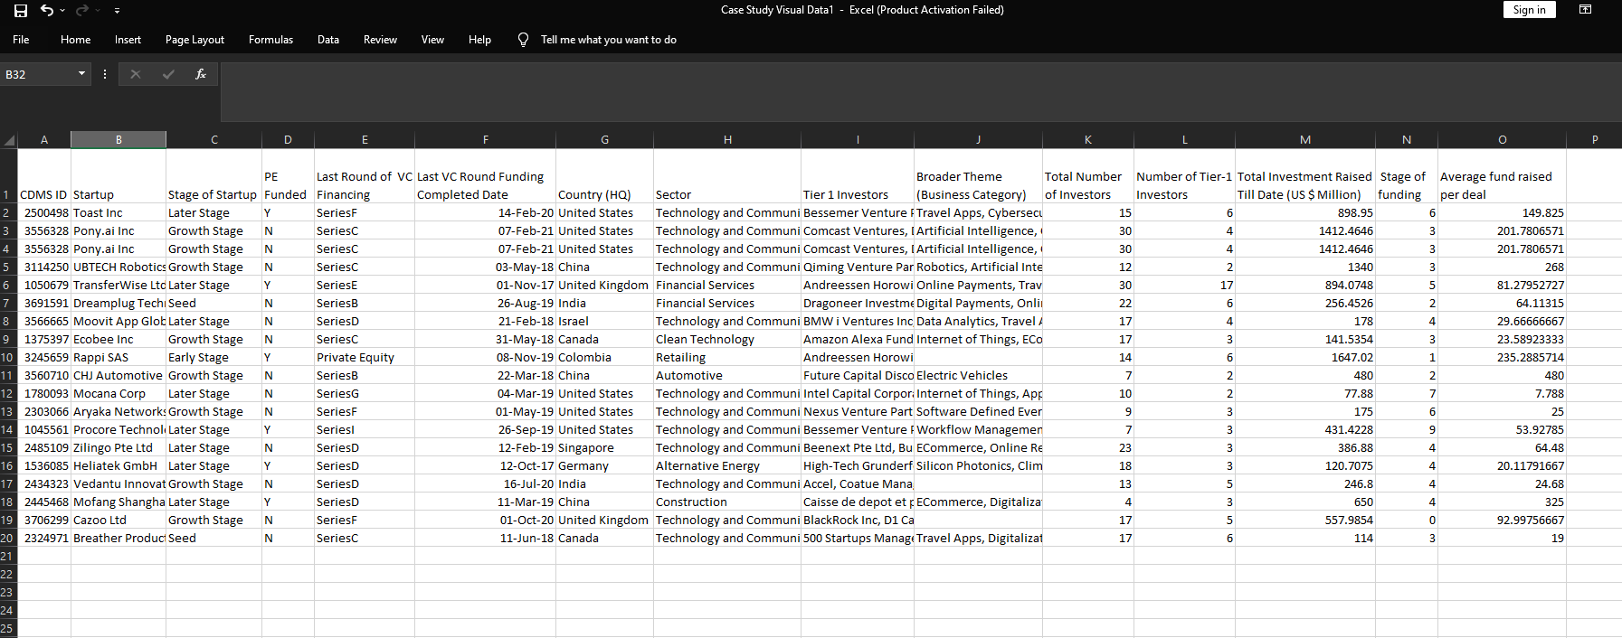
Sample Data

Slide 3
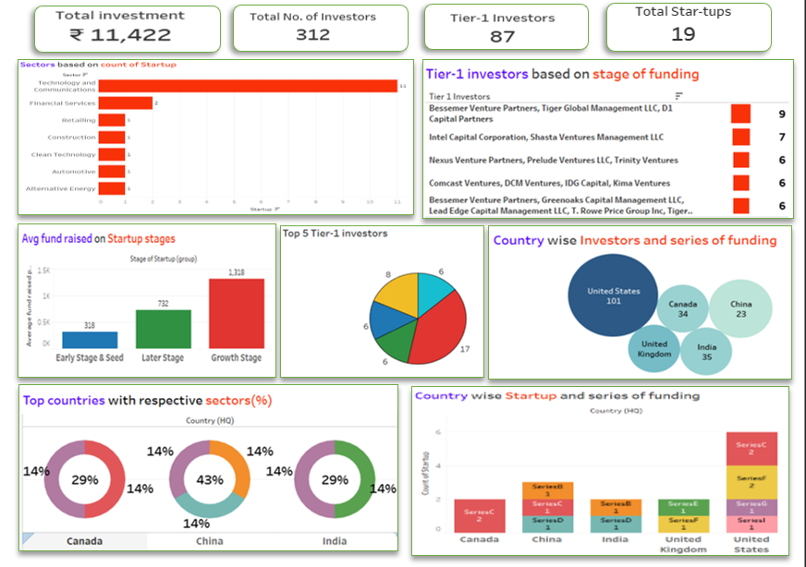
Wireframe

Slide 4
Wireframe points
KPI -Total investment- 11,422
Total investors- 312
Total Tier-1 Investors- 87
Total start-ups- 19
Sector wise start-ups.
Tier-1 investors based on stagr of funding.
Average fund raised on Startup stages.
Country wise investors and series of funding.
Top countries with Resprctive sectors (%).
Country wise start-ups and series of funding.

Slide 5
Estimation for this project
Work breakdown | Cost per Task Per hour | Time required to finish the Task | Total cost requied
Data Collection And Cleaning | 1000 | 5 hour | 1000*5=5000/-
Analysing Data and Creating key points | 1500 | 2 hours | 1500*2= 3000/-
Demo project | 1400 | 5 hours | 1400*5= 7000/-
Creating Charts and Dashboard | 1000 | 4 hours | 1000*4= 4000/-
Stories And Insights | 2000 | 8 hours | 2000*8= 1600/-
Final project Cost |  | 24 hours | 20,600/-

