Slide 1

Wireframe
-By Savita Golher

Slide 2
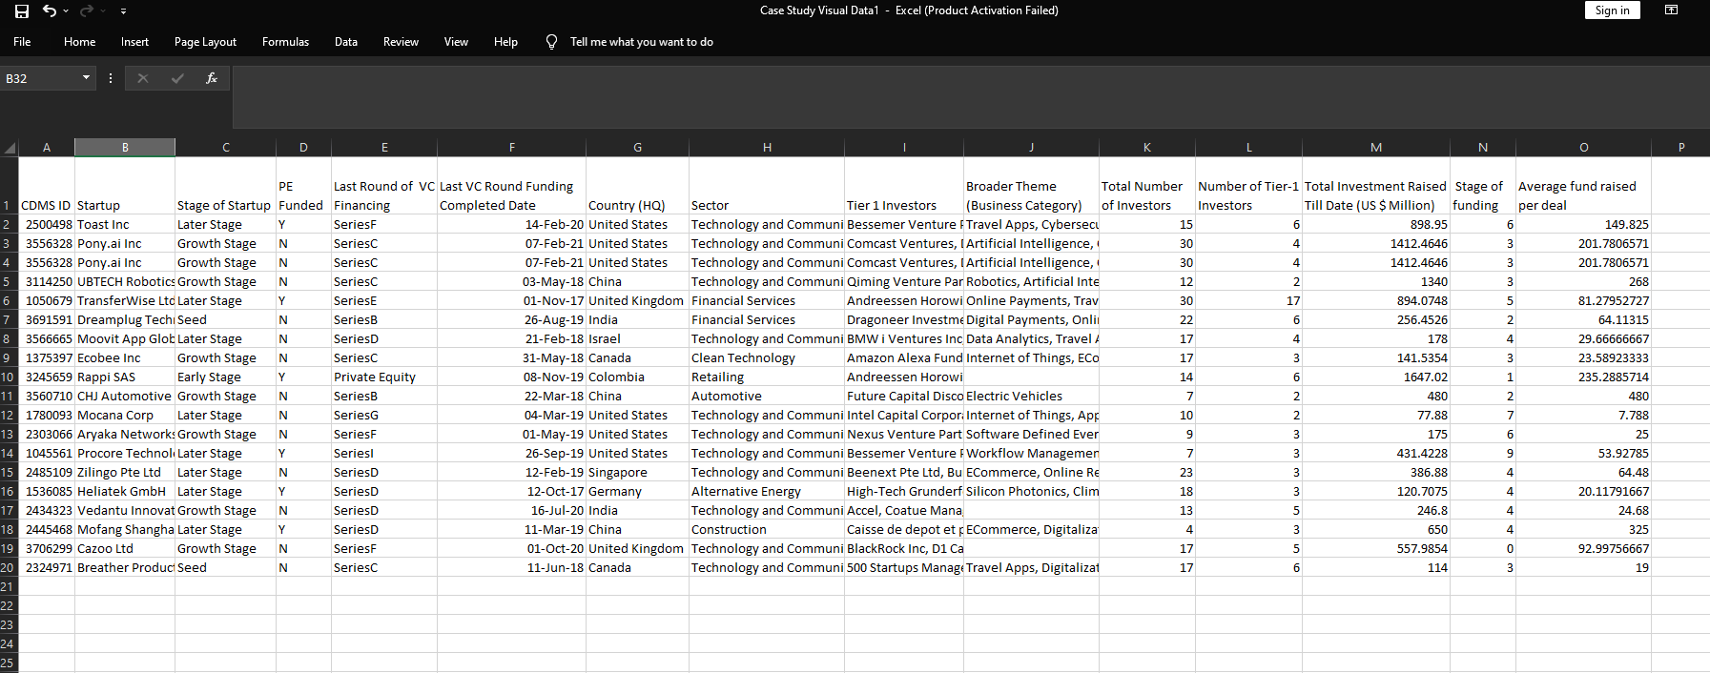
Sample Data

Slide 3
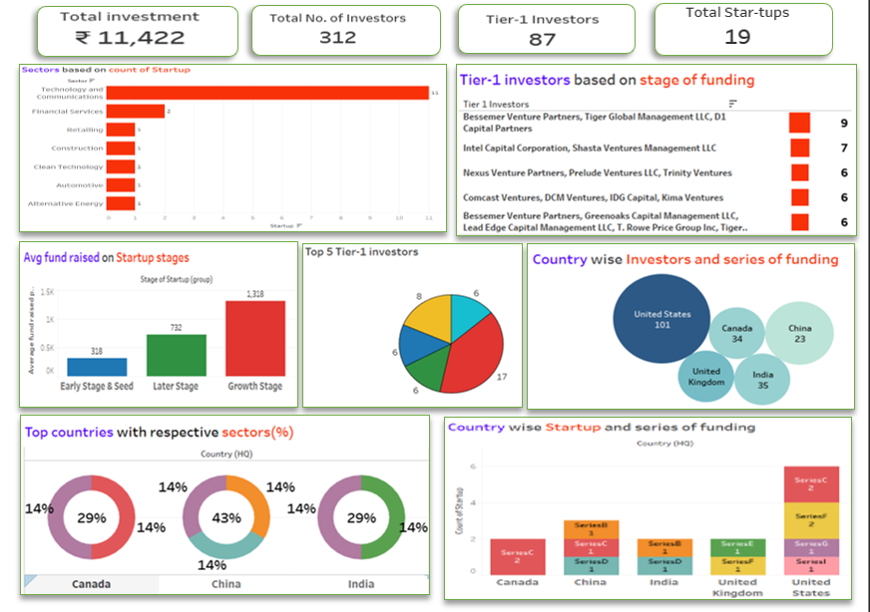
Wireframe

Slide 4
Wireframe points
KPI -Total investment- 11,422
Total investors- 312
Total Tier-1 Investors- 87
Total start-ups- 19
Sector wise start-ups.
Tier-1 investors based on stagr of funding.
Average fund raised on Startup stages.
Country wise investors and series of funding.
Top countries with Resprctive sectors (%).
Country wise start-ups and series of funding.

Slide 5
Estimation for this project
Work breakdown | Cost per Task Per Hour | Time Required to finish the Task | Total Cost Required
Data collection | 1200 | 3 hour | 1200*3= 3600/-
Exploring and Cleaning Data | 1000 | 5 hour | 1000*5= 5000/-
Analysing Data and Creating key points | 1500 | 2 hours | 1500*2= 3000/-
Demo Project | 1400 | 5 hours | 1400*5= 7000/-
Dashboard Visualization | 1000 | 4 hours | 1000*4= 4000/-
Predicting Future Trends | 1200 | 2 hours | 1200*2= 2400/-
Stories And Insights | 2000 | 8 hours | 2000*8= 1600/-
Final project Cost |  | 29 hours | 26,600/-

