Slide 1
IBM University Engagement Project Submission
“Exploring the Power of Agentic AI with IBM Granite and LangFlow”

Slide 2

Project Tile – [AI Interview Trainer Agent]
Domain of Project – [Education / Career Guidance]
Student Name | Recent Passport Photo | Email ID | Mobile number [WhatsApp]
Goli Malika |  | golimalika2255@gmail.com | 9154548204

Slide 3
Problem Statement -
Problem Statement :AI Interview Trainer Agent
The Challenge
Many students struggle during placements due to lack of interview preparation, confidence, and personalized guidance. Existing interview preparation platforms provide static content and generic questions, which fail to simulate real interview experiences.
Students often do not receive proper feedback on their answers, communication skills, or technical understanding. This creates fear, poor performance, and low placement success rates.
There is a need for an AI-powered intelligent interview preparation system that can generate personalized interview questions, evaluate answers, provide feedback, and help students improve continuously.
The Objective
The objective of the AI Interview Trainer Agent is to build an intelligent virtual interview coach that helps students prepare for HR and technical interviews through personalized AI interaction.
The system should:
• Generate technical and HR interview questions
• Evaluate user answers intelligently
• Provide feedback and scoring
• Suggest improvements
• Simulate mock interviews
• Help students improve confidence and communication skills

Slide 4
Technology Used
• LangFlow – Workflow orchestration
• IBM watsonx.ai – AI deployment
• IBM Granite Models – Question generation and evaluation
• Flask – Backend development
• HTML/CSS/JavaScript – Frontend UI
• SQLite – Database storage
• RAG – Retrieval-based intelligent responses

Slide 5
Proposed Solution -
Proposed Solution: AI-Powered Nutrition Agent
The proposed solution is an AI-powered Interview Trainer Agent developed using Flask, LangFlow, IBM watsonx.ai, and IBM Granite Models.
The system acts as a virtual interviewer that generates role-based interview questions and evaluates user responses in real time.
The solution uses Agentic AI architecture where multiple AI agents collaborate to:
• Generate interview questions
• Analyze answers
• Provide feedback
• Suggest improvements
• Track interview performance
The platform supports both technical and HR interview preparation and helps students improve placement readiness.

Slide 6
Langflow component Used -
1. Chat Input
Receives user role and interview answers.
2. IBM watsonx AI Agent
Processes user responses using Granite models.
3. Granite Model
Granite-4.0-8B-Instruct
4. Chat Output
Displays questions, scores, and feedback.
5. File Component
Stores resumes and interview history.
6. Vector Database
Stores interview question embeddings for RAG retrieval.

Slide 7
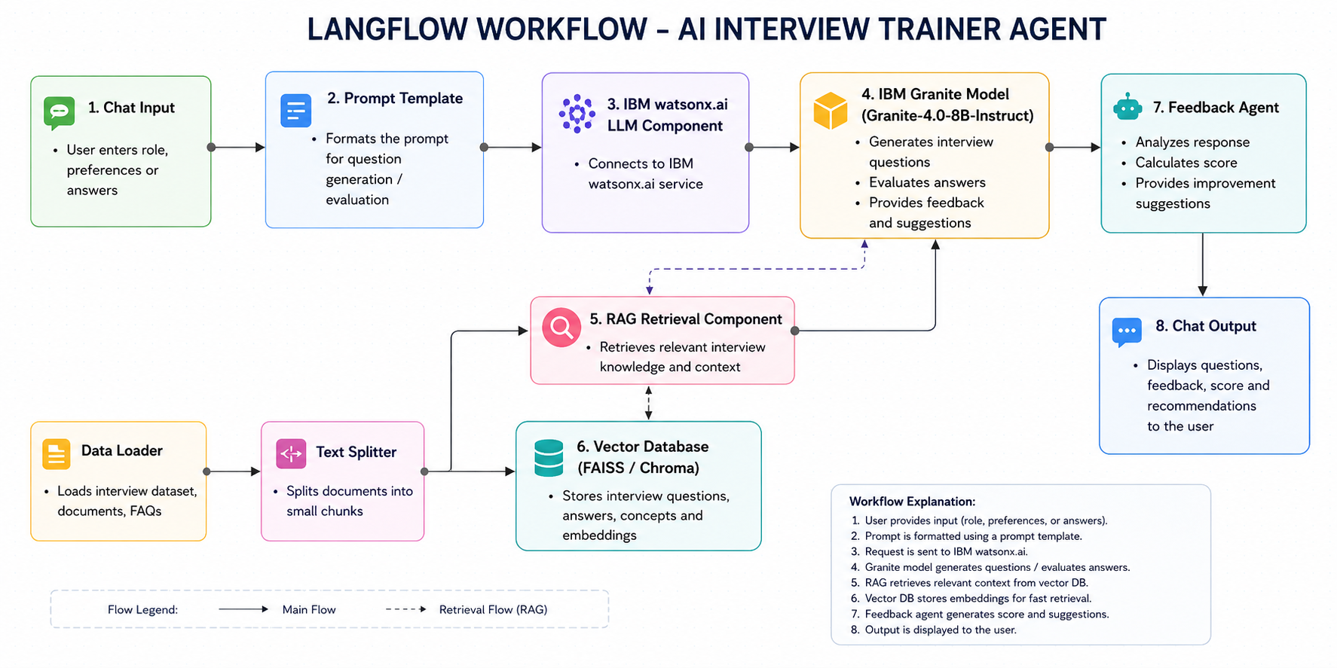
Langflow workflow -

Slide 8
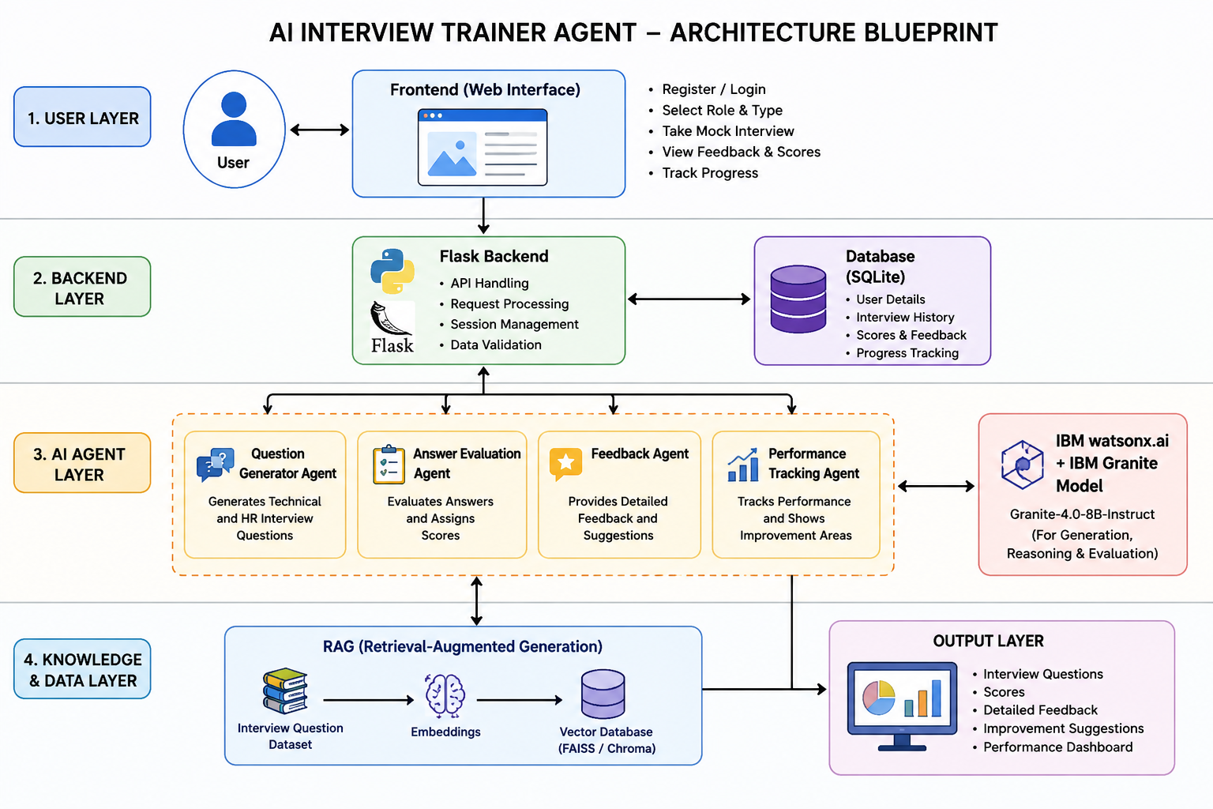
Architecture blueprint

Slide 9

Role of Agentic AI in the solution
Role of Agentic AI in AI Interview Trainer Agent
Agentic AI enables the system to function as an intelligent virtual interviewer rather than a basic chatbot.
Different AI agents collaborate to:
• Generate interview questions
• Evaluate answers
• Analyze communication quality
• Provide personalized feedback
• Suggest learning improvements
This multi-agent system creates a realistic and adaptive interview preparation experience for students.

Slide 10
Technology Used
1. LangFlow
Used for designing and orchestrating the multi-agent AI workflow visually.
2. IBM watsonx.ai
Used for deploying AI models, prompt engineering, embeddings, and AI governance.
3. IBM Granite Model
Granite-4.0-8B-Instruct model is used for interview question generation, answer evaluation, reasoning, and feedback generation.
4. Flask
Python-based backend framework used to handle APIs, routing, and application logic.
5. HTML, CSS, JavaScript
Used for developing the frontend user interface and improving user interaction.
6. SQLite Database
Used to store user details, interview history, scores, and feedback.
7. RAG (Retrieval-Augmented Generation)
Used to retrieve interview-related information and improve response accuracy.
8. Vector Database (FAISS/Chroma)
Used for storing embeddings and fast retrieval of interview questions and knowledge.

Slide 11
Novelty and Uniqueness
• Personalized interview preparation
• AI-generated technical and HR questions
• Intelligent answer evaluation
• Real-time feedback system
• Multi-agent AI architecture
• Placement-focused solution
• Scalable and interactive platform
• Supports multiple job roles

Slide 12
Git Hub Link
GitHub Link:
https://github.com/goli-malika/AI-Interview-Trainer-Agent
·
·
·

Slide 13
Future Scope
1. Voice-based mock interviews
2. Resume analysis system
3. AI confidence detection
4. Emotion and speech analysis
5. Multilingual interview support
6. Coding round simulator
7. Placement analytics dashboard.
·
·
·

Slide 14


