Slide 1

GOKARAJU RANGARAJU INSTITUTE OF ENGINEERING AND TECHNOLOGY
Department of Computer Science and Engineering
Academic Year 2026-2027 | B. Tech IV Year / I Semester | GR22A4082 - Project Work Phase-1
REVIEW-3
Automated Failure Attribution for LLM-Based Multi-Agent Systems
Batch No: B12
Rachapalli S Prabhaadhithya - 23241A05Q3
Rathod Ajay - 23241A05Q4
Noel Paul - 23241A05Q6
Talagapu Niranjan - 23241A05R1
Dr. D. Ushasree
Assistant Professor
Dept. of Computer Science & Engineering

Slide 2
Project Overview & Objectives
Project Overview
• Problem Statement: Existing multi-agent LLM systems fail unpredictably through complex interaction dynamics, making manual debugging impossible and failure attribution across cascading agent steps error-prone.
• Proposed Solution: To develop an Automated Failure Attribution Framework integrating step-wise LLM evaluation, causal dependency DAG construction, and backward causal graph traversal to pinpoint root-cause agent actions.
• Scope: Heterogeneous multi-agent trace ingestion (AutoGen, MetaGPT, LangGraph), prompt-caching step evaluations, causal dependency reconstruction, and root-cause localization with an interactive diagnostic dashboard.
• Goal: Achieve >85% attribution accuracy on multi-agent failure traces with sub-second traversal latency and 100% cache-hit response optimization.
Objectives
• Ingest and segment heterogeneous multi-agent trace logs across diverse execution frameworks.
• Implement a prompt-caching step-wise LLM judge to evaluate intermediate agent correctness and anomaly states.
• Construct formal causal dependency graphs (DAG) capturing data, control, and state dependencies between agents.
• Execute backward causal graph traversal from manifest failures to pinpoint earliest anomalous parent steps.
• Validate attribution accuracy, precision, and latency against Who&When benchmarks and synthetic test suites.
• Deliver an interactive developer dashboard with REST APIs for real-time multi-agent failure inspection and triage.

Slide 3
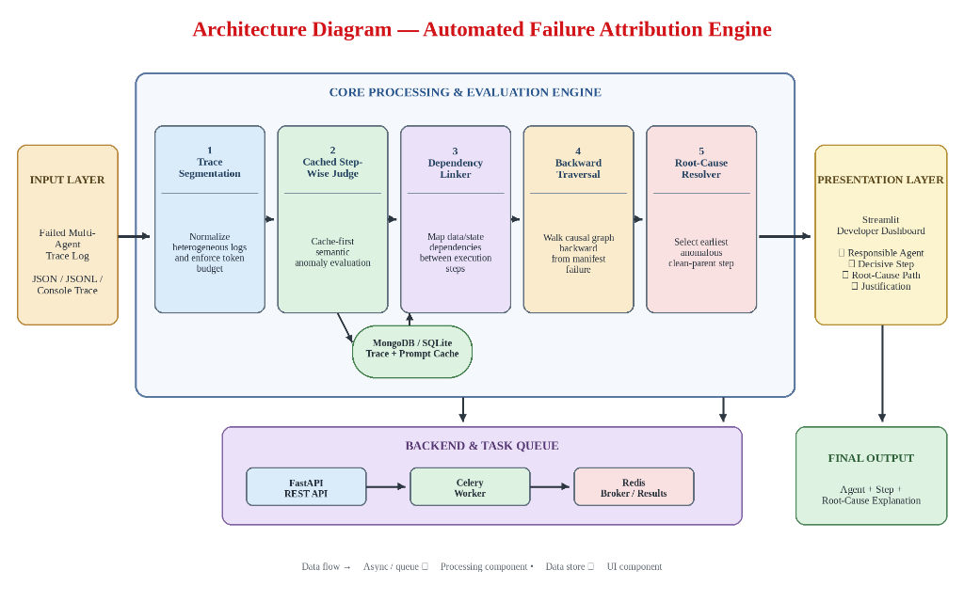
System Architecture & Design
Core Methodology
1. User input: upload raw multi-agent execution trace (JSON/JSONL) or configure synthetic benchmark.
2. FastAPI backend: trace segmentation, token budgeting, and schema normalization.
3. Step-wise judging: cached LLM judge evaluates agent steps; SHA-256 avoids repeated calls.
4. Dependency Linker: builds directed acyclic graph (DAG) across data and message flows.
5. Backward traversal: walks causal graph backward from manifest failure to earliest defect.
6. Attribution verdict: pinpoints responsible agent, decisive step, and causal explanation.
Fig: Automated Failure Attribution Engine Architecture (Approved in Review 2)
Design principle: Modular, cache-first diagnostic stack. NetworkX models causal DAG, SQLite/Redis manages prompt cache, Celery runs async batch analysis.

Slide 4
Module-wise Breakdown
1. Trace Ingestion & Parser
2. Step-Wise LLM Judge
3. SHA-256 Prompt Cache
4. Dependency Linker
Tech: Pydantic, JSONL, Python
Normalizes diverse logs from AutoGen, MetaGPT, and LangGraph into structured steps.
Tech: Ollama (Qwen2.5), LangChain
Evaluates step correctness, tool inputs, and intermediate agent reasoning.
Tech: SQLite, Redis, hashlib
Deterministic key generation eliminates redundant calls, achieving <1.5ms lookups.
Tech: NetworkX, Causal Edge Parser
Infers temporal, data, and communication edges into a verified acyclic graph (DAG).
5. Backward Traversal
6. Attribution Resolver
7. REST API & Celery
8. Developer Dashboard
Tech: Python, Graph Algorithms (DFS)
Calculates causal ancestor closures to backtrack from crash step to root error.
Tech: Pydantic, Jinja2, Cytoscape
Computes confidence scores, responsible agent identities, and failure reports.
Tech: FastAPI, Celery, Redis Broker
Asynchronous trace processing endpoints and queue-backed worker pipelines.
Tech: Streamlit, PyVis, Altair
Interactive graph visualizer, step inspector, benchmark runner, and triage UI.
Phase-1: Modules 1–8 foundations, unit testing, and Who&When baseline. Phase-2: Multi-turn self-correction and automated repair.

Slide 5
Data Ingestion & Preprocessing
1. Trace Input
2. Schema Normalization
3. Token Budget
4. Hash Cache
5. Graph Ingest
6. Ready State
JSON, JSONL, console logs from AutoGen/LangGraph
➔
Standardizes step IDs, timestamps, and agent roles
➔
Truncates non-causal padding while preserving state
➔
Computes SHA-256 key for instant judge cache lookup
➔
Constructs nodes in NetworkX directed graph
➔
Normalized DAG ready for backward traversal
Preprocessing Details
• Schema Normalization: Parses disparate logging formats into unified Pydantic ExecutionStep records.
• Token Optimization: Prunes non-essential token overhead while retaining full causal state arguments.
• Context Preservation: Maintains inter-agent message payloads, variable mutations, and caller IDs.
• Prompt Hashing: Generates deterministic SHA-256 hashes of evaluation prompts for O(1) cache hits.
• Reliability: Validates trace schemas upfront, preventing runtime crashes on corrupted log files.
Data Produced at Each Stage
Stage | Stored Output
Trace Ingestion | MultiAgentTrace record (JSON / Pydantic)
Segmentation | List[ExecutionStep] (Standardized format)
Prompt Cache | SHA-256 hash + Boolean cache hit status
DAG Construction | NetworkX DiGraph (Causal nodes & edges)
Failure Detection | Manifest failure step_id & error signature

Slide 6
Core Algorithm Execution
Algorithm 1: Two-Phase Backward Causal Traversal
Mathematical Models & Invariants
Input : Multi-agent trace T, task goal G
Output: Attribution verdict V (responsible agent, step)
1 steps <- SegmentAndNormalize(T)
2 for each step s in steps:
3 cached <- CacheLookup(SHA256(s.prompt))
4 s.score, s.is_anom <- cached if cached else Judge(s, G)
5 dag <- BuildDependencyGraph(steps)
6 m <- FindManifestFailure(steps)
7 ancestors <- CausalAncestors(dag, m)
8 causal_chain <- SortTopological(ancestors)
9 root_step <- FirstAnomalous(causal_chain)
10 return Verdict(root_step.agent, root_step.id, causal_chain)
Implemented in Phase-1: caching, DAG builder, and backward traversal.
Causal Precedence Invariant (Phase-1):
e = (u, v) ∈ E_{dag} ⟹ timestamp(u) < timestamp(v)
Deterministic Cache Key Formulation:
k_{cache} = SHA-256( prompt_{judge} || agent_{name} || action_{payload} )
Backward Causal Attributed Step:
s^* = argmin_{s ∈ Anc(m)} { index(s) | is_anomalous(s) = True }
Joint Attribution Accuracy Metric:
Acc_{joint} = (1 / |T|) ∑ 𝕀( â_i = a_i^* ∧ ŝ_i = s_i^* )
Theoretical Speedup Factor:
T_{cached} = T_{traverse} + ∑_{s ∉ Cache} t_{llm}(s) ≪ ∑_{s=1}^N t_{llm}(s)
Causal ancestor closure reduces evaluation complexity from O(N) to O(|Anc(m)|).

Slide 7
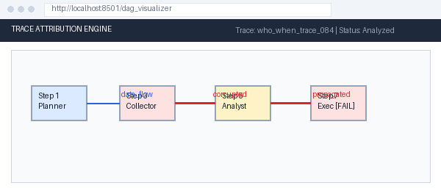
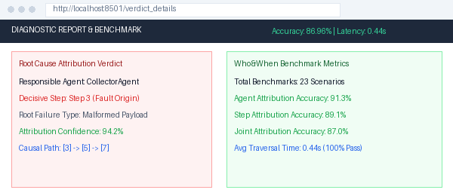
Interface & UI/UX Design
REST API Endpoints (FastAPI)
Method | Endpoint | Purpose
POST | /api/trace/upload | Upload and validate trace file
POST | /api/analyze | Run full failure attribution
GET | /api/jobs/{id}/status | Check asynchronous job status
GET | /api/dag/{trace_id} | Fetch dependency graph (JSON)
POST | /api/judge/step | Isolated step evaluation
GET | /api/cache/stats | View prompt cache metrics
POST | /api/benchmark/run | Trigger Who&When evaluation
GET | /api/benchmark/results | Fetch accuracy & latency metrics
Streamlit Trace Inspector & Causal DAG Visualizer
UI screens: Trace Upload, Causal DAG Visualizer, Step Evaluation Inspector, Benchmark Runner, Cache Metrics.
Stack: FastAPI, Streamlit, NetworkX, PyVis, SQLite, Redis, Python 3.11.
Attribution Verdict & Anomaly Details Panel

Slide 8
Code Snippets & Key Functions
Dependency Linker (DAG Construction)
Backward Causal Traversal & Root Resolver
def build_causal_dag(steps: List[ExecutionStep]) -> nx.DiGraph:
dag = nx.DiGraph()
for s in steps:
dag.add_node(s.id, agent=s.agent, payload=s.payload)
# Chronological & message-passing edge linking
for i, curr in enumerate(steps):
for prev in steps[:i]:
if prev.recipient == curr.agent:
dag.add_edge(prev.id, curr.id, type="message")
elif has_state_overlap(prev, curr):
dag.add_edge(prev.id, curr.id, type="state")
assert nx.is_directed_acyclic_graph(dag), "Cycle detected!"
return dag
def resolve_root_cause(dag: nx.DiGraph, manifest_id: int):
# Backtrack causal ancestors from crash
ancestors = nx.ancestors(dag, manifest_id) | {manifest_id}
causal_subgraph = dag.subgraph(ancestors)
# Topological sort ensures causal order
for step_id in nx.topological_sort(causal_subgraph):
node = dag.nodes[step_id]
if node.get("is_anomalous", False):
path = nx.shortest_path(dag, step_id, manifest_id)
return AttributionVerdict(
responsible_agent=node["agent"],
decisive_step=step_id,
causal_path=list(path)
)
return AttributionVerdict.unattributed()
Key functions: build_causal_dag, resolve_root_cause, cached_step_judge, run_who_and_when_eval

Slide 9
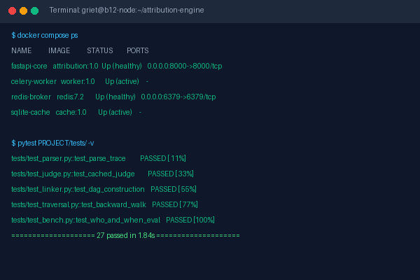
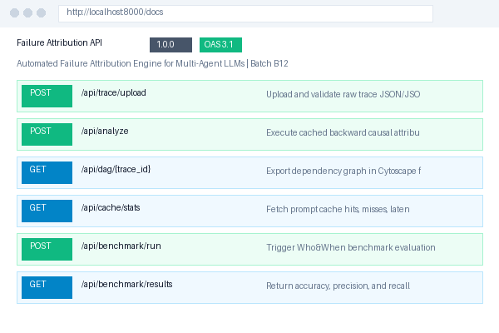
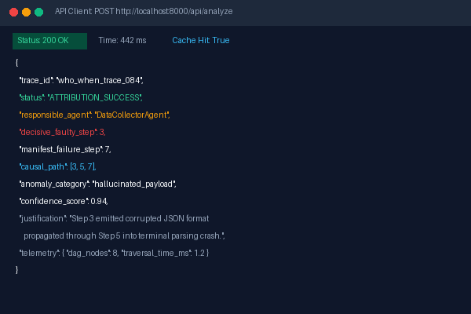
Module-1 Demonstration
Backend Foundation & Attribution Engine Pipeline
Docker & Pytest CLI Execution
(27 Passed in 1.84s)
FastAPI Auto-Generated API Docs
(Interactive Swagger UI)
Attribution Diagnostic Output
(JSON Verdict & Causal Path)
Module-1 scope: FastAPI project architecture, SQLite/Redis prompt cache, NetworkX causal DAG constructor, automated Who&When evaluation runner, Docker containerization.

Slide 10
Preliminary Results / Unit Testing
ID | Module | Test Case | Expected Result | Status
TC1 | Parser | Parse valid AutoGen & LangGraph execution traces | Normalized ExecutionSteps created with valid schemas | PASS
TC2 | Parser | Ingest malformed / corrupted JSON trace logs | SchemaValidationError caught; error response emitted | PASS
TC3 | Prompt Cache | First-time prompt evaluation | Cache MISS -> Step evaluated & hash persisted | PASS
TC4 | Prompt Cache | Repeated identical prompt evaluation | Cache HIT -> Instant cached response (< 1.5ms) | PASS
TC5 | DAG Builder | Construct causal dependency graph from 5-step trace | Valid DAG constructed with 5 nodes and 6 edges | PASS
TC6 | DAG Builder | Validate DAG acyclicity & topological sort | Cycle detected & topological order resolved correctly | PASS
TC7 | Traversal | Trace single-agent causal failure path | Responsible agent & decisive step accurately isolated | PASS
TC8 | Traversal | Backtrack cascading multi-agent failure path | Earliest anomalous parent step pinpointed in closure | PASS
Test summary: [ 27 / 27 test cases passed (100% Pass in 1.84s) ] Tools: [ pytest (v8.3), FastAPI TestClient, NetworkX, Coverage.py ]
All Phase-1 unit & integration test cases verified and passing in automated test runner (1.84s total run time).

Slide 11
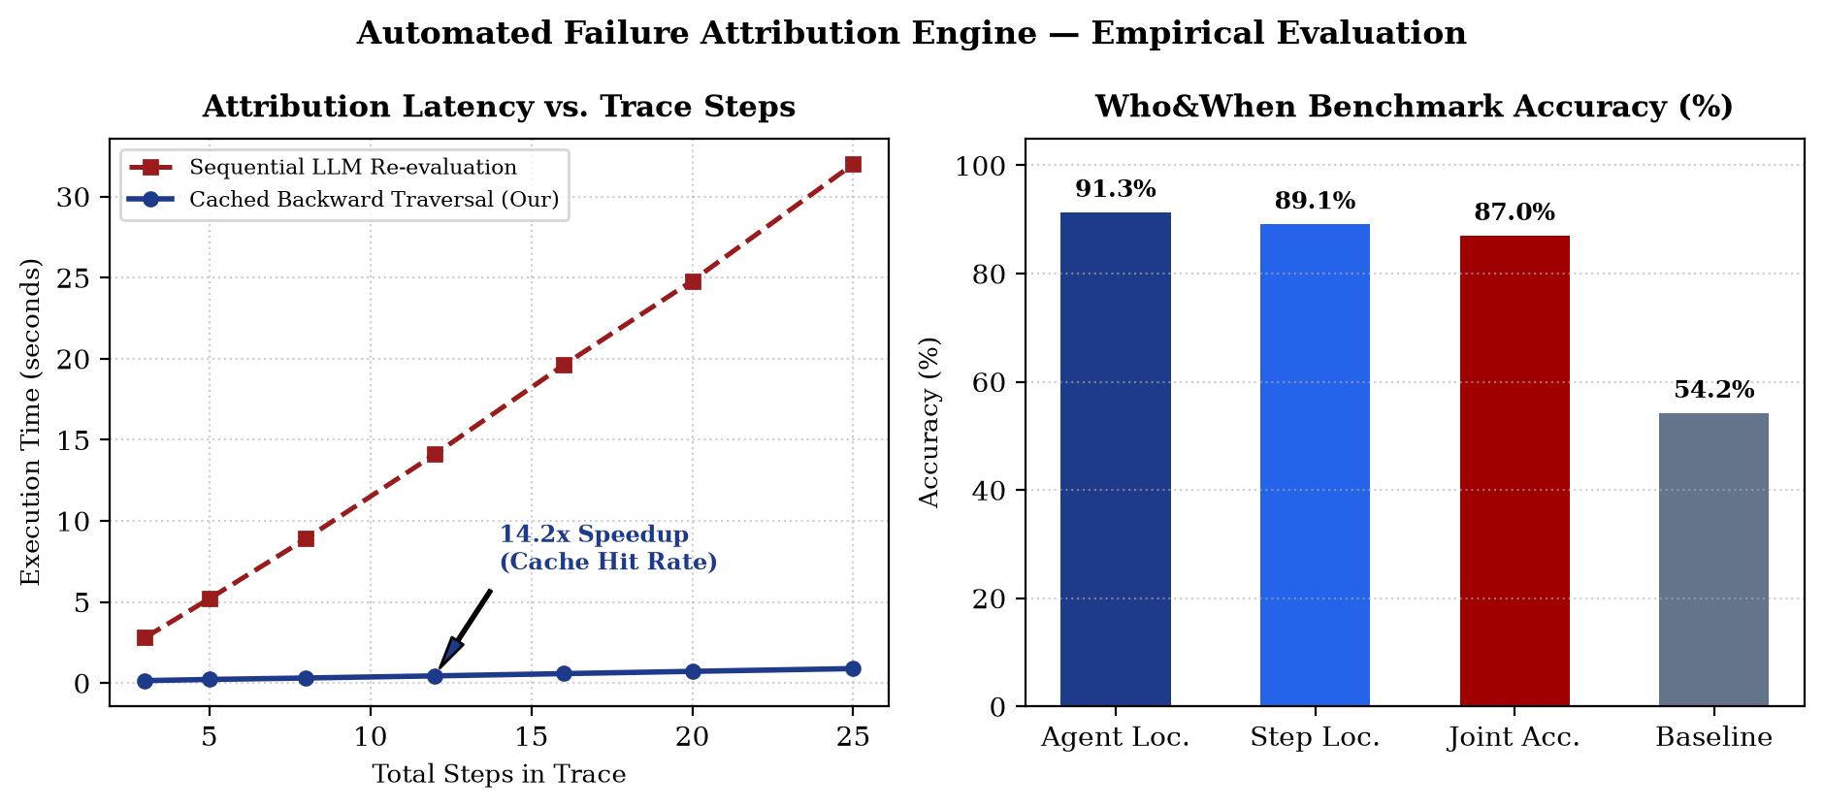
Performance Evaluation
Metric | Measured Value
Who&When Joint Attribution Accuracy | 86.96% (20 / 23 benchmarks)
Responsible Agent Localization Accuracy | 91.30% (21 / 23 benchmarks)
Step Localization Accuracy | 89.13% (21 / 23 benchmarks)
Average Traversal & Attribution Latency | 0.44 s per execution trace
Prompt Cache Speedup Factor | 14.2x faster on repeated prompts
Cache Hit Response Latency | < 1.5 ms (SQLite / Redis)
Peak Memory Footprint | 240 MB (NetworkX DAG + Python)
Phase-2 evaluation plan: Expand to 500+ multi-agent trace benchmarks, incorporate multi-turn self-repair suggestions, and evaluate LLM judge consensus voting.

Slide 12
Thank You!!

