Slide 1
















Incremental Decoding Inference
Incremental Decoding Inference Timeline
$$t_{0}$$
$$t_{0}$$
$$t_{1}$$
$$t_{2}$$
$$t_{3}$$
...
machine
learning
system
optimization
IncDecode
IncDecode
IncDecode
IncDecode
Iterations:
2
3
0
1
$$t_{1}$$
$$t_{2}$$
$$t_{3}$$
$$t_{4}$$
LLM
$$t_{0}$$
Speculative Inference Timeline
$$t_{4}$$
Spec
Spec
...
Spec
TreeVerify
Spec
TreeVerify
...
...
Outputs:
learning
system
optimization
is
Spec
Spec
...
$t_{1}→t_{2}$ $→t_{3}$ $→t_{4}$
$t_{5}→t_{6}$ $→t_{7}$ $→t_{8}$

Slide 2









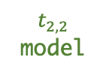

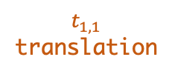
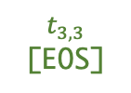
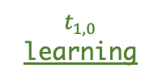

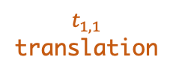











Learning-based Speculator ($§3$)
[inputs]
Collective Boost-tuned SSM Pool
Output 0: [machine] learning algorithm
Output 1: [machine] learning system design
Output 2: [machine] translation model
Fine-tuned
SSM
Quantized
LLM
Distillated
LLM
Tree Merging
$$t_{2,0}$$
algorithm
Knowledge
Retriever
User-Defined
Function
$$t_{1,0}$$
learning
$$t_{2,1}$$
system
$$t_{3,0}$$
design
$$t_{0}$$
machine
$$t_{1,1}$$
translation
$$t_{2,2}$$
model
Speculated
Token Tree
Verified output: machine learning system optimization
Synchronization
Linearization
Token Tree Verifier (§4)
$$t_{2,0}$$
algorithm
$$t_{3,1}$$
design
[machine] learning algorithm system design translation model
$$t_{1,0}$$
learning
$$t_{3,0}$$
design
$$t_{4,0}$$
[EOS]
Tree-based Parallel Decoding
LLM
$$t_{0}$$
machine
$$t_{2,1}$$
system
$$t_{1,1}$$
translation
$$t_{3,2}$$
optimization
Verified
Subtree
$$t_{2,2}$$
model
$$t_{3,3}$$
[EOS]
learning system design optimization [EOS] model [EOS]
machine learning system optimization model

Slide 3



























































































































Speculated
Token Tree
$$t_{5}$$
$$t_{4}$$
$$t_{i}$$
Verified tokens
KV-cache space
Verified token’s KV-cache
$$t_{2}$$
$$t_{3}$$
$$t_{6}$$
$$t_{7}$$
Computing token’s KV-Cache
X
The X-th GPU kernel
$$t_{8}$$
$$t_{9}$$
Sequence-based Decoding
Token-based Decoding
① ${t_{2}→t}_{3}→$ $t_{4}→t_{5}$
① ${t_{2}→t}_{3}$
$$t_{2}$$
$$t_{2}$$
$$t_{2}$$
$$t_{3}$$
$$t_{2}$$
$$t_{3}$$
$$t_{4}$$
$$t_{2}$$
$$t_{3}$$
$$t_{4}$$
$$t_{5}$$
② $t_{2}→t_{3}→t_{4}$
$$t_{2}$$
$$t_{3}$$
$$t_{8}$$
$$t_{9}$$
③ ${t_{2}→t}_{3}→t_{4}$ $→$ $t_{5}$
$$t_{2}$$
$$t_{3}$$
② $t_{2}→t_{3}→t_{4}→t_{6}→t_{7}$
$$t_{2}$$
$$t_{2}$$
$$t_{3}$$
$$t_{2}$$
$$t_{3}$$
$$t_{4}$$
$$t_{2}$$
$$t_{3}$$
$$t_{4}$$
$$t_{6}$$
$$t_{2}$$
$$t_{3}$$
$$t_{4}$$
$$t_{6}$$
$$t_{7}$$
④ ${t_{2}→t}_{3}→t_{4}$ $→$ $t_{6}$
$$t_{2}$$
$$t_{3}$$
$$t_{4}$$
$$t_{2}$$
$$t_{3}$$
$$t_{8}$$
⑤ ${t_{2}→t}_{3}→t_{4}$ $→$ $t_{6}→t_{7}$
③ $t_{2}→t_{3}→t_{8}→t_{9}$
⑥ ${t_{2}→t}_{3}→t_{8}$
$$t_{2}$$
$$t_{3}$$
$$t_{4}$$
$$t_{5}$$
$$t_{2}$$
$$t_{3}$$
$$t_{4}$$
$$t_{6}$$
$$t_{7}$$
$$t_{2}$$
$$t_{2}$$
$$t_{3}$$
$$t_{2}$$
$$t_{3}$$
$$t_{8}$$
$$t_{2}$$
$$t_{3}$$
$$t_{8}$$
$$t_{9}$$
⑦ ${t_{2}→t}_{3}→t_{8}→t_{9}$
$$t_{2}$$
$$t_{3}$$
$$t_{4}$$
$$t_{6}$$
Tree-based Decoding
① ${t_{2}→t}_{3}→$ $t_{4}→t_{5}$
①
②
③
$$t_{3}$$
$t_{3} t_{4} t_{5}$ $t_{6}$ $t_{7}$ $t_{8}$ $t_{9}$
$$t_{2}$$
$$t_{2}$$
$$t_{3}$$
$$t_{4}$$
$$t_{5}$$
$$t_{2}$$
$$t_{4}$$
$$t_{5}$$
$$t_{5}$$
$$t_{2}$$
$$t_{3}$$
$$t_{4}$$
$$t_{5}$$
$$t_{6}$$
$$t_{7}$$
$$t_{8}$$
$$t_{9}$$
$$t_{4}$$
② $t_{2}→t_{3}→t_{4}→t_{6}→t_{7}$
①
②
$$t_{7}$$
$$t_{2}$$
$$t_{3}$$
$$t_{6}$$
$$t_{2}$$
$$t_{3}$$
$$t_{2}$$
$$t_{3}$$
$$t_{4}$$
$$t_{3}$$
$$t_{4}$$
$$t_{6}$$
$$t_{7}$$
$$t_{2}$$
$$t_{4}$$
$$t_{5}$$
$$t_{6}$$
$$t_{7}$$
$$t_{8}$$
③
$$t_{9}$$
③ $t_{2}→t_{3}→t_{8}→t_{9}$
$$t_{2}$$
$$t_{3}$$
$$t_{2}$$
$$t_{3}$$
$$t_{8}$$
$$t_{3}$$
$$t_{8}$$
$$t_{9}$$
$$t_{2}$$
$$t_{4}$$
$$t_{5}$$
$$t_{6}$$
$$t_{7}$$
$$t_{9}$$

Slide 4
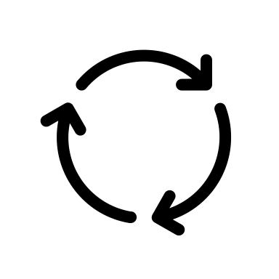

Fine-tuning
Fine-tuning
Fine-tuning
SSM 1
SSM 2
SSM 3
LLM
Output Matching
Output Matching
Output Matching
Filtering
Filtering
Output
Generation
SSM
SSM
SSM
SSM
Boost-tuned SSM Pool

