Slide 1
DEEP LEARNING COURSE PROJECT · DS306
RecallAI — A Deep Learning-Based
Personalized Study Assistant
Transforming complex study notes into structured summaries, zero-shot academic domain classifications, interactive flashcards, and vector-distractor quizzes.
COURSE INSTRUCTOR
Dr. Kongara Srinivasa Rao
Subject: Deep Learning (DS306)
SUBMITTED BY
1. Golla Madhulika
ID: 23STUCHH010826
2. Reethu Reddy
ID: 23STUCHH011082

Slide 2
DS306 · DEEP LEARNING PROJECT
Problem Statement: The Study & Retention Dilemma
1. Cognitive Overload
• Students encounter dense, unstructured academic textbooks and slide decks.
• Passive reading yields low retention (<20% recall after 48 hours).
• Manual summarization and card creation is tedious and time-consuming.
2. The LLM Hallucination Risk
• Generative LLMs frequently hallucinate facts or invent incorrect definitions.
• In STEM subjects, factual precision is non-negotiable for exam preparation.
• Generative text cannot guarantee verbatim fidelity to lecture syllabus.
3. The Proposed Solution
• RecallAI: A grounded deep learning study assistant.
• Extractive Centroid Summarization with 0% hallucination risk.
• Dense vector embeddings for active recall and semantic self-assessment.

Slide 3
DS306 · DEEP LEARNING PROJECT
Introduction: What is RecallAI?
Document Ingestion & Parsing
• PyMuPDF engine parses digital course lecture PDFs and raw notes.
• Robust validation removes non-text artifacts, noise, and scanned scans.
• Outputs clean sentence-level representations ready for vectorization.
Zero-Shot Academic Classification
• Categorizes incoming text across 10 academic domains automatically.
• No domain-specific fine-tuning required; generalizes across subjects.
• Provides confidence scores and secondary topic distributions.
Hallucination-Free Summarization
• Semantic Centroid MMR (Maximal Marginal Relevance) ranking.
• Selects verbatim central sentences that capture 70%+ information.
• 100% faithful to instructor notes — zero false statements.
Active Recall & Quiz Engine
• Generates MCQs using semantic distractor embeddings.
• Creates interactive concept flashcards with flip-to-reveal mastery.
• Tracks progress dynamically with personalized diagnostic scoring.

Slide 4
DS306 · DEEP LEARNING PROJECT
Deep Learning Technologies & Framework Stack
Sentence-Transformers
• Model: all-MiniLM-L6-v2
• Parameters: 22.7 Million
• Dimension: 384-d dense vectors
• Purpose: Dense semantic embeddings for sentences, cosine similarity search, and distractor ranking.
• Advantage: Blazing-fast inference on standard CPU environments.
DistilBERT Zero-Shot NLI
• Model: distilbert-base-uncased-mnli
• Parameters: 66 Million
• Architecture: 6-layer Transformer
• Purpose: Natural Language Inference hypothesis testing ('This text is about {topic}').
• Advantage: 40% smaller and 60% faster than BERT-base while retaining 97% accuracy.
Supporting Stack
• PyTorch (v2.6+): Tensor operations and neural inference runtime.
• Hugging Face Transformers: Model hub and tokenizer pipeline.
• PyMuPDF (fitz): High-speed PDF text stream extraction.
• Streamlit: Modern reactive dark-mode web application interface.

Slide 5
DS306 · DEEP LEARNING PROJECT
Deep Learning Architecture: End-to-End Pipeline
Step 1: Embedding Projection
Sentences are passed into all-MiniLM-L6-v2 to obtain 384-dimensional dense semantic vectors using Mean Pooling over contextual token states.
Step 2: Centroid & MMR Summarizer
Document centroid vector C is calculated. Maximal Marginal Relevance iteratively selects sentences with high cosine similarity to C while penalizing redundancy.
Step 3: Zero-Shot Classification
DistilBERT compares note embeddings against candidate academic hypotheses using softmax probability distribution over entailment logits.
Step 4: Vector Distractor Generation
Key terms are extracted; distractor options are sampled from semantically proximate yet incorrect embedding clusters to form challenging test questions.

Slide 6
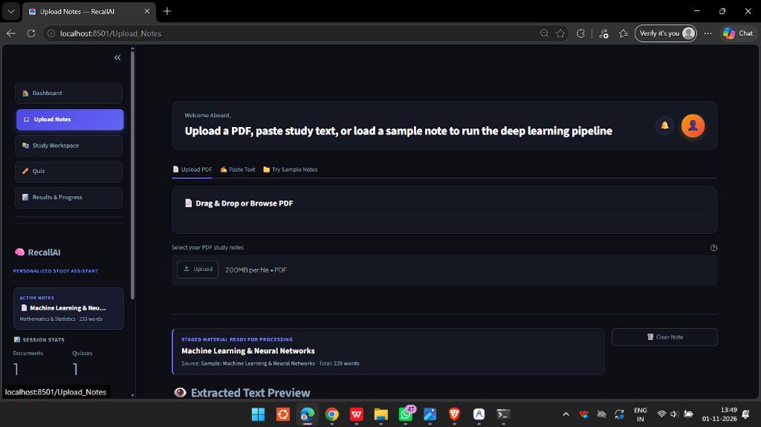
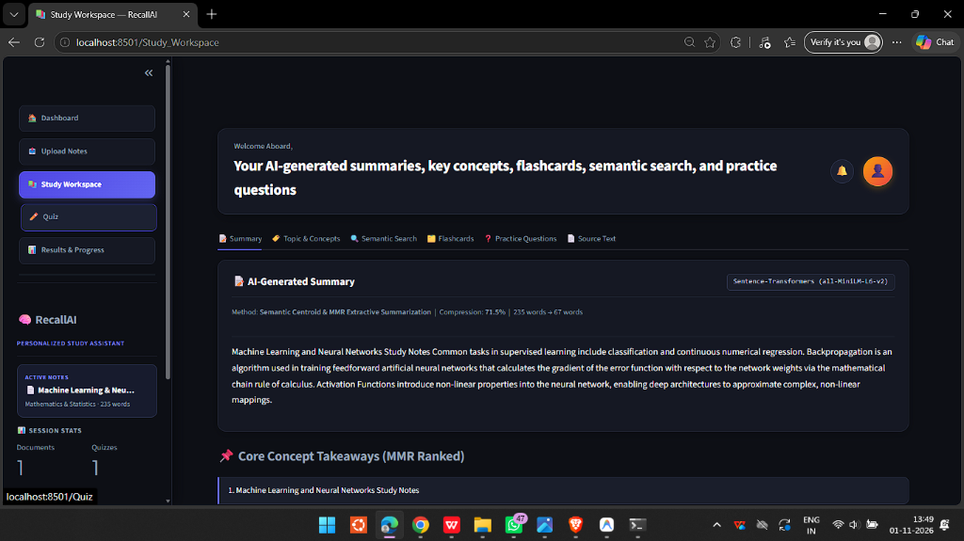
DS306 · DEEP LEARNING PROJECT
Working System: Note Ingestion & Study Workspace
1. Notes Ingestion & Processing
Supports PDF drag-and-drop, raw text pasting, or 1-click sample notes. Displays word count, token length, and processing status.
2. AI Study Workspace
Renders MMR-ranked summary (71.5% compression), core concept takeaways, interactive flashcards, and dense vector semantic search.

Slide 7
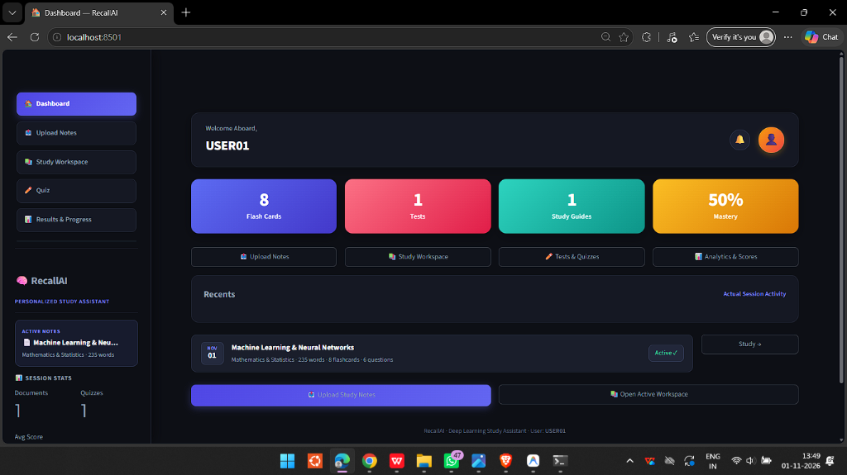
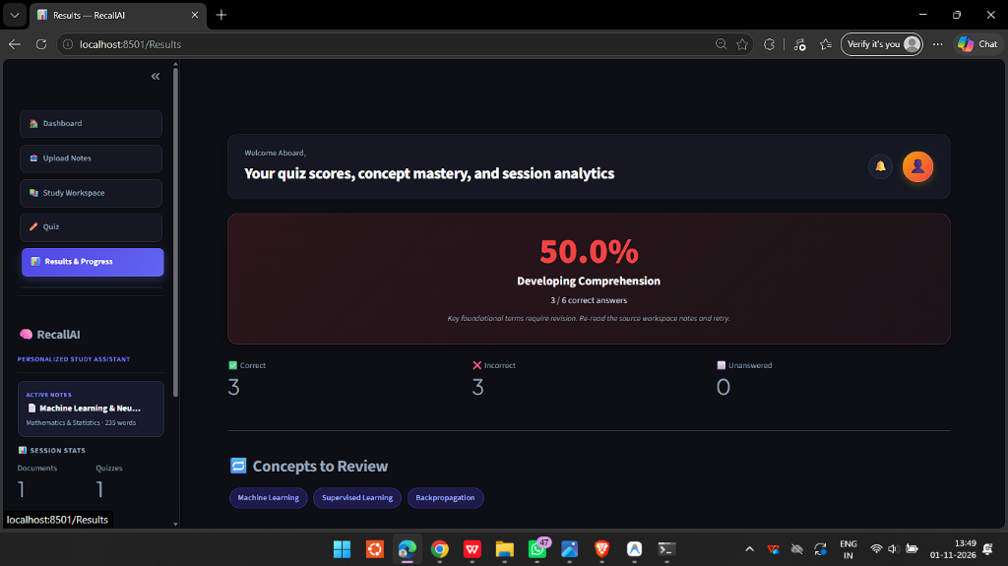
DS306 · DEEP LEARNING PROJECT
Working System: Student Dashboard & Quiz Results
3. Authentic Student Dashboard (USER01)
Real-time session statistics: Flash Cards (8), Tests (1), Study Guides (1), and active mastery (50%). Seamless 1-click workspace switching.
4. Diagnostic Quiz & Mastery Analytics
Detailed score breakdown (3/6 correct) with automated concept weakness diagnosis (Backpropagation, Supervised Learning) for targeted revision.

Slide 8
DS306 · DEEP LEARNING PROJECT
Conclusion & Future Research Directions
Key Achievements
• 100% Hallucination-Free: Verbatim extractive centroid summarization preserves academic accuracy.
• High Efficiency: Zero-shot DistilBERT and MiniLM achieve sub-second inference on standard CPU.
• Active Learning Impact: Converts passive reading into active testing through vector-matched distractors.
• User-Centric Architecture: Elegant dark academic desktop interface with real-time state tracking.
Future Scope
• Multimodal Learning: Vision-Language Models (e.g. CLIP / ViT) to summarize textbook diagrams and graphs.
• Adaptive Spaced Repetition: SuperMemo SM-2 algorithm to schedule flashcards based on forgetting curves.
• Cross-Document Synthesis: Semantic graph clustering across semester-long lecture series.
• Audio Lecture Transcription: Whisper integration to process recorded classroom audio directly into notes.

