Slide 1
B-Tech III SEMESTER
Cornerstone Project on
Library Management System
Review - 13-08-2026
Guided by
G.L.NARASAMBA.V
Assistant Professor
Presented by
G.Rambabu
B.Taraka Ram
G.Gayathri
Ch.Siva Rama Teja
Department of AIML

Slide 2
Contents
Abstract
Problem Statement
Objectives
No of Entities used
Attributes of each Entity
Primary and Foreign keys
Project Relational Schema
Advantages
Dis-Advantages
Conclusion

Slide 3

Abstract
The Library Management System is a DBMS project used to manage library records easily.
It helps to store and manage information about books, students, authors, and book issue/return details in a database.
The system reduces manual work and makes it easier to add, search, update, and manage library records.

Slide 4

Problem Statement
Managing a library manually can be difficult and time-consuming.
Maintaining book records manually is difficult.
Finding books takes more time.
Keeping student records is difficult.
Tracking issued and returned books can cause errors.
It is difficult to keep all library data organized.
Therefore, we propose a Library Management System to store and manage library information easily using DBMS.

Slide 5
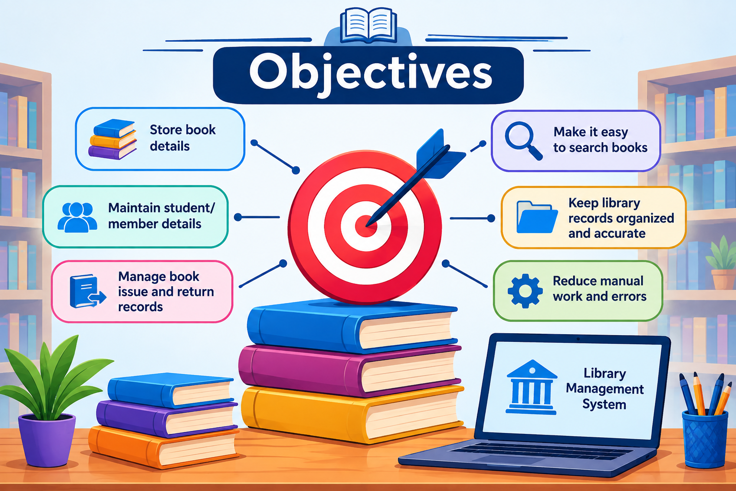
Objectives
Objectives
To store book details in the database.
To maintain student/member details.
To manage book issue and return records.
To make it easy to search books.
To keep library records organized and accurate.
To reduce manual work and errors.

Slide 6

No of Entities used
No. of Entities Used
Our Library Management System uses 5 Entities:
Student – Stores student details.
Book – Stores book information.
Author – Stores author details.
Issue – Stores book issue and return details.
Librarian – Stores librarian information.
Total Entities: 5

Slide 7
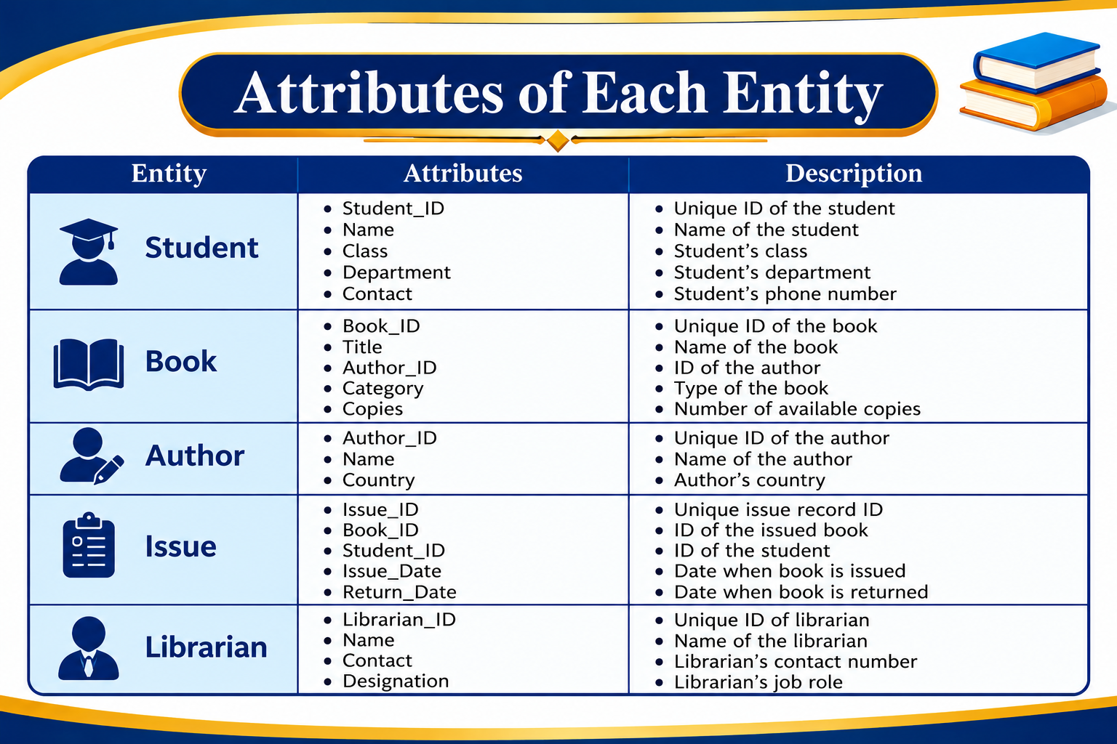

Slide 8
Primary and Foreign keys
Entity / Table | Primary Key (PK) | Foreign Key (FK) | References
Student | Student_ID | — | —
Author | Author_ID | — | —
Book | Book_ID | Author_ID | Author(Author_ID)
Librarian | Librarian_ID | — | —
Issue | Issue_ID | Book_ID, Student_ID, Librarian_ID* | Book(Book_ID), Student(Student_ID), Librarian(Librarian_ID)
.

Slide 9
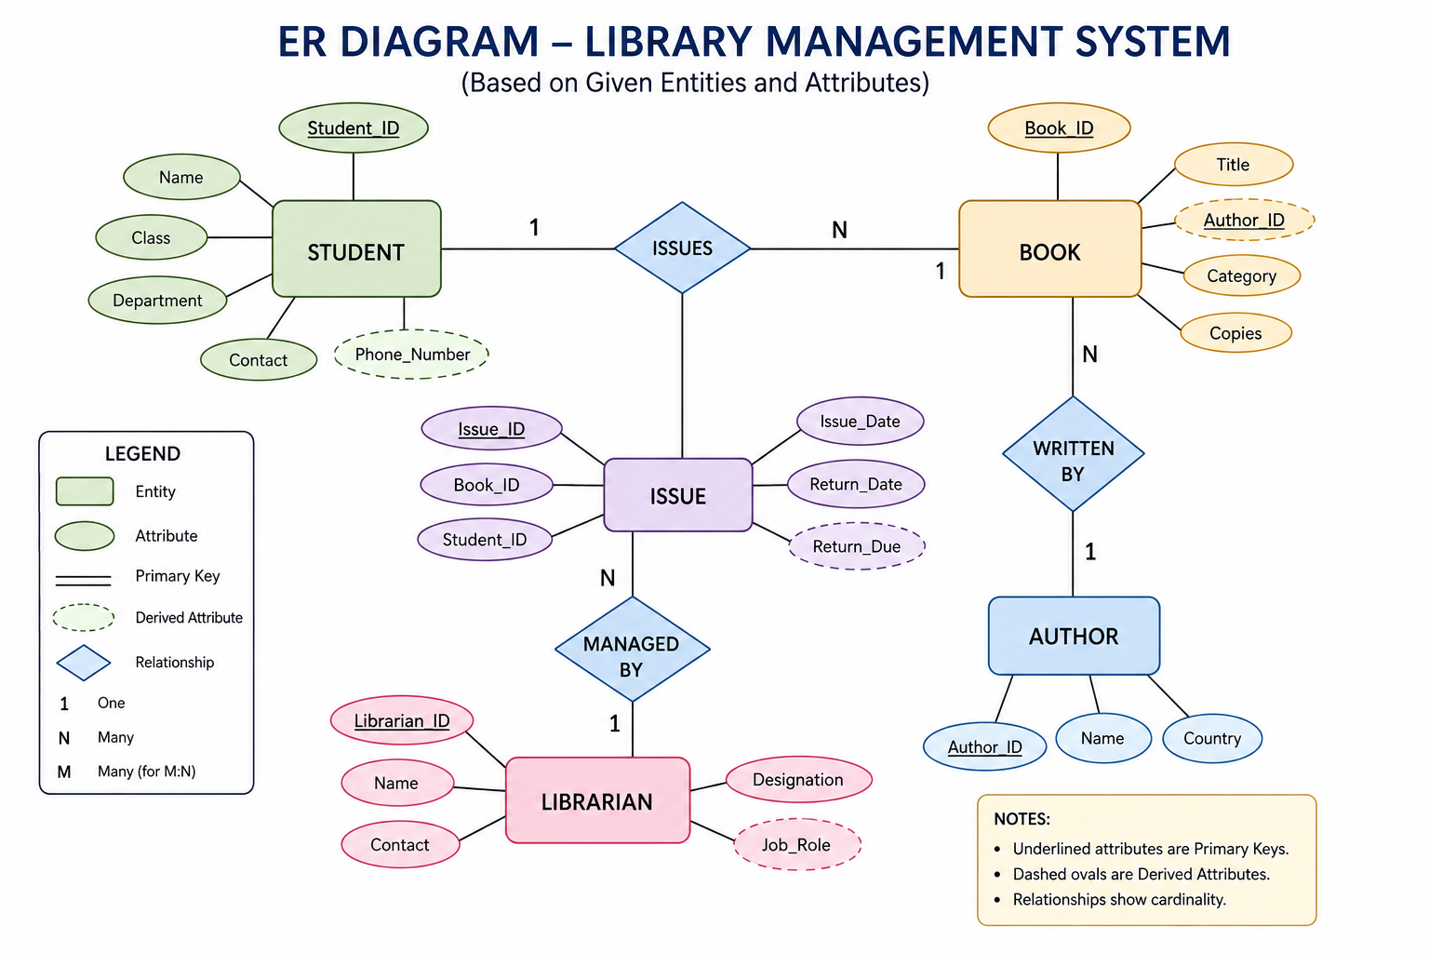

Slide 10
System Login
LIBRARY
Login to manage books, students and issue/return records
MANAGEMENT
SYSTEM
USERNAME
librarian
PASSWORD
DBMS PROJECT
••••••••
LOGIN
Demo output screen
Illustrative interface for presentation

Slide 11
System Dashboard
02
Library Management System • Sample Output
LIBRARY
Welcome, Librarian
Dashboard
Total Books
Students
Issued Books
Available
Books
250
180
36
214
Students
Recent Activity
Issue / Return
B-102 • Issued to S-018
Reports
B-087 • Returned by S-031
B-145 • New book added
Dashboard connects the main library operations

Slide 12
Book Management — Add / Search
03
Library Management System • Sample Output
Add New Book
Search Books
BOOK ID
TITLE
SEARCH BY TITLE / ID
B-145
Database Systems
Database
SEARCH
AUTHOR ID
CATEGORY
Search Result
A-014
Computer Science
Book ID
Title
Author
Available
COPIES
B-145
Database Systems
A-014
5
5
SAVE BOOK
B-087
Python Basics
A-009
2
✓ Book record saved successfully
Book records support quick search and organized storage

Slide 13
Issue Book — Transaction Output
05
Library Management System • Sample Output
Issue Book
Transaction Successful
ISSUE ID
STUDENT ID
I-2026-036
S-018
✓
BOOK ID
ISSUE DATE
B-145
28-09-2026
Issue ID
I-2026-036
DUE DATE
LIBRARIAN ID
Student
S-018
05-10-2026
L-01
Book
B-145
CONFIRM ISSUE
Status
Issued
Issue table links Book, Student and Librarian records

Slide 14
Complete Working Flow & Output
07
Library Management System • Sample Output
1
2
3
4
5
6
LOGIN
→
ADD / SEARCH
BOOK
→
REGISTER
STUDENT
→
ISSUE
BOOK
→
RETURN
BOOK
→
UPDATE
DATABASE
Final database result
Books
Students
Authors
Issues
250 records
180 records
45 records
36 active
The output screens demonstrate the intended workflow from user entry to database update.
Presentation-ready illustrative outputs based on the project entities and objectives

Slide 15
Advantages of Library Management System
Easy Book Management – Stores book details such as title, author, category, and copies.
Quick Book Search – Students and librarians can easily find book information.
Issue & Return Tracking – Keeps accurate records of issued and returned books.
Reduces Manual Work – Minimizes paperwork and saves time.
Data Accuracy – Reduces errors and duplicate records.
Better Record Security – Student, book, and issue information can be stored systematically.

Slide 16
Disadvantages of Library Management System
Initial Cost – Requires computers, software, and database setup.
Technical Knowledge – Librarians need basic computer knowledge.
System Failure Risk – Hardware or software problems may temporarily stop operations.
Maintenance Required – Database and software need regular maintenance.
Data Security Issues – Unauthorized access can cause data loss or misuse.
Training Required – Users may need training to use the system effectively.

Slide 17
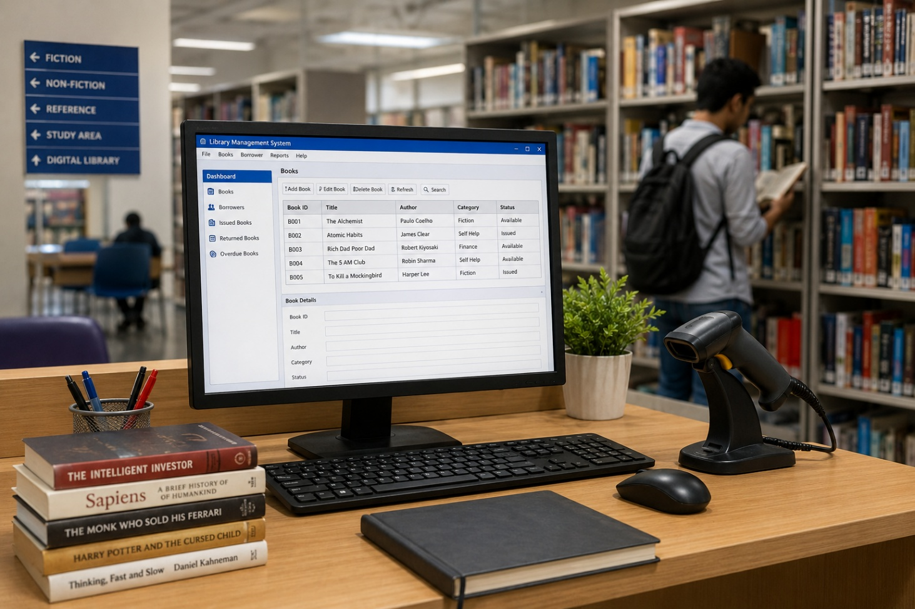
CONCLUSION
The Library Management System provides an efficient and organized way to manage students, books, authors, librarians, and issue records. By using a database and proper relationships between entities, it reduces manual work, improves data accuracy, and makes book issue and return tracking easier. Overall, the system helps the library operate faster, more accurately, and systematically.

Slide 18
Thank you

