Slide 1

CORNERSTONE PROJECT REVIEW – 2 2026–2027
Object Oriented Programming through C++
Bank Account Management System Using C++
Presented By: 25B11AI349- G Srinivas 25B11AIA53 - P Sai Tharun 25B11AI136- B Venkatesh 25B11AI982-T Harika
Guided By:
T Vijaya Lakshmi madam
Department : Artificial Intelligence & Machine Learning

Slide 2

INDEX
Abstract
Introduction
Problem Statement
Objectives of Project
Users of the system
Modules/Functionalities
Architecture Diagram
ER Diagram / DFD
Planning and Timeline Diagram
Role of each individual

Slide 3

ABSTRACT
The Bank Account Management System is a C++-based application designed to simulate basic banking operations in a simple and organized environment. The system allows users to create and manage bank accounts and perform operations such as depositing money, withdrawing money, checking account balance, and viewing account details. The main purpose of the project is to provide a simple and user-friendly environment for understanding banking operations, account management, transaction handling, and basic financial activities

Slide 4
INTRODUCTION
The Bank Account Management System is a C++-based application developed to manage basic banking activities in a simple and organized way. It allows users to create bank accounts, store customer details, and perform common operations such as deposit, withdrawal, balance enquiry, and viewing account details. It provides a simple and user-friendly approach to handling banking operations and demonstrates the practical implementation of Object-Oriented Programming concepts in C++, such as classes, objects, data members, and member functions.

Slide 5

PROBLEM STATEMENT
Manual management of bank accounts can be time-consuming and may cause errors in maintaining customer details and transactions. A simple and user-friendly system is needed to manage account creation, deposits, withdrawals, balance enquiry, and account details efficiently.

Slide 6
PROPOSED SOLUTION
Develop a C++ Bank Account Management System that provides account creation, customer details management, deposit, withdrawal, balance enquiry, and account information management. The system will maintain account records and transaction details for each customer Thus, the system helps users understand banking operations, account management, transaction handling, and basic financial activities in a simple, organized, and practical way.

Slide 7
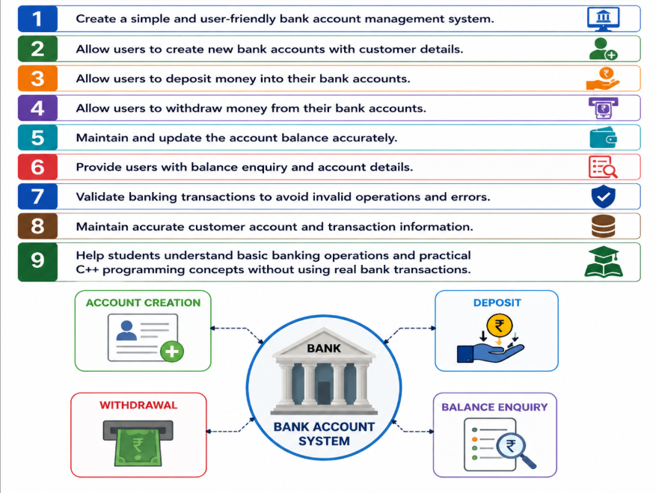
OBJECTIVES OF PROJECT

Slide 8

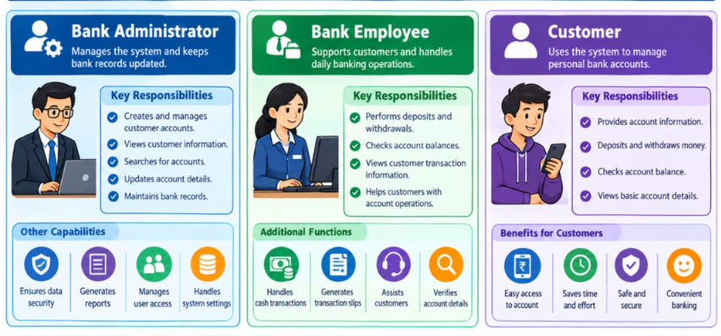
USERS OF THE SYSTEM

Slide 9
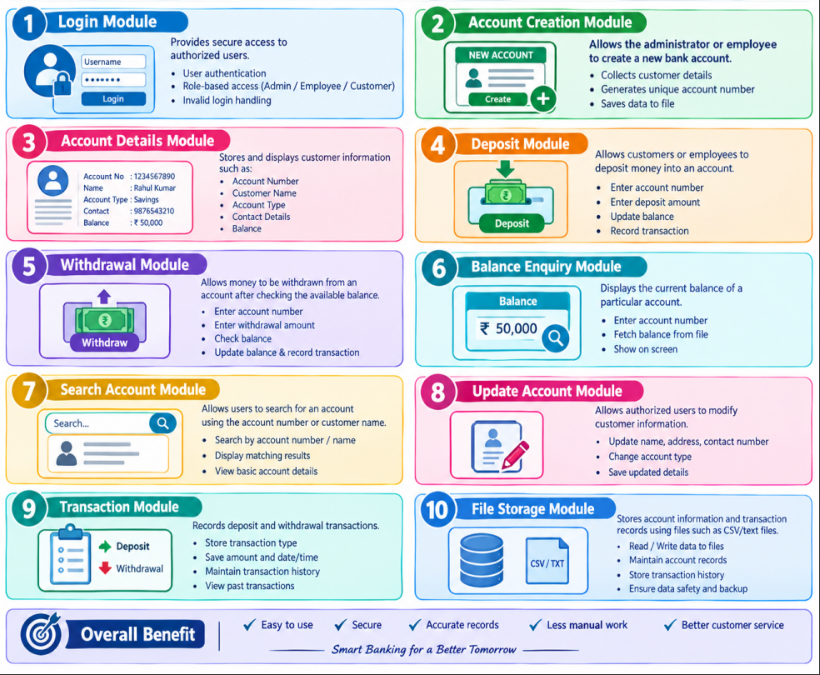
MODULES/FUNCTIONALITIES
Login Module – Provides secure access to authorized users.
Account Creation – Creates new customer bank accounts.
Account Details – Stores and displays customer and account information.
Deposit – Adds money to the customer’s account.
Withdrawal – Allows users to withdraw available money.
Balance Enquiry – Shows the current account balance.
Search Account – Finds accounts using account number or customer name.
Update Account – Modifies customer or account details.
Transaction Module – Records deposits and withdrawals.
File Storage – Saves account and transaction records in files.

Slide 10
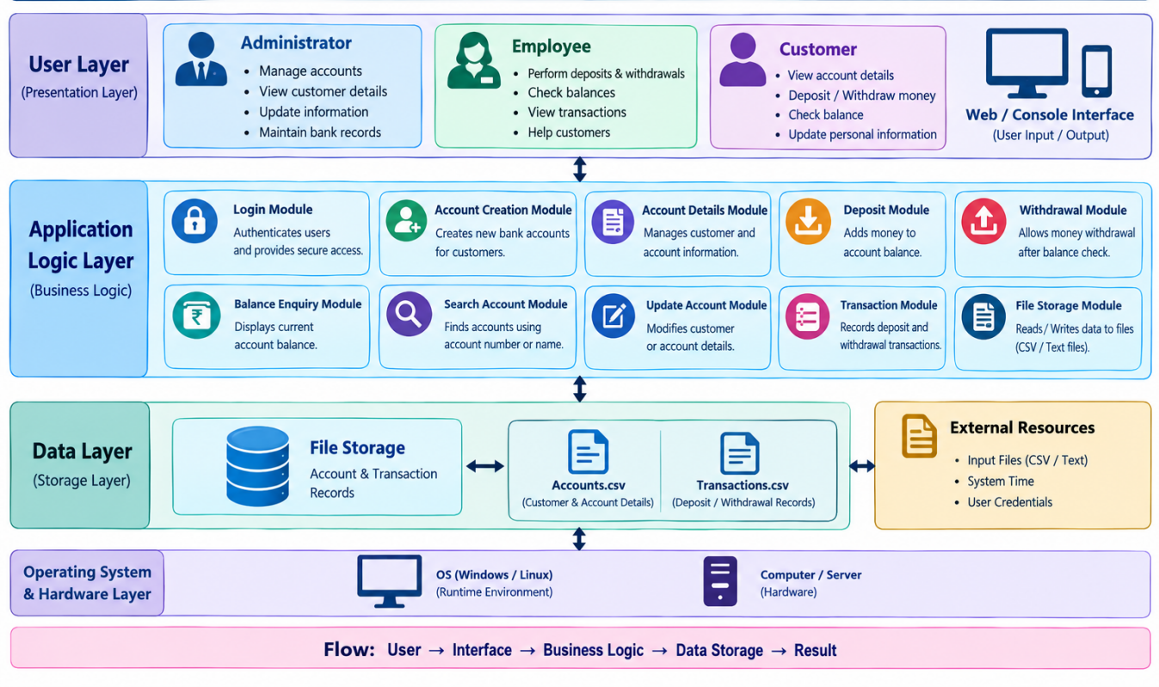
ARCHITECTURE DIAGRAM

Slide 11
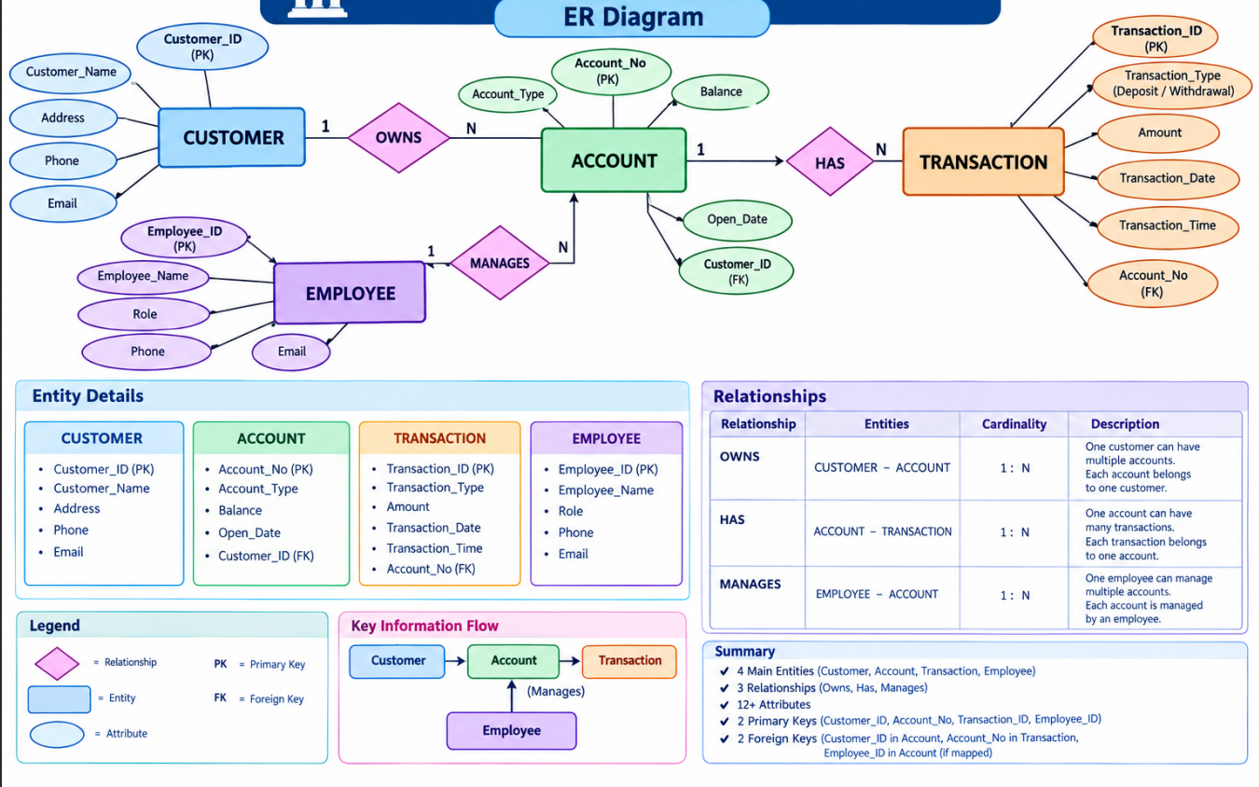
ER DIAGRAM / DFD

Slide 12
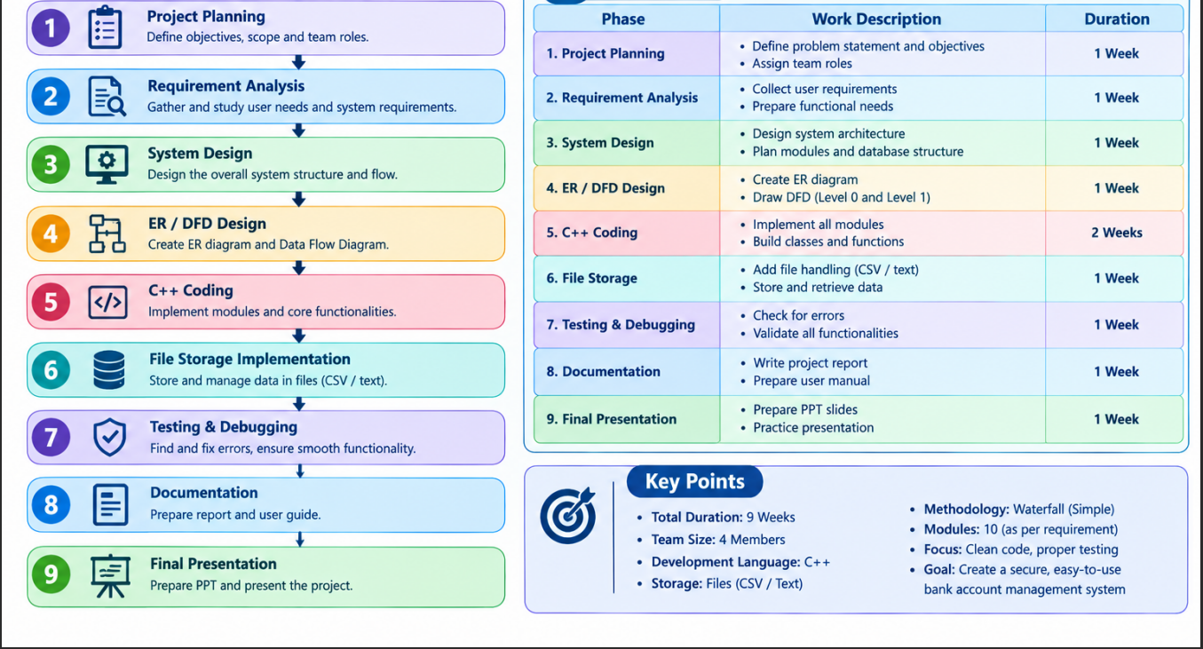
PLANNING AND TIMELINE DIAGRAM

Slide 13
ROLE OF EACH INDIVIDUAL
~ G Srinivas - Project Manager & System Analyst
Defines project objectives and requirements.
Plans the overall project workflow.
Coordinates the work of all team members.
Design the basic system architecture.
Helps integrate all modules.
Monitors project progress.
~ B Venkatesh – Transaction Developer
Develops the Deposit Module.
Develops the Withdrawal Module.
Implements transaction recording.
Check sufficient balance before withdrawal.
Update account balance after transactions.
Tests deposit and withdrawal operations.
~ P Sai Tharun - Account Management
Develops the Account Creation Modules.
Implements customer and account details.
Develops Search Account functionality.
Implements Update Account functionality.
Implements Balance Enquiry.
Tests account-related operations.
~ T Harika – Database, Testing & Documentation
• Design the ER Diagram and DFD.
Implements CSV/Text File Storage.
Manages customer, account, and transaction records.
Perform system testing and debugging.
Prepares project documentation and PPT.
Supports final project demonstration.

Slide 14

THANK YOU!

