Slide 1

Online Shopping (E-Commerce) System Group No 04
Student ID Register Number Section
2510030006 N Srikar S-2
2510030386 G Ganesh S-2
2510040072 Megha Shyam S-2
2510040010 Hari Chandra Reddy S-2
Department of Freshman Engineering (FED)
KONERU LAKSHMAIAH EDUCATION FOUNDATION

Slide 2
Role played in the project
2510030006
2510030386
2510040072
2510040010
File Data Handling, Exception Handling with Linked lists.
Arrays, Stacks.
Searching, Linked Lists.
Sorting, Queues with Bank Loans.

Slide 3
OBJECTIVE
Design a system of Online Shopping
(E-Commerce)System.
DESCRIPTION
The project is a simple menu based system with features like Print Catalogue,Display Cart,Remove Product,Undo-Redo Operations.

Slide 4
WORKFLOW
Menu
Print Catalogue
Display Cart
Remove Product
Undo-Redo
Exit

Slide 5
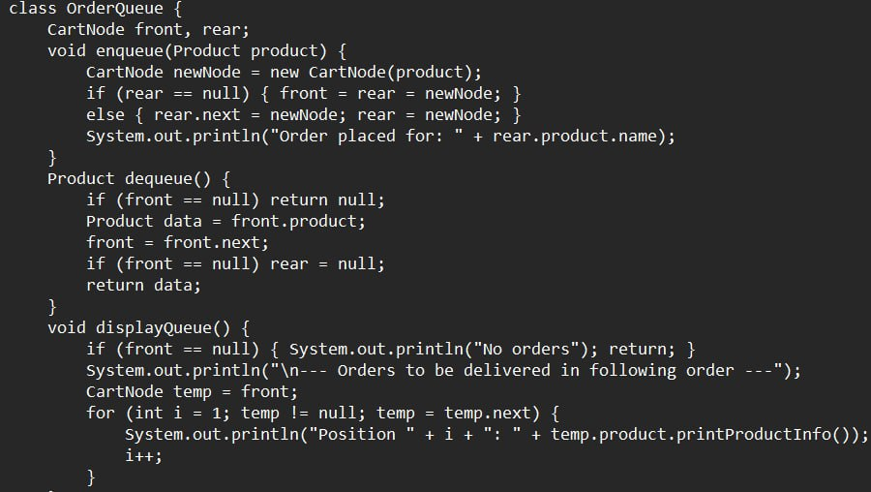
Order Queue

Slide 6
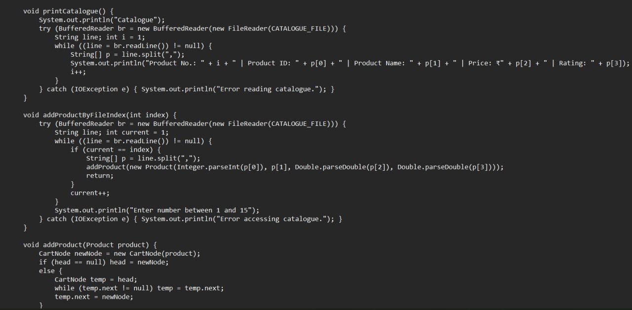
Print Catalogue and add Product

Slide 7
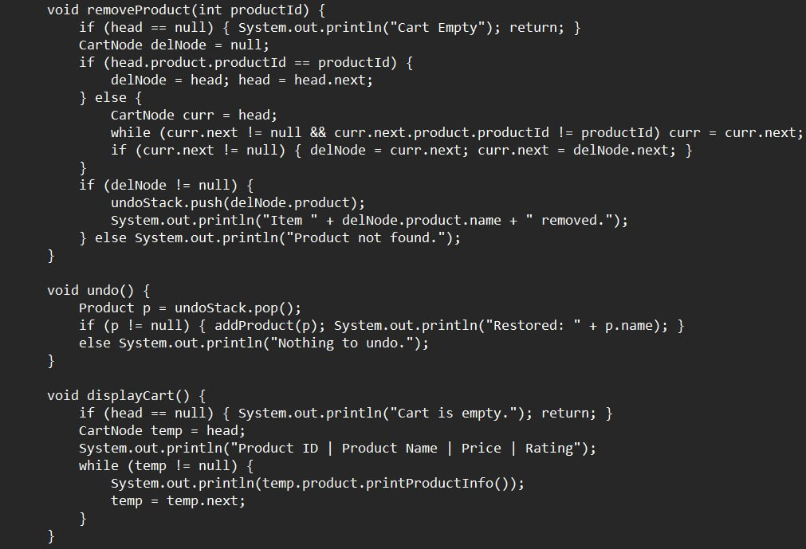
Remove Product, Undo, Display Cart.

Slide 8
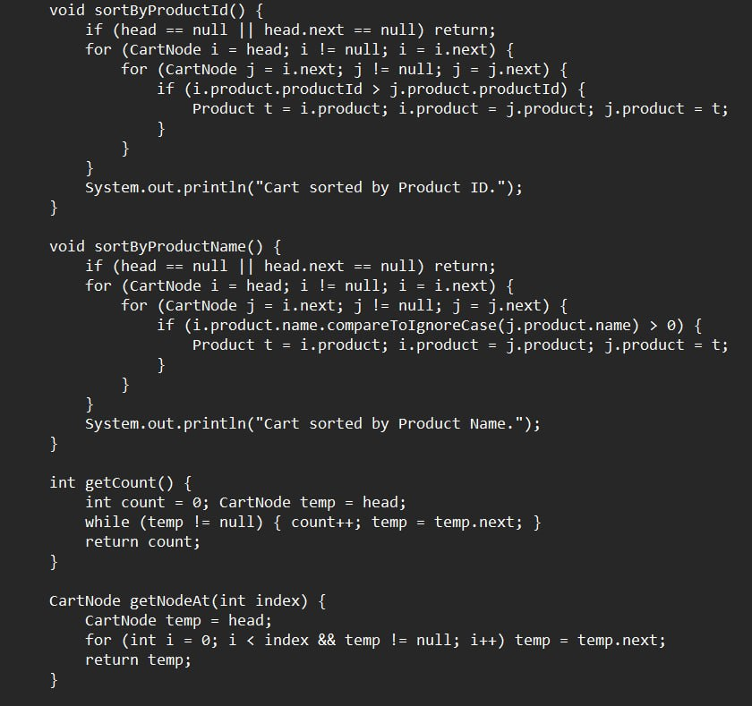
Sort Products

Slide 9
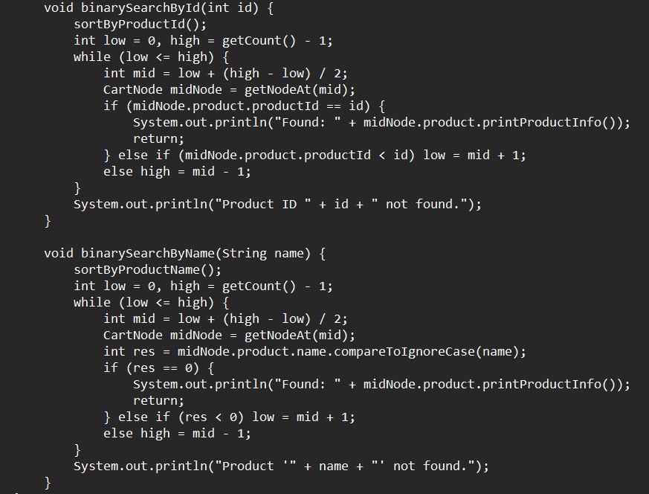
Search Product

Slide 10
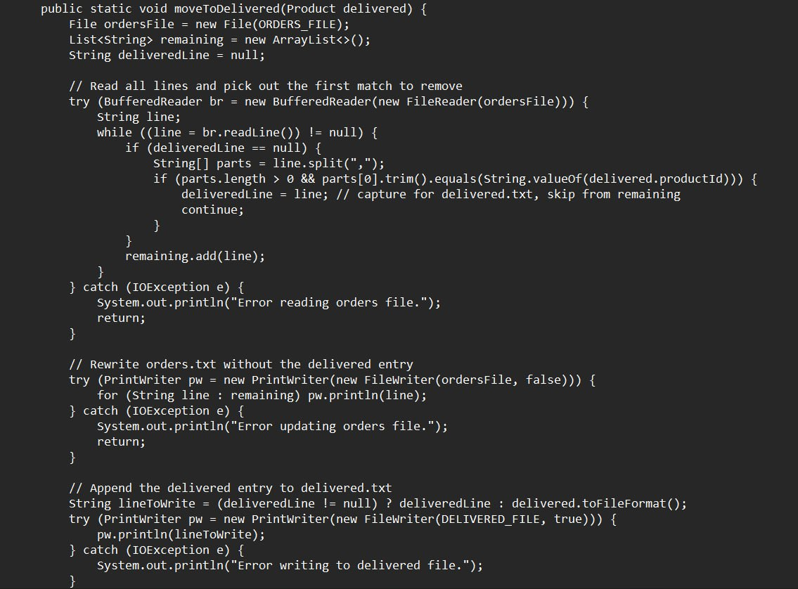
File Write

Slide 11
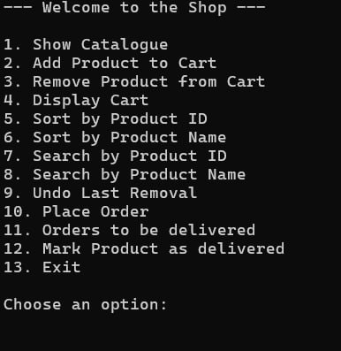
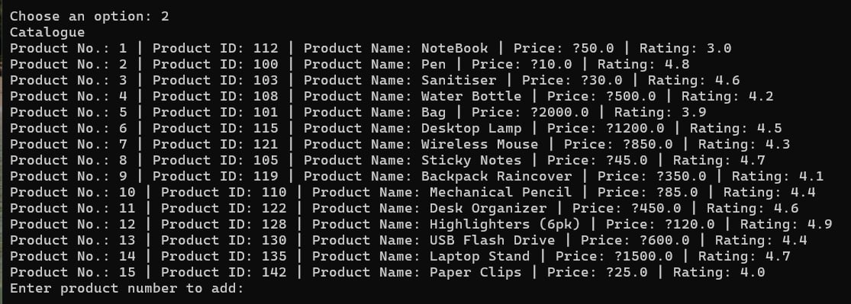
Output

Slide 12
Thank You

