Slide 1
Android Phone Management System
Project Presentation
Using C++ & Data Structures

Slide 2
Introduction
Simulates mobile phone operations
Manages contacts, messages, call history
Console-based C++ application

Slide 3
Objective
Understand real-world use of data structures
Improve C++ programming skills
Implement efficient data handling

Slide 4
Modules
Contacts → Linked List
Messages → Queue (FIFO)
Call History → Stack (LIFO)

Slide 5
System Features
Add & view contacts
Send & delete messages
Make calls & view call logs
Menu-driven interface

Slide 6
Algorithm
Start program
Display menu
User selects option
Perform operation using switch-case
Repeat until exit

Slide 7
Methodology
Modular design
Separate functions for each task
Validation using conditions
Efficient memory management

Slide 8
Requirements
Hardware: Computer, Keyboard
Software: C++ Compiler
OS: Windows/Linux/Mac

Slide 9
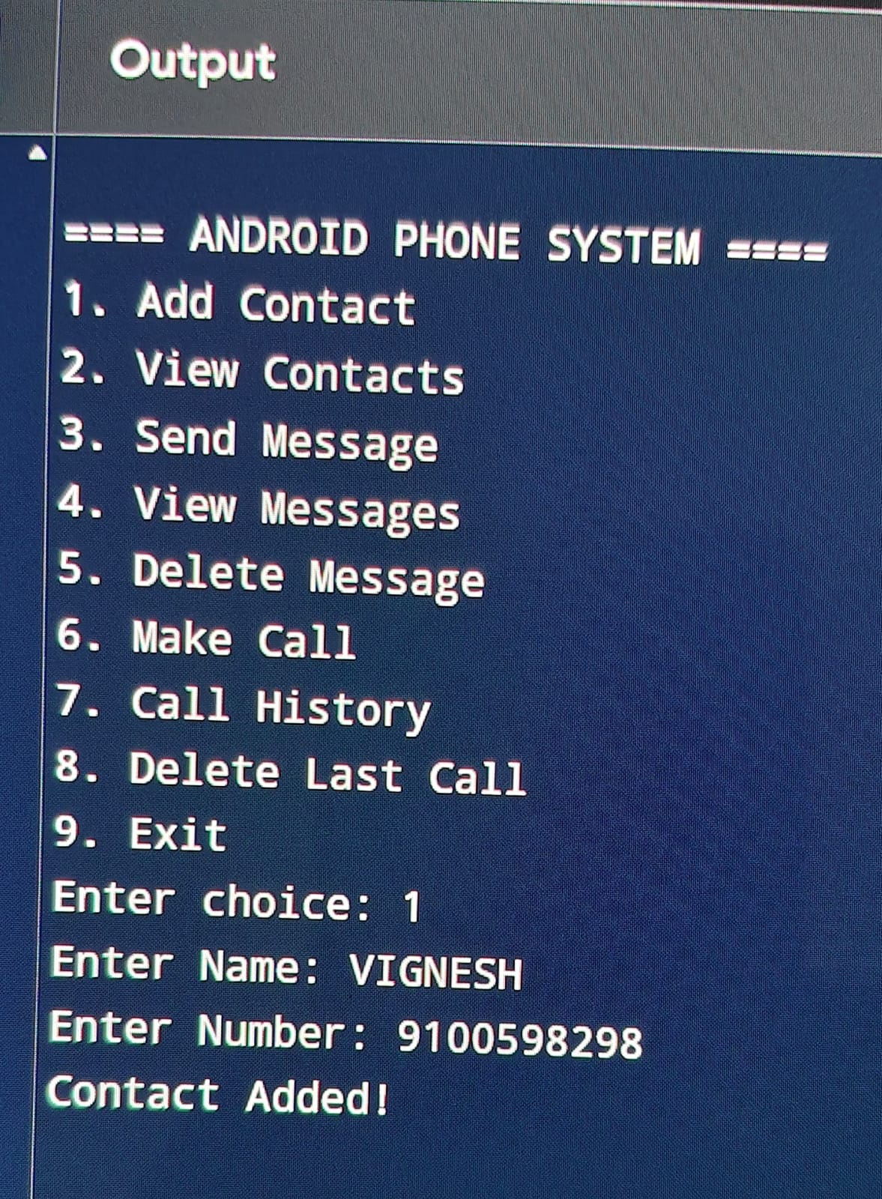
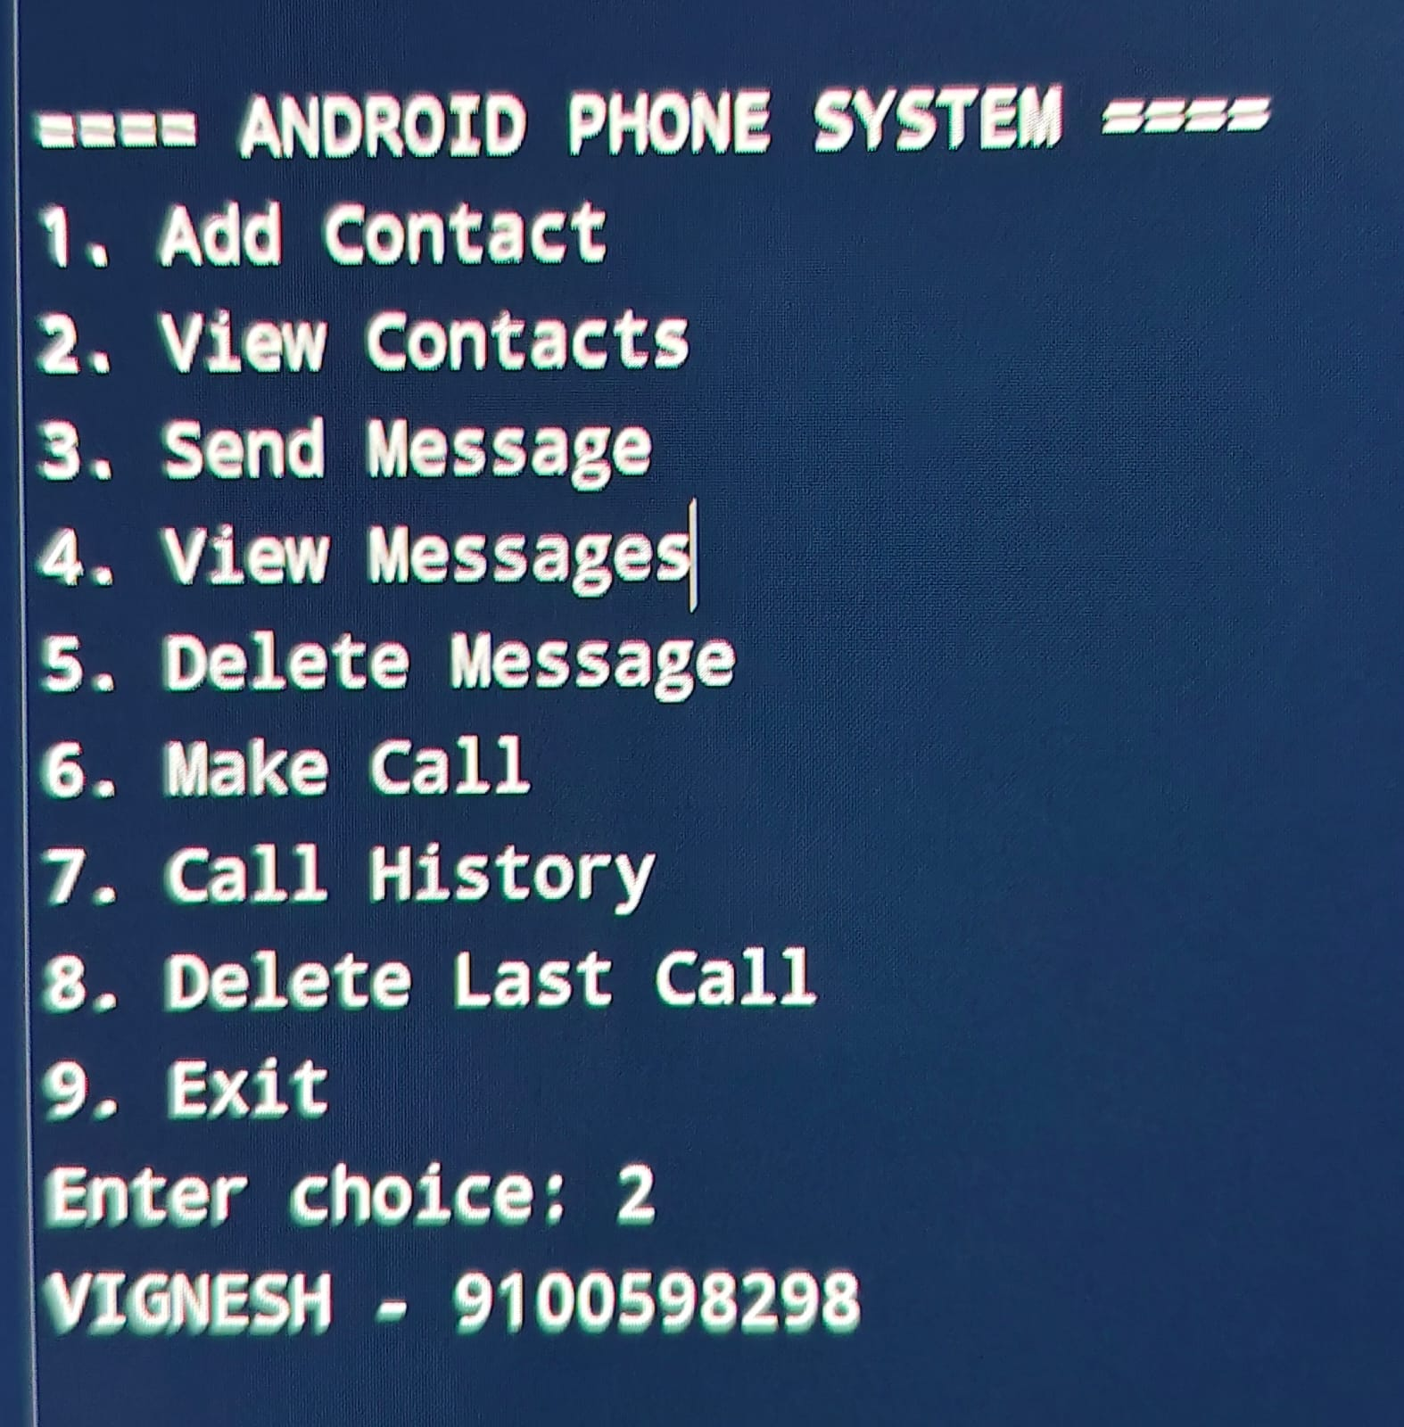
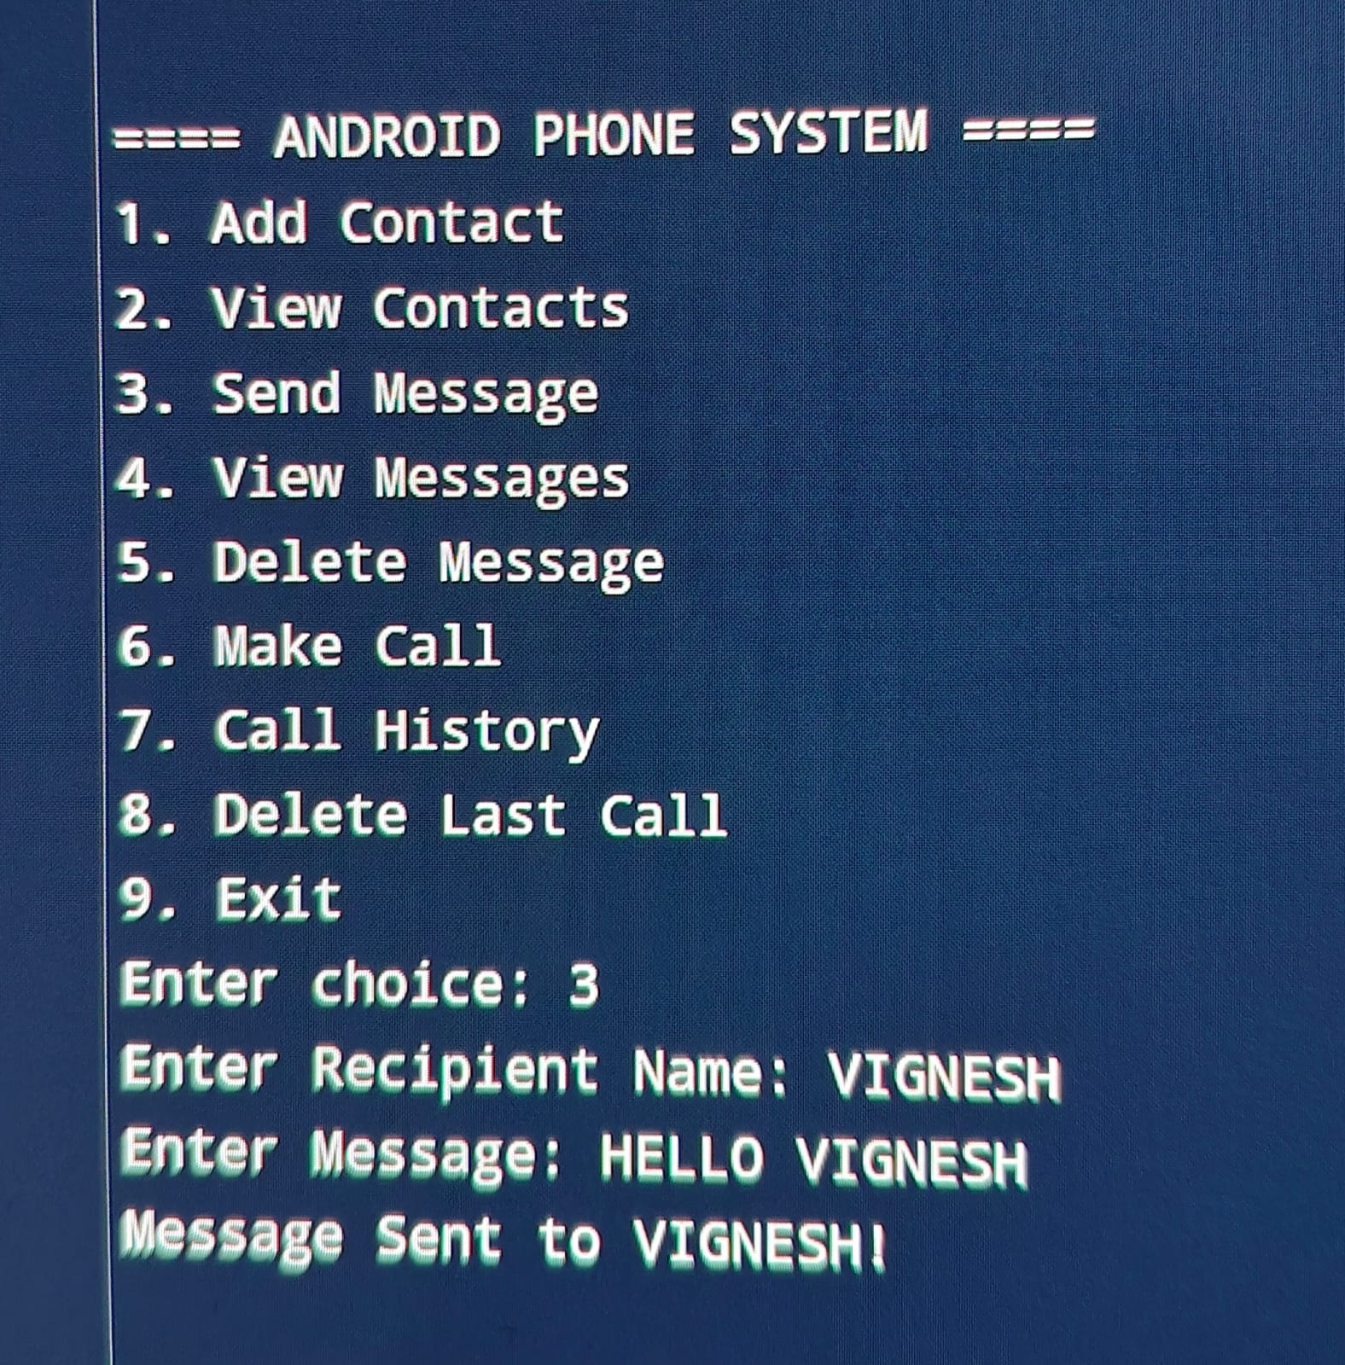
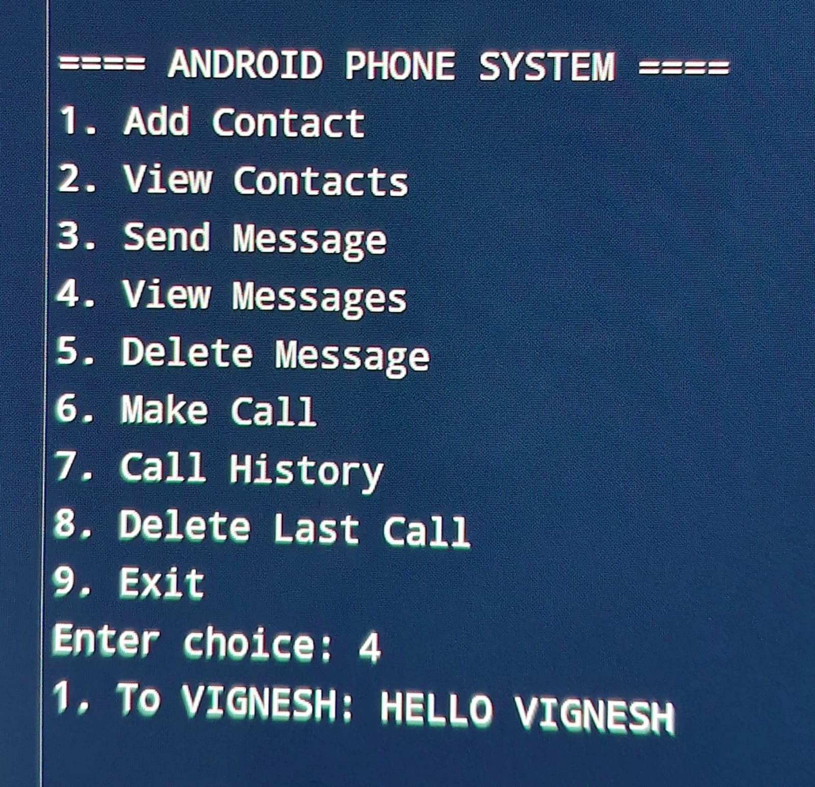
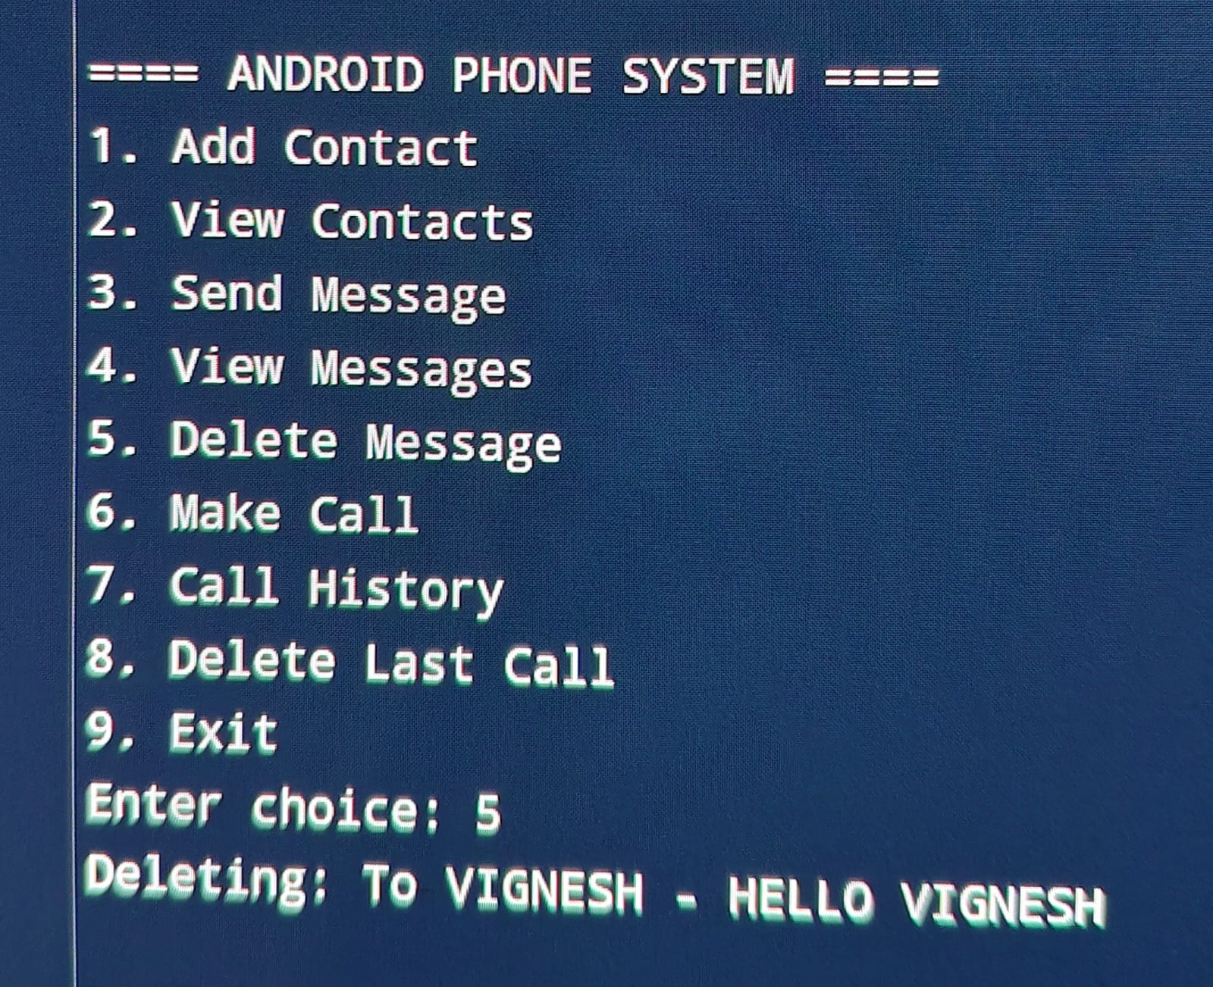
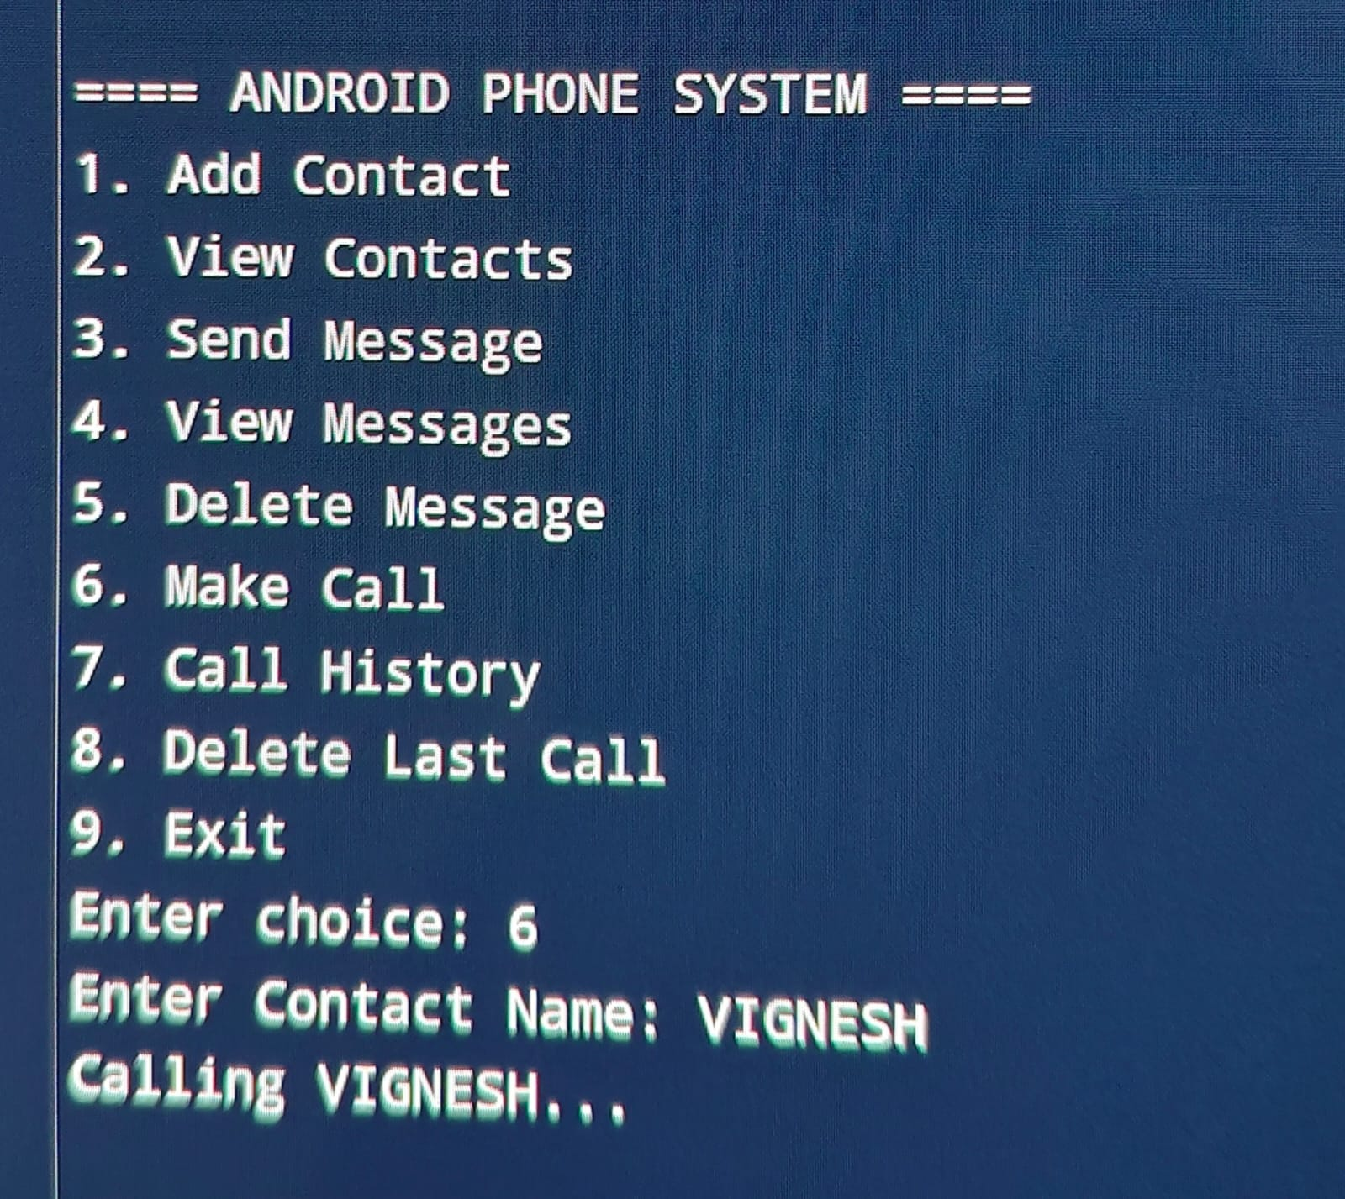

Slide 10
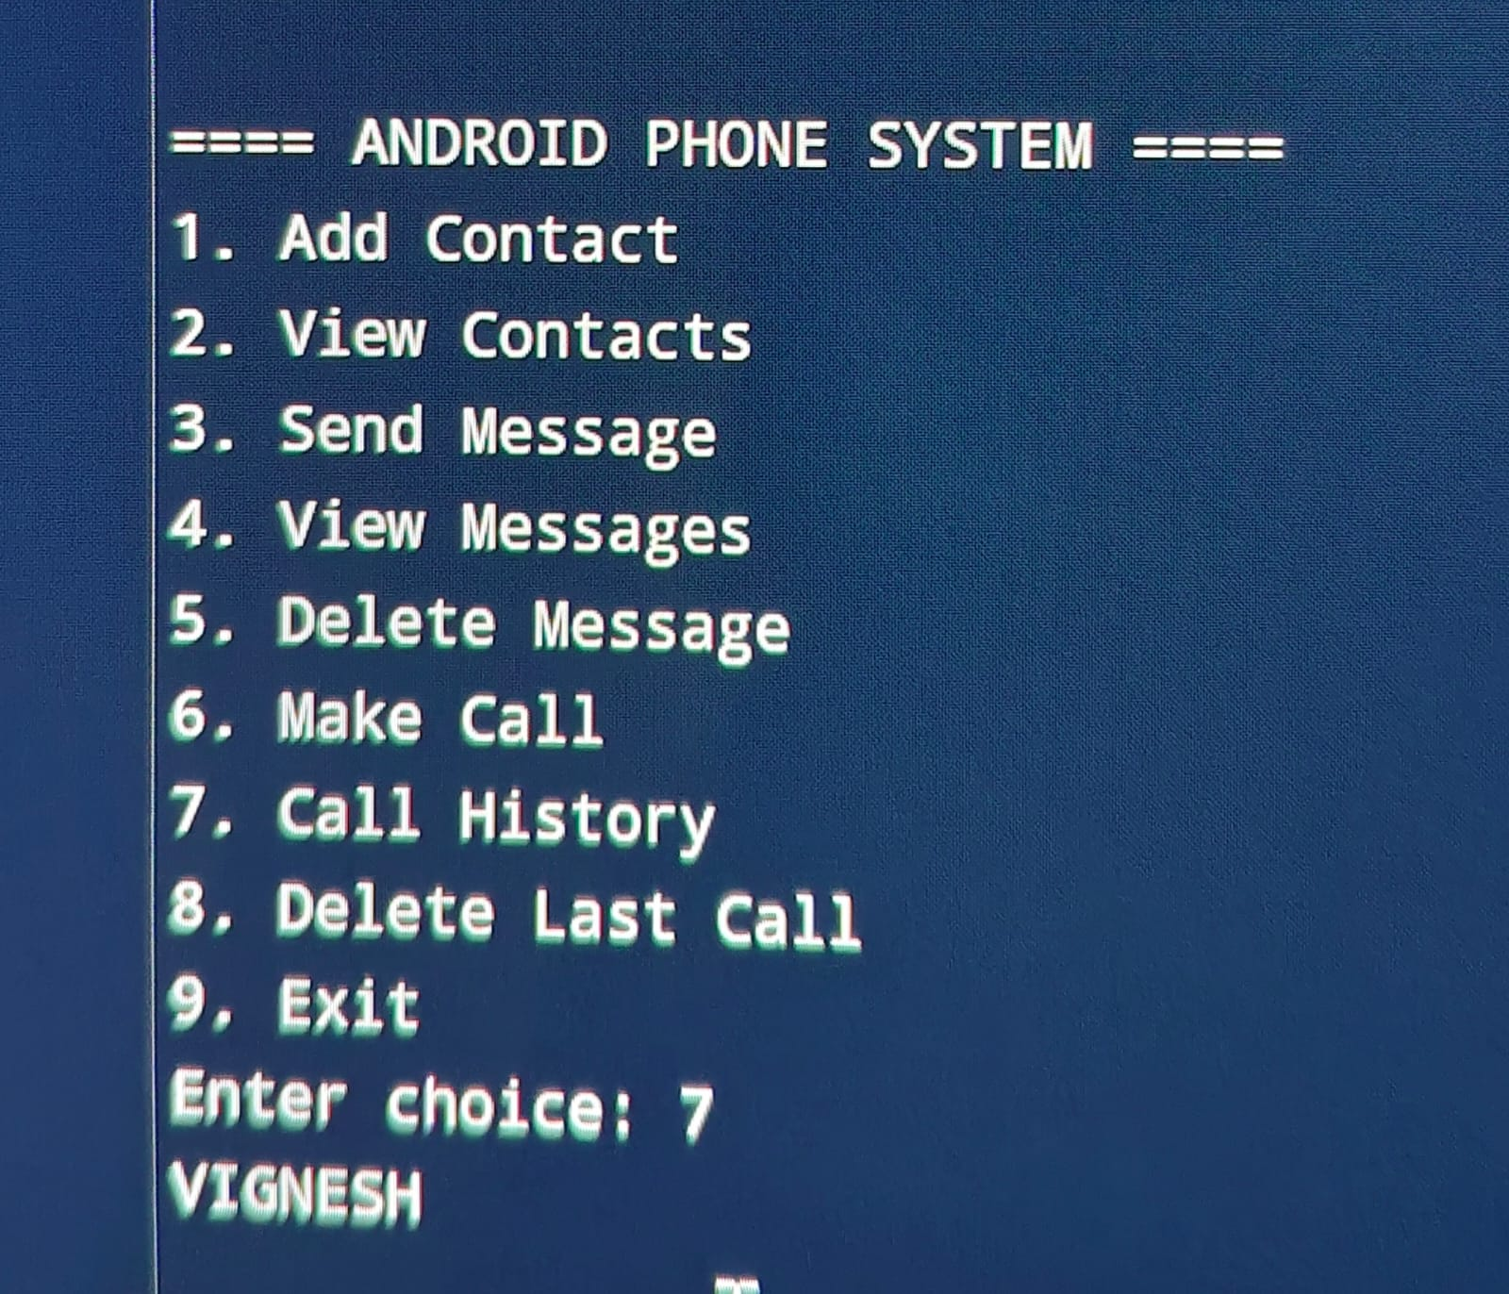
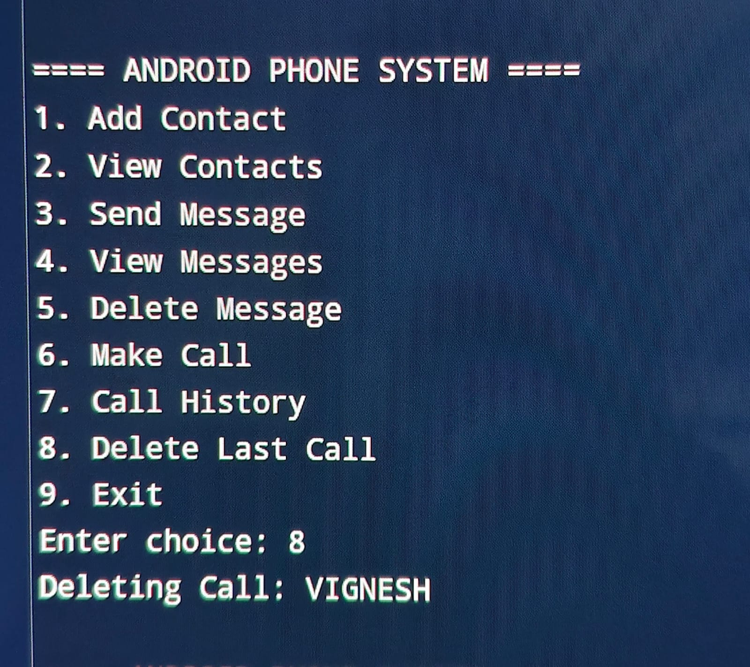
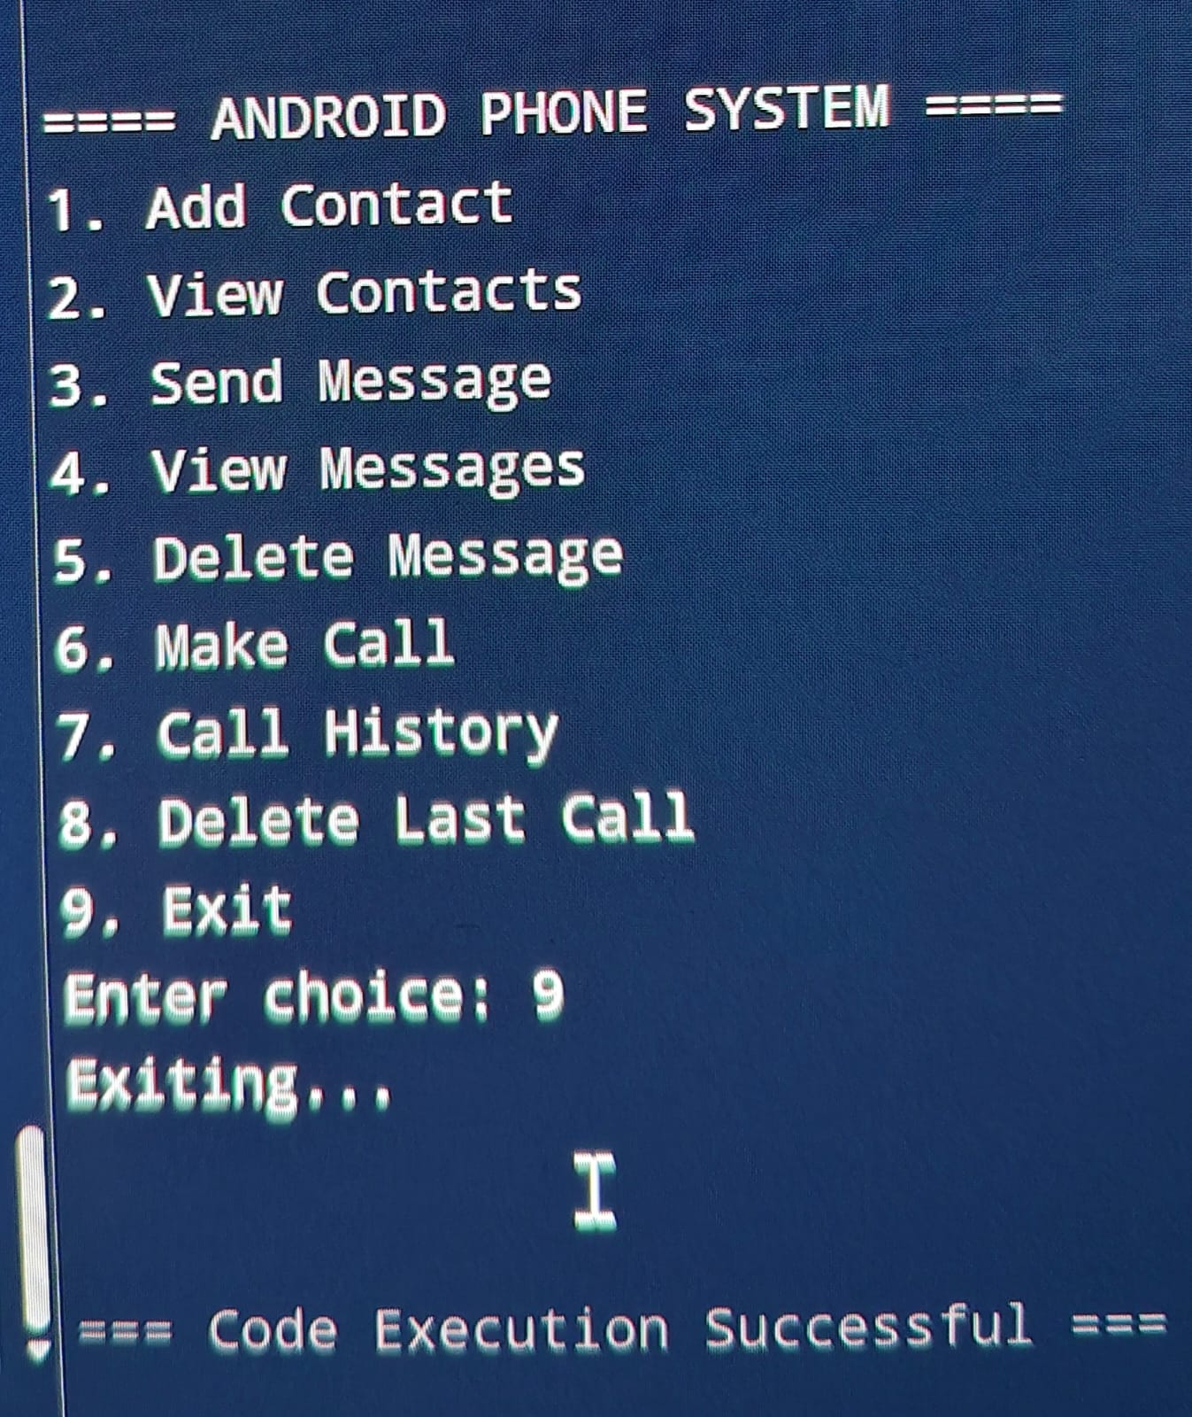

Slide 11
Advantages
Efficient data handling
Faster operations
Structured program design
Easy to use

Slide 12
Conclusion
Demonstrates practical use of data structures
Improves problem-solving skills
Useful academic project

Slide 13
Future Work
Add GUI interface
Database storage
Search & edit contacts
Security features

