Slide 1

GOLNOOSH TOOSI LU# 20558659
TIMESERIES ANALYSIS:
Comal Dataset
San MarcosDataset
J-17 Dataset

Slide 2
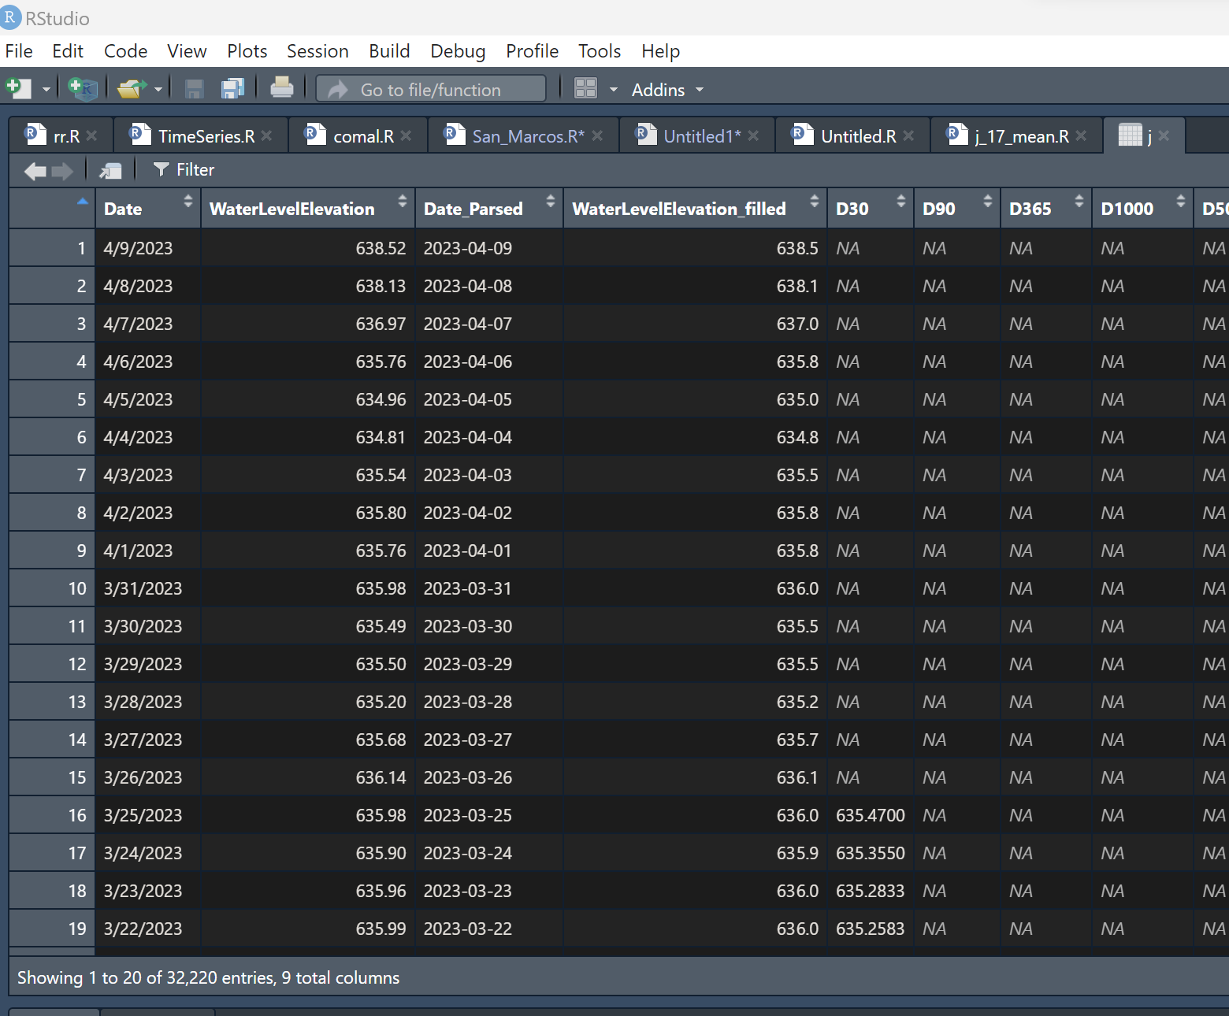

J-17 Data set:
Columns: Date(M/D/Y) , WaterLevelElevation
Adding columns : WaterLevelElevation_filled, D30, D90, D365, D1000, D5000
NA values

Slide 3
Comparison of Summary before and after moving average:
Before Filling missing values
After Filling missing values
Min | 1st Qu | Median | Mean | 3rd Qu | Max
612.5 | 653.7 | 667.5 | 664.7 | 676.5 | 703.3
Min | 1st Qu | Median | Mean | 3rd Qu | Max
612.5 | 653.7 | 667.5 | 664.7 | 676.5 | 703.3
After moving average
D30 |  | D90 |  | D365 |  | D1000 |  | D5000
Min | 614.7 | Min | 616.7 | Min | 622.3 | Min | 627.9 | Min | 650.7
1st Qu | 654.1 | 1st Qu | 654.7 | 1st Qu | 655.9 | 1st Qu | 656.8 | 1st Qu | 661.7
Median | 667.5 | Median | 667.5 | Median | 667.2 | Median | 667.5 | Median | 664.3
Mean | 664.7 | Mean | 664.7 | Mean | 664.8 | Mean | 664.8 | Mean | 664.3
3rd Qu | 676.3 | 3rd Qu | 676.2 | 3rd Qu | 675.0 | 3rd Qu | 673.8 | 3rd Qu | 670.4
Max. | 701.0 | Max. | 698.0 | Max. | 692.7 | Max. | 687.7 | Max. | 673.8
NA’s | 30 | NA’s | 90 | NA’s | 364 | NA’s | 1000 | NA’s | 5000

Slide 4
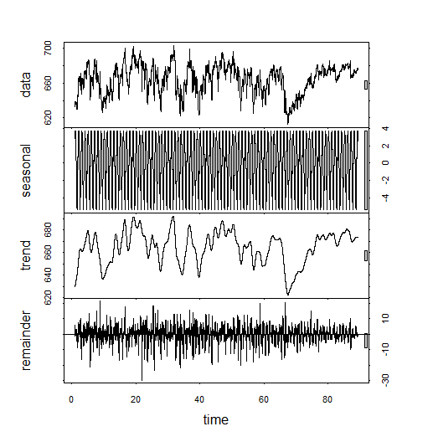
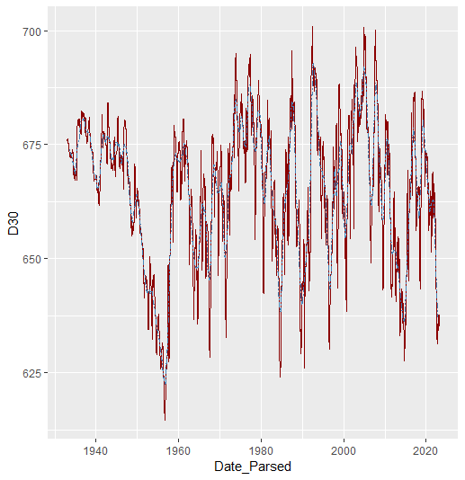
PLOTS

Slide 5
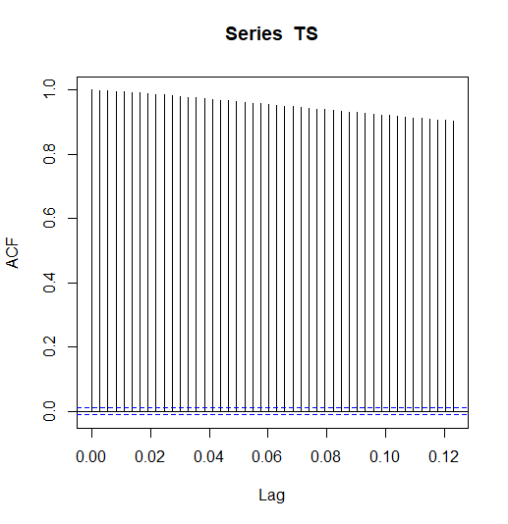
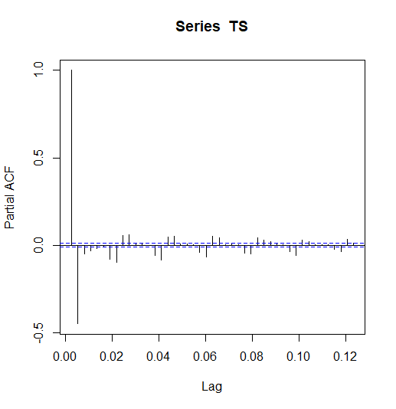
PLOTS

Slide 6
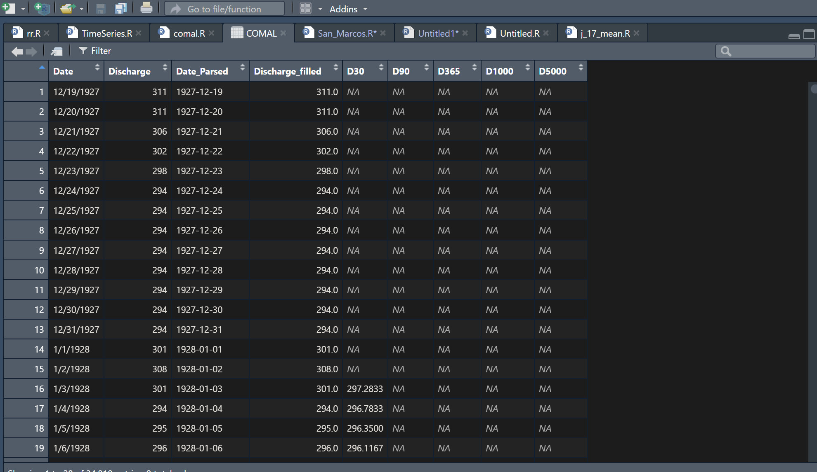

Comal Data set:
Columns: Date(M/D/Y) , Discharge
Adding columns : Discharge_filled, D30, D90, D365, D1000, D5000
NA values

Slide 7
Comparison of Summary before and after moving average:
Before Filling missing values
After Filling missing values
Min | 1st Qu | Median | Mean | 3rd Qu | Max
0.0 | 238.0 | 299.0 | 286.1 | 343.0 | 534.0
Min | 1st Qu | Median | Mean | 3rd Qu | Max
0.0 | 238.0 | 299.0 | 286.1 | 343.0 | 534.0
After moving average
D30 |  | D90 |  | D365 |  | D1000 |  | D5000
Min | 0.0 | Min | 0.0 | Min | 24.11 | Min | 67.76 | Min | 208.1
1st Qu | 239.0 | 1st Qu | 241.1 | 1st Qu | 245.40 | 1st Qu | 246.19 | 1st Qu | 268.7
Median | 299.2 | Median | 298.6 | Median | 298.64 | Median | 303.98 | Median | 287.0
Mean | 286.2 | Mean | 286.3 | Mean | 286.97 | Mean | 287.61 | Mean | 286.7
3rd Qu | 342.2 | 3rd Qu | 342.8 | 3rd Qu | 341.34 | 3rd Qu | 332.34 | 3rd Qu | 318.5
Max. | 486.1 | Max. | 472.9 | Max. | 445.99 | Max. | 399.59 | Max. | 337.5
NA’s | 30 | NA’s | 90 | NA’s | 364 | NA’s | 1000 | NA’s | 5000

Slide 8
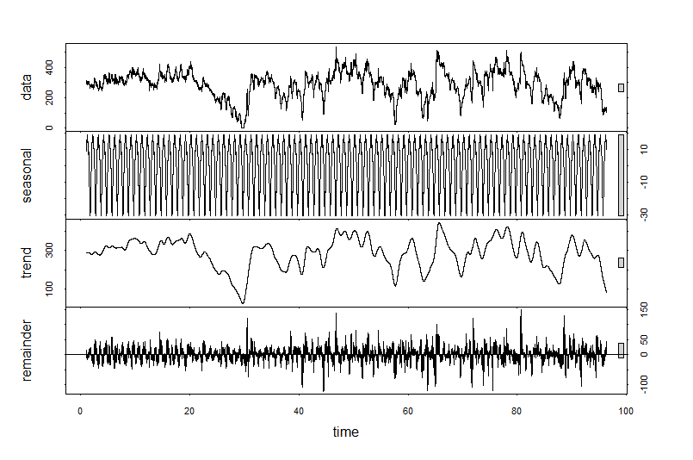
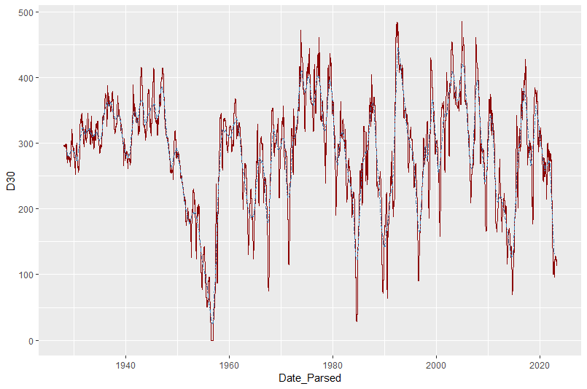
PLOTS

Slide 9
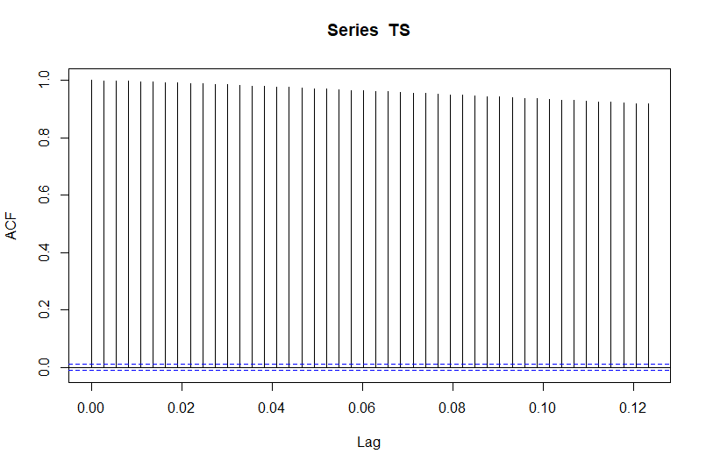
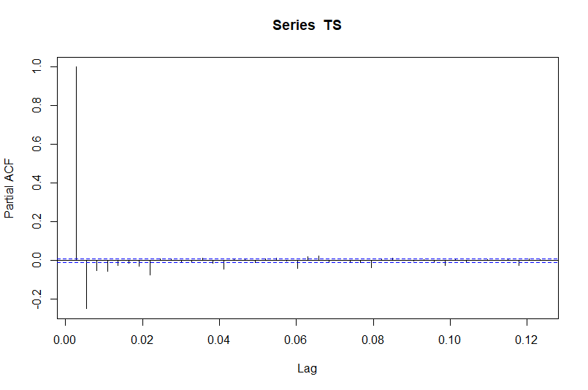
PLOTS

Slide 10
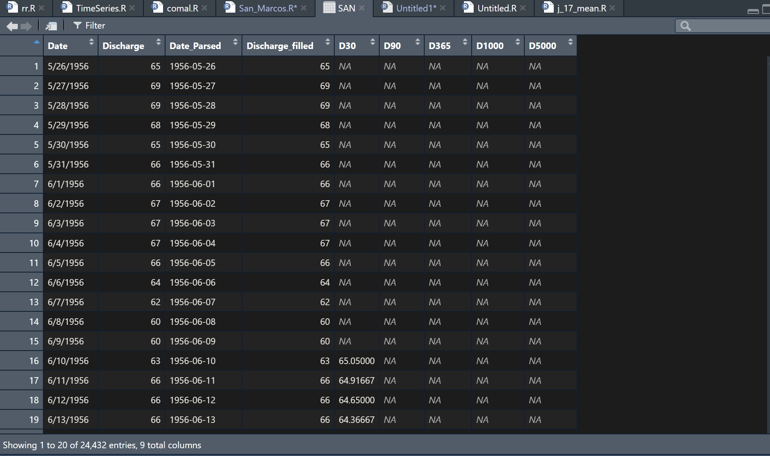

San Marcos Data set:
Columns: Date(M/D/Y) , Discharge
Adding columns : Discharge_filled, D30, D90, D365, D1000, D5000
NA values

Slide 11
Comparison of Summary before and after moving average:
Before Filling missing values
After Filling missing values
Min | 1st Qu | Median | Mean | 3rd Qu | Max
46.0 | 124.0 | 162.0 | 173.7 | 211.0 | 451.0
Min | 1st Qu | Median | Mean | 3rd Qu | Max
46.0 | 124.0 | 162.0 | 173.7 | 211.0 | 451.0
After moving average
D30 |  | D90 |  | D365 |  | D1000 |  | D5000
Min | 52.23 | Min | 55.54 | Min | 82.43 | Min | 109.5 | Min | 152.7
1st Qu | 124.95 | 1st Qu | 127.08 | 1st Qu | 135.29 | 1st Qu | 151.0 | 1st Qu | 171.1
Median | 162.97 | Median | 164.41 | Median | 168.32 | Median | 172.9 | Median | 177.1
Mean | 173.79 | Mean | 174.04 | Mean | 175.12 | Mean | 175.8 | Mean | 176.5
3rd Qu | 210.65 | 3rd Qu | 210.39 | 3rd Qu | 206.82 | 3rd Qu | 196.2 | 3rd Qu | 182.5
Max. | 446.38 | Max. | 430.74 | Max. | 349.03 | Max. | 255.1 | Max. | 203.9
NA’s | 30 | NA’s | 90 | NA’s | 364 | NA’s | 1000 | NA’s | 5000

Slide 12
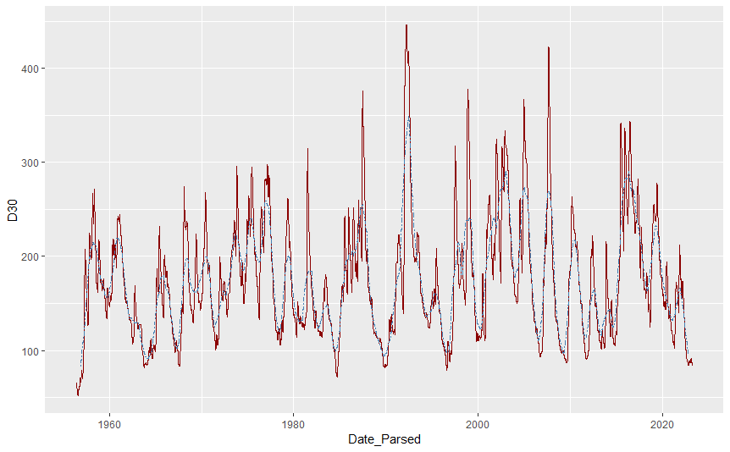
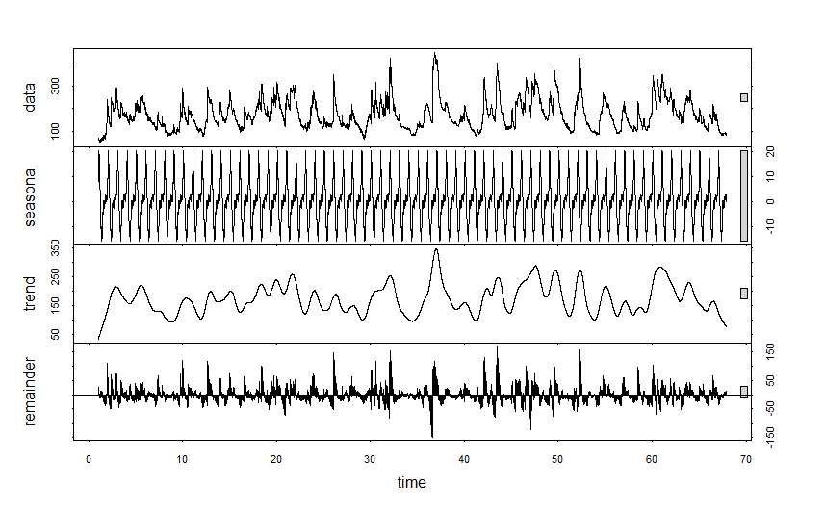
PLOTS

Slide 13
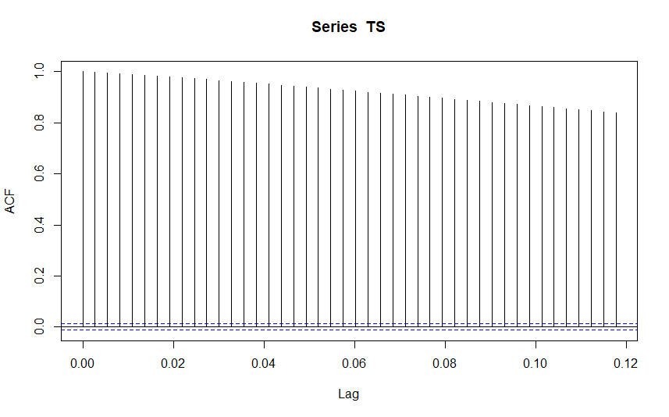
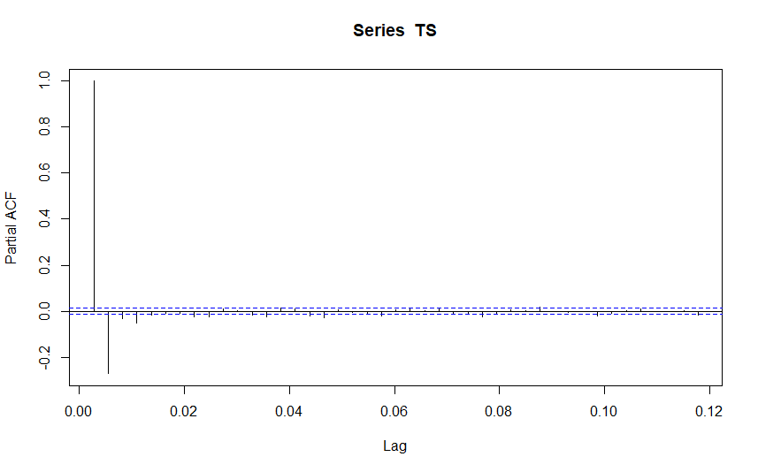
PLOTS

Slide 14
References:
https://waterdata.usgs.gov/nwis/dv?referred_module=sw&site_no=08168710
https://waterdata.usgs.gov/nwis/dv/?site_no=08170000
https://www.edwardsaquifer.org/science-maps/aquifer-data/historical-data/

