Slide 1

TIMESERIES PREDICTION MACHINE LEARNING-LSTM
Golnoosh Toosi- L# 20558659

Slide 2
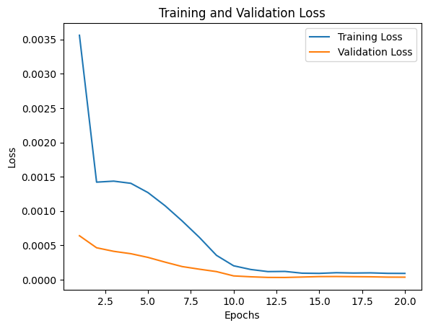
J-17 Dataset:
Columns: Date and WaterLevelElevation
Starting Date: 1932-11-12 to 2023-04-09
The 'WaterLevelElevation' column has 0 null values

Slide 3
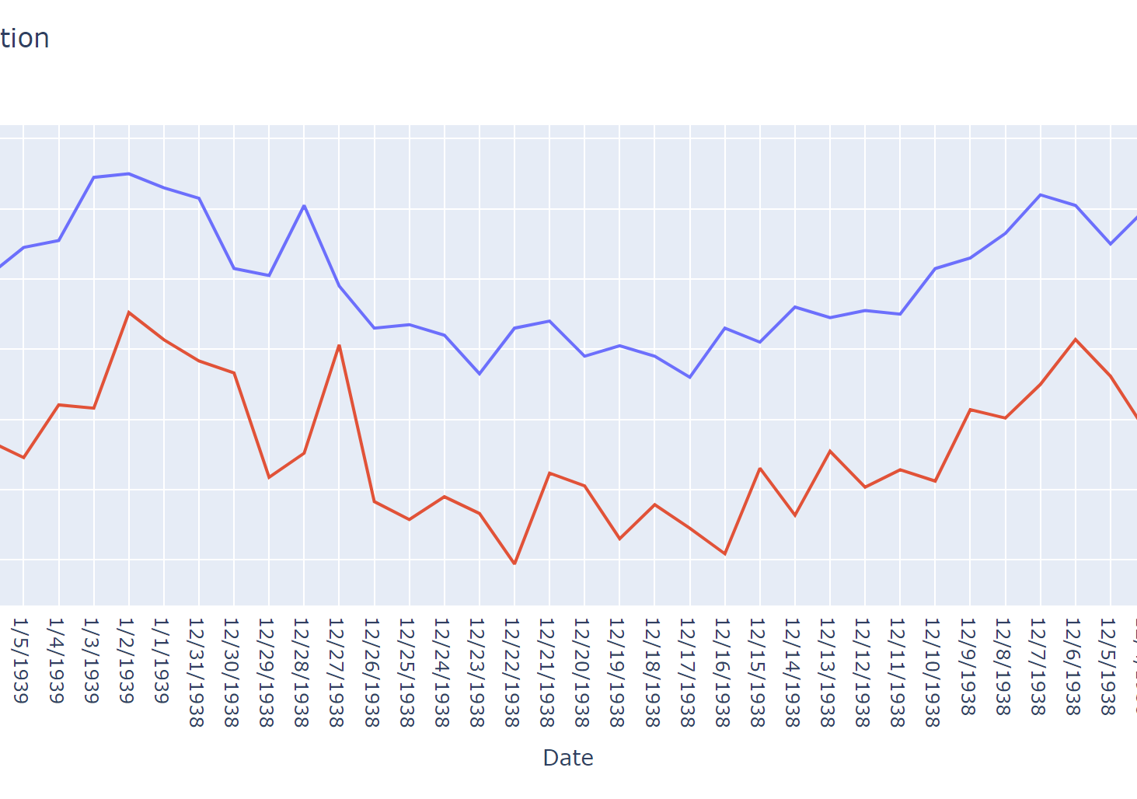
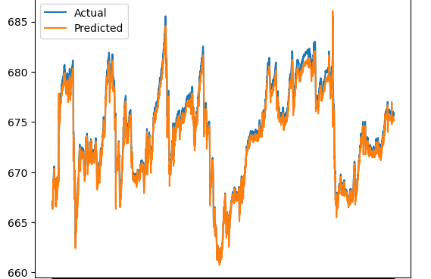
Plots
WaterLevelElevation vs Time

Slide 4
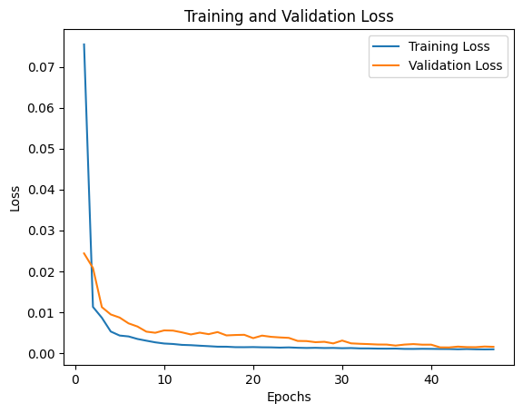
Comal Dataset:
Columns: Date and Discharge
Starting Date: 1927-12-19 to 2023-04-16
The 'Discharge' column has 51 null values

Slide 5
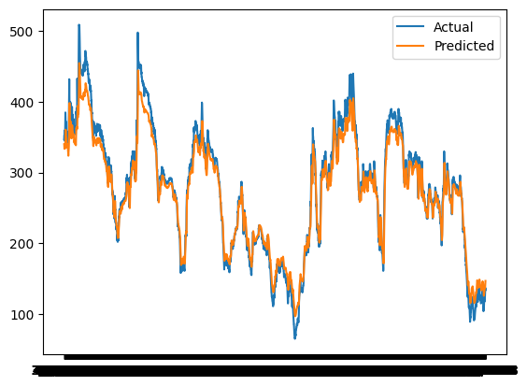
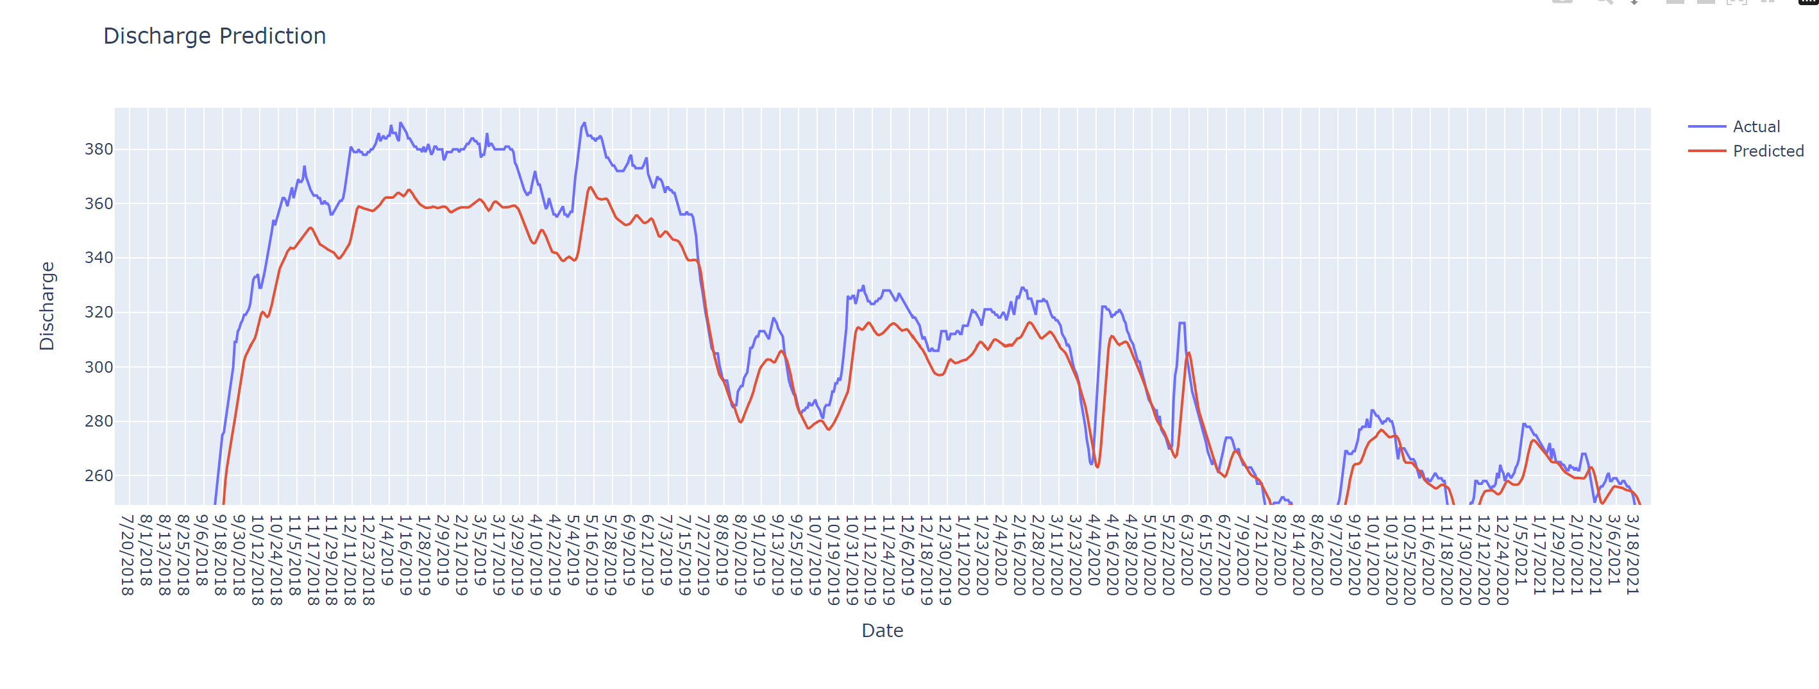
PLOTS
Discharge vs Time

Slide 6
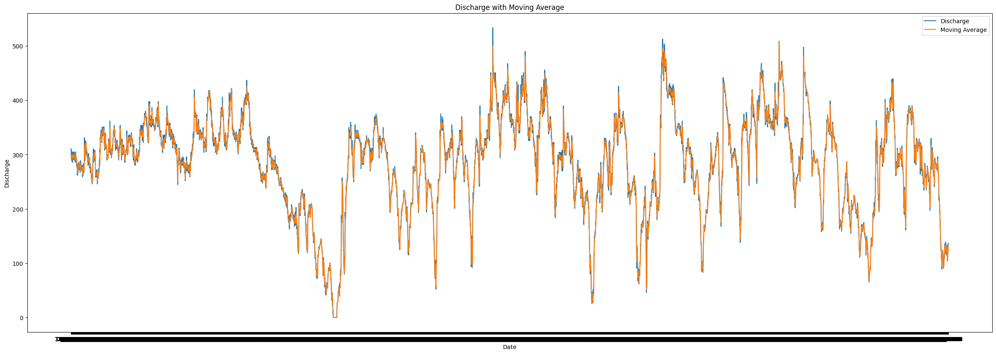
Moving average with window 10

Slide 7
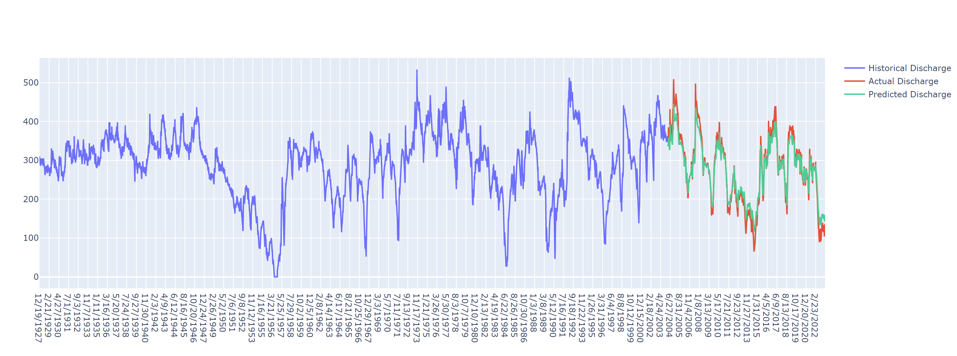
Comal discharge prediction

Slide 8
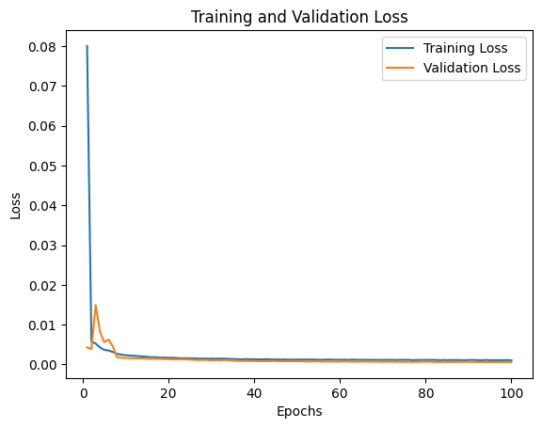
San marcos Dataset:
Columns: Date and Discharge
Starting Date: 1956-05-26 to 2023-04-16
The 'Discharge' column has 2 null values

Slide 9
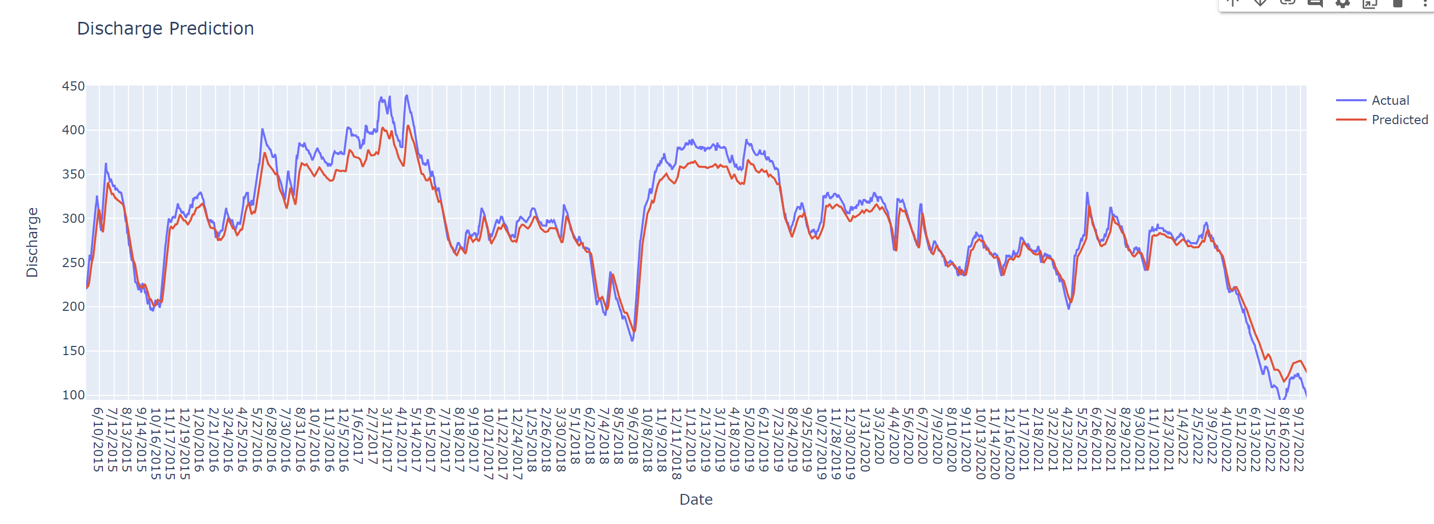
PLOTS
Discharge vs Time

Slide 10
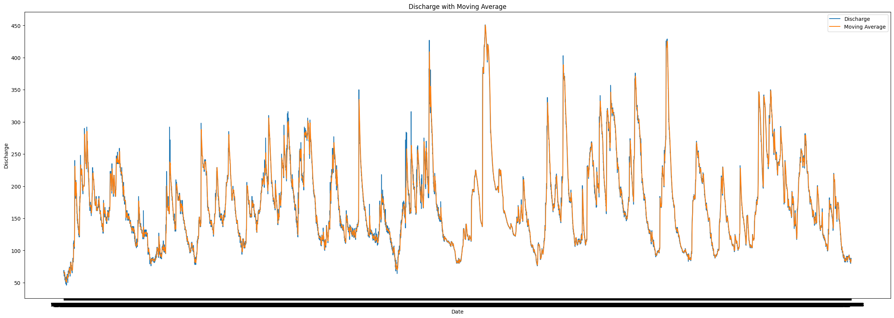
Moving average with window 10

