Slide 1
Customer Shopping Behavior Analysis
Insights from 3,900 purchases
Python | PostgreSQL | Power BI
Notes:
Welcome everyone. This deck walks through what 3,900 customer purchases tell us about spending, loyalty, products and subscriptions, and what we recommend doing about it.

Slide 2
Snapshot of 3,900 purchases
3,900
$233K
$59.76
3.75
Purchases analyzed
Total revenue
Average purchase
Average review rating
Key takeaways
Male customers generate about 68% of revenue
Subscribers spend no more per order than non-subscribers
Five products sell on discount about half the time
Notes:
Headline numbers: 3,900 purchases, roughly $233 thousand in revenue, a typical purchase of about $60 and an average rating of 3.75 out of 5. Three takeaways to keep in mind as we go.

Slide 3
How we prepared the data
1
2
3
4
Load and inspect
Clean
Add features
Analyze and show
Imported 3,900 rows and 18 columns with pandas and reviewed summary statistics.
Filled 37 missing review ratings with each category's median. Standardized column names.
Created age_group and purchase_frequency_days. Dropped the redundant promo_code_used.
Loaded into PostgreSQL, answered 10 business questions, built a Power BI dashboard.
Notes:
Four steps. Only the review rating column had gaps, so we filled those 37 values with the category median instead of losing rows. We also created age groups and a purchase-frequency-in-days column, and dropped promo_code_used because it duplicated discount_applied.

Slide 4
Men generate two-thirds of revenue
68%
of revenue comes from male customers
Female customers contribute $75K (32%). Growing this group is a clear opportunity.
Notes:
Men generated $157,890 and women $75,191, so men are about 68 percent of revenue, more than double women. This points to room to grow among female customers.

Slide 5
Revenue is spread across age groups
10%
gap between top and bottom group
Young Adults lead at $62.1K, Seniors trail at $55.8K. No group can be ignored.
Notes:
Young Adults bring in the most revenue at about $62 thousand, and Seniors the least at about $56 thousand. That is only a 10 percent spread, so campaigns should not neglect any age band.

Slide 6
Subscribers don't spend more per order
Subscribers
Non-subscribers
Customers
1,053
Customers
2,847
Average spend
$59.49
Average spend
$59.87
Total revenue
$62,645
Total revenue
$170,436
Only 27% of customers subscribe. Perks must give people a real reason to join.
Notes:
Subscribers are 1,053 customers spending about $59.49 per purchase; non-subscribers are 2,847 customers spending $59.87. Subscribing is not currently linked to higher spend, so the program needs stronger benefits.

Slide 7
Four in five customers are loyal
72%
of repeat buyers are not subscribed
2,518 of 3,476 customers with more than 5 purchases have no subscription. Buying often doesn't lead to subscribing on its own.
Notes:
3,116 customers are Loyal, 701 Returning and only 83 New. Among customers with more than five purchases, 2,518 are not subscribers versus 958 who are, so frequent buyers are a ready audience for subscription offers.

Slide 8
Top-rated and best-selling products
Highest average rating
Best seller in each category
Product | Rating (of 5)
Gloves | 3.86
Sandals | 3.84
Boots | 3.82
Hat | 3.80
Skirt | 3.78
Category | Product | Orders
Accessories | Jewelry | 171
Clothing | Blouse / Pants | 171
Footwear | Sandals | 160
Outerwear | Jacket | 163
Ratings sit in a narrow 3.78 to 3.86 band, so no single product stands out. Feature both the top-rated and best-selling items in campaigns.
Notes:
Gloves, Sandals, Boots, Hat and Skirt have the best average ratings. Among best sellers, Jewelry leads Accessories, Blouse and Pants tie in Clothing, Sandals lead Footwear and Jacket leads Outerwear.

Slide 9
Five products rely on discounts
839
discount users still spent above average
Discounts attract more than bargain hunters, but watch the margin.
Notes:
Hats, Sneakers, Coats, Sweaters and Pants are sold with a discount in roughly half of purchases. At the same time, 839 customers used a discount and still spent above the average purchase amount.

Slide 10
Express shoppers spend about $2 more
Standard shipping
Express shipping
+$2.02
$58.46
$60.48
per purchase
average purchase
average purchase
A small gap, but Express buyers are a natural audience for targeted offers and premium services.
Notes:
Average purchase is $60.48 with Express shipping versus $58.46 with Standard, a difference of about two dollars.

Slide 11
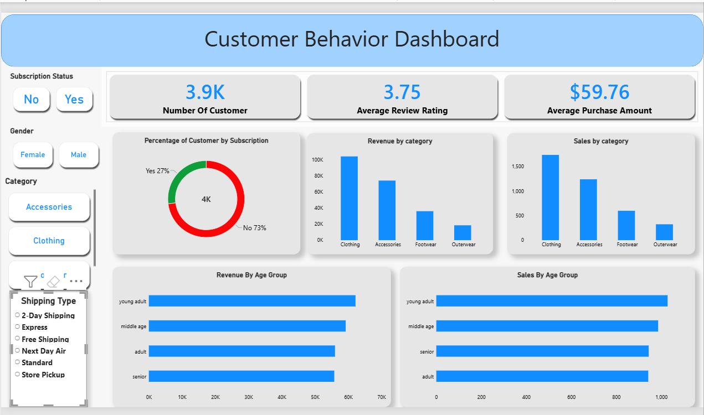
Interactive Power BI dashboard
Filter by subscription, gender, category and shipping type
See customers, average spend and rating at a glance
Compare revenue and sales by category and age group
Notes:
The dashboard lets anyone slice the data by subscription, gender, category and shipping type, and shows headline KPIs plus revenue and sales by category and age group.

Slide 12
Five ways to act on the findings
1
Grow subscriptions
Offer real perks, like exclusive deals or free shipping, to make joining worthwhile.
2
Reward loyalty
Launch a loyalty program that moves Returning customers into the Loyal tier.
3
Rethink discounts
Check that heavy discounting on Hats, Sneakers and Coats isn't eroding margin.
4
Promote winners
Feature top-rated and best-selling products in campaigns.
5
Target smartly
Focus on top-revenue age groups and Express shoppers, and grow the female customer base.
Notes:
Our five recommendations: strengthen subscription benefits, reward repeat buyers, review the discount policy, promote the strongest products, and target the highest-value segments while working to grow the female customer base.

Slide 13
Thank you
Questions and discussion
Notes:
Open the floor for questions.

