Slide 1

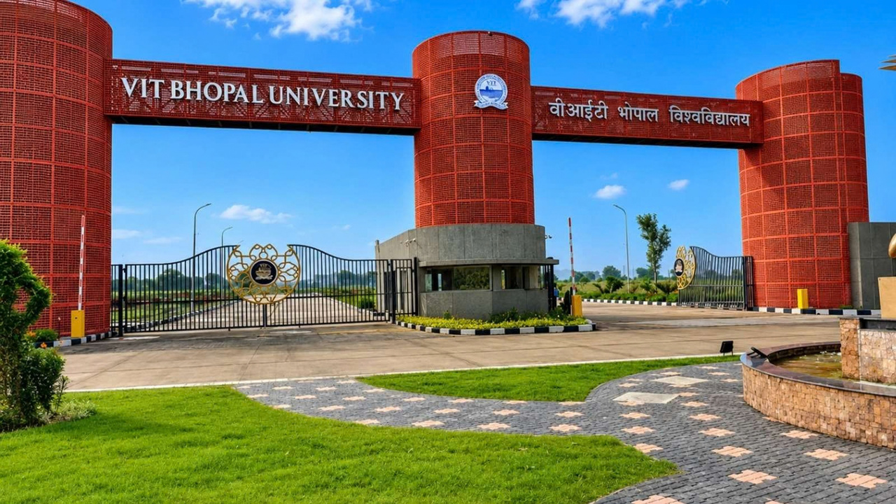
AB1
(TEAM NO.157)
VIT BHOPAL UNIVERSITY
CAMPUS DIGITAL TWIN
A living digital representation of the VIT Bhopal campus —built to help students discover, navigate and connect.
PROJECT EXHIBITION - 1
~by
ADITYA BAKSHI(25BCE10475)
SUNIL MATWA(25BCE10466)
DHEERAJ KUMARMAHTO(25BCE10465) KANAV LUTHRA(25BCE10417)
PRIYAM MANGLA(25BCE10415)
From physical campus → digital experience
VIT Bhopal University Digital Twin • 1

Slide 2
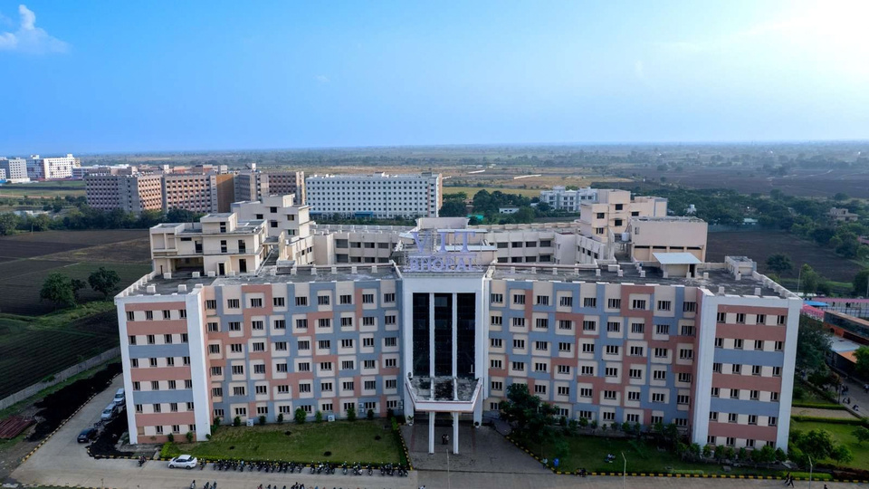

01 • CONTEXT
Why build a Digital Twin for VIT Bhopal?
Thephysicalcampusalreadycontainstheinformation.Thechallengeismakingiteasytoaccess at the right moment.
The student experience today
•
Finding the right building, lab or facility can be time-consuming.
•
Event information can be spread across notices, groups and social channels.
•
Visitors and new students may not know where to go.
•
There is no single digital layer connecting place + information + context.
Opportunity → turn the campus into an interactive information layer
VIT Bhopal University Digital Twin • 2

Slide 3
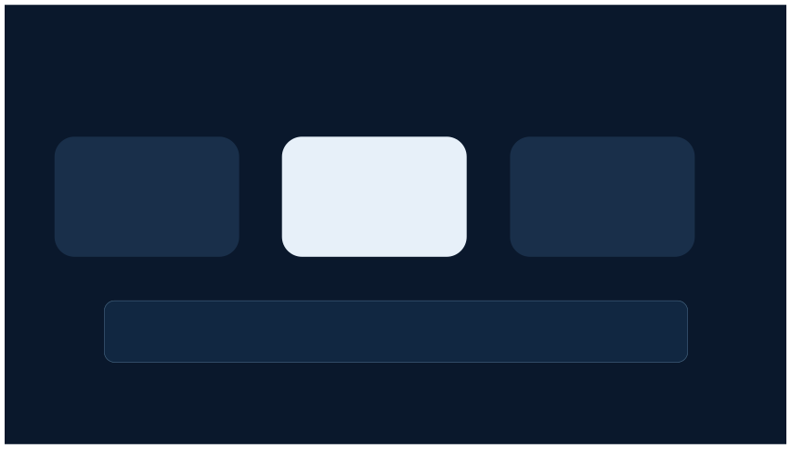
02 • VISION
One VIT Bhopal. One digital experience.
The digital twin becomes the front door to the campus.
PHYSICAL CAMPUS
DIGITAL TWIN
SMART EXPERIENCE
→
→
Buildings • roads • facilities
Locations • map • data
Search • navigate • discover
The point is not “just a 3D model.” The point is a useful
digital layer over the real VIT Bhopal campus.
VIT Bhopal University Digital Twin • 3

Slide 4

03 • CORE EXPERIENCE
What the user will actually see
EXPLORE
SEARCH
NAVIGATE
Interactive map of VIT Bhopal
Find a place instantly
Get campus-level directions
Campus, buildings, facilities
Building, lab, library, facility
From selected point → destination
DISCOVER
TRUST
MANAGE
See what is happening
Know who published it
Admin controls the system
Events shown at their locations
Verified publisher accounts
Locations, events, publishers
VIT Bhopal University Digital Twin • 4

Slide 5
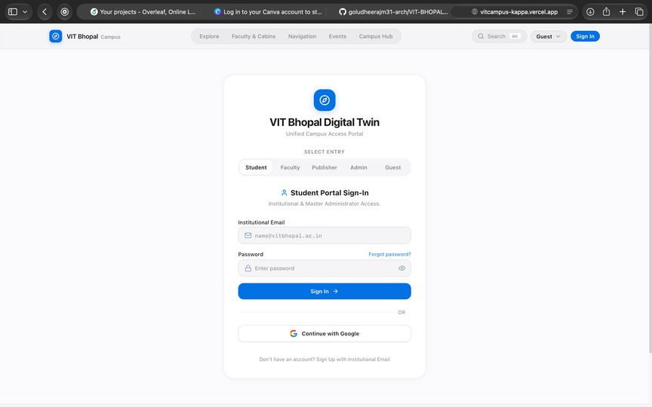
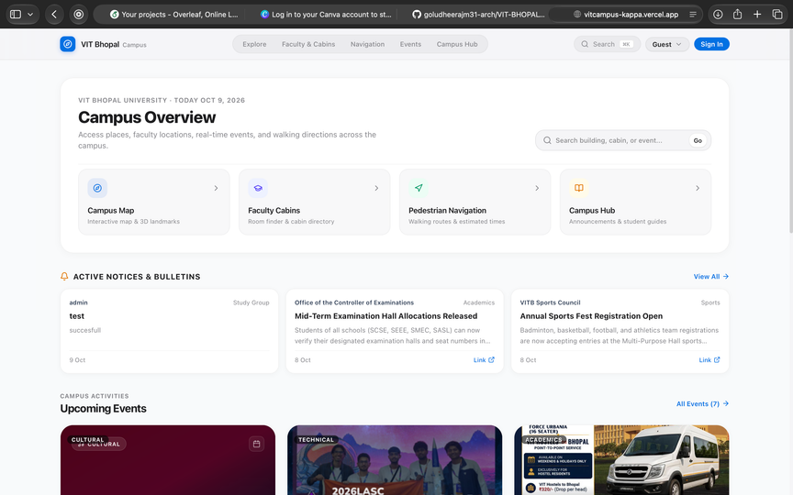
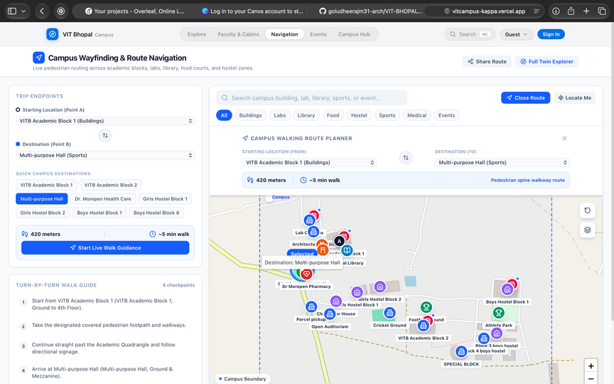
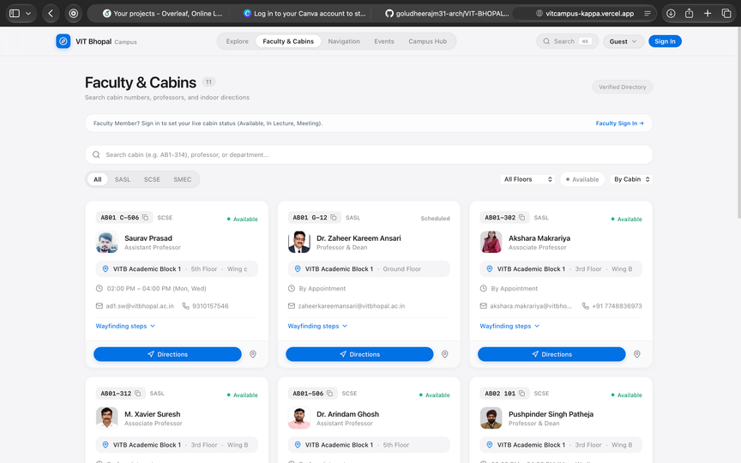
Project Implementation and User Interface
Authentication and Login Module
Project Implementation and User Interface
Campus Map and Navigation Interface
mplementation of Key Features

Slide 6

04 • THE DEMO
Real-World Problem:
01
Search
“AI Club Workshop”
IMAGINE..
“I have an event in 10 minutes -
where is the venue?”
02
Locate
Venue highlighted on map
03
Navigate
Route from selected location
The student searches the event → the destination appears → the route is highlighted → event details open.
04
Discover
Time, organizer & event details
VIT Bhopal University Digital Twin • 5

Slide 7

05 • TRUST LAYER
Not every post should look official
The digital twin becomes more useful when users can tell which information is verified.
ADMIN
VERIFIED PUBLISHER
USERS
→
Creates official events and announcements for their organization
→
Approves and manages publisher accounts
Guest • Student
explore trusted information
Core principle: publish once, verify the source, connect it to the correct campus location.
VIT Bhopal University Digital Twin • 6

Slide 8
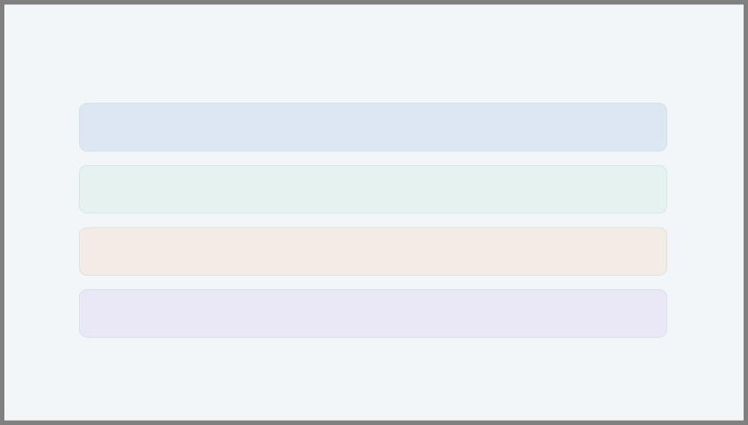
06 • SYSTEM DESIGN
Simple architecture. Real project. Easy to defend.
USER LAYER
Guest • Student • Publisher • Admin
↓
FRONTEND
React + TypeScript + responsive UI + map interface
↓
BACKEND
Node.js + Express + REST APIs + role-based access
↓
DATA
PostgreSQL: users • locations • events • announcements • routes
Optional future layer: 3D visualization • AI discovery • IoT integrations
VIT Bhopal University Digital Twin • 7

Slide 9

07 • TECHNOLOGY
Chosen for feasibility —not because the stack looks impressive
React + TypeScript
Fast UI development and clean component structure.
Leaflet + OpenStreetMap
Practical map layer for campus locations and routes.
Node.js + Express
Simple REST API and same language family as the frontend.
PostgreSQL
Strong relationships for users, publishers, events and locations.
JWT + bcrypt
Secure login + role-based authorization.
Git + Cloud deployment
Team collaboration, repeatable builds and online demo.
Design rule: the MVP works without AI/IoT/3D —those become extensions, not dependencies.
VIT Bhopal University Digital Twin • 8

Slide 10
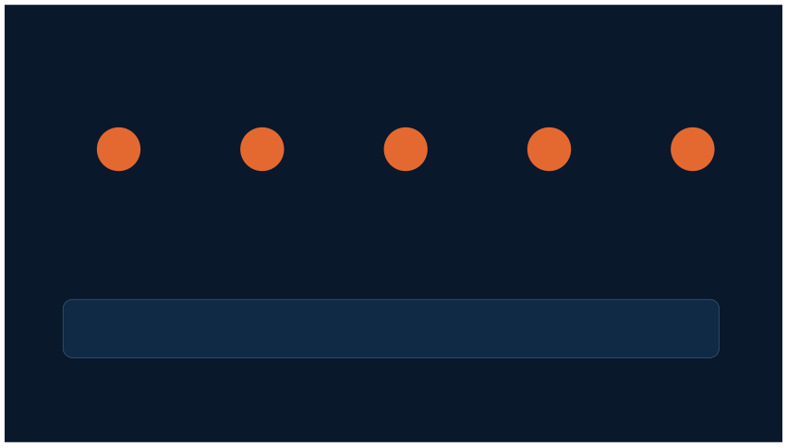
08 • EXECUTION
Build the foundation first. Then make it smarter.
A reliableMVPismore valuableinajuryroomthanahuge unfinishedfeaturelist.
1
→
2
→
3
→
4
→
5
FOUNDATION
CORE PLATFORM
USER FLOWS
CONTROL
POLISH
Requirements • UI • database
Map • search • location details
Navigation • events • announcements
Authentication • verified
Testing • deployment • demo
publishers • admin
Future-ready, not future-dependent: 3D campus • AI event discovery • analytics • IoT when real data is available.
VIT Bhopal University Digital Twin • 9

Slide 11
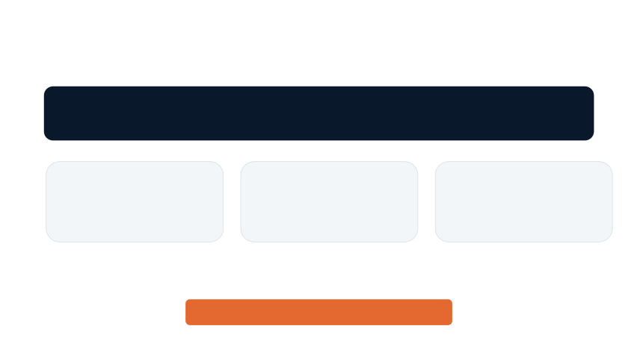
09 • IMPACT
What makes this a Digital Twin —not just a campus map?
A digital twin connects the real campus with a digital representation that carries useful context.
PHYSICAL
DIGITAL
USEFUL
VIT Bhopal campus
Locations + events + roles + routes
Search + navigation + trusted
information
The long-term vision: VIT Bhopal becomes a campus you can understand before you even reach the right building.
• THANK YOU •
VIT Bhopal University Digital Twin • 10

