Slide 1

Customer Shopping Behavior Analysis
Uncovering insights from 3,900 purchases to guide strategic business decisions through data-driven analysis of spending patterns, customer segments, and product preferences.

Slide 2
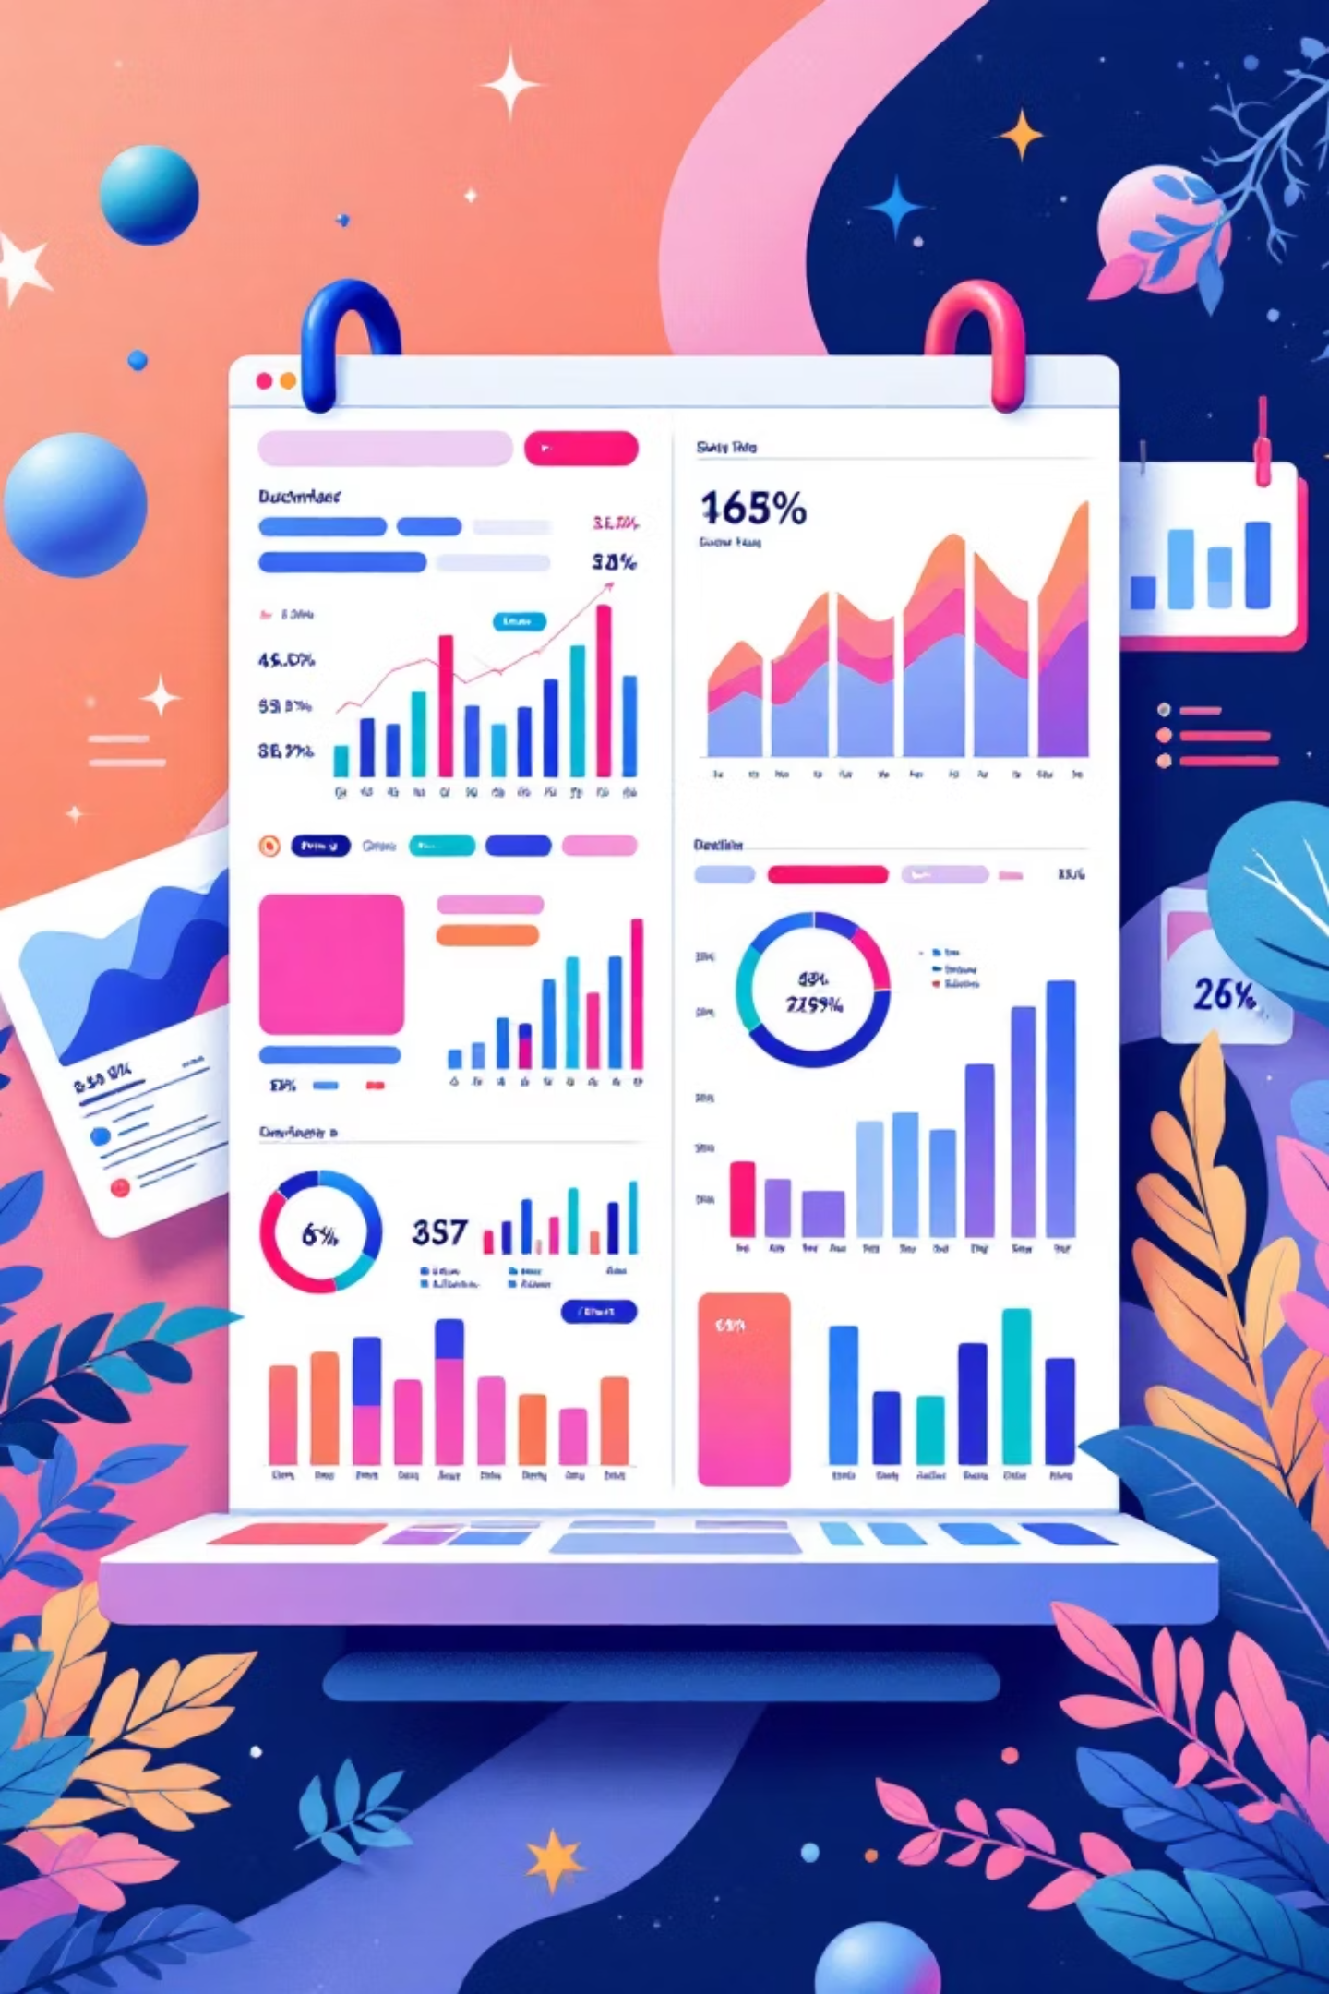
Dataset Overview
3,900
18
50
Total Purchases
Data Columns
Locations
Transactions analyzed across all categories
Comprehensive customer and purchase attributes
Geographic diversity in customer base
25
Products
Unique items across four categories

Slide 3

Data Preparation & Engineering
Python Analysis Pipeline
Key Data Points
Loaded dataset using pandas for exploration
Average Purchase: $59.76
Age Range: 18-70 years
Imputed missing Review Rating values using median by category
Average Rating: 3.75/5.0
Missing Data: 37 values in Review Rating (handled via imputation)
Standardized columns to snake_case format
Created age_group and purchase_frequency_days features
Integrated cleaned data into PostgreSQL database

Slide 4

Revenue Insights
Gender Revenue Split
Male customers generated $157,890 in total revenue, more than double the $75,191 from female customers.
High-Value Discount Users
839 customers used discounts while spending above the $59.76 average, indicating strategic discount usage.
Shipping Preferences
Express shipping users spend $60.48 on average vs. $58.46 for Standard, suggesting premium service attracts higher spenders.

Slide 5
Product Performance
Top Rated: Gloves
Sandals
Boots
Highest average rating at 3.86/5.0
Second highest rating at 3.84/5.0
Strong performance at 3.82/5.0
Top-rated products show consistent quality across accessories and footwear categories, providing opportunities for featured marketing campaigns.

Slide 6
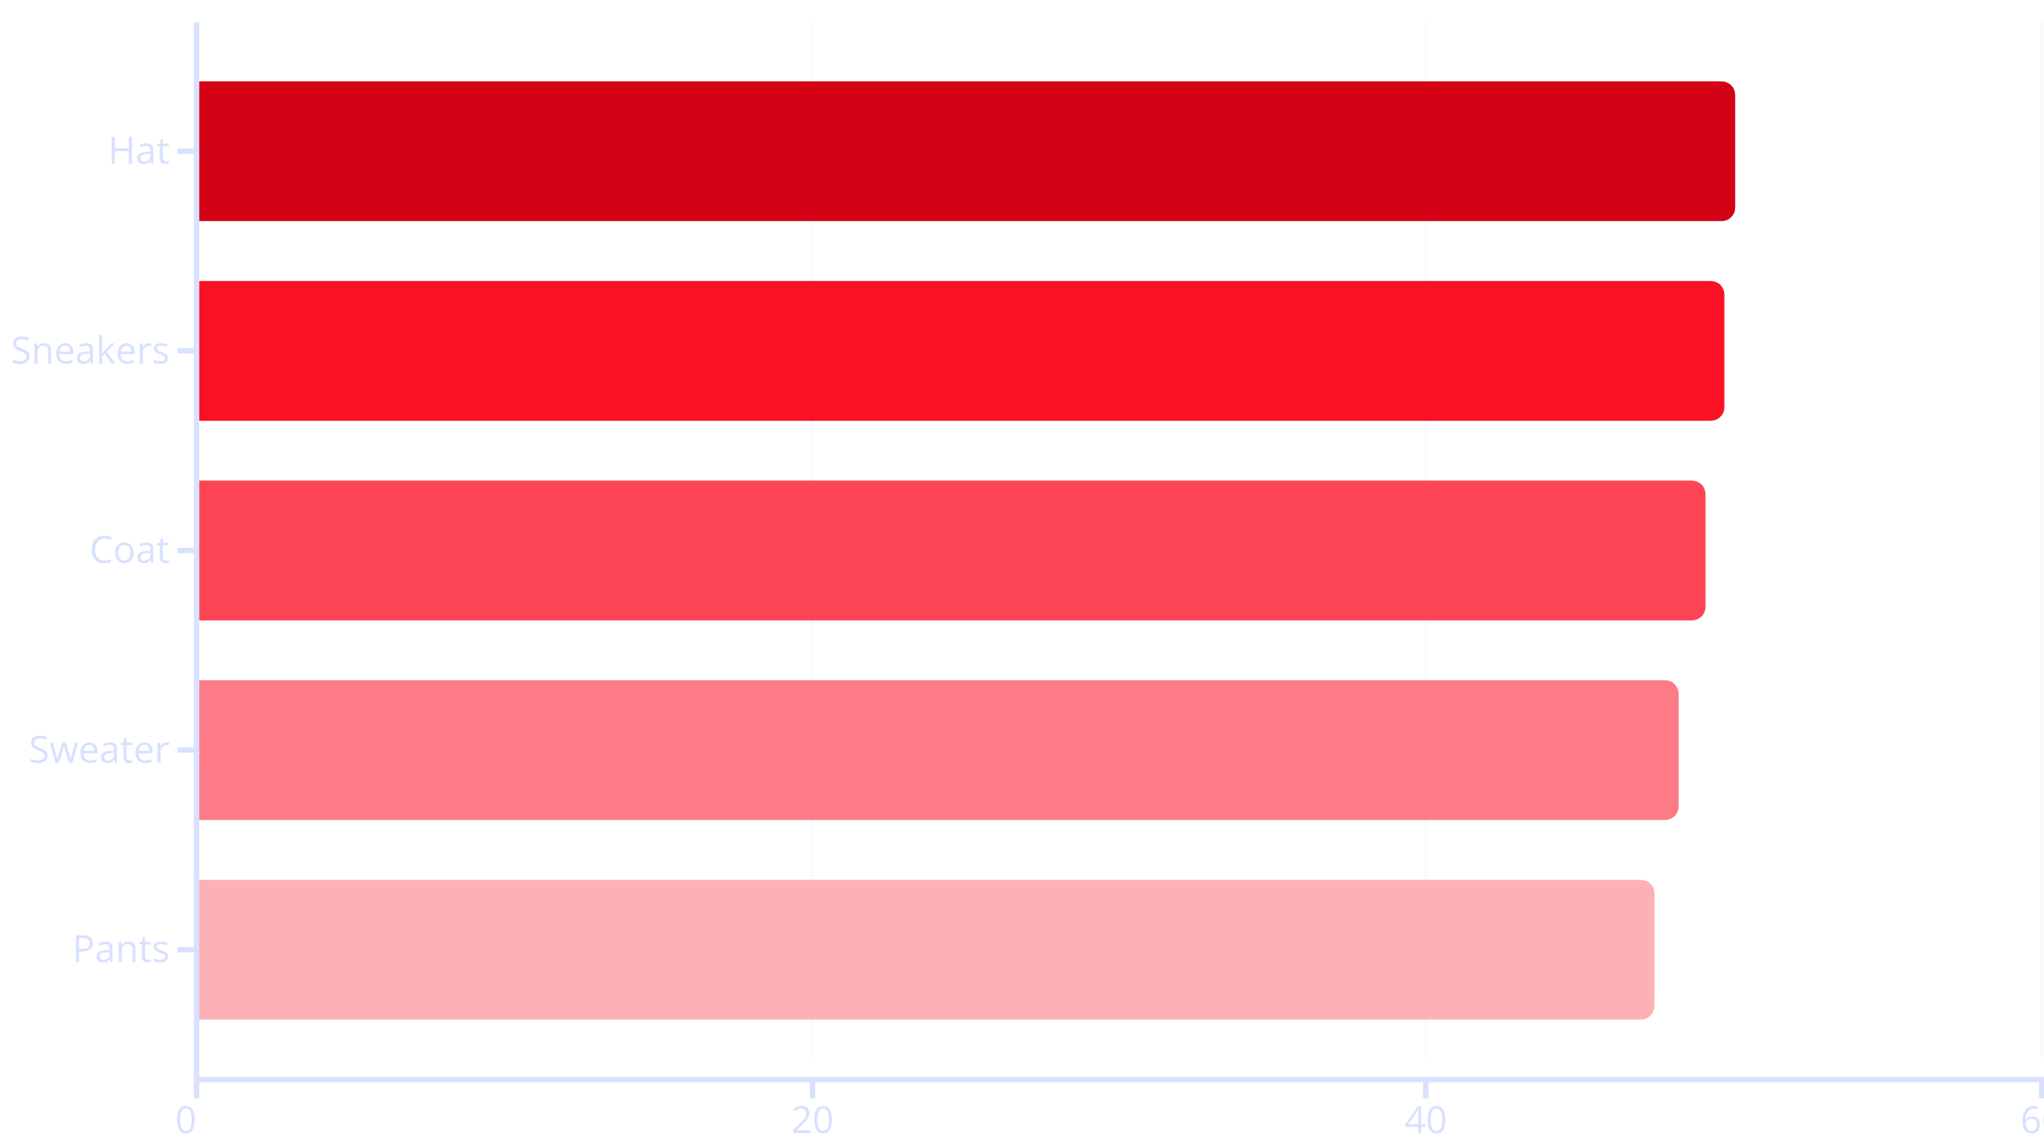
Discount Strategy Analysis
Nearly half of all purchases for these products involved discounts, suggesting price sensitivity. Balance promotional strategies with margin protection.

Slide 7




Customer Segmentation
Returning
701 customers (18%) with 2-4 purchases
Loyal Customers
3,116 customers (80%) with 5+ purchases
New Customers
83 customers (2%) with first purchase

Slide 8



Subscription Impact
27%
Subscription Rate
1,053 of 3,900 customers subscribed
958
Loyal Subscribers
Repeat buyers (5+ purchases) who subscribe
Subscribers spend $59.49 on average vs. $59.87 for non-subscribers, generating $62,645 total revenue. Opportunity exists to convert high-frequency buyers into subscribers.

Slide 9
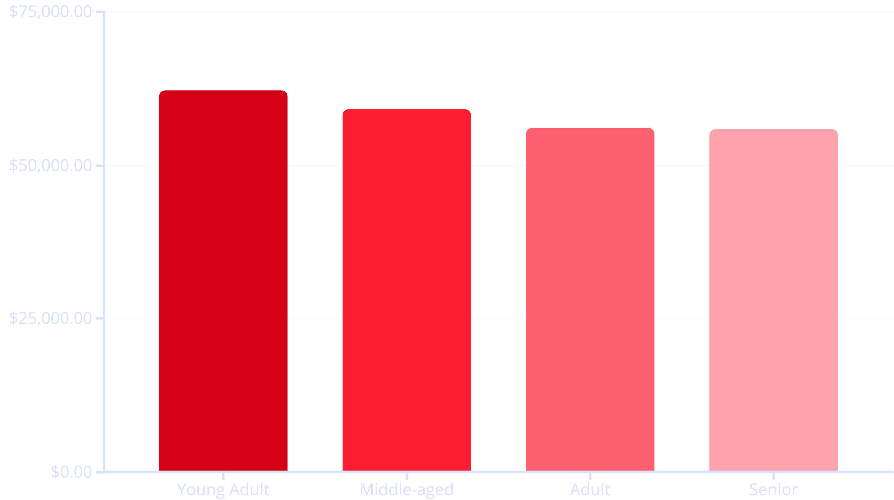
Age Group Revenue Distribution
Young adults lead revenue generation at $62,143, followed closely by middle-aged customers. Relatively balanced distribution suggests broad market appeal across demographics.

Slide 10
Strategic Recommendations
Boost Subscriptions
Customer Loyalty Programs
Review Discount Policy
Promote exclusive benefits to convert the 958 loyal repeat buyers into subscribers, increasing predictable revenue.
Reward the 701 returning customers to accelerate their transition into the loyal segment.
Balance promotional strategies for discount-dependent products (Hats, Sneakers, Coats) with margin control.
Product Positioning
Targeted Marketing
Feature top-rated products (Gloves, Sandals, Boots) and best-sellers (Blouse, Jewelry) in marketing campaigns.
Focus efforts on young adults and express-shipping users who demonstrate higher spending patterns.

