Slide 1


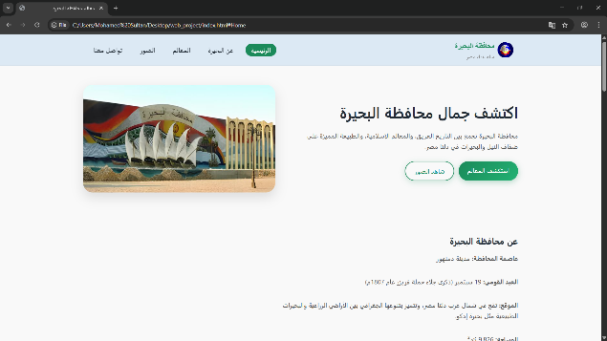
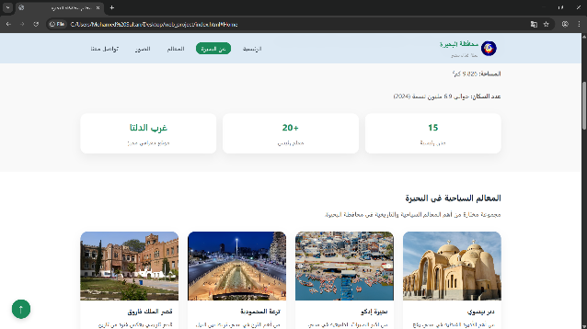
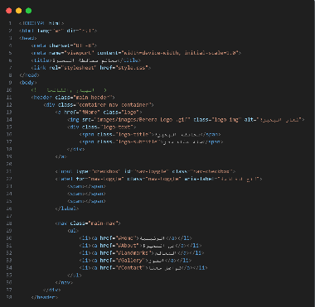
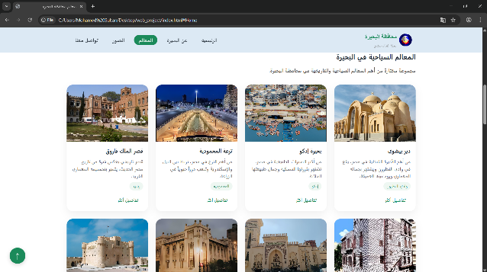
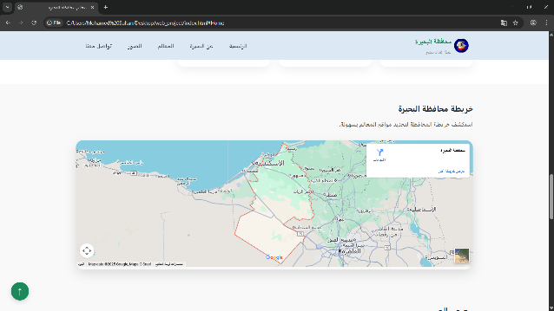
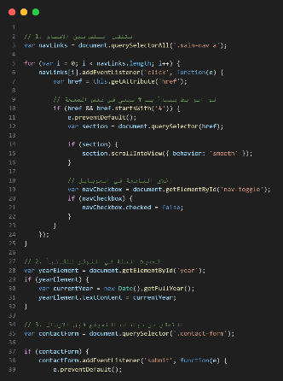
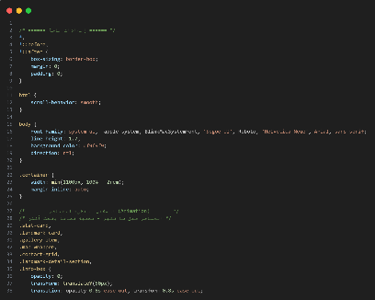
Beheira Landmarks Website
Research Project (2025 - 2026)
Discussed at: 9/12/2025
Supervised by:
Eng\: Abdelrahman Abu Zaid
Eng\: Mohamed Abdullatif
Damanhur
University
Faculty of Computers
and Information
Mohamed Adel
Khaled Ahmed
Mohamed Sultan
Introduction:
Results:
Future Work:
This project develops a static tourism website for Beheira Governorate showcasing historical landmarks and natural attractions. The platform features 12+ pages about Wadi El Natrun, Rosetta Stone, Qaitbay Castle, and Lake Idku with responsive design and interactive elements.
Features Delivered:
- 12+ landmark detail pages
- Responsive navigation with smooth scrolling
- Interactive image gallery with zoom
- Google Maps integration
- Contact form with validation
- Scroll animations
- Mobile-responsive design
- Fast loading performance
- Dark/Light mode toggle
- Advanced search functionality
- Weather widget for locations
- Print-friendly pages
- Offline mode support
- Social media integration
Methodology & Tools:
Technologies: HTML5, CSS3, JavaScript, Google Maps API, Git/GitHub
Development: Research landmarks → Design wireframes → Build HTML structure → Style with CSS → Add JavaScript interactivity → Test responsiveness
References:
- MDN Web Docs
- W3Schools Tutorials
- Beheira Gov. Website
- Egyptian Tourism Ministry
- Google Maps API Docs
Procedure:
acknowledgments:
1. Research landmarks information
2. Design website layout
3. Develop HTML pages
4. Style with CSS (Flexbox/Grid)
5. Add JavaScript features
6. Integrate Google Maps
7. Test across devices
8. Optimize performance
Conclusion:
Thanks to Damanhur University Faculty of Computers and Information and our supervisors:
Eng\: Abdelrahman Abu Zaid
Eng\: Mohamed Abdullatif
for their guidance and support throughout this project.
Successfully created a functional tourism website using HTML, CSS, and JavaScript. The team gained practical web development experience while promoting Beheira's cultural heritage. The platform serves both educational and tourism purposes.

