Slide 1
BookMyShow App Design
Initial design

Slide 2
Class Diagram
User ------------------------------- userId password/secrets/token
bookedTicketHistory
profileDetails
Movie ------------------------------- movieId title genre
language description cast crew
Include paging sorting options
Show ------------------------------- showId LocalDateTime startTime List<Seat>
Movie movie Cinema cinema
Ticket ------------------------------- ticketId bookedUserId bookedMovieId, showID
Cinema ------------------------------- cinemaId name location
state
Country
Payment ------------------------------- paymentId timestamp
City ------------------------------- cityId
location
Seat ----------------------------------- seatId, seatNumber, isbooked

Slide 3
Microservices
API Gateway service: Proxy Load balancer Authentication
Service discovery - microservice
DB
MovieDataService: getMoviesByCity(City cityId) getTheatresByCity(City cityId)
getMoviesByTheatre(Theatre theatreId)
TicketBookingService: bookTicket() expireBookedSeats() – for timeout on 10 mins after-seat allocation isSeatAvailable()
MessagingService
UserService
PaymentService

Slide 4
BookMyShow App Design
-Enhanced

Slide 5
Microservices | Description | Status
bms-api-gateway-service | API Gateway | Done
bms-service-discovery | Eureka service discovery | Done
bms-booking-service | For booking movie | Done
bms-movie-service | Movie/Cinema/Show details | Done
bms-messaging-service | To send a message on successful booking | Done
bms-user-service | User login, registration | Done
bms-payment-service | For payment on booking | Done
bms-ui | For angular service | Pending few changes
Docker config for all backend services |  | Pending

Slide 6
API | Details
/bms/movie/movieDetails/addMovie
/bms/movie/movieDetails/movies-by-city
/bms/movie/movieDetails/movies-by-cinema
/bms/movie/movieDetails/shows-by-movie-cinema
/bms/movie/movieDetails/seats-by-show
/bms/movie/movieDetails/lock-seats
/bms/booking/bookingDetails/initiateBooking
/bms/payment/paymentDetails/initiatePayment
/bms/user/userDetails/register
/bms/user/userDetails/login
/bms/user/userDetails/verify-otp
/bms/user/userDetails/getUserDetails

Slide 7
Communication | Topic/ url | From service | To service
Kafka | payment-success | Payment | Booking
Kafka | payment-failed | Payment | Booking
Kafka | booking-confirmed | Booking | Messaging
Rest (HTTP) | lock-seats | Booking | Movie
Rest (HTTP) | getUserDetails | Messaging | User

Slide 8
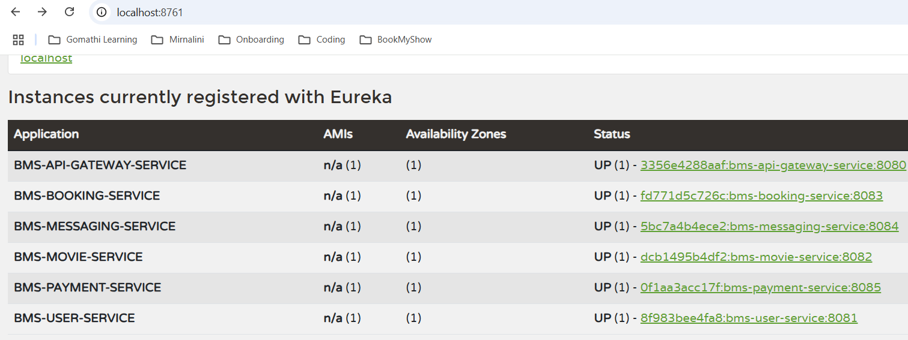
Book my show app - output

Slide 9
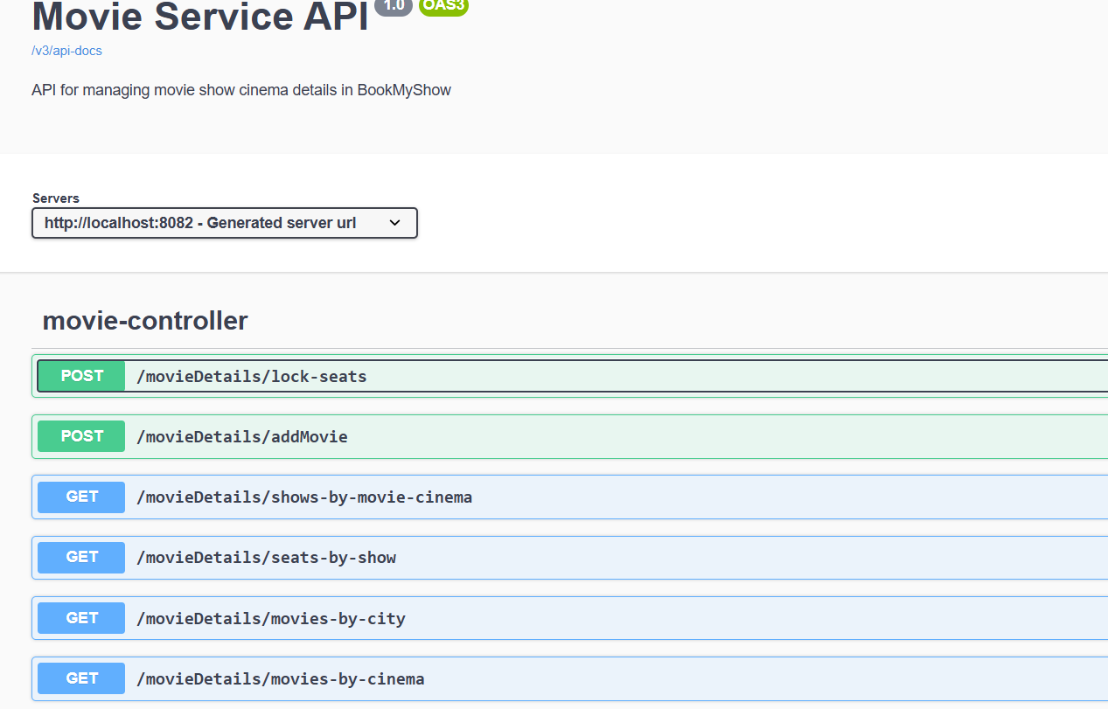

Slide 10
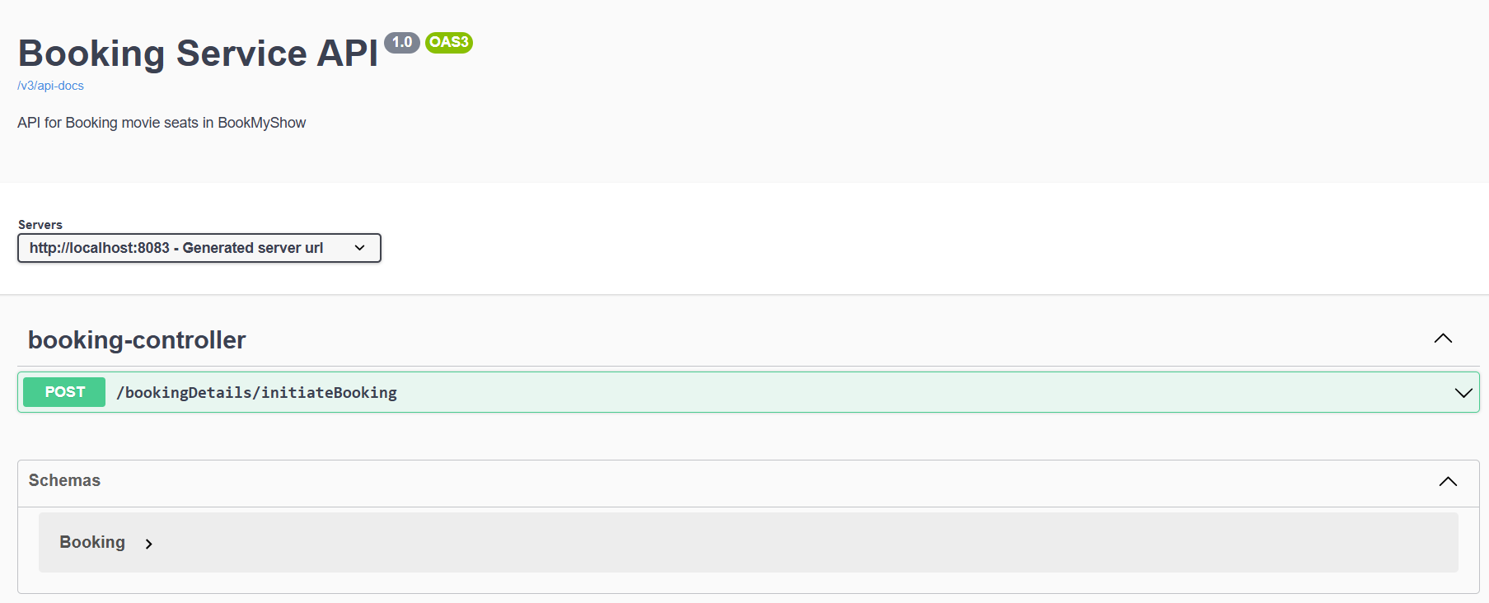

Slide 11
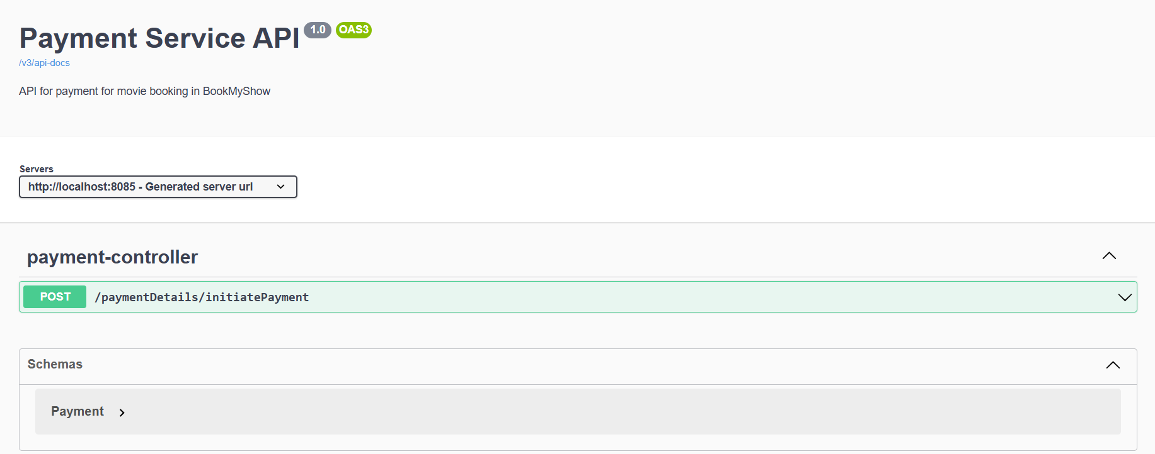

Slide 12
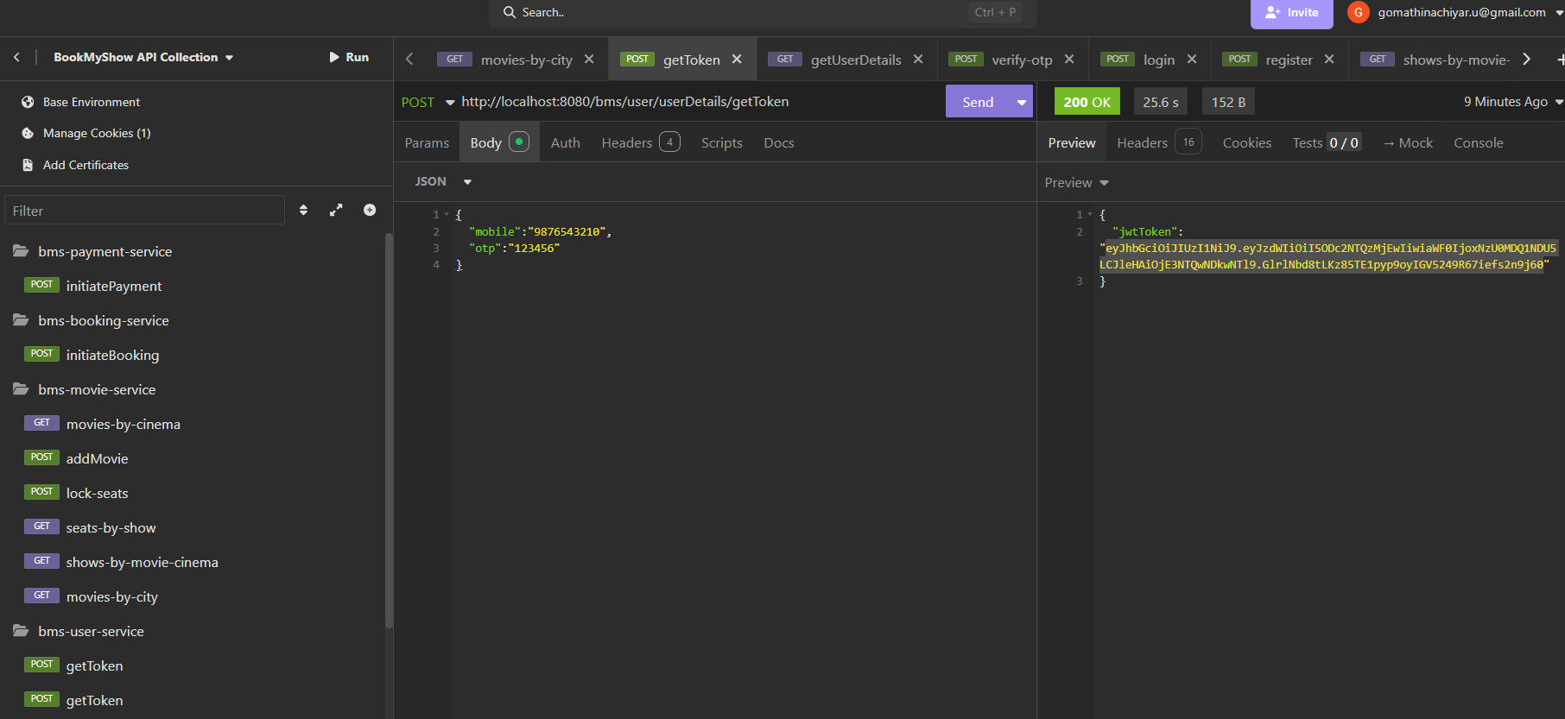

Slide 13
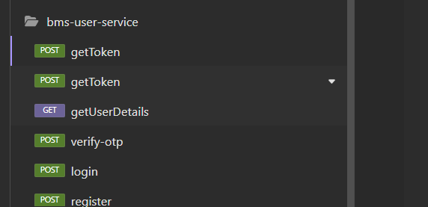

Slide 14
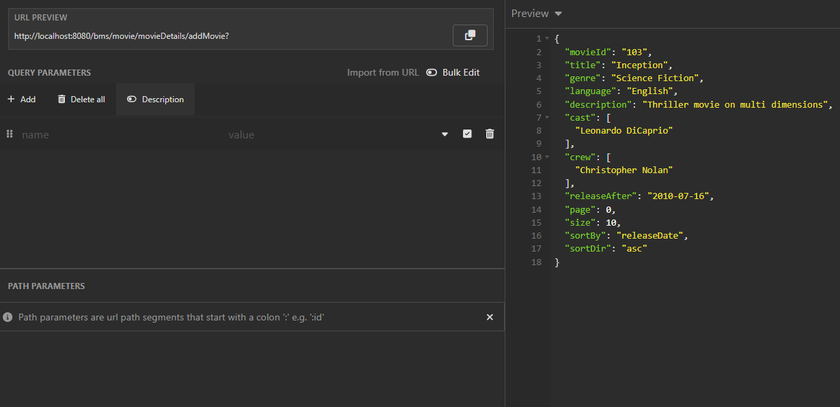

Slide 15
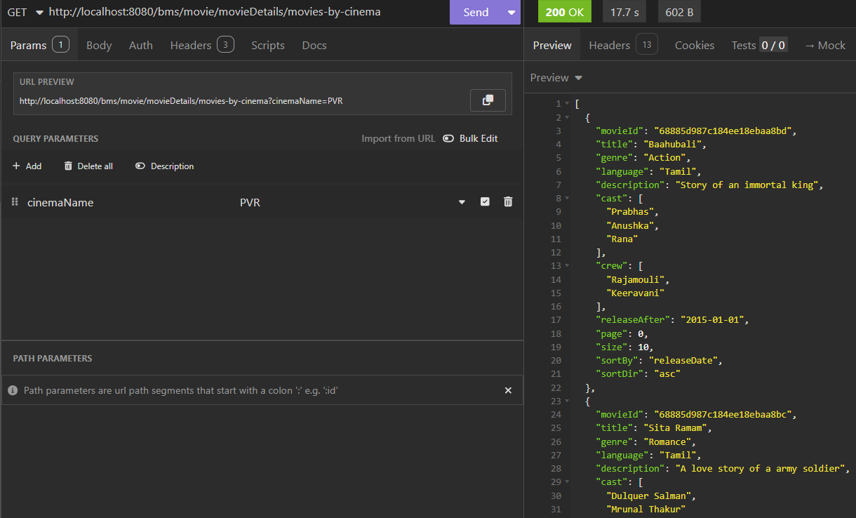

Slide 16
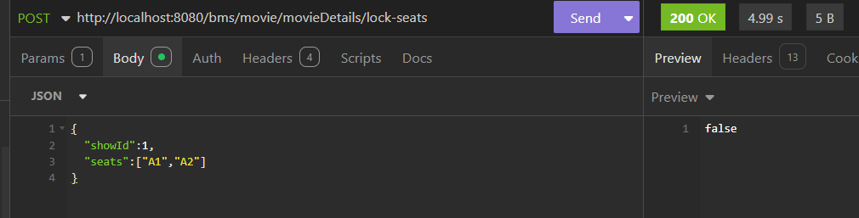

Slide 17
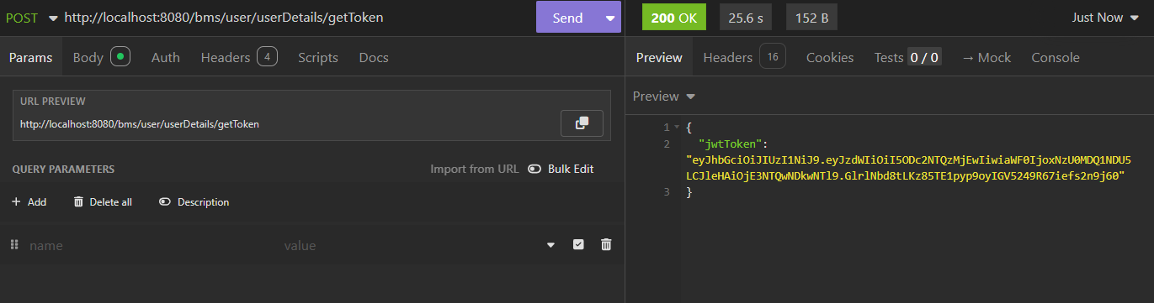

Slide 18
Logging tracing improvisation:
Inclusion of correlation id, mobile, service name fields in app logs

Slide 19
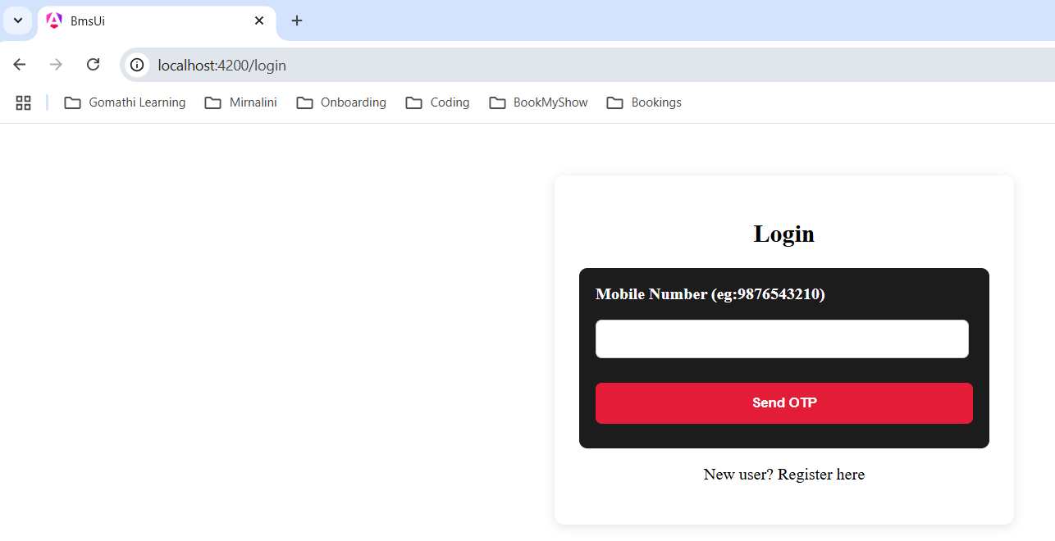

Slide 20
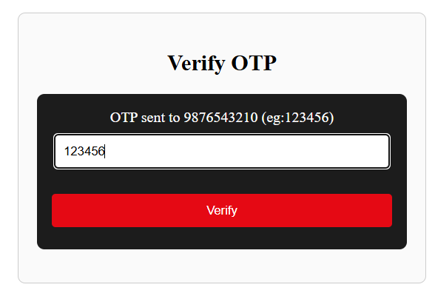

Slide 21
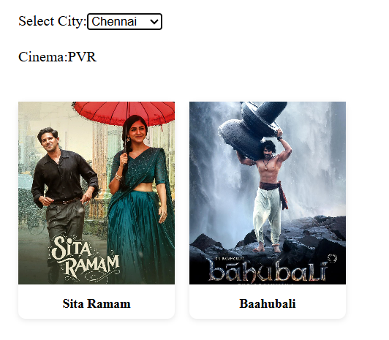

Slide 22
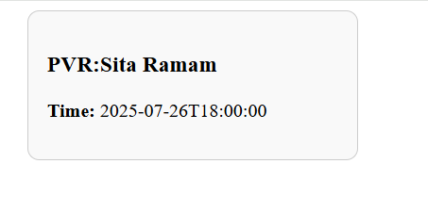

Slide 23
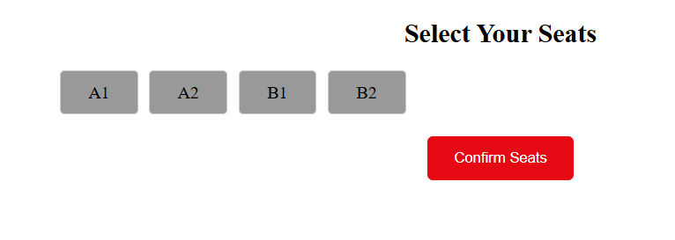

Slide 24
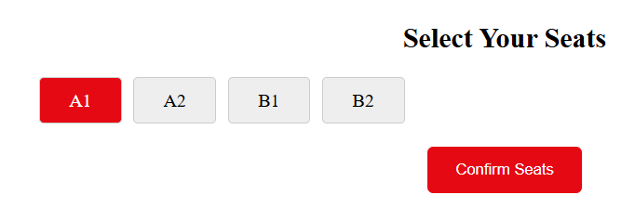

Slide 25
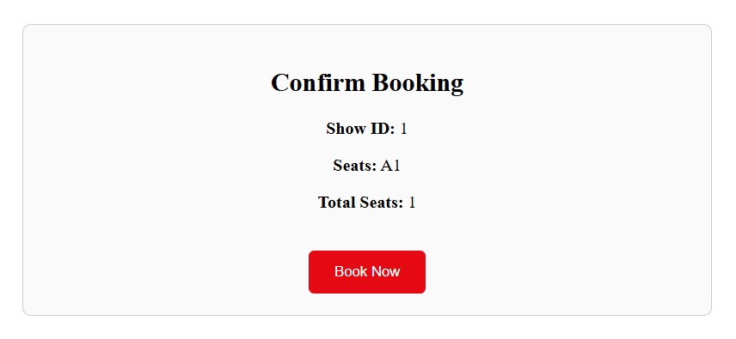

Slide 26
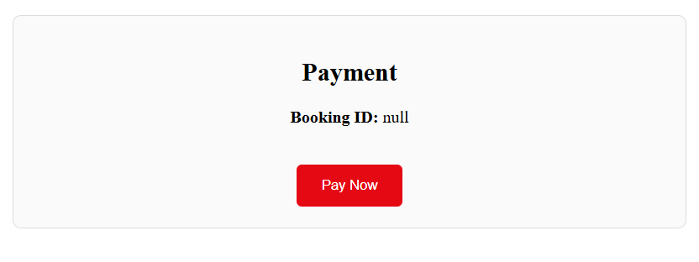

Slide 27
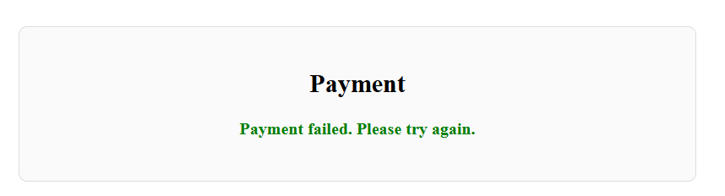
Case1: Payment failed

Slide 28
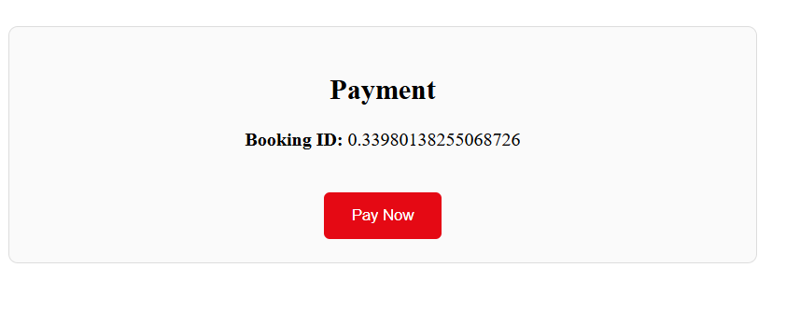

Slide 29
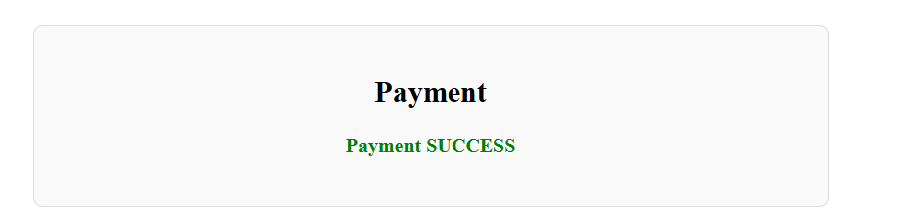

Slide 30
