Slide 1
Racing Game Course Design
Presenter：Yuxuan Deng

Slide 2
Table of Contents
Overview of the Design
Introduction to Key Functions
Analysis and Problem Solving
Summary

Slide 3
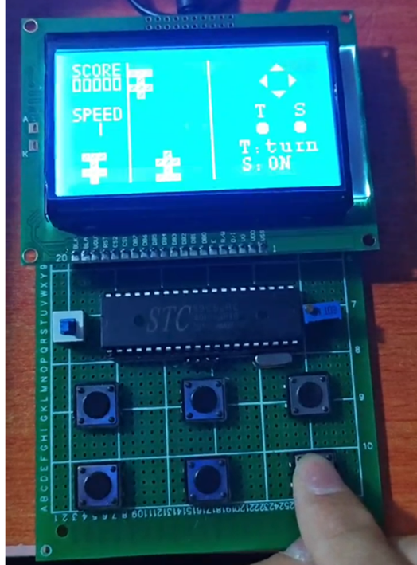
Overview of the Design
This design is a simple racing game based on the 89C52 microcontroller. The game involves controlling a car on the screen to avoid obstacles and score points. Key components include:
Core Processing Unit
89C52 microcontroller with a 12MHz main frequency and 40 pins.
Display Section
The game visuals are rendered on an LCD 12864 screen.
Control Section
The car is controlled using buttons to move up, down, left, and right.
Timer interrupts are used to refresh obstacles and update screen graphics.
Game Logic
Each time the car moves, it checks for collision with obstacles. If no collision and the obstacle moves out of the track, the score increases by 1.
If there is a collision, the game ends.
延迟符号

Slide 4
Introduction to Key Functions
Microcontroller System Initialization
Timer Initialization
LCD Display Unit
LCD Display Control
Microcontroller Minimum System
Button Recognition
Hardware
Section
Software
Section
Timer Interrupt Handling
Button Circuit
Game Logic Handling
延迟符号

Slide 5
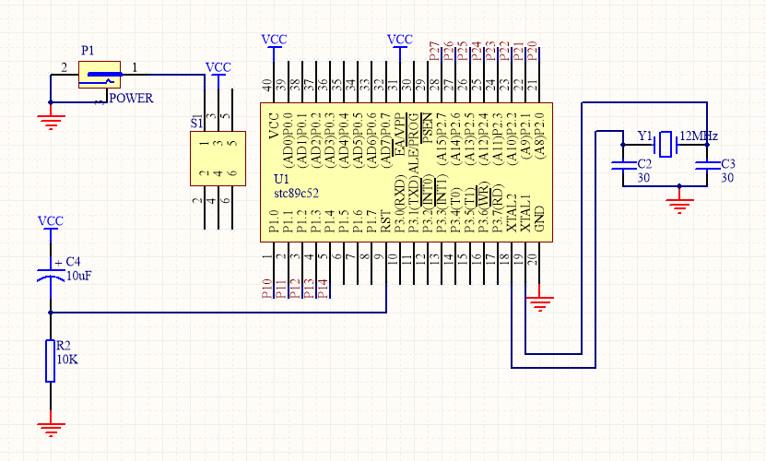
Hardware Section — Microcontroller Minimum System
Microcontroller Minimum System:
1. Power, reset circuit, MCU pin connections, and crystal oscillator circuit
延迟符号

Slide 6
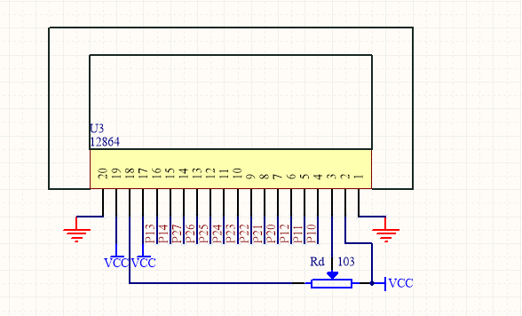
Hardware Section — LCD Display Unit
LCD Display Unit Composition: 12864 LCD
Connection Principle with MCU - Parallel Mode
Apart from the power supply, the module's CS, SCLK, SID, and DB0-DB7 pins need to be connected to the microcontroller one by one. PSB connects to VCC, and RST connects to VCC (low-level reset).
Interface Definitions with the Microcontroller:
- DB0-DB7 --> P2
- LCD_RS --> P1^0
- LCD_RW --> P1^1
- LCD_E --> P1^2
- LCD_CS2 --> P1^4
- LCD_CS1 --> P1^3
- LCD_RST --> P3^7

Slide 7
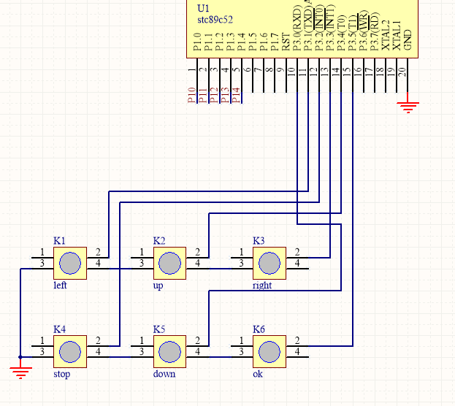
Hardware Section—Button Circuit
Button Unit:
1. The microcontroller connects to button pins configured as pull-up input, with low level effective when the button is pressed.
延迟符号

Slide 8
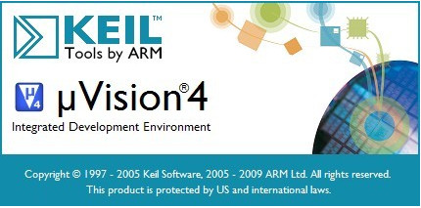

Software Section
Compilation Software
Use the popular KEIL-V4 IDE to create a project based on the 89C52 microcontroller, write and debug the code, generate the HEX file, and download it to the chip using a programming tool.
Flowchart Drawing
Use yED software to draw flowcharts to organize the game code project logic.
延迟符号

Slide 9
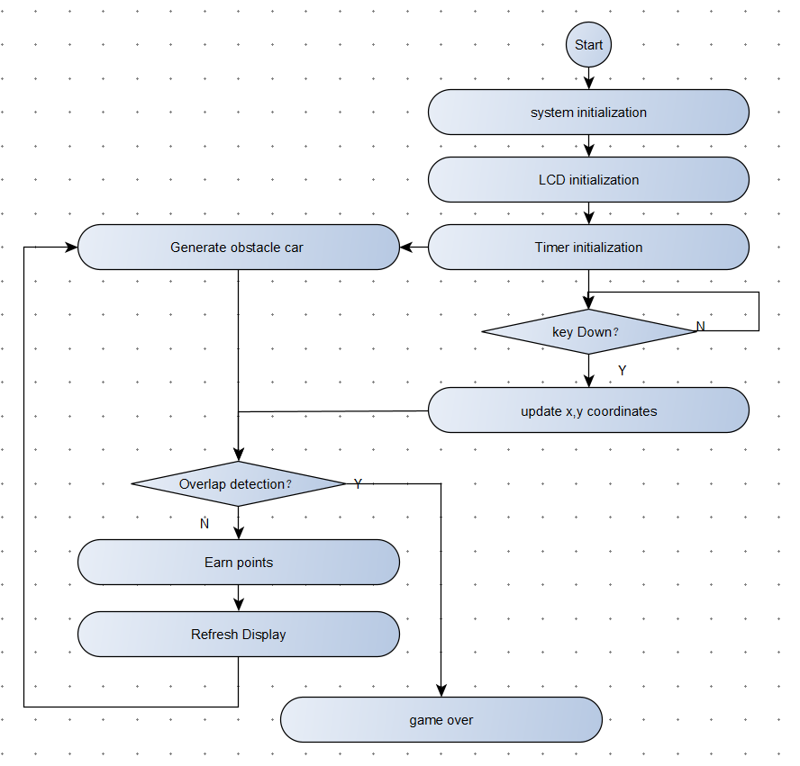
Software Section — Flowchart
延迟符号

Slide 10
Software Section — System Initialization
Microcontroller Peripheral Initialization
LCD Initialization
Game Interface Initialization
Clock Initialization
I/O Port Initialization
Timer Initialization
Interrupt Enable
Display Settings
Set Starting Line
Set Page Address
Set Display Register
Clear Screen
Display Startup Screen
Prepare Speed Selection Page
Prepare Game Control Page Layout
延迟符号

Slide 11
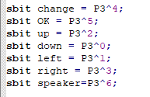
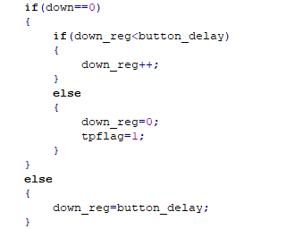
Software Section—Button Recognition
Button Port Definition
Button Recognition Handling
Hardware Wiring
One end of the button connects to P1.0, and the other end connects to GND.
Button Detection
Low level indicates the button is pressed, high level indicates the button is released.
Debouncing
If the button press duration exceeds `button_delay`, it is considered valid.

Slide 12
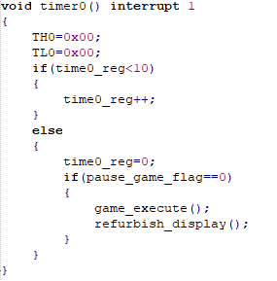
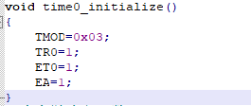
Software Section — Timer Interrupt
Timer Initialization
Timer Interrupt Service Routine
Initialization:
- Configure Timer 0 to Mode 3 (split mode), splitting Timer 0 into two independent 8-bit timers TL0 and TH0.
- Start Timer 0.
- Enable Timer 0 interrupt.
- Enable global interrupt.
In the Timer Interrupt Service Routine:
- Execute game logic checks.
- Refresh the interface.

Slide 13
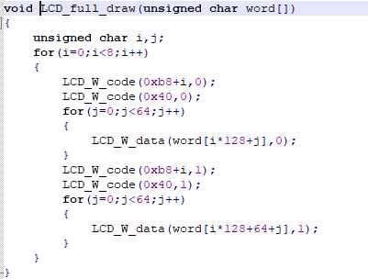
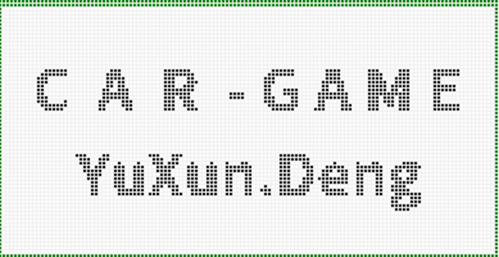
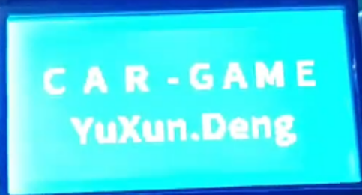
Software Section — LCD Display
Software Section — LCD Display
Display Character Patterns
Actual Display
Character Pattern Generation:
- Use PS software to create a 128x64 BMP image.
- Use a pattern extraction software to generate the character pattern array.
Display:
- Refresh the LCD image by drawing the array to the screen.
延迟符号

Slide 14

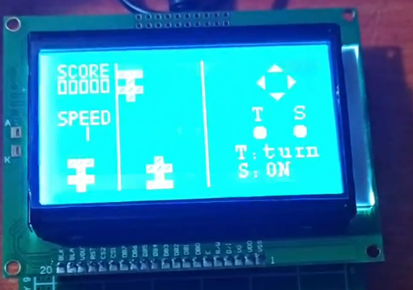

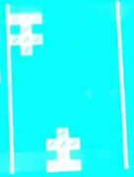
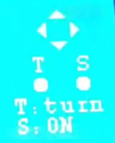
Game Logic Handling — Interface Layout Display
Score/Speed Display
- Top left corner of the screen: shows the game score.
- Bottom: shows the current game speed.
Racing Area Display
- Area where our car and obstacle cars operate.
Operation Indication Display
- Area indicating the up, down, left, and right button prompts.

Slide 15
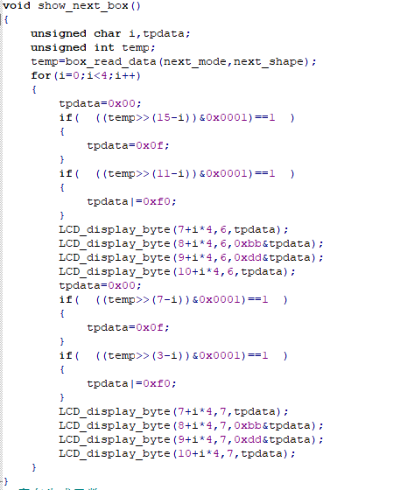
Game Logic Handling — Vehicle Generation Display
车辆生成
□■□□
■■■□
□■□□
■■■□
Our Vehicles
■■■□
□■□□
■■■□
□■□□
Obstacle Vehicles

Slide 16
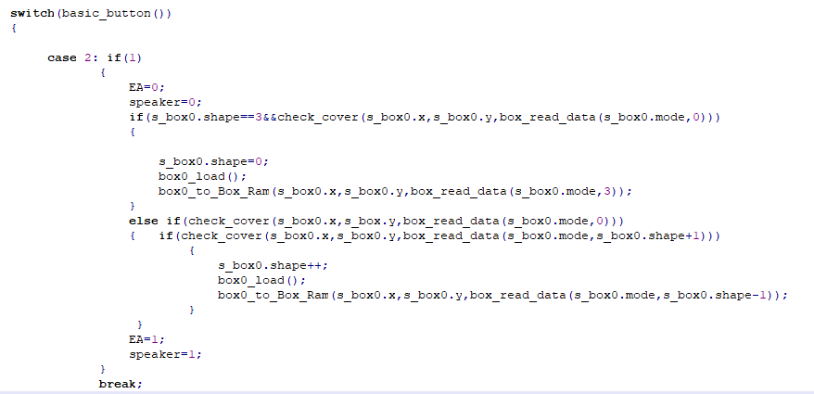
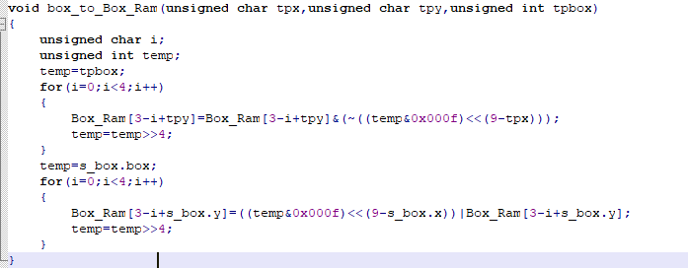
Game Logic Handling — Car Movement
1
Identify Button Press to Change Corresponding Graphic Coordinates
2
Timer Interrupt, Process New Coordinate Graphics
3
Change the position of the graphic in memory, delete the original graphic, and refresh the new graphic at the new calculated coordinates.

Slide 17
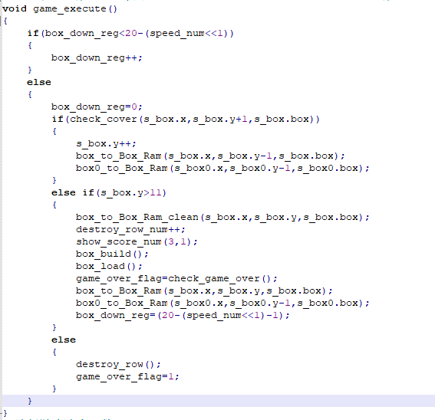
Game Logic Handling — Collision Detection
1
Timer Periodic Execution
2
Check if the obstacle car has moved out of the racing area. If it has, remove the obstacle car from memory and increase the score.
3
Check if the obstacle car and our car have collided. If they have, the game ends.

Slide 18
Analysis and Problem Solving
Issue 1: No pull-up resistor added in the hardware
Solution: Configure the port for pull-up
Button Recognition Issue
LCD Display Abnormalities
Issue: Full Screen Display is Garbled
Solution: When using image character patterns, ensure the size is 128x64.
Issue 2: Button has false triggers
Solution: Handle with debouncing using a delay
Issue: When moving our car and simultaneously refreshing obstacle cars, residue is displayed.
Analysis: Refreshing during the timer interrupt is not completed before a new interrupt occurs.
Solution: Disable interrupts while moving, then re-enable them after the movement is complete.
问题：赛车会随着左右移动移出边界
解决：在内存刷新时，增加边界判断记录，设定不能 超越边界
Display Remain
Car Out of Bounds
延迟符号

Slide 19


Summary
Hardware Design
LCD Display
Racing Game
By studying the Arduino hardware system and relevant materials, I researched and learned about the hardware system based on the 89C52 microcontroller, applying and transferring the hardware knowledge gained.
Compared to the 1602 LCD previously used, the 12864 display has a larger area, is more flexible to operate, and supports the use of character patterns and fonts, allowing for a deeper understanding of the LCD display functionality.
This game is relatively difficult to produce. It not only utilizes the knowledge of Arduino microcontrollers, buttons, displays, timers, and interrupt handling learned in class, but also incorporates knowledge of image buffering and coordinate management. The learned knowledge has been verified and elevated through this project.

