Slide 1
VBA and Macro creation (using Excel)
DSC340
Mike Pangburn

Slide 2
Agenda for Today
Object-Oriented Programming
Creating Macros with VBA

Slide 3
OBJECT ORIENTED
PROGRAMMING:
VBA

Slide 4
What is O-O programming?
A programming style that uses “objects” to comprise programs.
Objects:
In a pure O-O language, every thing in the program is an object.
An object is a data structure consisting of attributes (data ﬁelds) and methods (actions).
The attributes of the object hold its current information
The methods of the object determine what the object can do

Slide 5

Different objects types: classes
Each programming environment comes with many different kinds of predefined objects.
An object type is called a class. A class is thus some type of object.
All objects within a class hold the same kind of information (identical attributes) and can perform the same actions (identical methods).
A class is the “cookie cutter”/template you use to create new object instances.
Hollywood analogy: in Battlestar Galactica there are 12 “classes” of human robots. One of these 12 model types was the Sharon model.

Slide 6
Creating and using objects
You 1st need a class
class Sharon
Attributes: height, 3Dbodyshape, faceimage, currentlocation, currentlove, pastexperienceslog
Methods: imitateHuman, fallInLove(person), doSecretMission(password)
You then “declare” a new object and can subsequently assign its attribute value and invoke its methods.
Example: declaring a new Sharon object, assigning a value, and calling a method
Sharon sharonNo55
sharonNo55.currentlocation = “KA.493.X7.1034”
sharonNo55.fallInLove(Helo)

Slide 7
Object Oriented Programming Fundamentals
Appropriate object classes (their attributes and methods) heavily depend on the problem you are working on.
Example: A system for a bank:
◦ Objects: Customers, Accounts, etc.
◦ Attributes: First Name, Last Name, SSN, Address, etc.
◦ Methods: Withdraw, Open an account, Deposit, Cash check, etc.

Slide 8
VBA: Visual Basic for Applications
VBA is a specialized version of Microsoft’s well-known Visual Basic
language.
VBA is an Object-Oriented language within Microsoft Ofﬁce suite:
◦ Excel, Word, Access, and Power Point.
◦ We will focus on Excel.
◦ Shortcut to access the VBA interface in Excel: Alt+F11.
Excel treats everything in a spreadsheet as objets. So, VBA lets us play
with all these objects.
◦ Object that we are interested in: Workbooks, worksheets, cells, rows, ranges.
◦ There are over 200 different class (types of objects) in Excel.

Slide 9
Coding with VBA
There are two approaches to write a code in VBA:
Standard Coding
Macro Recording
The Macro approach “records” a series of mouse-clicks and keyboard
strokes.
Advantage: Corresponding VBA code is created automatically and recorded for you.
Disadvantage: It’s limited.
To tackle this limitation, we use a mixed approach:
First, record a simple macro.
Then, tweak it to achieve more complex tasks.

Slide 10
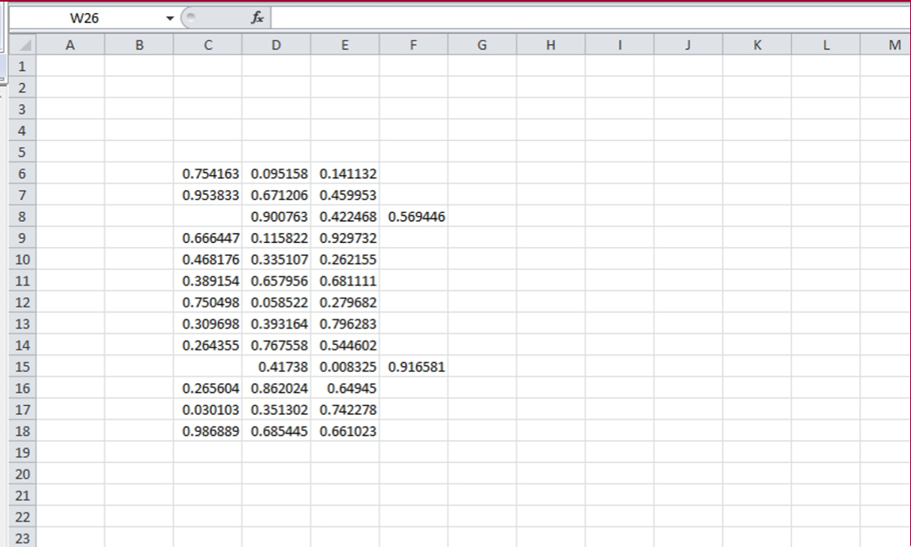
Problem Deﬁnition
We have data spanning 3 columns and 13 rows (C6:F18).
◦ Data should be stored in the given range in order to use it for other application.
◦ Unfortunately, there are some errors in the data entry process, so some of the rows are shifted
to the right by one column.

Slide 11
Problem Deﬁnition
We have data spanning 3 columns and 13 rows (C6:F18).
◦ Data should be stored in the given range in order to use it for other application.
◦ Unfortunately, there are some errors in the data entry process, so some of the rows are shifted
to the right by one column.
Our job is to correct all these mistakes:
◦ First, record a simple macro that correct a speciﬁc row (say Row 8).
◦ Then, tweak it to make correction in any given row.
◦ Finally, we let the code check any mistake and correct it.
While doing this, we learn how to
◦
◦
◦
◦
Declare and name variables.
Create Subroutines and Functions (We’ll learn what they are shortly).
Use conditional statements.
Create repetitions.

Slide 12
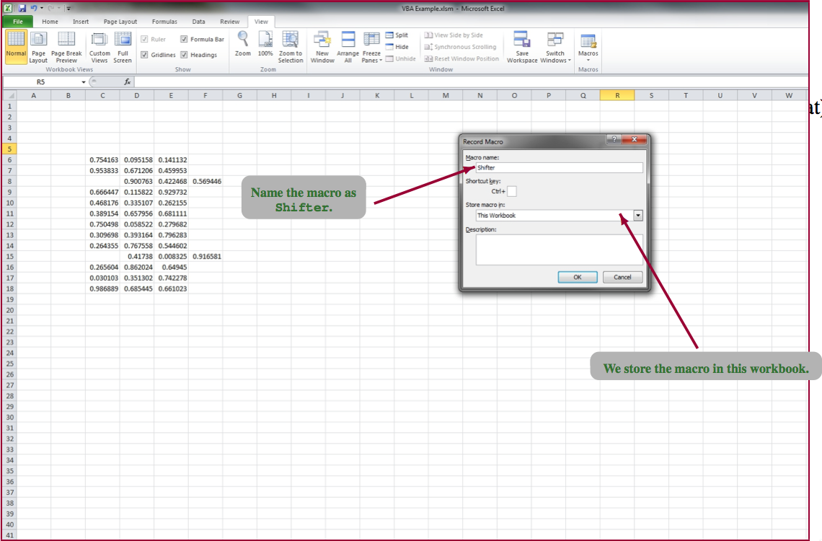
Our First Macro
Download and open VBA_Example_class.xlsm
In Excel 2010, we should save the ﬁle as a Macro Enabled Workbook (i.e., in the .xlsm format).

Slide 13
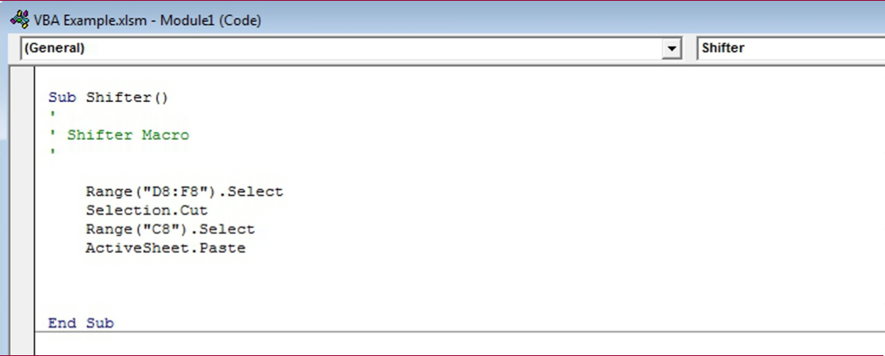
Our First Macro
Find the Macros option under the Excel 2010 View tab to record a VBA macro.
Let’s call our Macro “Shifter.” We want our macro to do the following:
◦
◦
◦
◦
Select the range D8:F8.
Cut the selected cells.
Select cell C8.
Paste the cut cells.
To see the VBA code generated by your actions, go into VBA (Alt+F11) and
then near the upper left of the window expand the Modules folder and
double-click on Module1.

Slide 14
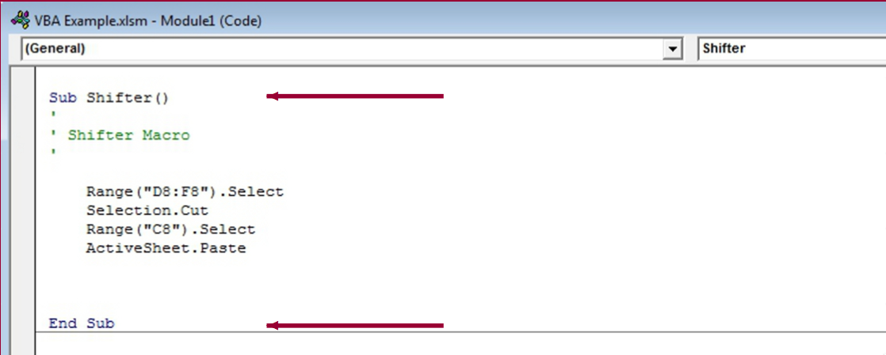
Subroutines
Notice that the code starts with Sub command and ends with End Sub command.
Sub refers to the Subroutines.
◦ Subroutine: A portion of code within a larger program that performs a speciﬁc task and is
relatively independent of the remaining code.
◦ We can use a subroutine in a different subroutine by “calling” it.
◦ e.g., Call Shifter().

Slide 15
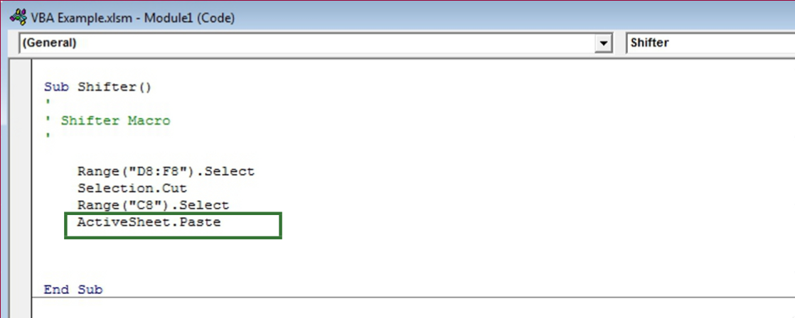
Execution of Subroutines
Each line of a subroutine is executed sequentially.
Let’s see how our macro is executed.
(The first three green lines following each ‘ are simply comments/documentation.)
The real ﬁrst line is Range("D8:F8").Select, and it selects the cells we want to select.
The second line, Selection.Cut, cuts the selected cells.
The third line, Range("C8").Select, selects the cell C8.
Finally, the last line, ActiveSheet.Paste, pastes the cut values to the selected cell of the worksheet.

Slide 16
Subroutines with Input Arguments
The limitation of Shifter is that it only corrects Row 8.
We can solve this by creating a subroutine which will take a row number as an input
parameter.
Sub ShiftOneColumn (RowNum As Integer)
CODE BLOCK
End Sub
◦ RowNum is the input variable. We name it.
◦ As Integer part declares the data type of our input variable.
◦ Common Data Types:
Data Type
Boolean
Integer
Double
String
Description
Holds either TRUE or FALSE value.
Integers between -32000 and 32000
Double precision numbers, can hold fractional numbers (The
range of double number is very large)
A set of characters (like sentences)

Slide 17
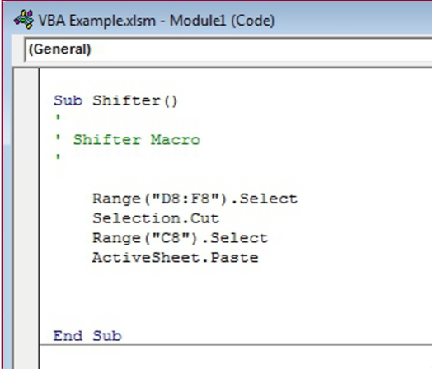
Shifting Any Given Column
Sub ShiftOneColumn (RowNum As Integer)
Range("D" & RowNum & ":F" & RowNum).Select
Selection.Cut
Range("C" & RowNum).Select
ActiveSheet.Paste
End Sub
How do we tell VBA to shift the row according to our input, RowNum?
◦ Currently, we select cells D8,E8,F8 by writing "D8:F8".
◦ We will construct that D#:F# syntax, for our row # (i.e., RowNum)
Range("D" & RowNum & ":F" & RowNum).Select
◦ In Excel and VBA the & operator simply combines (“concatenates”) text together

Slide 18

Shifting Repeatedly
We now have a subroutine that can correct any given row.
We want to apply this subroutine to any rows between 6 and 18.
We use a loop (e.g., a FOR-NEXT Loop) for this task:
For-Next Loop Syntax
For varName=start_val To end_val Step step_size
CODE BLOCK
Next varName
◦ The above code assigns the value of variable varName to start_val.
◦ Then, executes the code inside the loop.
◦ After that, increases the value of variable varName by step_size
◦ And, runs the code again.
◦ Repeats that until the value of variable varName reaches end_val.

Slide 19
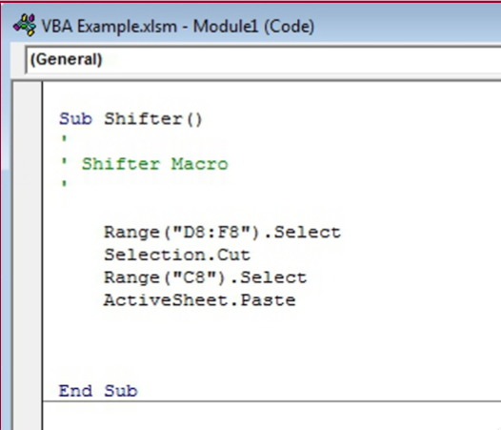
Shifting Repeatedly
Sub ShifterLoop
For RowNum=6 To 18 Step 1
Call ShiftOneColumn(RowNum)
Next RowNum
End Sub
Let’s create our FOR-NEXT Loop.
◦ The variable whose value we change is RowNum.
◦ The Start value is 6. The End value is 18.
◦ And, the Step Size is 1.
In each step, we call the subroutine ShiftOneColumn.
Notice that we have started to use the value called RowNum that we introduced….

Slide 20
Variable Declaration
The subroutine ShiftOneColumn requires an integer input.
We decided to introduce something called RowNum which stores
a row number.
◦ We want the data type for RowNum to be Integer. The VBA interpreter will attempt to
guess (scary!) the data type if you forget to declare your variables.
To avoid that problem, we need to deﬁne the variables we use properly:
Variable Declaration in VBA
Dim varName As dataType
Some rules about variable declaration:
◦ Variables names have to start with a letter, and have no spaces.
◦ VBA is not case sensitive (RowNum and rownum are the same).
◦ Names that are more than one word are usually written with the ﬁrst letter of words
capitalized; it’s not required but it’s fairly standard practice).

Slide 21
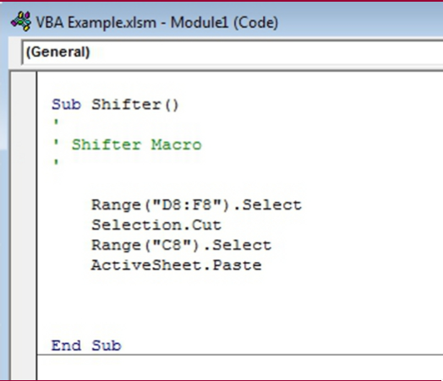
Shifting Repeatedly
So, we add a line before the loop where we declare our variable RowNum.
Sub ShifterLoop
Dim RowNum As Integer
For RowNum=6 To 18 Step 1
Call ShiftOneColumn(RowNum)
Next RowNum
End Sub

Slide 22
Checking If First Column is Empty
We need to check whether the ﬁrst column of a row is empty or not.
VBA’s conditional statement IF-THEN-ELSE allows us to achieve this
goal.
IF-THEN-ELSE Syntax
If test_cond Then
...
CODE BLOCK executed if test_cond holds
...
Else
...
CODE BLOCK executed if test_cond fails
...
End If

Slide 23
A Function to Check the First Column
We could write our conditional statement to check the ﬁrst column
within the subroutine, but we will deﬁne a separate “Function” for
the checking task.
Functions are very similar to the subroutines. Then, why a function?
◦ Unlike a subroutine, but Functions return a value.
◦ Useful for reporting the result of a calculation or other results.
◦ Our function will return…
1 if the ﬁrst column is empty
0 otherwise.

Slide 24
More on Functions vs. Subroutines
Functions are not always the right choice:
◦ A function cannot directly write data back to the spreadsheet.
◦ We can write data to the spreadsheet via subroutines. Easiest way:
How to write data to cells
Cells(row_num,col_num).Value= x
◦ e.g., Cells(10,3).Value= "Ducks Rock" writes Ducks Rock to the cell
C10. (Try it!)
◦ In this example, our function doesn’t need to change the value of cell, but our function does return a value.

Slide 25
A Function to Check the First Column
Let’s go back to our task: Creating a function to check the ﬁrst column.
We name our function as CheckColOne.
What is our input argument? Row Number.
Function to check the ﬁrst column
Function CheckColOne (RowNum as Integer)
If Cells(RowNum,3).Value="" Then
CheckColOne=1
Else
CheckColOne=0
End If
End Function
How do we check if the ﬁrst column is empty?
◦
◦
◦
◦
We can use Cells(row_num,col_num).Value. Then, check whether it is empty.
We know the row number: It’s our input argument, RowNum.
The column number is 3 since the ﬁrst column of data is in Column C.
So, our test condition is if Cells(RowNum,3).Value="".

Slide 26
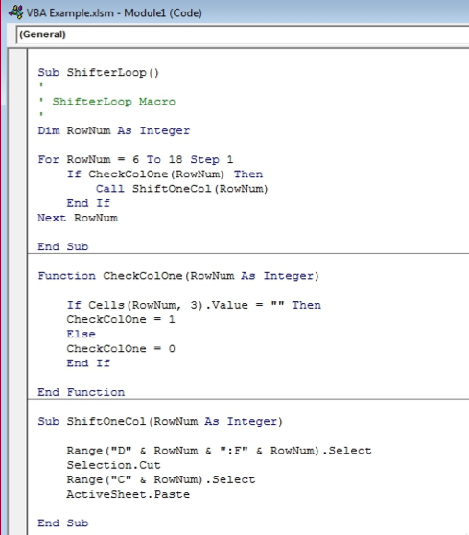
Using the Check Function in the Main Subroutine
Sub ShifterLoop ()
Dim RowNum As Integer
For RowNum=6 To 18 Step 1
If CheckColOne(RowNum) Then
Call ShiftOneColumn(RowNum)
End If
Next RowNum
End Sub

Slide 27
Practice: Extending our program
How would we extend our program if we wanted to have the program highlight each moved row with a yellow background?
Remember the approach most business people using VBA take:
Perform “Macro Recording” to start
Use/modify the resulting code

