Slide 1
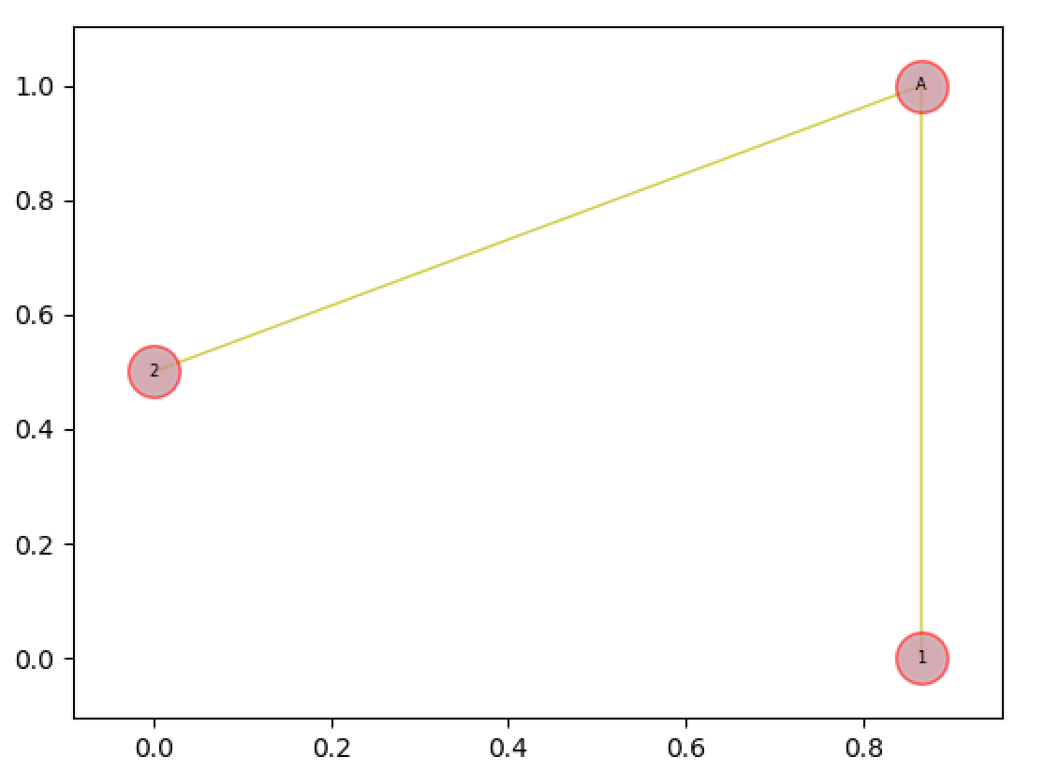
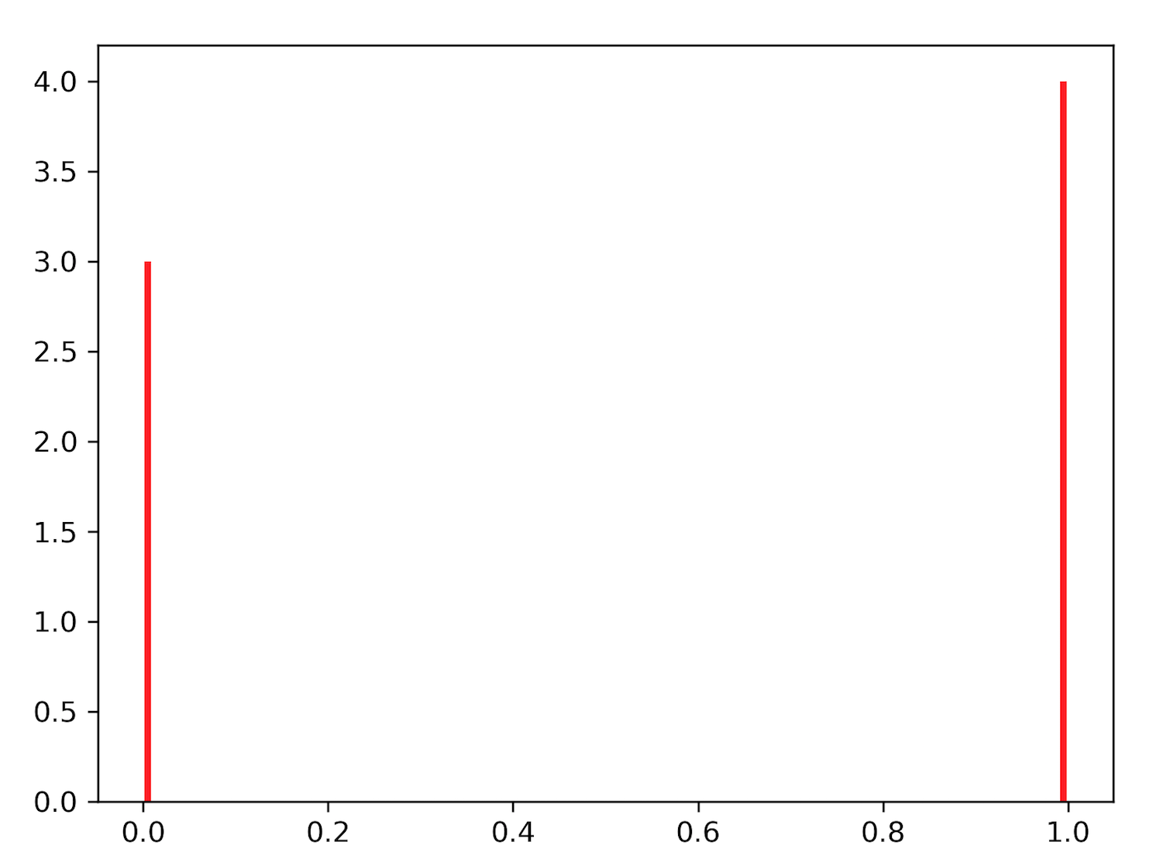
Seeds: A 1.0, B 1.0 Nodes: A-1 0.99,A-2 10^E-05 solve_diffusion_eqn (tol = 0.00001)
{'A': OrderedDict([('A', [1.0, 1]), ('1', [0.9999999999990709, 0]), ('2', [0.9999999999990626, 0])]), 'B': OrderedDict([('B', [1.0, 1]), ('A', [0.0, 0]), ('1', [0.0, 0]), ('2', [0.0, 0])])}
Notes:
Dummy 1

Slide 2
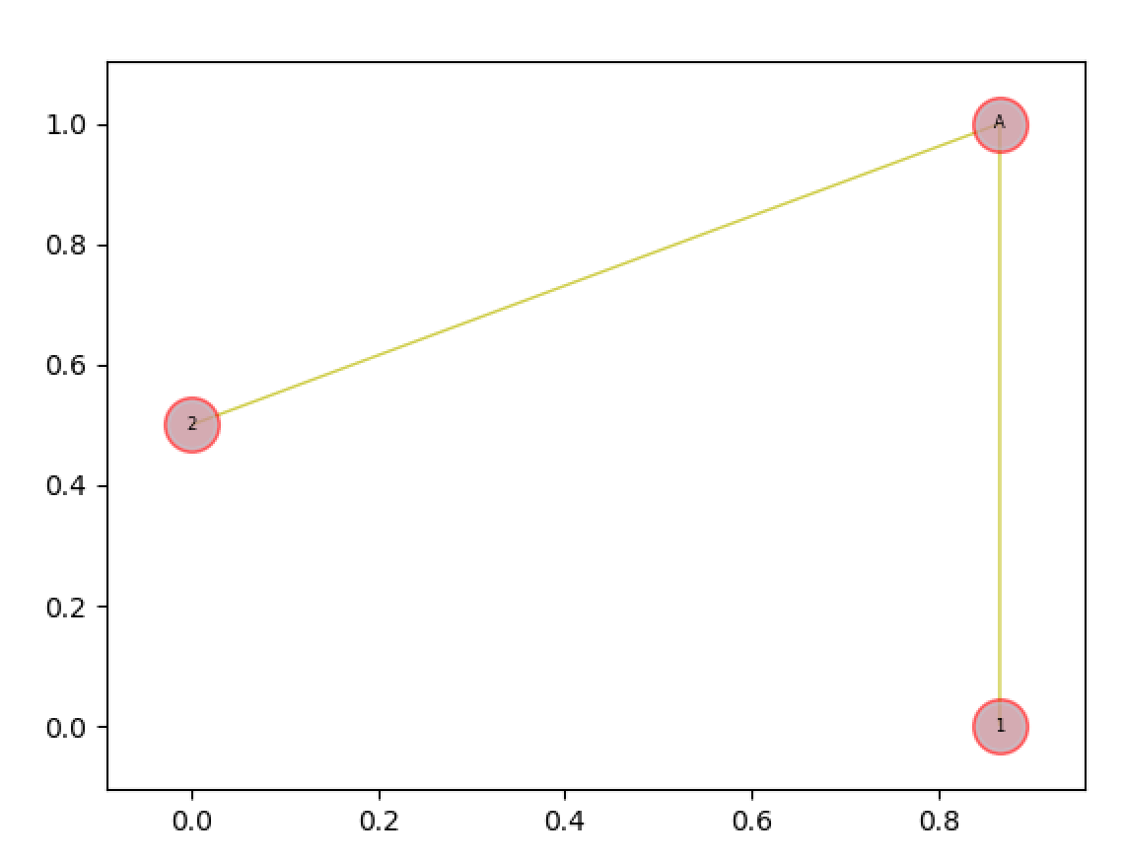
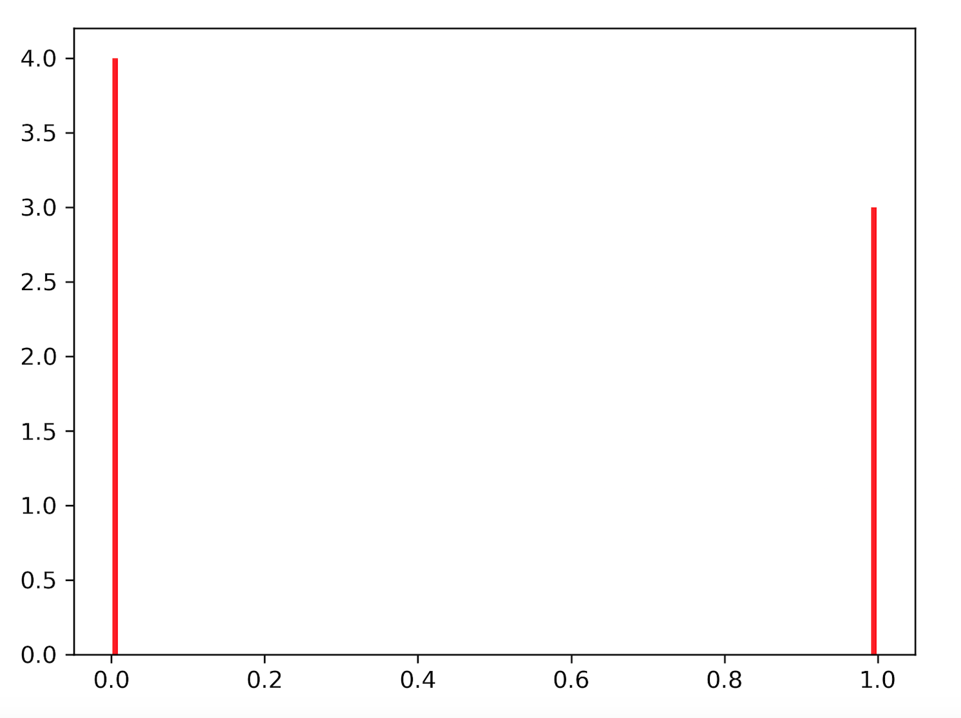
Seeds: A 1.0, B 1.0 Nodes: A-1 0.99,A-2 10^E-05 solve_diffusion_eqn (tol = 0.01)
{'A': OrderedDict([('A', [1.0, 1]), ('1', [1.0000000000000009, 0]), ('2', [1.010101010101011e-05, 0])]), 'B': OrderedDict([('B', [1.0, 1]), ('A', [0.0, 0]), ('1', [0.0, 0]), ('2', [0.0, 0])])}
Notes:
Dummy 1

Slide 3
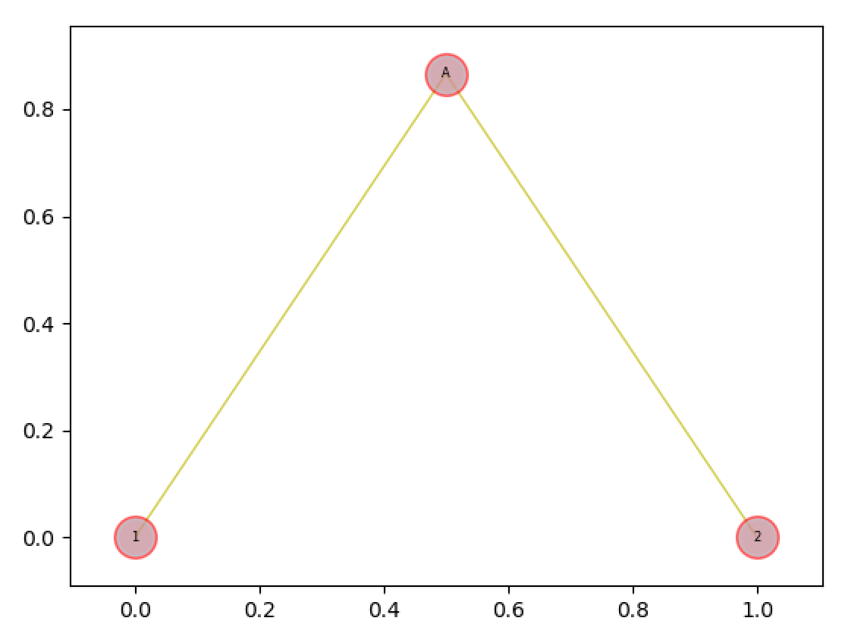
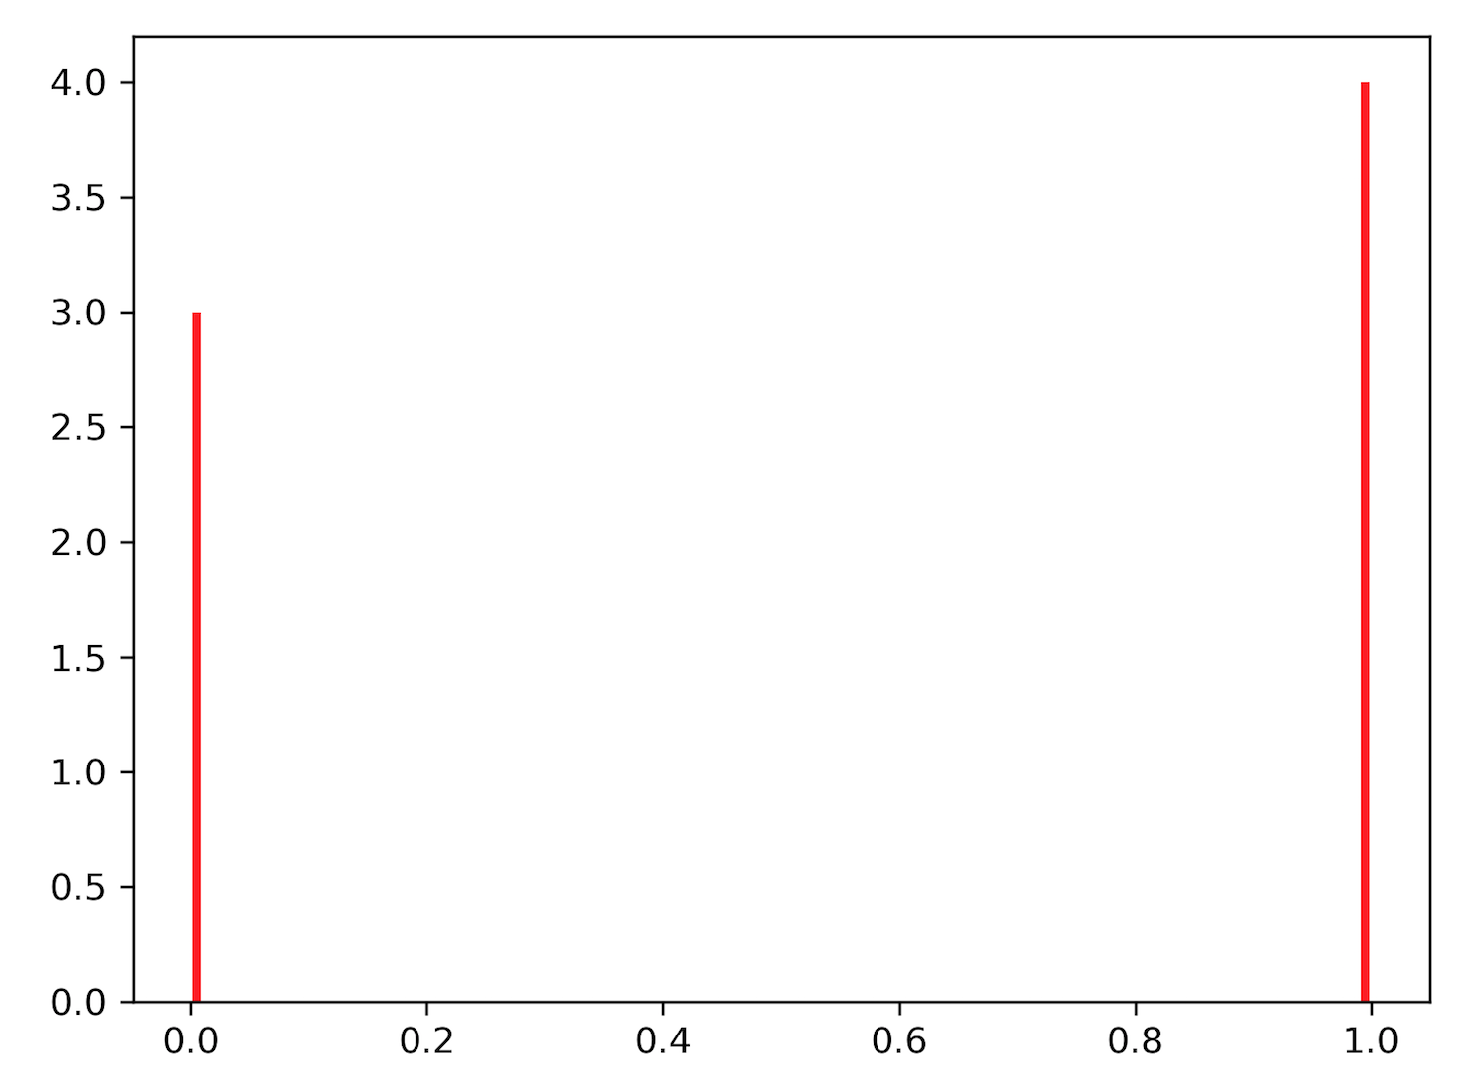
Seeds: A 1.0, B 1.0 Nodes: A-1 0.99,A-2 0.99 solve_diffusion_eqn (tol = 0.01)
{'A': OrderedDict([('A', [1.0, 1]), ('1', [0.9999999999999999, 0]), ('2', [0.9999999999999999, 0])]), 'B': OrderedDict([('B', [1.0, 1]), ('A', [0.0, 0]), ('1', [0.0, 0]), ('2', [0.0, 0])])}
Notes:
Dummy 2

Slide 4
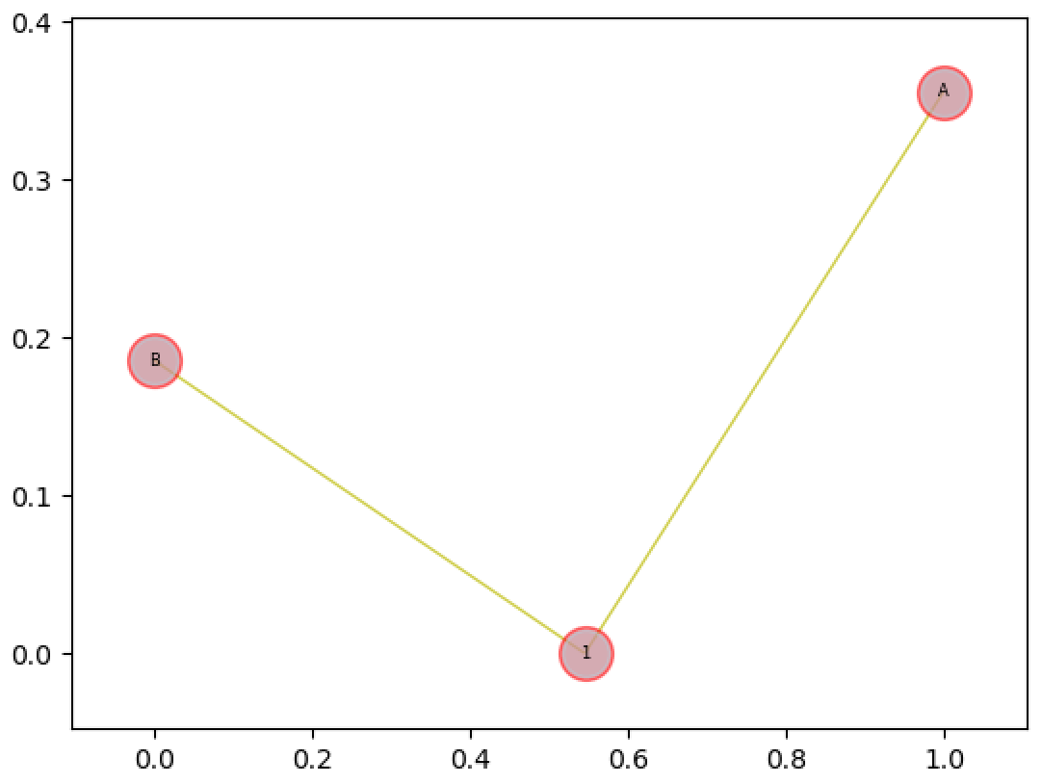
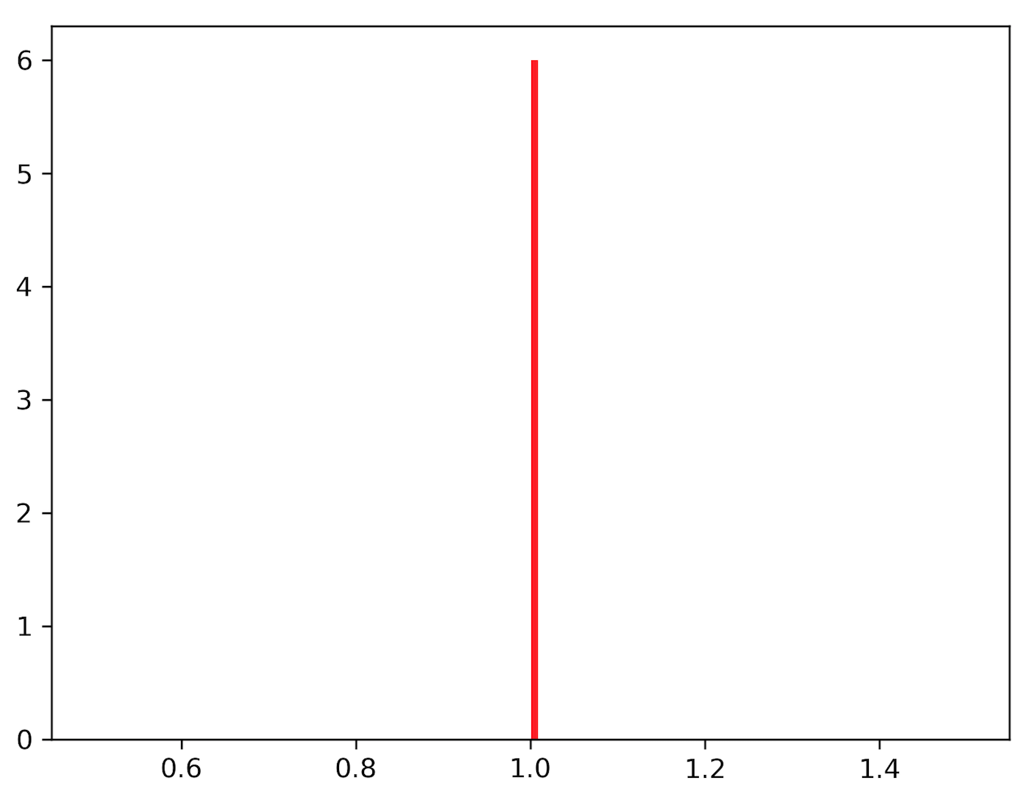
Seeds: A 1.0, B 1.0 solve_diffusion_eqn (tol = 0.01)
{'A': OrderedDict([('A', [1.0, 1]), ('1', [1.0, 0]), ('B', [1.0, 0])]), 'B': OrderedDict([('B', [1.0, 1]), ('A', [1.0, 0]), ('1', [1.0, 0])])}
A 1 0.99
B 1 0.99
Notes:
Dummy 3
spring_pos = nx.spring_layout(H, dim=2, k=None, pos=None, fixed=None, iterations=50, weight='weight', scale=1.0, center=None)

Slide 5
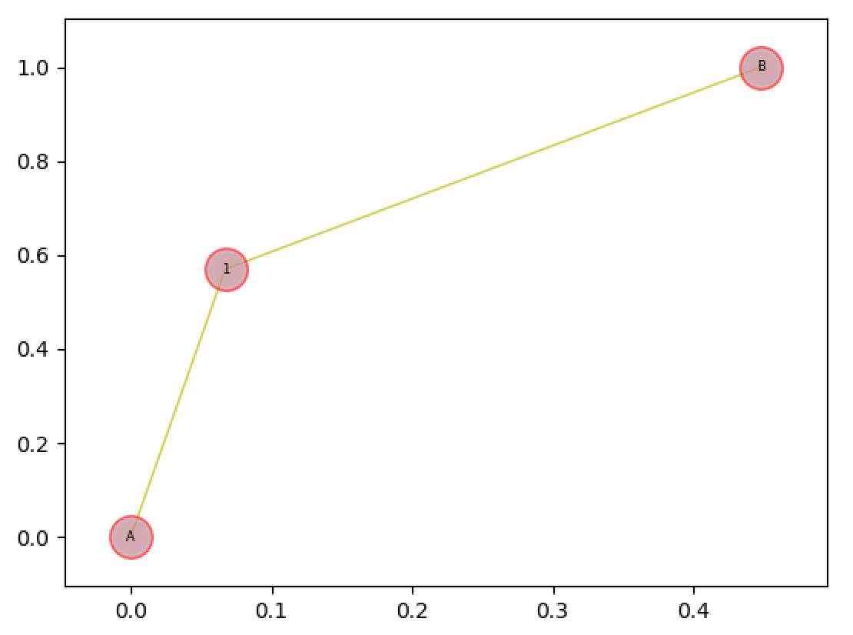
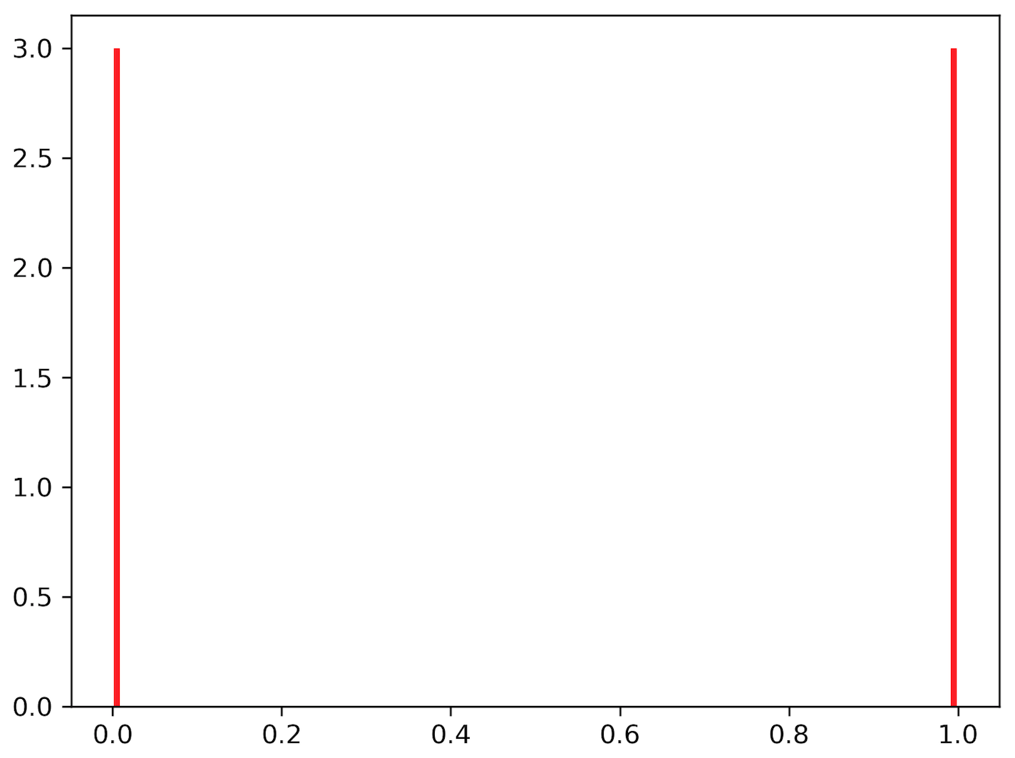
Seeds: A 1.0, B 10E-05 solve_diffusion_eqn (tol = 0.01)
A 1 0.99
B 1 0.99
{'A': OrderedDict([('A', [1.0, 1]), ('1', [1.0, 0]), ('B', [1.0, 0])]), 'B': OrderedDict([('B', [1e-05, 1]), ('A', [9.999999999999997e-06, 0]), ('1', [9.999999999999999e-06, 0])])}
Notes:
Dummy 4
spring_pos = nx.spring_layout(H, dim=2, k=None, pos=None, fixed=None, iterations=50, weight='weight', scale=1.0, center=None)
Turns out seed value is not hard coded to 1.

Slide 6
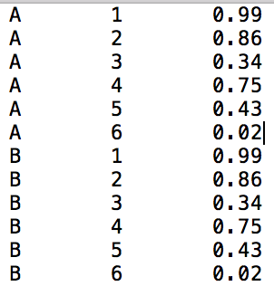
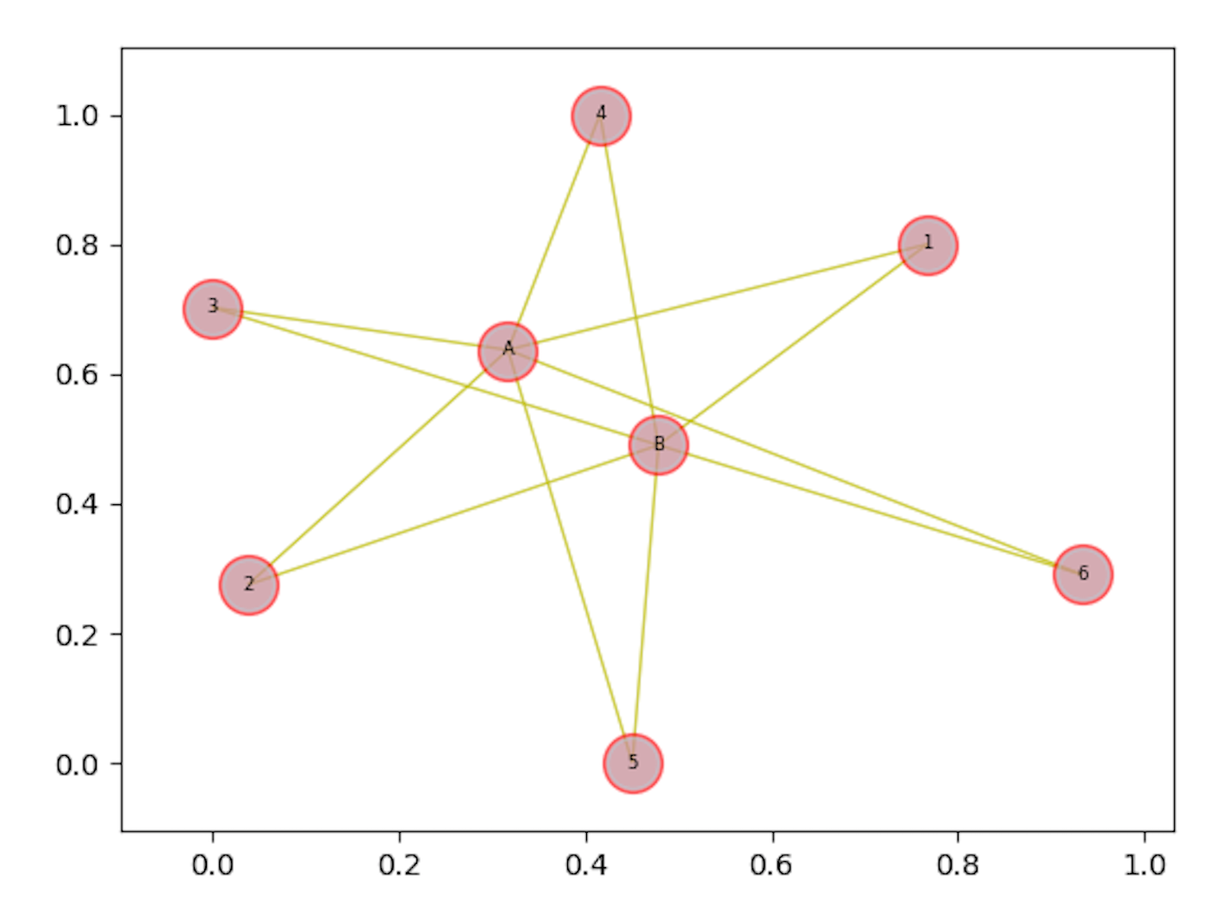
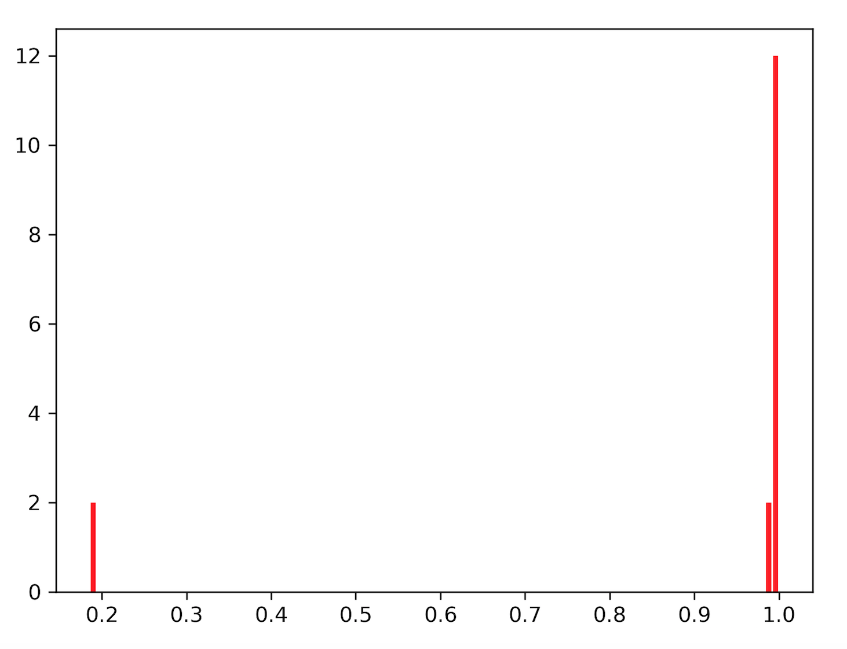
Seeds: A 1.0, B 1.0 solve_diffusion_eqn (tol = 0.01)
{'A': OrderedDict([('A', [1.0, 1]), ('B', [0.990215549310885, 0]), ('1', [0.9951401049860942, 0]), ('3', [0.9988396279511981, 0]), ('2', [0.9944258792648063, 0]), ('5', [0.9919796891883057, 0]), ('4', [0.9958385890143236, 0]), ('6', [0.1856858082089944, 0])]), 'B': OrderedDict([('B', [1.0, 1]), ('A', [0.990215549310885, 0]), ('1', [0.9951401049860942, 0]), ('3', [0.9988396279511981, 0]), ('2', [0.9944258792648063, 0]), ('5', [0.9919796891883057, 0]), ('4', [0.9958385890143236, 0]), ('6', [0.1856858082089944, 0])])}
Notes:
Dummy 5
spring_pos = nx.spring_layout(H, dim=2, k=None, pos=None, fixed=None, iterations=50, weight='weight', scale=1.0, center=None)

Slide 7
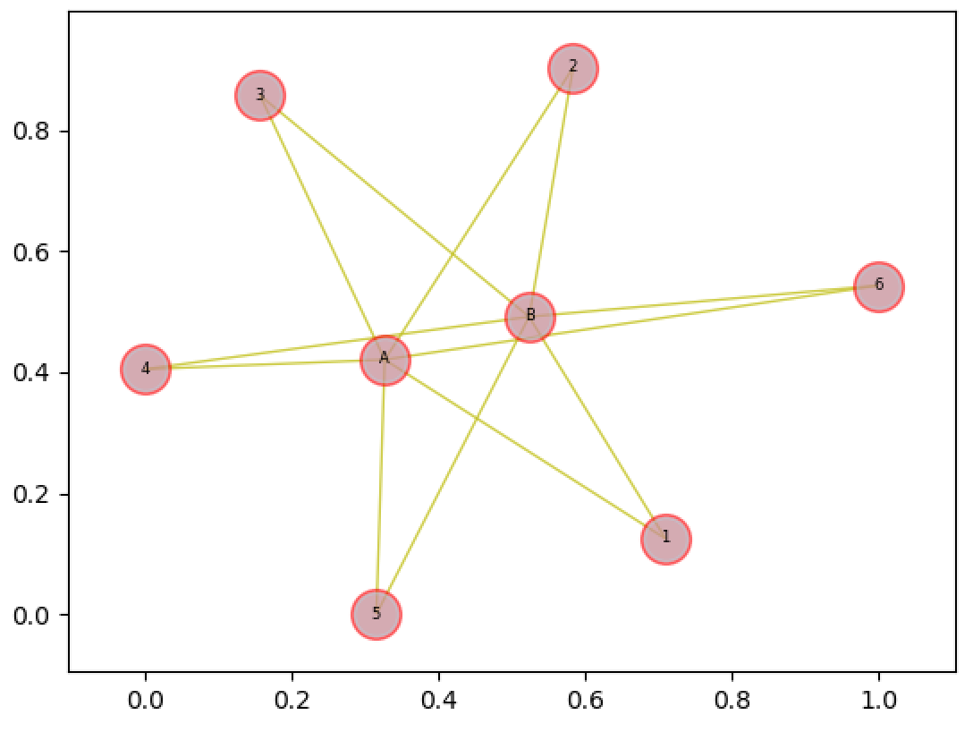
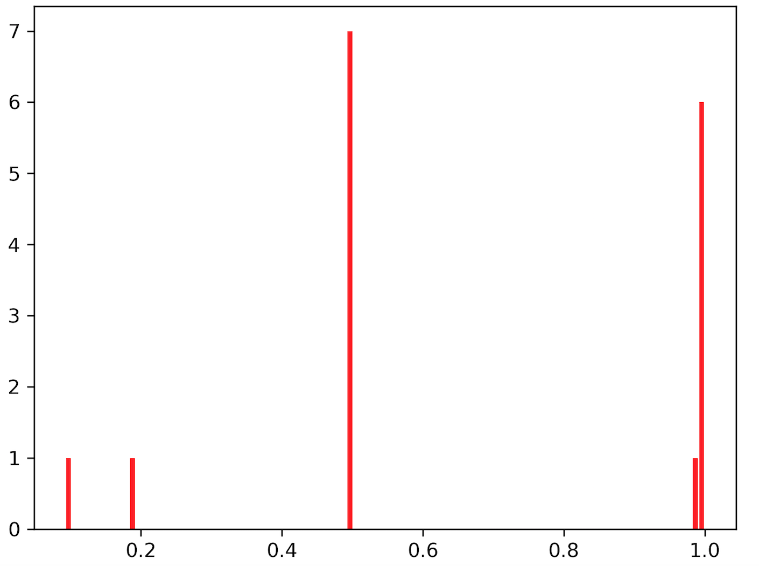
Seeds: A 1.0, B 0.5 solve_diffusion_eqn (tol = 0.01)
{'A': OrderedDict([('A', [1.0, 1]), ('B', [0.990215549310885, 0]), ('1', [0.9951401049860942, 0]), ('3', [0.9988396279511981, 0]), ('2', [0.9944258792648063, 0]), ('5', [0.9919796891883057, 0]), ('4', [0.9958385890143236, 0]), ('6', [0.1856858082089944, 0])]), 'B': OrderedDict([('B', [0.5, 1]), ('A', [0.4951077746554425, 0]), ('1', [0.4975700524930471, 0]), ('3', [0.49941981397559904, 0]), ('2', [0.49721293963240315, 0]), ('5', [0.49598984459415285, 0]), ('4', [0.4979192945071618, 0]), ('6', [0.0928429041044972, 0])])}
Notes:
Dummy 6
spring_pos = nx.spring_layout(H, dim=2, k=None, pos=None, fixed=None, iterations=50, weight='weight', scale=1.0, center=None)
Turns out seed value is not hard coded to 1.

Slide 8
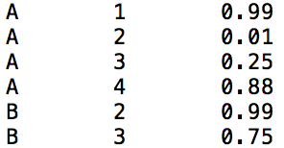
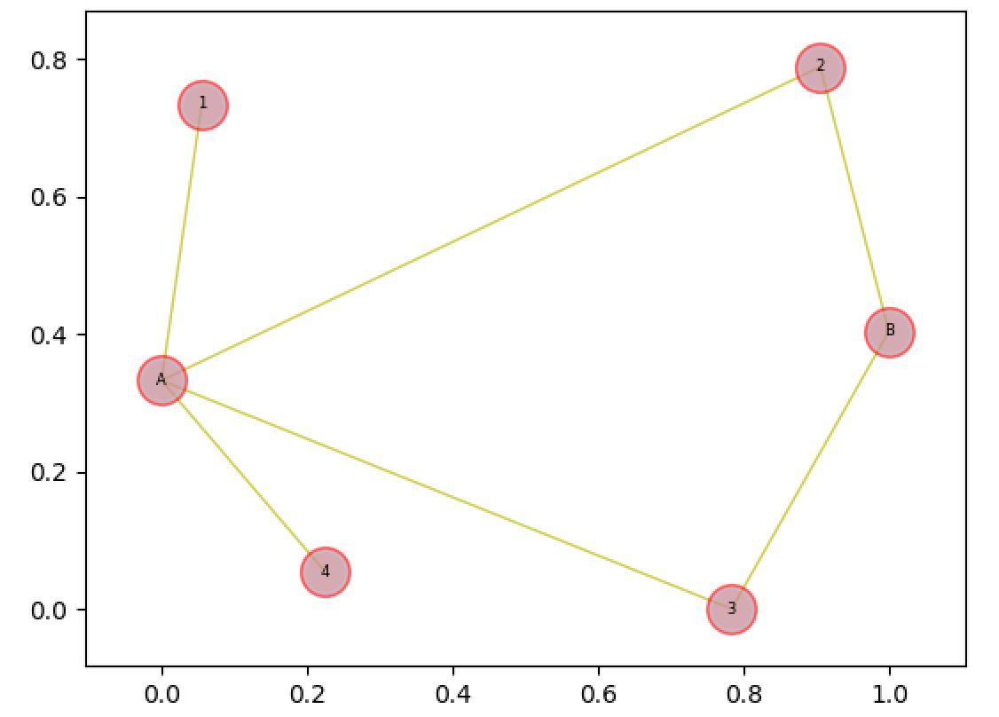
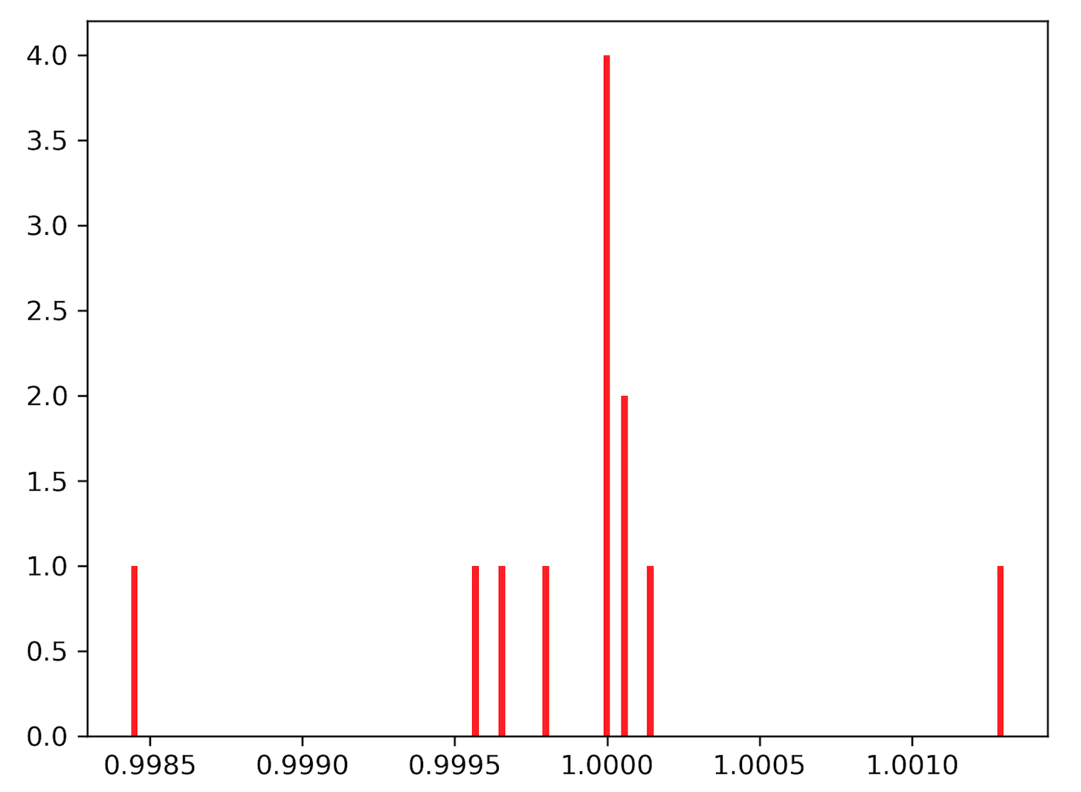
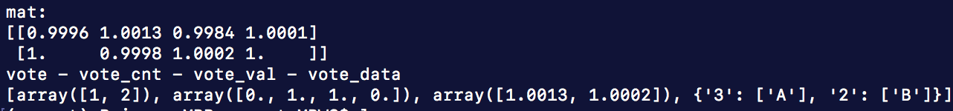
Voting Modules
Seeds: A 1.0, B 1.0 solve_diffusion_eqn (tol = 0.01)
Notes:
Dummy 7
Diffusion scores go over 1.
Too many “_ does not exist in the diffusion field.” warnings

Slide 9
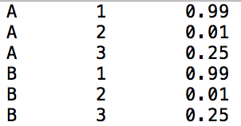
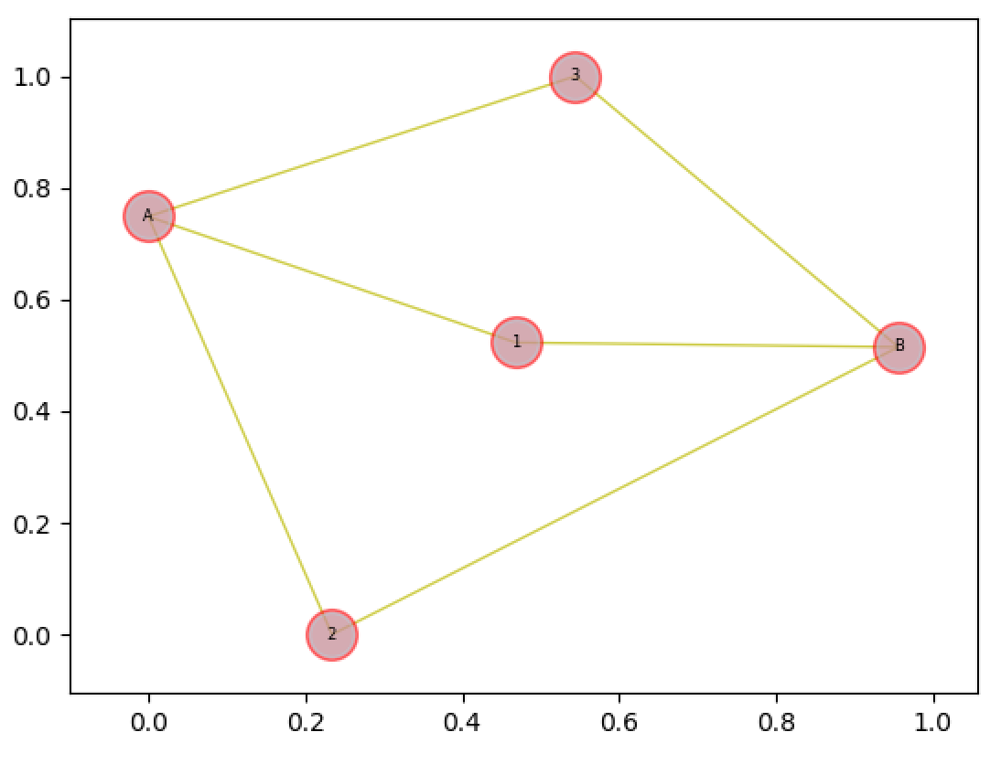
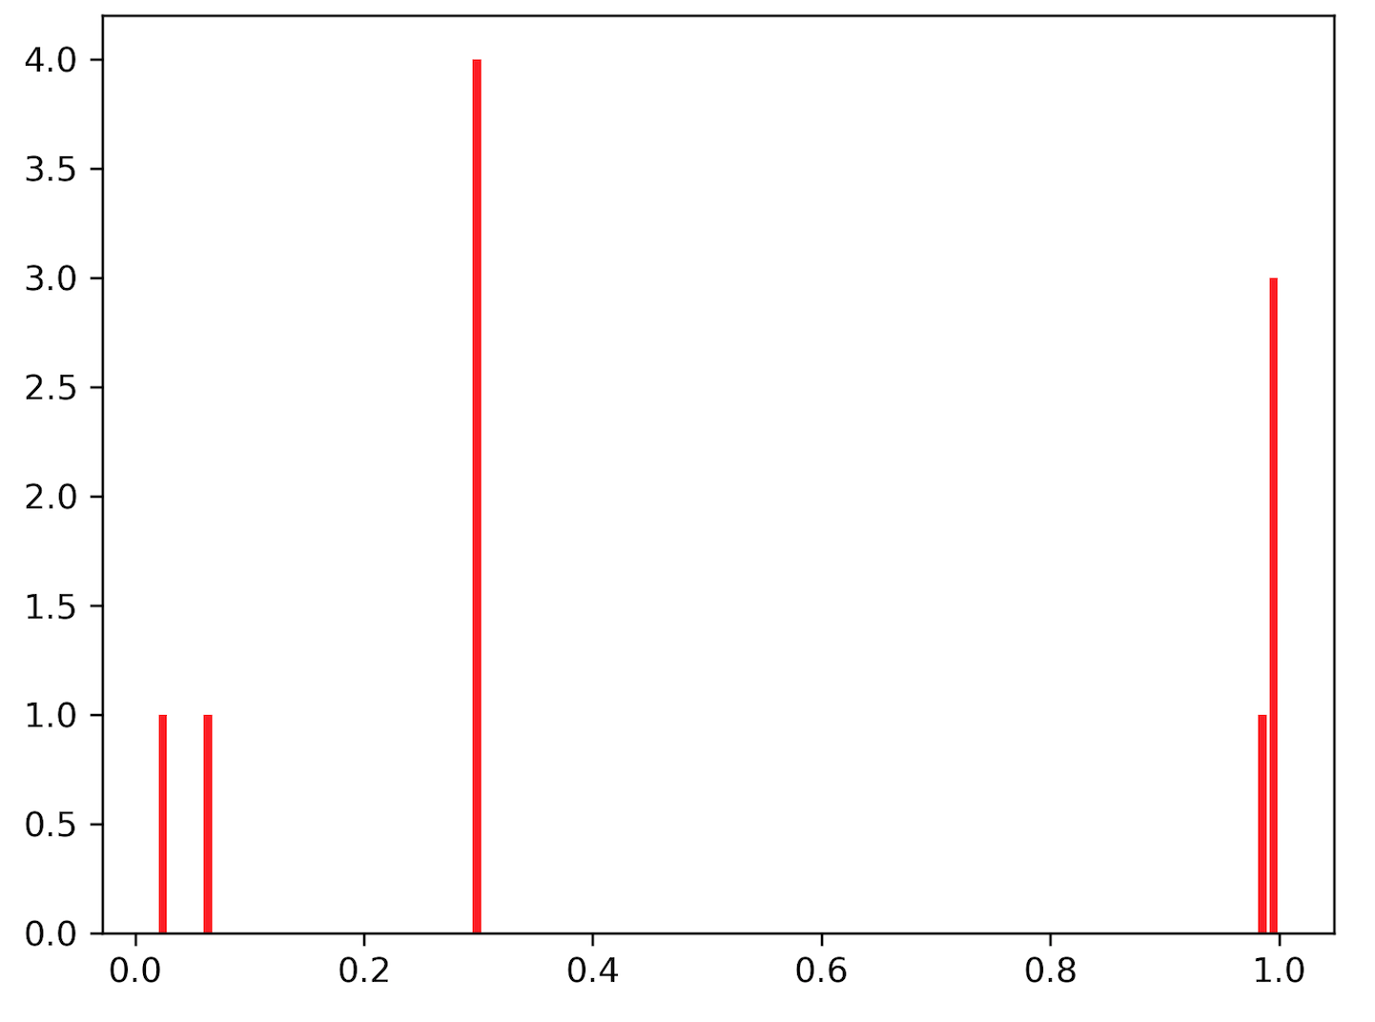
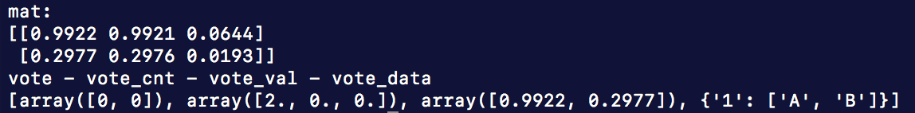
Voting Modules
Seeds: A 1.0, B 0.3 solve_diffusion_eqn (tol = 0.1)
Notes:
Dummy 8
Same targets, different seed scores. As expected, non-seed 1 gets the highest vote (highest diffusion scores from A and B separately)

