Slide 1
Adoption is everyone’s business
London Adoption Board Conference
Thursday 18th June 2015
Anthony Douglas CBE
Chief Executive, Cafcass
Chair, BAAF

Slide 2
Why is adoption everyone’s business?
A show of hands
Over one million people in the UK today are adopted. It is a mass movement, an invisible and unconnected network
The Placement Order cliff means that some of the most vulnerable children in the country are getting a raw deal
Attachments, identity and mental health matter to all of us
Permanence is a personal construct and needs to be in the mainstream vocabulary
Non-consensual adoption has always been a political issue – and it is a social issue to raise public awareness about, as the needs of children are becoming obscured in the politicisation of adoption

Slide 3
What’s happening now nationally?
At least 4000 children are waiting for adoption, despite record numbers of new adopters having been recruited
The record numbers have not radically increased the number of children placed
Around 1450 children have had their adoption plans changed in the last year – ADM and judicial caution?
More efforts are going into children staying at home or living in kinship care, than being placed permanently outside of their families
Despite some ground-breaking services like Adoption Activity Days, and despite good matching and ‘stretching’ work, it remains hard to place some children, especially boys, and in London, BME children (this is the 1970’s revisited)
Permanence Orders (as in Scotland?); or assessing carers for permanence first, and legal status (of the placement) second

Slide 4
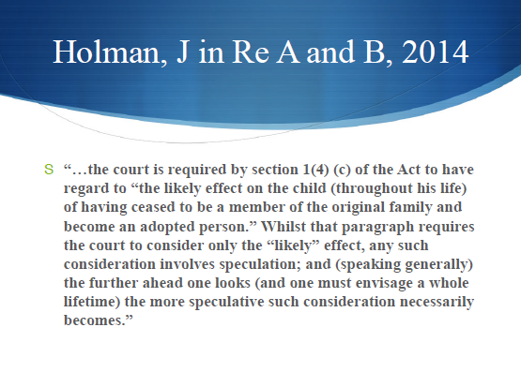
The shelf life of assessments
Holman, J in Re A and B, 2014

Slide 5
THE ADOPTION REFORM PROGRAMME

Slide 6
OBJECTIVE 1: Ensuring all children with a robust and well evidenced adoption care plan are adopted
Where are we? There were a record number of adoptions in 2013-14 - 5,050, a 63% increase since 2010-11. A big part of this is thanks to the strides made in adopter recruitment, which was the biggest constraint on adoption, and now is not.
What has been done?
1. Clear leadership and priority locally and nationally
2. Greater transparency and sharpened accountability - quarterly data collection, local authority (LA) scorecards, and changes to the Ofsted framework.
3. The Adoption Leadership Board has been established to drive sector-led improvement across the system.
4. Adoption Reform Grant - £150m in 2012-13, and £50m in 2013-14; and VAA booster package - £16m
5. First4Adoption national information service established – accessed by over 250 000 people in first 18 months of operation
6. Introduced a two stage approval process for adopter approval to reduce unnecessary delays
7. Invested in the evidence base re: what adopter recruitment marketing is most effective

Slide 7
OBJECTIVE 2: Removing unnecessary delay from the system
The average length of time between entry to care and adoption order was down two months between 2012-13 and 2013-14. Latest quarterly data shows this improving trajectory is continuing. The number of children completing the process within a year has increased from 19% in 2012-13 to 27% in 2014-15. But there is still a long way to go – the whole journey still takes an average of 2 years 4 months.
What has been done?
1. Supporting local authority practice – scorecards, thresholds, interventions in 45 authorities, including brokering improvement support
2. Reforming the family justice system – as a result, standard care case duration down to 29.9 weeks from 56 weeks when the Family Justice Review reported in November 2011
2. Reforms that allow matching to be more adopter-led (Activity Days, Exchange Days, reforms to the national Adoption Register) – latest figures show activity days are achieving a 26% match rate, with one recent event achieving 40%
3. Reforms that focus on bringing in adopters for the children still waiting - £16million VAA booster package has been refocused in 2015-16 to incentivise the approval of parents who can meet the needs of children waiting.

Slide 8
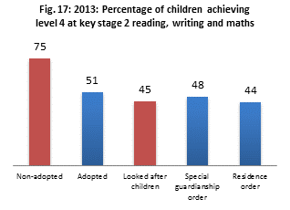
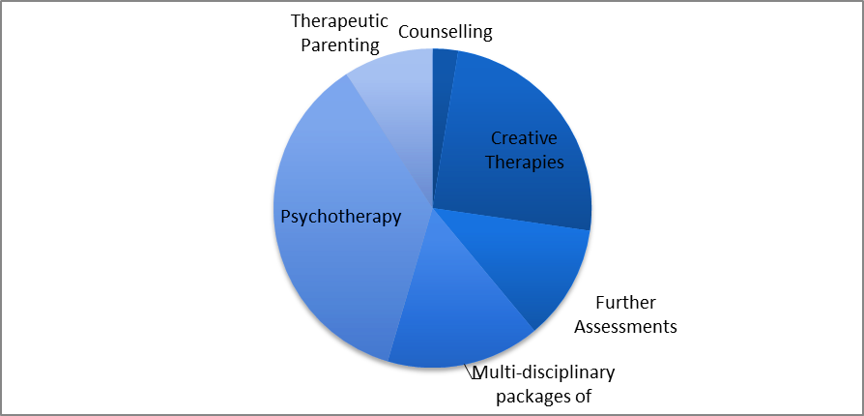
OBJECTIVE 3: Improving support to adopters and adopted children
Reforms are in place to remove the cliff edge between care and adoption, including enhanced support in early years and education. The foundations have been laid for improved access to specialist adoption support through the testing of the Adoption Support Fund which will be fully launched in May 2015.
What has been done?
1. Published the Adoption Passport setting out adopters’ entitlements .
2. Introduced the Pupil Premium, priority school admissions and 2 year old offer for children adopted from care. Early Years Pupil Premium will also apply.
3. Piloted the Adoption Support Fund in ten LAs and developed the national model for rollout in May to ensure therapeutic services are more easily accessible to adoptive parents.
4. Delivered £980,000 to 3 VCS organisations to deliver and evaluate adoption support services.
5. Tested a new assessment of need tool in LAs and delivered training to 350 social workers on adoption support .
6. Equalised pay and leave with that of birth parents (from April 2015).
Types of services funded through the Adoption Support Fund in 10 pilot LAs
3.2%
National adoption disruption rate
Creative therapies
25%
Psychotherapy
Adoptive parents reporting major challenges at home

Slide 9
CURRENT CHALLENGES
Ensuring children with a robust adoption care plan are adopted
We have seen a significant decrease in adoption decisions over the last 18 months, in response to recent court judgments
Removing unnecessary delay from the system
Children still wait too long for adoption in many authorities - the whole journey still takes an average of 2 years 4 months, and the time between placement order and match is not improving as much as the first part of the journey
Improving support to adopted children and adopters
The adoption support market is underdeveloped and needs to expand rapidly
The slow down in children entering the system means there is now a small surplus of adopters
The Regional Adoption Boards are new and need time to bed in
The slow down in children coming into the system has exposed an ongoing problem with matching, particularly for harder to place children. Despite having more than enough adopters, 3 470 children still wait for adoption. Raises questions about system structure
The evidence base on the veracity of adoption support interventions is underdeveloped

Slide 10
Current legal cases…

Slide 11
Re R (A Child) [2014] EWCA Civ 1625
The president set the record straight about the interpretation of Re B-S and confirmed that there had been no intention to put a gloss on what the statute says, which is that the court has to consider the child’s welfare throughout his life as paramount before making an adoption order. The court would not expect every option on the spectrum between no order and adoption to be considered but all those which are realistically possible. And an adoption order must be the only option before it is made.

Slide 12
A and B v Rotherham Metropolitan Borough Council - [2014] All ER (D) 86 (Dec)
Adoption application refused on the basis of the child’s lifelong welfare. The facts were that a child was placed for adoption at 7 months of age. Then a father turned up and said he wanted his sister assessed as carer . The sister had a very positive assessment from an ISW and the judge decided he had to consider the child's life long welfare and it was better to remove the child from the adopters where he had settled and bonded and place him with a family member and exchange short term pain for long term gain.

Slide 13
Re P [2014] EWCA Civ 1174
The high hurdle of nothing else will do was not appropriate in an application for adoption from a step parent as the level of interference in family life is not as significant and the order reflected the commitment of the step father to being a life long parent, and the children both expressed a wish for the order to be made.

Slide 14
Re A (Children) [2013] EWCA Civ 1611
A judgement was overturned when the first instance judge concluded that adoption was NOT in the best interests of the children unless certain conditions were fulfilled, and the Court of Appeal concluded that this was not a lawful order. The initial court had crossed the line between what was the responsibility of the court and that of the local authority. The courts job was to establish whether adoption was in the interests of the child and it could not attach conditions.

Slide 15
Re B-S [2013] EWCA Civ 1146
The Court of Appeal reminded everyone of the fact that adoption was a draconian order, and confirmed the need for practitioners (social workers, guardians and judges) to undertake full analytical assessments of evidence before coming to a conclusion, ensuring that the orders made are the only reasonable option for a child, and that all other options for permanence had been explored and assessed before being rejected.

Slide 16
Re B [2013] SC 33
Supreme Court case in which the court set out the salient points for the courts to consider before making Adoption Orders
The child’s interests include being brought up by the natural family unless overriding requirements make that not possible
The court must consider all the options before coming to a decision
The court’s assessment of the parents must take into account the assistance and support the local authority can provide.

Slide 17
Shall we be half-full or half-empty?
Half full | Half empty
It’s great for children to have options | Late or rushed SGO assessments, leading to placements which will break down
Restorative parenting by adopters | Non-consensual adoption

Slide 18
Adoption is everyone’s business
London Adoption Board Conference
Thursday 18th June 2015
Anthony Douglas CBE
Chief Executive, Cafcass
Chair, BAAF

