Slide 1
Reopening West Berkshire town centres

Slide 2
Guidance
Social distancing guidance is likely to be in force for some time
Non-essential retailers will be allowed to re-open from 15th June
Hospitality businesses and others services, such as personal care, will be allowed to re-open from 4th July (estimated)

Slide 3

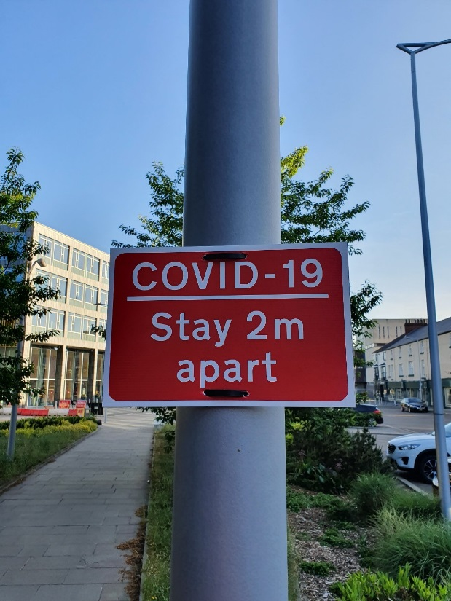
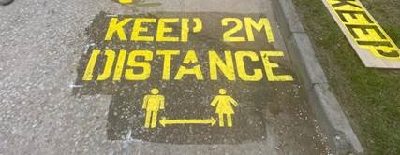
New signage in town centres

Slide 4
Newbury
Town centre pedestrianisation
Considering a range of active travel measures.
Cycle lanes/walking routes
Cycle parking
Market Place – looking at how we can be more creative with the use of space
Considering how we can streamline table and chair application process.
Working with the BID to manage the Town Centre space

Slide 5
Hungerford
Progress is being made of the following temporary measures:
Parking bay suspensions to provide passing places for pedestrians on narrow footways and queuing areas outside shops
Social distancing signage
Potential areas for additional outdoor seating for dining etc
Additional cycle parking

Slide 6
Thatcham
Additional signage for social distancing
Crown Mead: introducing one-way system to provide more space for queuing outside Chemist
Temporary reduction in carriageway width in Broadway to allow Market to expand
Parking bay suspensions to provide passing places for pedestrians on narrow footways and queuing areas outside shops
Additional cycle parking

Slide 7
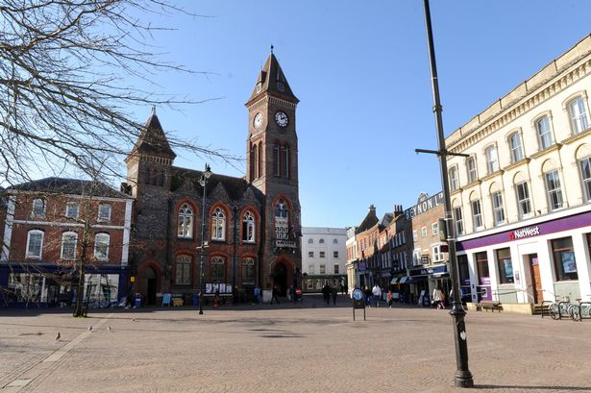
Tables and chairs
Any requests should go to trafficandroadsafety@westberks.gov.uk

Slide 8
How we have been supporting local businesses
All business rates deferred for April and May
Almost £27m of grant funding allocated to eligible local businesses
A further £1.225m in discretionary funding is currently being distributed
Detailed advice and guidance made available on our website
Fully-funded business advice available through Berkshire Growth Hub

Slide 9
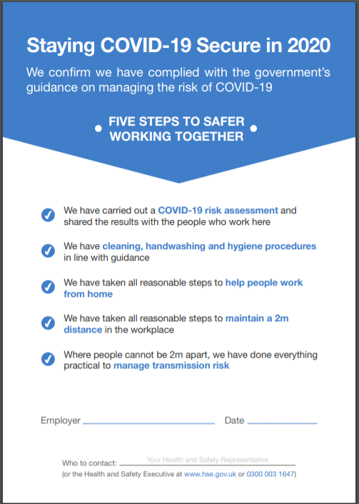
5 steps to working safely
Carry out a Covid-19 risk assessment
Develop cleaning, handwashing and hygiene procedures
Help people to work from home where possible
Maintain 2m social distancing where possible
Where people cannot be 2m apart, manage transmission risk

Slide 10
Re-Opening Town Centres Safely Fund
Development of an action plan for how the local authority may begin to safely reopen their local economies.
Communications and public information activity to ensure that reopening of local economies can be managed successfully and safely.
Business-facing awareness raising activities to ensure that reopening of local economies can be managed successfully and safely.
Temporary public realm changes to ensure that reopening of local economies can be managed successfully and safely.

Slide 11
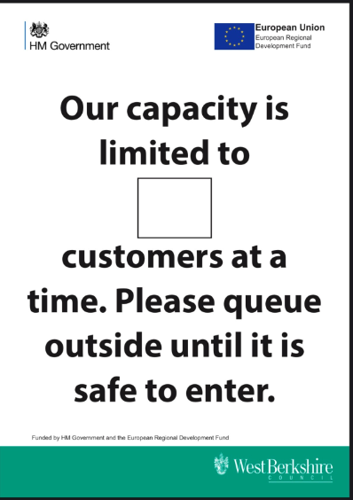


Signage available for businesses

Slide 12
Plans so far
Poster printing and distribution
Advice booklet
Bringing in a town centre administrator
Ongoing support through Berkshire Growth Hub

Slide 13
Public Protection Partnership
Environmental Health – Health & Safety including Covid19 advice compliance
Environmental Health - Food Safety
Trading Standards – Covid19 Business Restrictions
Licensing – interface between licensing and other controls e.g. off sales of alcohol, licensed areas etc

Slide 14
PPP- Further information
Telephone advice - 01635-519930
Advisory visits
Social media updates
www.publicprotectionpartnership.org.uk/covid-19/
Report concerns regarding compliance failings

Slide 15

Any questions?

Slide 16
Next steps
If you have further questions or are in need of support you can contact:
trafficandroadsafety@westberks.gov.uk
gabrielle.mancini@westberks.gov.uk
www.publicprotectionpartnership.org.uk/covid-19/

Slide 17

Thank you!

