Slide 1

Introduction to RDM & Data Management Plans
Sarah Jones
Digital Curation Centre, Glasgow
sarah.jones@glasgow.ac.uk
Twitter: @sjDCC
CODATA Research Data Science School, 9 August 2018, Trieste #DataTrieste

Slide 2
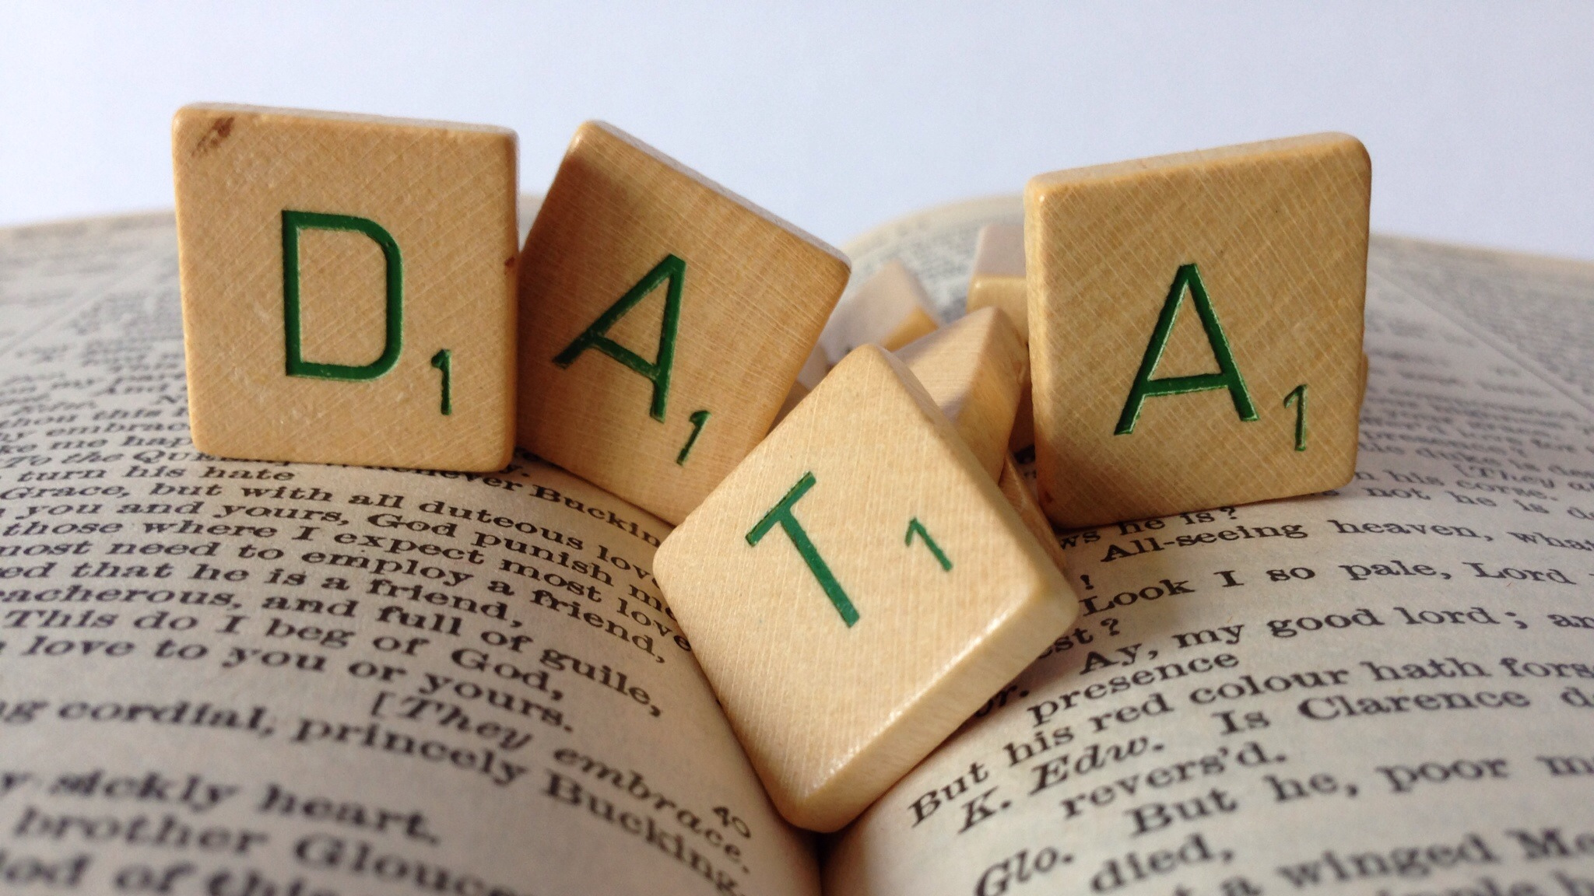
What is RDM?
Image CC-BY-SA by Janneke Staaks www.flickr.com/photos/jannekestaaks/14411397343

Slide 3

What is Research Data Management?
“the active management and appraisal of data over the lifecycle of scholarly and scientific interest”
Create
Document
Use
Share
Preserve
Store
Data management is part of
good research practice

Slide 4
What is involved in RDM?
Data Management Planning
Data creation
Annotating / documenting data
Analysis, use, versioning
Storage and backup
Publishing papers and data
Preparing for deposit
Archiving and sharing
Licensing
Citing…
Create
Document
Use
Share
Preserve
Store

Slide 5
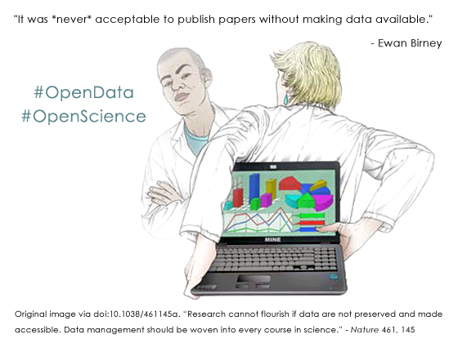
Why make data available?
Notes:
To avoid accusations of fraud or bad science
Evidence findings and enable validation of research methods
Meet codes of practice on research conduct
Many research funders worldwide now require Data Management and Sharing Plans

Slide 6
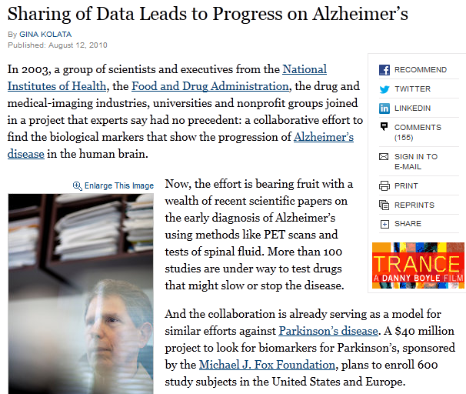
Sharing leads to breakthroughs
“It was unbelievable. Its not science the way most of us have practiced in our careers. But we all realised that we would never get biomarkers unless all of us parked our egos and intellectual property noses outside the door and agreed that all of our data would be public immediately.”
Dr John Trojanowski, University of Pennsylvania
www.nytimes.com/2010/08/13/health/research
/13alzheimer.html?pagewanted=all&_r=0
...and increases the speed of discovery
Notes:
Promote innovation and allow research in your field to advance faster
For greater visibility, impact and new research collaborations
So others can reuse and build on your data

Slide 7
Benefits for you: sharing data increases citations!
Want evidence?
Piwowar, Vision – 9% (microarray data)
Drachen, Dorch, et al – 25-40%, astronomy
Gleditch, et al – doubling to trebling (international relations)
Open Data Citation Advantage
http://sparceurope.org/open-data-citation-advantage
Notes:
To make your research easier!
Stop yourself drowning in irrelevant stuff
Make sure you can understand and reuse your data again later
Advance your career – data is growing in significance

Slide 8
What is a data management plan?
A brief plan written at the start of a project to define:
how the data will be created?
how it will be documented?
who will access it?
where it will be stored?
who will back it up?
whether (and how) it will be shared & preserved?
DMPs are often submitted as part of grant applications, but are useful whenever researchers are creating data.

Slide 9

Why write a DMP?
Non pecuniae investigationis curatore
sed vitae facimus programmas datorum procurationis
(Not for the research funder, but for life we make data management plans)
Make informed decisions to anticipate and avoid problems
Avoid duplication, data loss and security breaches
Develop procedures early on for consistency
Ensure data are accurate, complete, reliable and secure
Save time and effort to make your life easier!

Slide 10
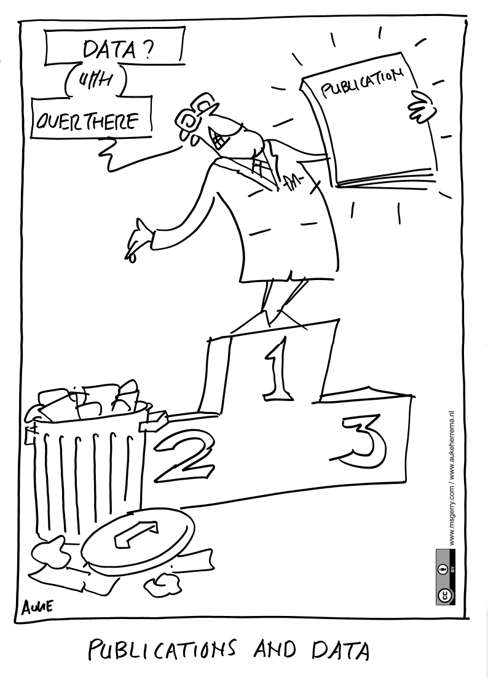
Don’t undervalue research data

Slide 11
Common themes in DMPs
Description of data to be collected / created
(i.e. content, type, format, volume...)
Standards / methodologies for data collection & management
Ethics and Intellectual Property
(highlight any restrictions on data sharing e.g. embargoes, confidentiality)
Plans for data sharing and access
(i.e. how, when, to whom)
Strategy for long-term preservation

Slide 12
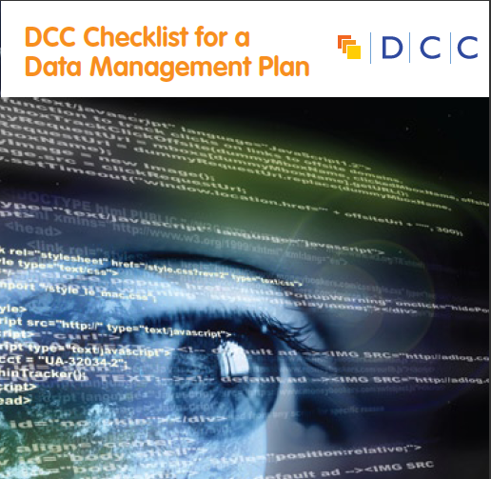
DCC Checklist for a DMP
The DCC assessed existing funder requirements, DMP templates and other best practice to see what should be included in plans. This was synthesised down into common themes and questions.
13 questions on what’s asked across the board
Prompts / pointers to help researchers get started
Guidance on how to answer
www.dcc.ac.uk/sites/default/files/documents/resource/DMP_Checklist_2013.pdf

Slide 13
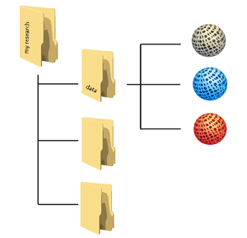

Planning trick 1: think backwards
What data organisation would a re-user like?
CREATING DATA
PROCESSING DATA
ANALYSING DATA
PRESERVING DATA
GIVING ACCESS TO DATA
RE-USING DATA
Design how you will organise data in the project (folder structure, file naming convention, …)

Slide 14
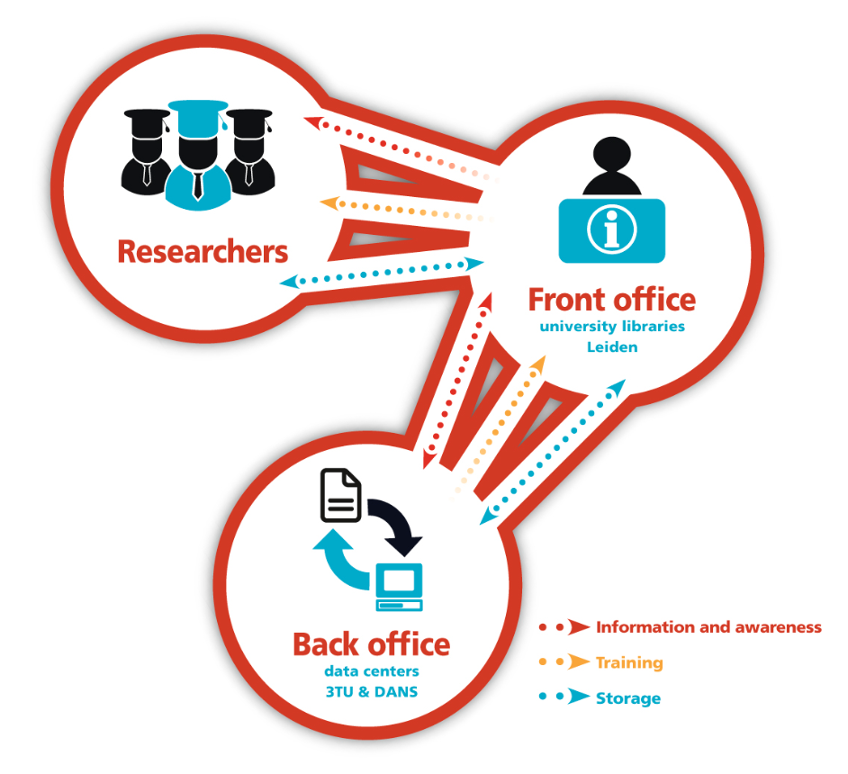



Planning trick 2: include RDM stakeholders
Commercial partners
Institution
RDM policy
Facilities
Publishers
Data Availability policy
€$£
Research funders
www.openaire.eu/briefpaper-rdm-infonoads

Slide 15


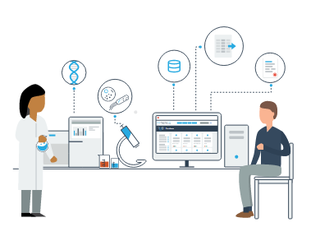
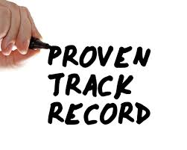
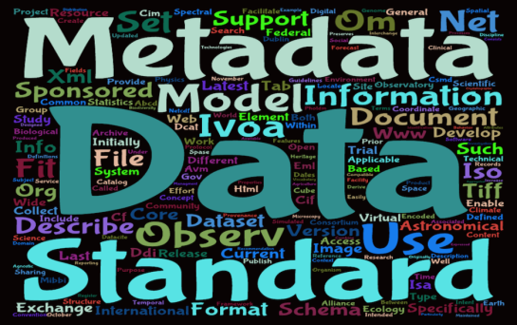
Planning trick 3: ground your plan in reality
Base plans on available skills, support and good practice for the field – show it’s feasible to implement

Slide 16
What makes a good DMP?
Clear, detailed information that is relevant to the science
adopting recognised standards
practices in line with norms for that field
use of support services e.g. university storage, subject repositories…
Proper justification of restrictions and costs
Explanation of what approach is chosen and why
Evidence of consultation and seeking advice
Have you taken time to reflect on what to do?

Slide 17
Example plans
Plans from several funders and disciplines via DCC
www.dcc.ac.uk/resources/data-management-plans/guidance-examples
108 DMPs from the National Endowment for the Humanities www.neh.gov/divisions/odh/grant-news/data-management-plans-successful-grant-applications-2011-2014-now-available
Scientific DMPs submitted to the NSF (USA) provided by DataOne
https://www.dataone.org/data-management-planning
DMPs published in RIO journal
http://riojournal.com/browse_user_collection_documents.php?collection_id=3&journal_id=17
Share yours! - www.dcc.ac.uk/share-DMPs

Slide 18
Data description examples
The final dataset will include self-reported demographic and behavioural data from interviews with the subjects and laboratory data from urine specimens provided.
From NIH data sharing statements
Every two days, we will subsample E. affinis populations growing under our treatment conditions. We will use a microscope to identify the life stage and sex of the subsampled individuals. We will document the information first in a laboratory notebook and then copy the data into an Excel spreadsheet. The Excel spreadsheet will be saved as a comma separated value (.csv) file.
From DataOne – E. affinis DMP example

Slide 19
Metadata examples
Metadata will be tagged in XML using the Data Documentation Initiative (DDI) format. The codebook will contain information on study design, sampling methodology, fieldwork, variable-level detail, and all information necessary for a secondary analyst to use the data accurately and effectively.
From ICPSR Framework for Creating a DMP
We will first document our metadata by taking careful notes in the laboratory notebook that refer to specific data files and describe all columns, units, abbreviations, and missing value identifiers. These notes will be transcribed into a .txt document that will be stored with the data file. After all of the data are collected, we will then use EML (Ecological Metadata Language) to digitize our metadata. EML is one of the accepted formats used in ecology, and works well for the types of data we will be producing. We will create these metadata using Morpho software, available through KNB. The metadata will fully describe the data files and the context of the measurements.
From DataOne – E. affinis DMP example

Slide 20
Data sharing examples
The videos will be made available via the bristol.ac.uk website (both as streaming media and downloads) HD and SD versions will be provided to accommodate those with lower bandwidth. Videos will also be made available via Vimeo, a platform that is already well used by research students at Bristol. Appropriate metadata will also be provided to the existing Vimeo standard.
All video will also be available for download and re-editing by third parties. To facilitate this Creative Commons licenses will be assigned to each item. In order to ensure this usage is possible, the required permissions will be gathered from participants (using a suitable release form) before recording commences.
From University of Bristol Kitchen Cosmology DMP
We will make the data and associated documentation available to users under a data-sharing agreement that provides for: (1) a commitment to using the data only for research purposes and not to identify any individual participant; (2) a commitment to securing the data using appropriate computer technology; and (3) a commitment to destroying or returning the data after analyses are completed.
From NIH data sharing statements

Slide 21
Examples restrictions
Because the STDs being studied are reportable diseases, we will be collecting identifying information. Even though the final dataset will be stripped of identifiers prior to release for sharing, we believe that there remains the possibility of deductive disclosure of subjects with unusual characteristics. Thus, we will make the data and associated documentation available to users only under a data-sharing agreement.
From NIH data sharing statements
1. Share data privately within 1 year.
Data will be held in Private Repository, but metadata will be public
2. Release data to public within 2 years.
Encouraged after one year to release data for public access.
3. Request, in writing, data privacy up to 4 years.
Extensions beyond 3 years will only be granted for compelling cases.
4. Consult with creators of private CZO datasets prior to use.
Pis required to seek consent before using private data they can access
From Boulder Creek Critical Zone Observatory DMP

Slide 22
Archiving examples
The investigators will work with staff at the UKDA to determine what to archive and how long the deposited data should be retained. Future long-term use of the data will be ensured by placing a copy of the data into the repository.
From ICPSR Framework for Creating a DMP
Data will be provided in file formats considered appropriate for long-term access, as recommended by the UK Data Service. For example, SPSS Portal format and tab-delimited text for qualitative tabular data and RTF and PDF/A for interview transcripts. Appropriate documentation necessary to understand the data will also be provided. Anonymised data will be held for a minimum of 10 years following project completion, in compliance with LSHTM’s Records Retention and Disposal Schedule. Biological samples (output 3) will be deposited with the UK BioBank for future use.
From Writing a Wellcome Trust Data Management and Sharing Plan

Slide 23
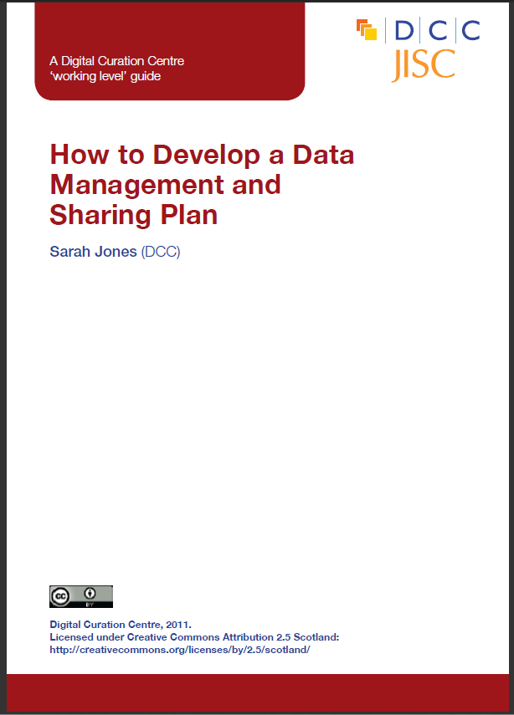
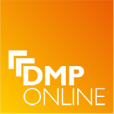
DCC support on DMPs
Webinars and training materials
How-to guides and other advisory documents
Checklist on what to cover in DMPs
Example DMPs
DMPonline
www.dcc.ac.uk/resources/data-management-plans

Slide 24
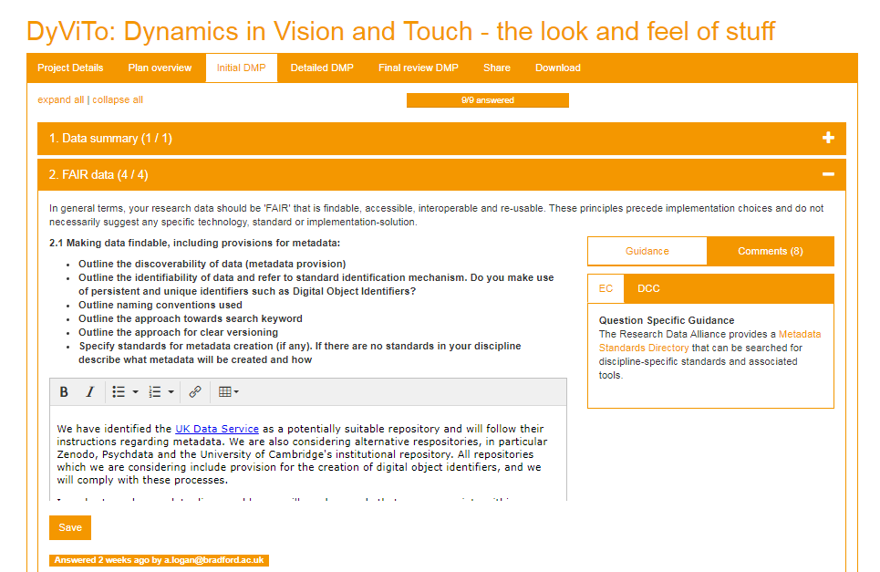
What is DMPonline?
A web-based tool to help researchers write DMPs
https://dmponline.dcc.ac.uk

Slide 25







How does DMPonline help?
Pulls together requirements and guidance, tailored to your context
Requirements from funders, institutions and others
DMP
Guidance and examples from your funder, uni, research community and others

Slide 26
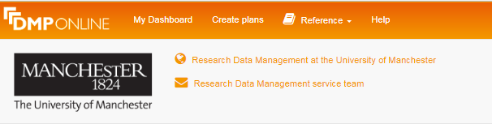
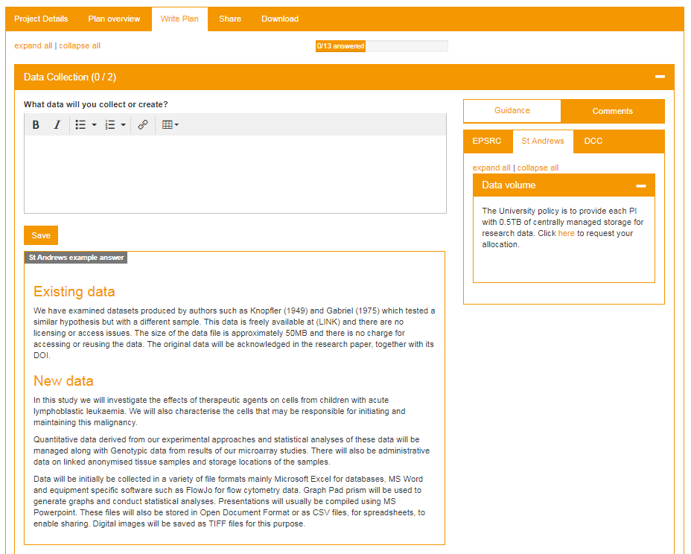
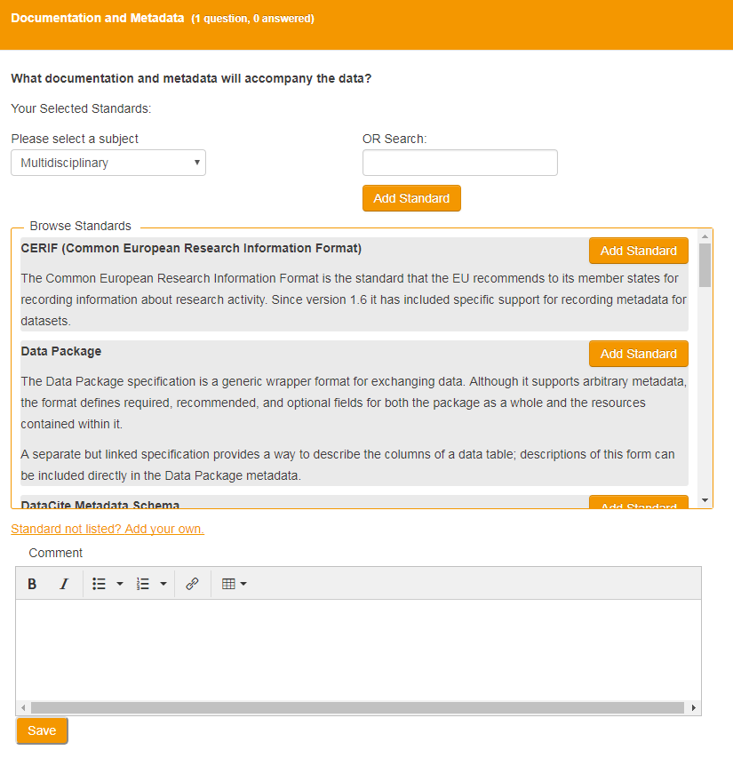
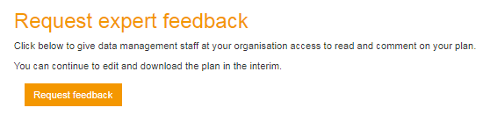
Local support and guidance

Slide 27



A single platform for all things DMP
Agreed to converge on a single codebase, based on DMPonline with additional features from DMPTool
Bring together features and strengths of each tool
Co-manage, co-develop and issue joint roadmap
DMPRoadmap: https://github.com/DMPRoadmap

Slide 28
Key messages
Data management is part of good practice whether you plan to make the data open or not
it benefits you!
The process of planning is as important as the DMP. Think about the desired end result and plan for this.
The data management plan is an evolving object. It should change, along with the research.

Slide 29
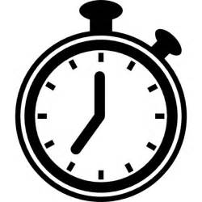
What makes a good DMP
Review the Open Access Journal DMP (20 mins)
https://repositorian.github.io/DOAJ_Exercise
Discuss in groups what you think of the DMP (20 mins)
Highlight elements which impress you
Identify aspects that could be improved
Feedback:
http://tiny.cc/triestecards
Notes:
[hand out the template]

