Slide 1
Evidence for Enhancement: Data Delving: Engaging Staff in Student Experience Data
Nathaniel Pickering
Senior Lecturer in Research and Evaluation
Sheffield Hallam University
15 January 2019

Slide 2

Transformation through data
“Big data” is transforming... industries such as insurance, finance, retail, and professional sport, in time, it will transform education. And when it does, it will resolve some long-standing dilemmas for educators and enable that long-term aspiration for evidence-informed policy at every level, from the classroom to the whole system, to be realised. (Michael Barber in DiCerbo & Behrens, 2014)

Slide 3
A new frontier in England and beyond?
The Office for Students is an evidence based regulator. This means it will use data and information to inform its effective, efficient and intelligent regulation in the student interest.

Slide 4
A new frontier in England and beyond?
The Office for Students is an evidence based regulator. This means it will use data and information to inform its effective, efficient and intelligent regulation in the student interest.
OfS
National Student Survey
Teaching Excellence Framework
Longitudinal Education Outcomes
Postgraduate Student Survey (Pilot)
Other Areas
HESA
Graduate Outcomes Survey
League Tables
JISC
Student Academic Experience Survey
Lobbying Groups, External Agencies/Bodies

Slide 5
A new frontier in England and beyond?
The Office for Students is an evidence based regulator. This means it will use data and information to inform its effective, efficient and intelligent regulation in the student interest.
OfS
National Student Survey
Teaching Excellence Framework
Longitudinal Education Outcomes
Postgraduate Student Survey (Pilot)
Other Areas
HESA/JISC
Graduate Outcomes Survey
Lobbying Groups, External Agencies/Bodies
League Tables
Student Experience/Engagement Surveys

Slide 6

Question
How prepared is your institution for the growing data landscape?

Slide 7

Student satisfaction data
While many institutions have become reasonably skilled in collecting large amounts of student satisfaction data, making sense of rich data sources and acting upon the data is complex and cumbersome. (Rienties, Li et al., 2015)
Notes:
In many cases it is not always clear that there is a means to close the loop between data collection and effective action, let alone feedback to students on action taken
For this to happen requires that the institution has in place a system for:
Establishing this is not an easy task, which is why so much data on student views is not used to effect change, irrespective of the good intentions of those who initiate the enquiries. Williams (2002) noted that, to gain support and trust, the student feedback process must be transparent and senior management must be committed to the approach. Action should result to improve the student learning experience: resources must be made available and the agenda for change must be progressive rather than recriminatory (Harvey et al., 1997). Without evident action, students grow cynical about the process and are less willing to take part in the quality enhancement process (Powney & Hall, 1998).

Slide 8
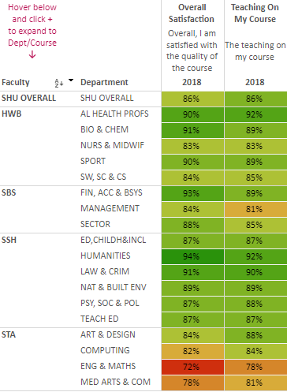
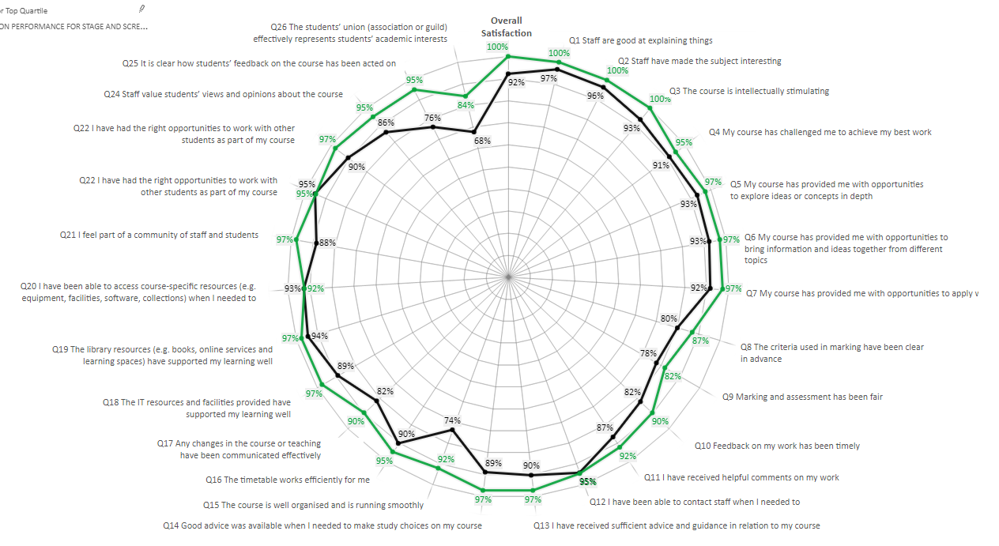
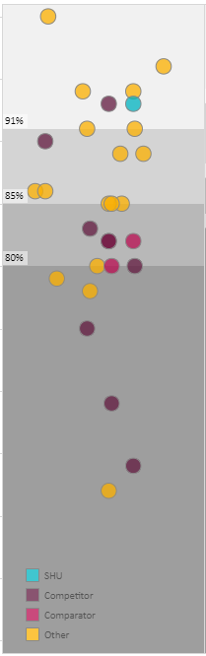
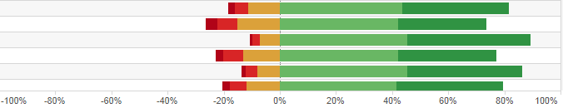
Established reporting tools
Faculty
Departments
Faculty
Departments
Faculty
Departments
Faculty
Departments

Slide 9
The National Student Survey
The NSS can suffer from being viewed as a managerial and bureaucratic exercise in box-ticking.... the NSS is used as a stick to beat departments and faculties, rather than as a positive encouragement to improve. (Buckley, 2012)
There is a significant difference in scores across different types of university, which calls into question the use of these scores of student satisfaction in university rankings. (Lenton, 2015)
Analysis of the NSS data has repeatedly provided evidence of the robustness of the instrument and the conceptual validity of the dimensions of the student experience that it assesses. (Ramsden, Batchelor et al., 2010)

Slide 10
Challenges for data delving
Methodological
Understanding and knowledge of student experience data
Trust in the reliability and validity of the data
Institutional
Ownership, responsibility and accountability
Reactionary, and deficiency focused
Staff
Varying levels of IT/data skills​
​Using student experience data for enhancement

Slide 11

Question
What is the main challenge for you or your organisation when it comes to data delving?

Slide 12

A STEER approach to data delving
Open, accessible and intuitive
Positive, supportive and empowering
Collaborative, developmental and formative

Slide 13
A different approach to the NSS
Purpose​
Use their NSS data to share good practice and ideas for success, consider improvement strategies and design tangible actions with measurable outcomes to enhance course experience for all their students.​
Benefits​
For you: providing a supportive environment in which to consider course enhancements which enable you to design realistic actions and outcomes and share good practice with colleagues across the institution.
For your students: enjoying a better course experience and seeing how NSS evidence and feedback has been acted upon directly.
For your institution: improving our NSS trajectory by enhancing course experience within the context of a collegial and supportive environment that draws on proven practical ideas for success.

Slide 14
A vehicle for change: Appreciative inquiry
AI adopts a social constructionist view based on affirmation, appreciation and positive dialogue ​
AI shifts the focus from problems to be solved to discovering and building on what works well​
AI offers a flexible framework to facilitate change from the grass roots up ​
AI helps build effective partnerships and collaborations that can be used to meet particular needs of an organization​
Individuals and groups are empowered to improve their situation and move towards visions for a more egalitarian future

Slide 15
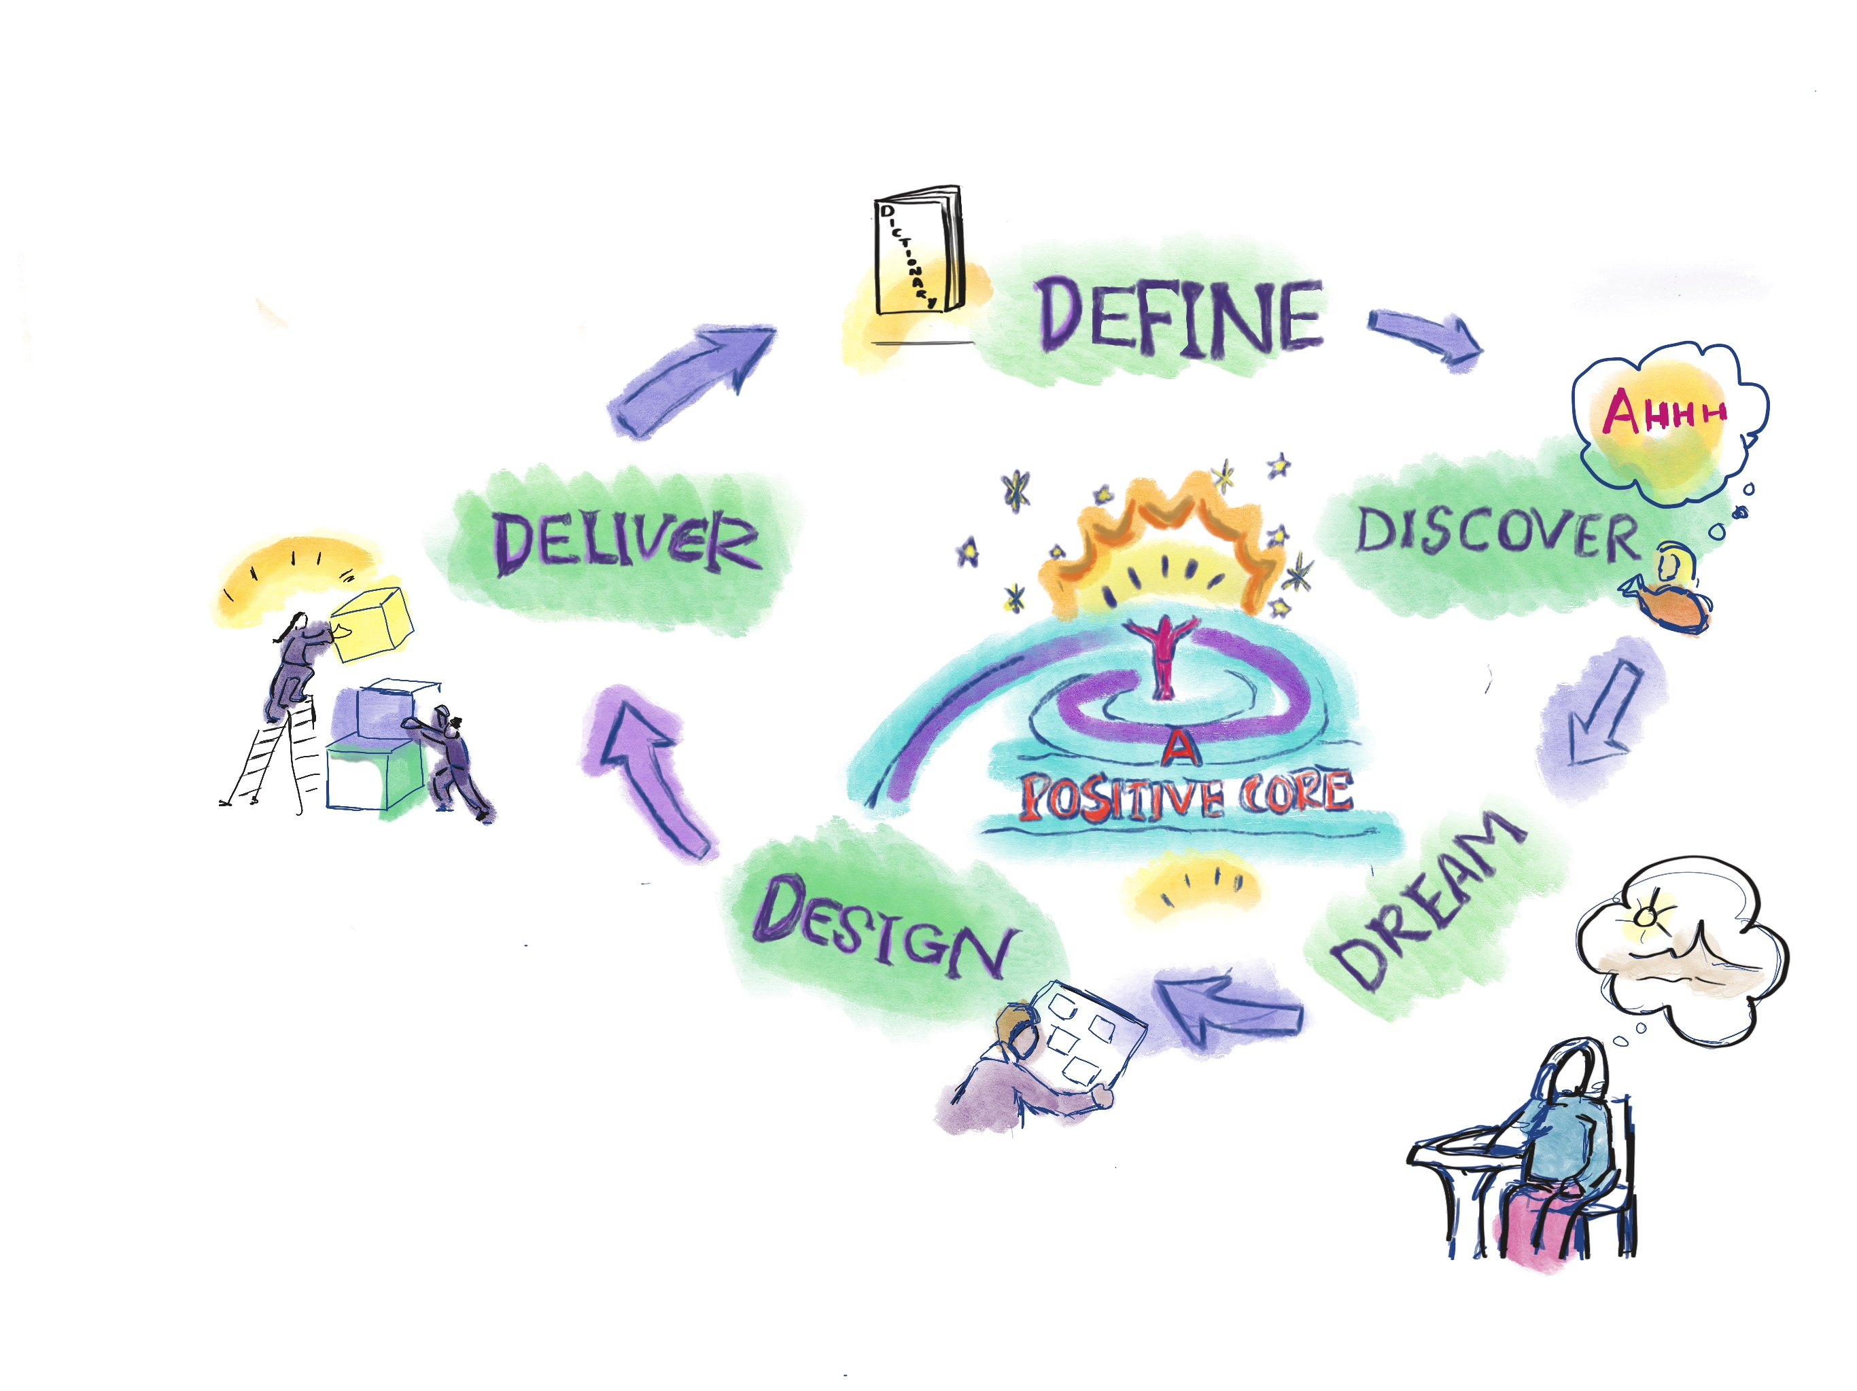

AI Process

Slide 16
Meaningful insight - a needle in a haystack?
Confidence
Not asking questions
Relationship to the data
A lack of objectivity and criticality
A narrow/focus perspective of the student experience
A lack of action setting (short, medium and long term)
Isolated analysis of data
Trust in the reliability and validity of the data
Navigating the reports
Lack of prioritisation

Slide 17
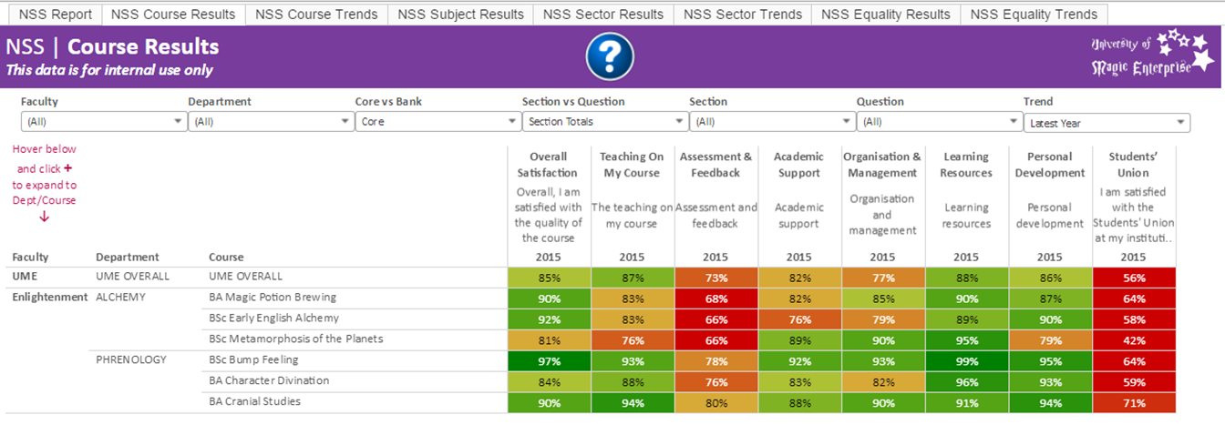
University of Magic Enterprise: Discussing survey data in a 'safe and non-judgemental space'

Slide 18
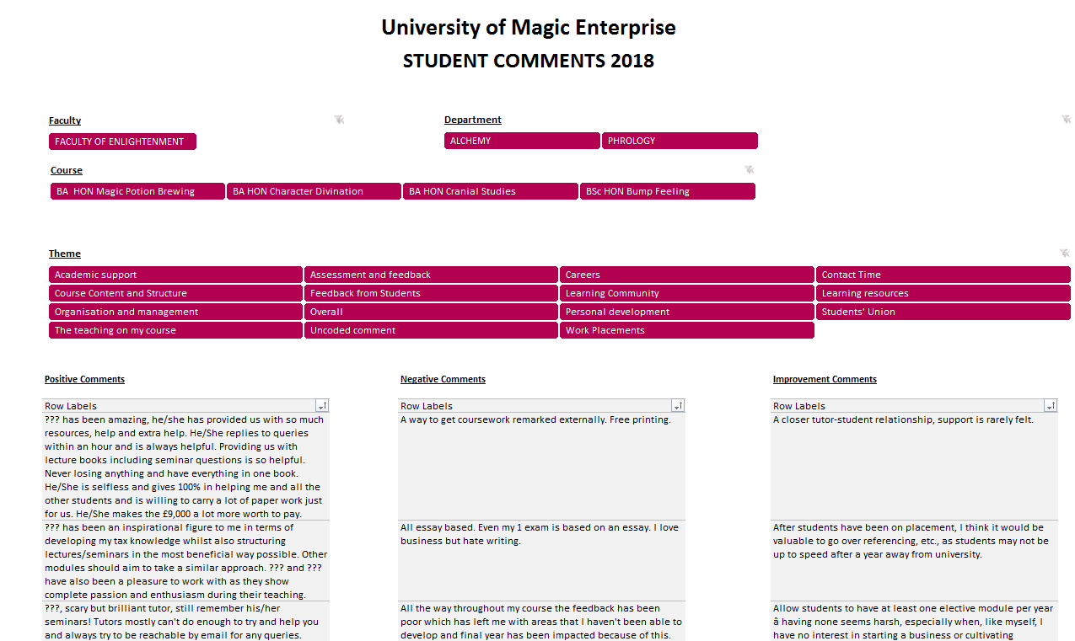
Student comments

Slide 19
Scenarios
Scenario 1: FACULTY OF ENLIGHTENMENT (FoE) Senior Management Team
As a senior management team, you have been requested to report the key findings from this year's student surveys to the University Leadership Team.
Scenario 2: DEPARTMENT OF ALCHEMY Head of Department (HoD)
As HoD, you have been requested to report the key findings from this year's student surveys to the Faculty Senior Management Team.
Scenario 3: DEPARTMENT OF PHRENOLOGY Teaching Excellence Framework (TEF)
You and your colleagues in the Department of Phrenology have been requested to report the key findings in relation to the TEF metrics (teaching, assessment and feedback, academic support) from this year's results at a department meeting. The meeting will include senior management and academic staff responsible for learning and teaching and quality enhancement
Scenario 4: BSC HON BUMP FEELING Course Teams
As a course team you have been requested to report the key findings from this year's student surveys to the Head of Department.

Slide 20
What next........
The people in a data strategy
The role of students
Value for money debate
Is it evaluation, research or reporting?

Slide 21
Questions/Reflections
How can Higher Education Providers identify and delegate responsibility for action in relation to the National Student Survey more effectively?
What resources would your organisation need to commit to in order to enhance staff data delving capabilities?

Slide 22
Evidence for Enhancement: Data Delving: Engaging Staff in Student Experience Data Let's continue the conversation.......... n.pickering@shu.ac.uk @Nathaniel__P #datadelving n.pickering@shu.ac.uk www.blogs.shu.ac.uk/steer @SHU_StEER Made with images from: Pixabay Google - Labelled for reuse Lydia Westerman

Slide 23
References
Buckley, A. (2012). Making it count: Reflecting on the National Student Survey in the process of enhancement. York: Higher Education Academy. Retrieved from https://www.heacademy.ac.uk/system/files/resources/making_it_count.pdf
Chapman, V. (2011) Appreciative Inquiry as evaluation: enhancing and developing academic practice. In: Saunders, Murray; Trowler, Paul; Bamber, Veronica, eds. Reconceptualising evaluation in higher education the practice turn. Maidenhead, UK: Open University Press.
​Cockell, J. and McArthur-Blair, J. (2012) Appreciative inquiry in higher education: A Transformative force. San Francisco, Wiley.
DiCerbo, K. E., & Behrens, J. T. (2014). Impacts of the Digital Ocean on Education. London: Pearson. Retrieved from https://www.pearson.com/content/dam/one-dot-com/one-dot-com/global/Files/about-pearson/innovation/open-ideas/DigitalOcean.pdf
Harvey, L. (2003). Student Feedback [1]. Quality in Higher Education, 9, 3-20.
Kung, S., Giles, D. and Hagan, B. (2013) Applying an appreciative inquiry process to a course evaluation in higher education. International Journal of Teaching and Learning in Higher Education, 2013(1), pp. 29–37
Lenton, P. (2015). Determining student satisfaction: An economic analysis of the National Student Survey. Economics of Education Review, 47, 118-27.
Ramsden, P., Batchelor, D., Peacock, A., Temple, P., & Watson, D. (2010). Enhancing and Developing the National Student Survey: Report to HEFCE by the Centre for Higher Education Studies at the Institute of Education. Higher Education Funding Council England: Bristol. Retrieved from https://webarchive.nationalarchives.gov.uk/20120118165739/http://www.hefce.ac.uk/pubs/rdreports/2010/rd12_10/
Rienties, B., Li, N., & Marsh, V. (2015). Modeling and managing student satisfaction: use of student feedback to enhance learning experience. Gloucester: Quality Assurance Agency. Retrieved from https://oro.open.ac.uk/46057/7/Modelling-and-Managing-Student-Satisfaction-15.pdf
Trajkovski, S., Schmied, V., Vickers, M. and Jackson, D. (2013) Using appreciative inquiry to transform health care. Contemporary Nurse, 45(1), pp. 95–100

