Slide 1
Transport of goods, carbon efficiency and logistics
22nd November 2017

Slide 2

Introduction -
NHS Supply Chain
DPDHL
UK landscape
Case Studies – making a difference for the NHS
Urban Consolidation
Inbound Logistics
Way forward

Slide 3
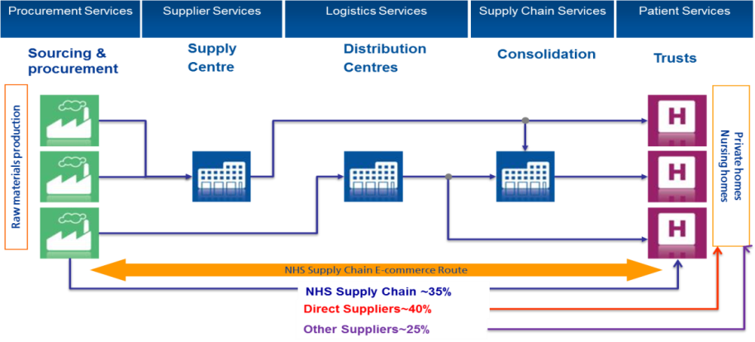
NHS Supply Chain
NHS Supply Chain is the only provider with OJEU compliant frameworks across its full range

Slide 4
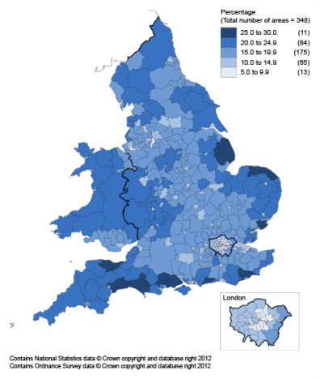
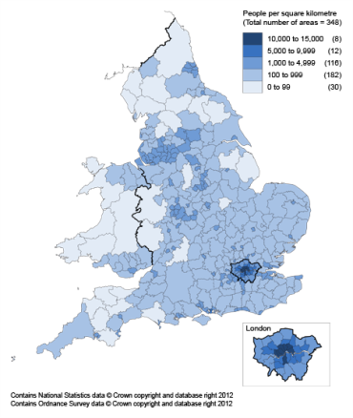
UK Population Density
Demographics
Areas with the highest number of residents aged over 65

Slide 5
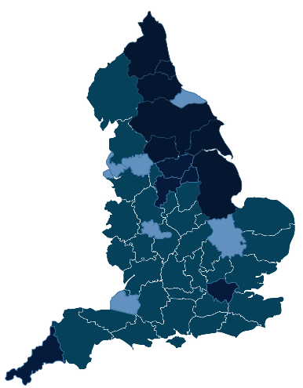
Devolved Authorities
Combined Authority | Status
1. London | Devolution deal - long standing Mayor – Sadiq Khan (Labour)
2. Greater Manchester | Established Combined Authority - Devolution Deal Metro Mayor – Andy Burnham (Labour).
3. Tees Valley | Established Combined Authority - Devolution Deal Metro Mayor – Ben Houchen (Conservative).
4. Liverpool | Established Combined Authority – Devolution Deal Metro Mayor – Steve Rotheram (Labour).
5. West Midlands | Established Combined Authority - Devolution Deal Metro Mayor – Andy Street (Conservative).
6. Cambridge & Peterborough | Established Combined Authority - Devolution Deal Metro Mayor – James Palmer (Conservative).
7. West of England | Established Combined Authority Metro Mayor – Tim Bowles (Conservative).
8. Cornwall | Devolution deal
9. North East | Discussions re-opened after original deal was rejected.
10. Yorkshire | Early discussions, no deal agreed yet.
11. Sheffield City Region | Metro mayor election delayed until May 2018, after High Court ruled public consultation illegal.
12. Greater Lincolnshire | Deal currently off, after County Councillors voted against it.
9
9
9
3
10
10
10
4
2
11
11
12
5
6
7
1
8

Slide 6
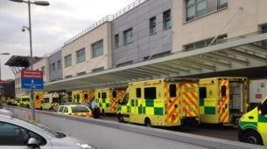
NHS Challenges
72% of NHS carbon footprint comes from the procurement of goods and services
Outdoor air pollution is contributing to about 40,000 early deaths a year in the UK
18% of NOx at a sample trust associated with vehicles making deliveries
Increase in activity and associated goods and services required
NOx
18% of emissions are associated with the last 1% of the journey

Slide 7
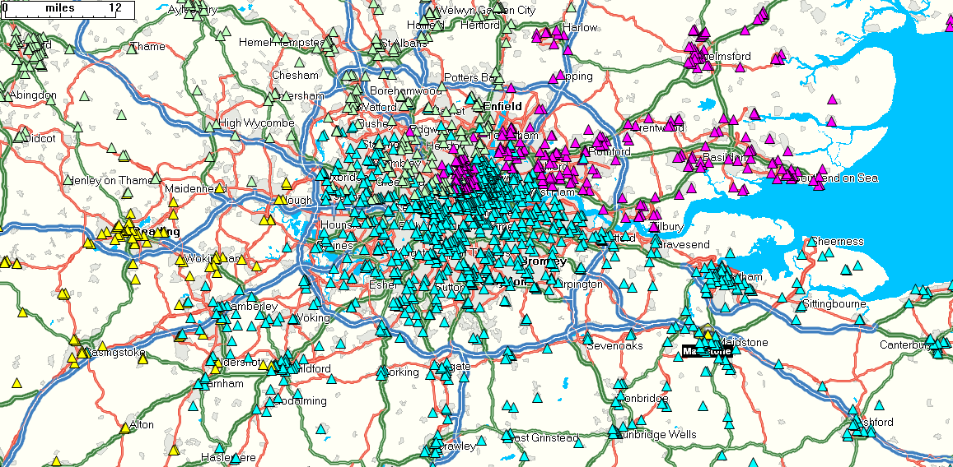
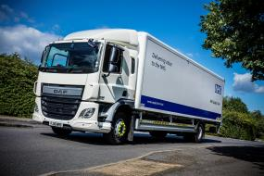
Urban Consolidation - London Consolidation Centre
Historical Position
Delivery profiles overlapping due to NHS IT ‘district’ set up
Customers could receive multiple deliveries to the same stores on the same day
Sub optimal utilisation of vehicles and drivers
Excessive distance travelled
Historic delivery profile – different colours represent different originating distribution centres

Slide 8
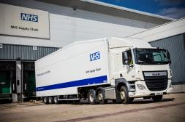

Urban Consolidation - London Consolidation Centre
Solution
Cross Dock Centre in Enfield
Central ‘master plan’ for LCC deliveries across all 3 Distribution Centres focussing on multi drop activity
Trunking schedule (on double deck trailers for maximum utilisation) from the 3 host distribution centres to LCC
Secondary deliveries to customers on LCC fleet
Small consignments delivered direct to customer from Host DCs via UK Mail network
Public sector & DHL collaboration
DHL operated Camden council consolidation centre moved to LCC
Sharing management, space and resource
Home Delivery Service outbase moved to LCC further resource
sharing and operational synergies

Slide 9

Urban Consolidation - London Consolidation Centre
Benefits
Reduction of 6 vehicles for NHS Supply Chain
Annual reduction of 281,000 miles travelled (20% of miles related to London deliveries)
Annual reduction in emissions of 250 tonnes of CO2.
Annual cost saving of £160k
Improved visibility and planning processes
Improvement in customer experience
Reduction in no of physical deliveries to hospital stores
Locally based fleet with ability to flexibility to respond quickly to daily requirements and issues
Platform for collaboration
Next Steps
Evaluation of roll out of approach in UK regions – principally North West (Manchester / Liverpool) and South West (Bristol and beyond)

Slide 10


What is Inbound Logistics?
A supplier collection service, dealing only with NHS Supply Chain inbound volume
Run by NHS Supply Chain for Suppliers to NHS Supply Chain
Why?
A realisation of the potential to use the NHS outbound delivery fleet
To generate benefit to NHS Supply Chain.
To provide a mutually beneficial route to market for suppliers
Driven through DHL’s commitment to reduce operating costs to the NHS, generate cash releasing savings and part of DHL’s mission 2050

Slide 11

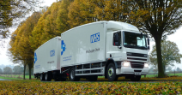

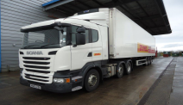

Inbound Logistics - Network
European Freight
NHS SC Network
Bellshill
Containers
Normanton
Dublin
DHL Healthcare Fleet
Runcorn
Alfreton
COALVILLE
Bury St. Edmunds
Rugby
NHSSC Coalville
Bridgwater
Maidstone
Parcel Carriers
NHSSC Depots
www.supplychain.nhs.uk

Slide 12

Inbound Logistics – Scale and Benefits
152 Suppliers
1000+ pallets daily
Operational cost savings
195 FTL Deliveries per week
1,380 tonnes CO2 saved per annum
87% Less Gate Receipts per week
www.supplychain.nhs.uk

Slide 13

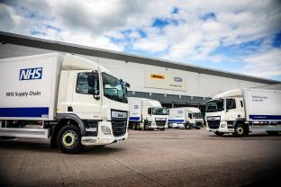

Way Forward
Consolidation
Reduce final mile activity and associated emissions
Focus on urban population centres
North West
Yorkshire
North East
Collaboration
STPs
Devolved authorities
Other public sector organisations
Private Sector
www.supplychain.nhs.uk

Slide 14



Way Forward
Understand the true supply chain
Measure
Map
Quantify
Think Differently
Break down the Silos
Innovate – how can we serve the rural / coastal populations more effectively
Work with those who can add value
www.supplychain.nhs.uk

