Slide 1


Youth ASCENDS
Plymouth’s SEND youth forum

Slide 2
Who are we?
Youth ASCENDS has three parts:
A group of young people 10-25 years old who represent the views of every child and young person with SEND across Plymouth
A group of five schools (currently) who host conversations around SEND and feed into the Steering Group
We try to reach any young people who are not able to participate in the hubs through other possible means
Steering Group
Hubs
Citywide Participation

Slide 3
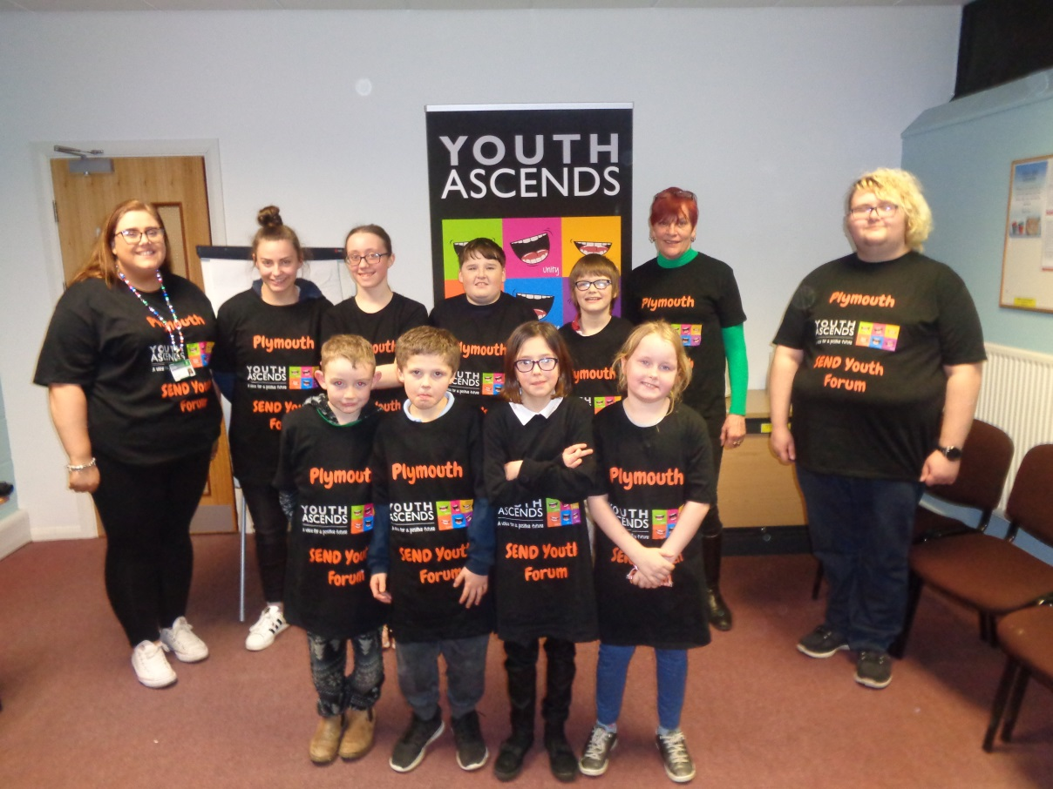
Steering Group
Every other Monday the steering group meets, alternating between the older group of 13-25 year olds who are more equipped for discussion based groups, and the 10-13 year old group with young people 13-25 years helping to support them. The latter group tends to be more activity based.
The job of the steering group is to gather the views of young people with SEND in Plymouth and feed them into Plymouth City Council

Slide 4
Hubs
While still in it’s infancy, the Youth ASCENDS hubs are very promising. There are going to be 5 hubs initially who will be hosting discussions on a variety of subjects around SEND and SEND services around Plymouth. The initial hubs will be:
ACE Dover Road
Brook Green Special School
City College Plymouth
Courtlands Special School
Stoke Damerel Community College

Slide 5
Citywide Participation
We welcome input from any child or young person 0-25 with SEND! For more information please contact:
This will include all home educated children who have Special Educational Needs and Disabilities if they wish to be involved or find out more. Put your details on this piece of paper or email.
YPForum@plymouth.gov.uk

Slide 6
Any Questions?

