Slide 1
Leadership Essentials: Leading Planning The Planning Service Resource Landscape
Steve Barker
Principal Consultant
October 2015
www.pas.gov.uk

Slide 2
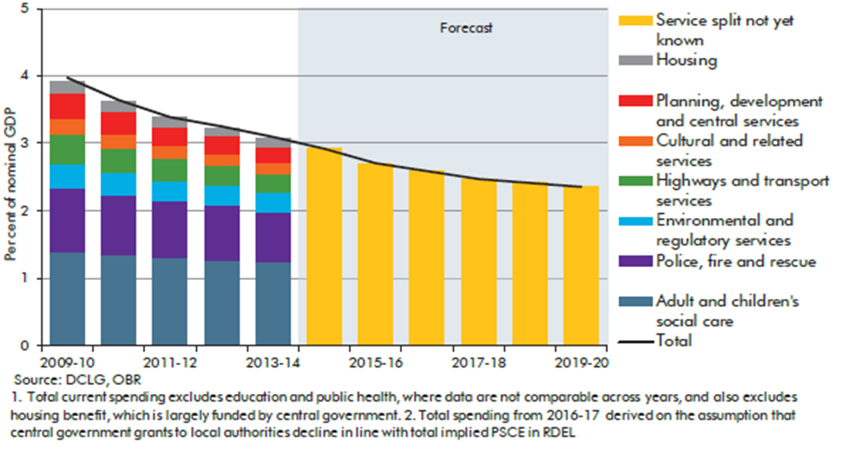
The resource challenge
OBR forecast for Local Authority spending
Notes:
Guess what: There will be less money !!!!!!!

Slide 3
The resource challenge

Slide 4
The resource challenge
What has happened in the last few years?
Councils made a larger reduction in spending on planning and development services (11.5 per cent, on average) in 2012/13 than they had budgeted for
Planning and development saw the largest average reductions in spending from 2010/11 to 2013/14: 37.6 per cent in real terms
(Audit Commission, Tough Times 2013)

Slide 5
The resource challenge
The planning outlook
Assumptions about planning expenditure
CPI inflation on supplies and services
Pay drift on salaries
Projected change in population
income from charges increases by CPI (in long term)
“efficiencies” on gross cost of 1% per annum
£0.5 billion “gap” by 2019/20 in planning alone
Notes:
Consumer Price Index
That’s the picture nationally
The gap is largely created by social care swallowing more and more budget

Slide 6
The resource challenge
Spending and funding
Planning is one service where expenditure has (fairly direct) influence on funding
Council Tax base
Business Rates retention
New Homes Bonus
Cuts to planning expenditure in year 1 might reduce funding in year 2/3/4… a vicious circle?
And fees don’t cover costs

Slide 7
Positive Planning – making the argument
Planning services need to be able to show the value of the service:
income and effect of the service:
returns on decisions: fees, NHB, Business Rate Retention, CIL, …
the role of planning decisions to bring income into the area
the support the service gives to the delivery of council strategies: delivering economic gain to an area, delivering good places, …..

Slide 8
Positive Planning – making the argument
Planning services can show:
an understanding of the service: how resources are used, what makes income, what costs money, how they compare to others,…
an understanding your customers; are they happy, is it a good service, …
National Indicators aren’t very good at recognising a good service ……
…..but there is something that does!
PAS Planning Quality Framework programme

Slide 9
Positive Planning – what’s it look like
Recognition of importance of new development both nationally & locally
Having a service that interacts with applicants and streamlines the process in proportion to the issues of the application
Making the most use of the resources available
Giving as much certainty in the process
Working together to influence and deliver good develop that aligns to council and community needs

Slide 10
Positive Planning – what’s it look like
Provides guidance, advice and decisions where its needed and in the shortest time possible
Creating a chance to work collaboratively with a developer on larger schemes
Making those discussions worthwhile so people to be bothered doing it
Simplifying the process where it is practical and advantageous to do so.
Its all about delivery!

Slide 11
Positive Planning
Ask yourself: How would your planning service stand against that description?

