Slide 1


Welcome The Trauma Audit & Research Network (TARN) Foundation course

Slide 2
Background
Largest: European Trauma registry: >800,0000 injured patients with >50,000 injured children
Review and monitor process of care & outcome
Report to Trusts & Commissioners
Inform changes in practice: Improve Trauma Care
100% membership in England, Wales, ROI and Northern Ireland
Members in Denmark and Switzerland
220 Hospitals submitting data
Clinically led (BOARD and Executive committees), Academic, Independent

Slide 3

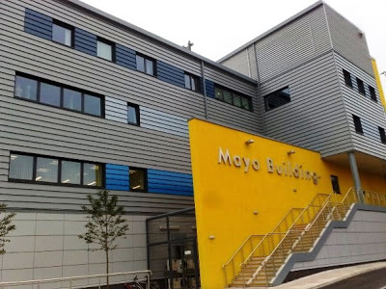

The beginning
1988: Report by RCS: The Management of patients with Major Injuries
“Serious deficiencies in the management of severely injured patients”
Enhancing pre-hospital care, ensuring appropriate medical intervention
Rapid transfer to the best local facility
Assessing the use of helicopters
Adopting ATLS principles
Integrating trauma services within and between hospitals
Investing in rehabilitation services
System of Auditing & Research
TARN Established in 1989: Based Salford Royal Hospital

Slide 4

Major Trauma Network development
Public Accounts Committees March 2010
Chief Executive of NHS on public record as ......
Committing to development of Major Trauma Networks across England by end of 2011/12
Mandating TARN membership
Most Major Trauma Networks “live” April 2012

Slide 5
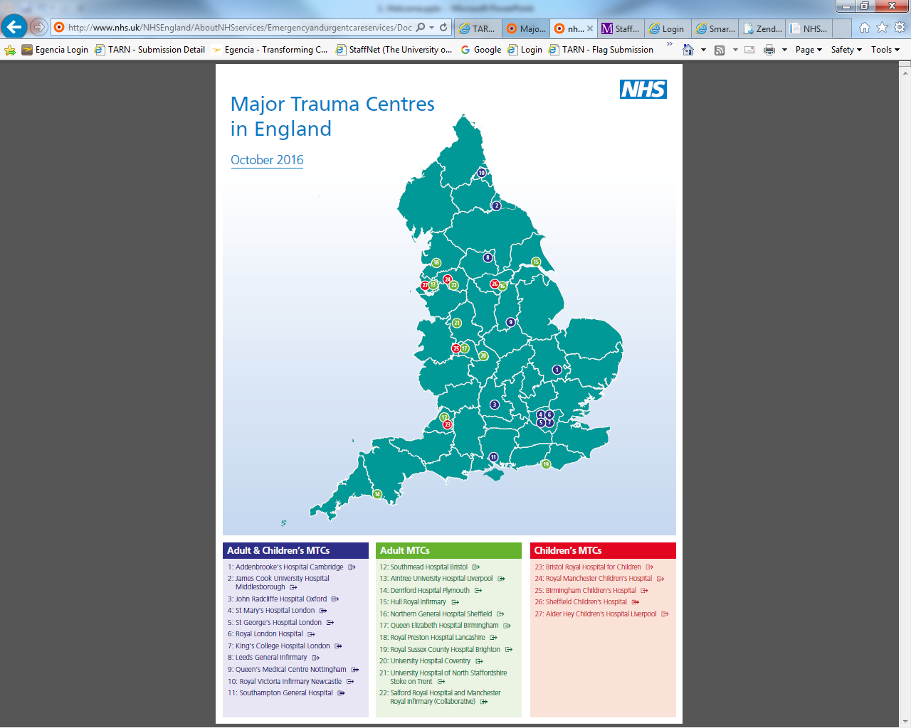

Slide 6
What has changed
On scene patient triage: Positive
Direct to MTC
(< 45 mins travel)
TARN
Indirect Transfer
(>45 mins, time critical intervention)
MAJOR TRAUMA CENTRE
Consultant led trauma team
Immediate operating theatre
All specialties: neurosciences
Immediate CT scan
Interventional radiology
Specialist critical care
Trauma Unit
Trauma team
Immediate CT Resuscitate, Assess & ? Transfer

Slide 7
Major Trauma Centre: Best Practice Tariff Year (19-20)
Additional payment made to Major Trauma Centres only
Based on Injury Severity
Level 1: Moderate Trauma (ISS>8): £1,500
Level 2: Major Trauma (ISS>15): £3,000
Conditional on ‘Best Practice’ targets being met & data correctly entered onto TARN database
BPT worth 51 million per annum
Last year 5 million in missed payments

Slide 8
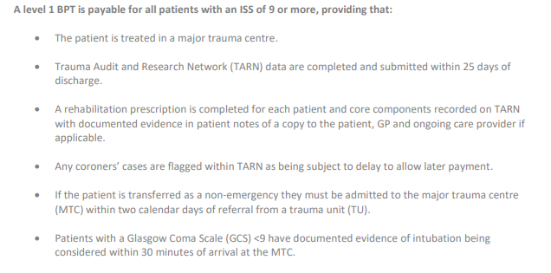
Major Trauma Centre: Best Practice Tariff Year (19-20)

Slide 9
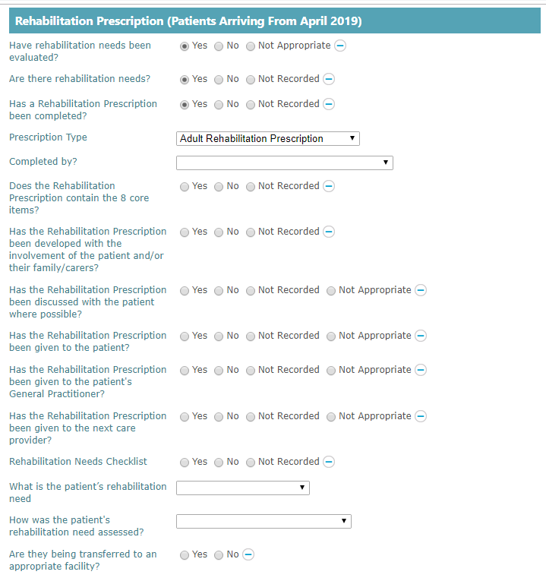
Rehabilitation prescription 2019
Launched April 2019 as part of new BPT 19-20 criteria
All patients admitted from April 2019 must have this section completed in order to be eligible for BPT.
Existing BPT rehabilitation questions will remain, and continue to determine BPT payment for all patients admitted before April 2019. Must be answered to ensure BPT payment for these patients.
Prescription matches TARN system exactly
Guidance document in Resources section of TARN website.
BPT flowchart document from NHS E & Professor Chris Moran available on website

Slide 10
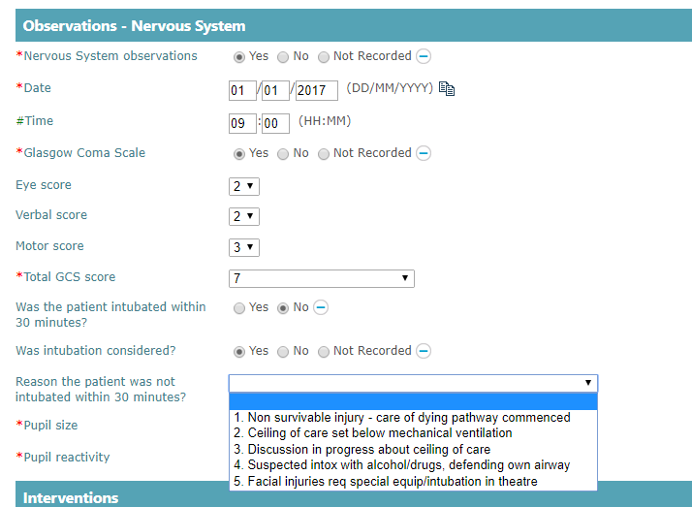
BPT 19-20 Consideration of Intubation
Launched April 2019 as part of new BPT 19-20 criteria
Patients with a GCS of <9 must have documented evidence of intubation being considered within 30 minutes of arrival at the MTC.
This includes patients transferred in to the MTC.
This question appears in ED and CC if a GCS of less then 9 is recorded.
If a patient arrives intubated and ventilated in the MTC no GCS should be recorded, this does not affect BPT eligibility.

Slide 11
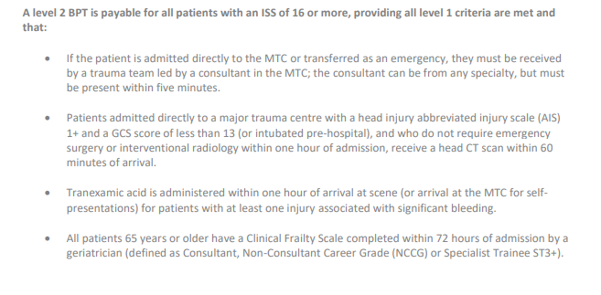
Major Trauma Centre: Best Practice Tariff (19-20)

Slide 12
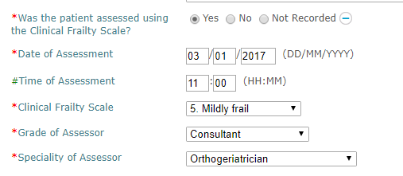
BPT 19-20 Clinical Frailty Scale
Launched April 2019 as part of new BPT 19-20 criteria
All patients age 65 or older must have a Clinical Frailty Scale completed within 72 hours of admission by a geriatrician (defined as a Consultant, Non-Consultant Career Grade (NCCG) or Specialist Trainee ST3+).
This is completed in the ‘At Discharge’ section of a TARN submission
The Clinical Frailty Scale can be completed for all patients regardless of age, but this is only a BPT requirement for those 65 and older.
You can record a Clinical Frailty Scale that has been completed by a clinician of any grade, but only those grades listed above meet BPT criteria.

Slide 13
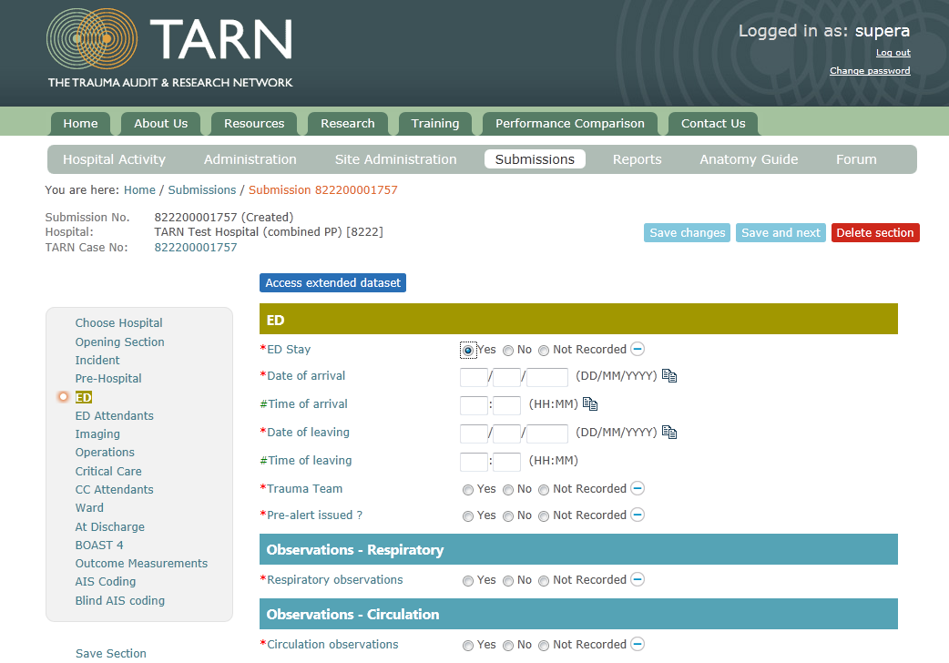
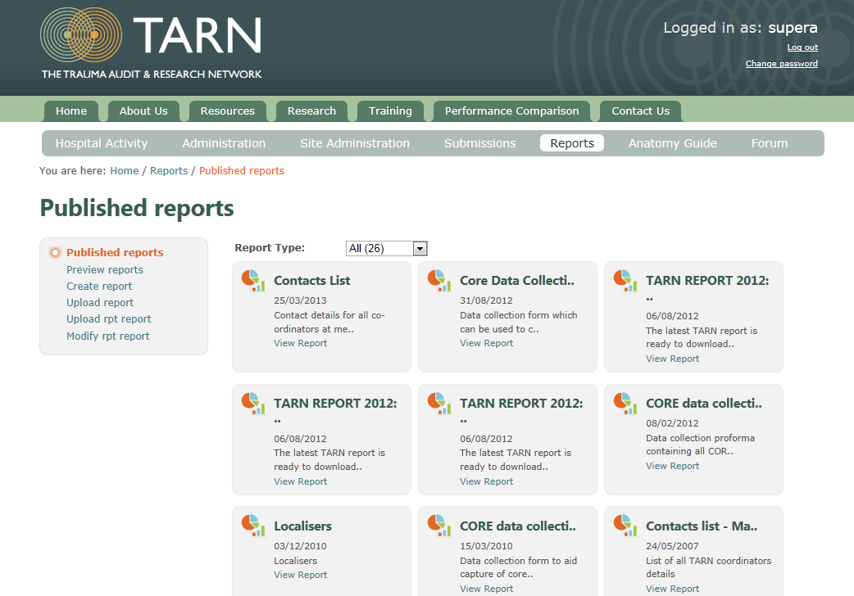
Web-based Trauma Data Collection
Electronic data collection & reporting system
Secure on-line system through patient pathway
Data Collection AND Reporting

Slide 14

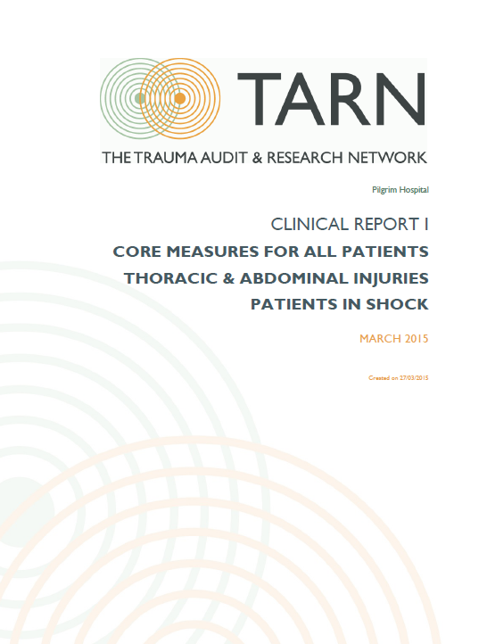
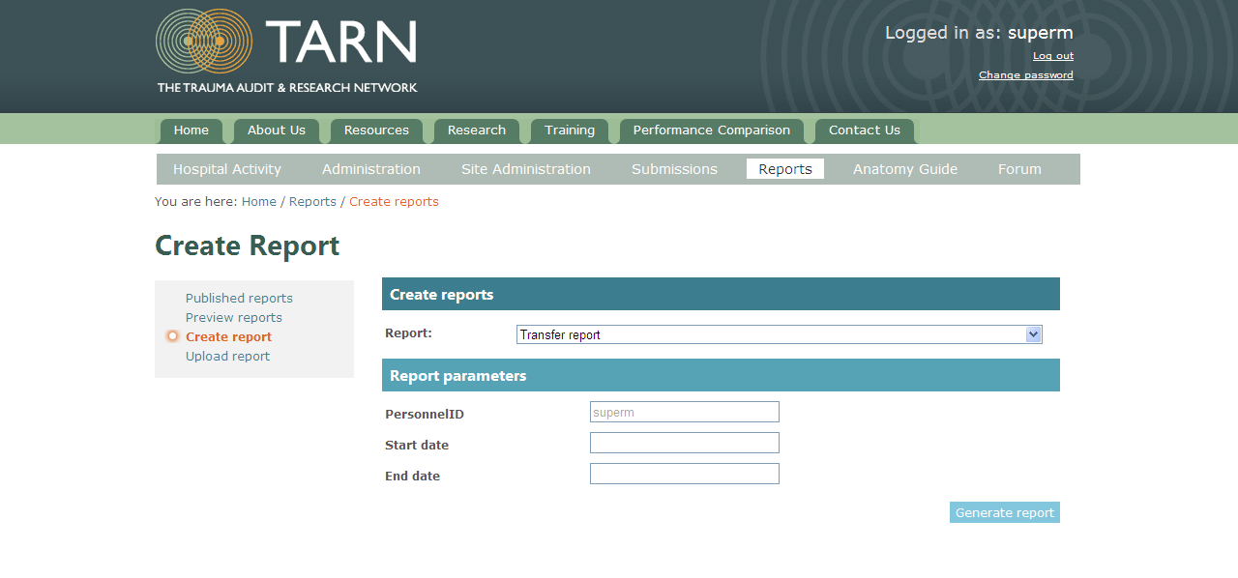
TARN Reports
Clinical Reports: Uploaded March, July, November. Email notification to all users
Performance Comparisons: Updated March, July, November. Available to all.
Online Reports: Self produced reports
Ad Hoc analysis: Available any time
Dashboards: Published Quarterly for MTC and Trauma Units, half yearly for CMTCs
Separate Reporting & Refresher Training session

Slide 15
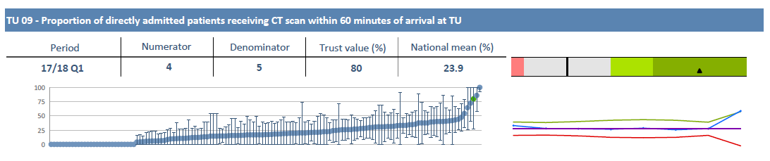
Trauma Dashboards Benchmarking between comparable hospitals
Major Trauma Centre Dashboard
Developed by MTC Clinical Reference Group
Children’s Major Trauma Centre Dashboard
Developed by TARNLet
Trauma Unit Dashboard
Developed by Trauma Unit Working Party

Slide 16
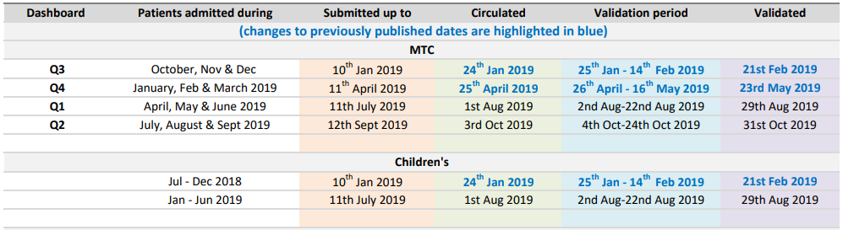
MT Dashboard timescales
Initial Dashboard uploaded to Reports section of website
3 week Validation period: amendments submitted via Excel spreadsheet
Validated Dashboard published on website: initial dashboard hidden

Slide 17
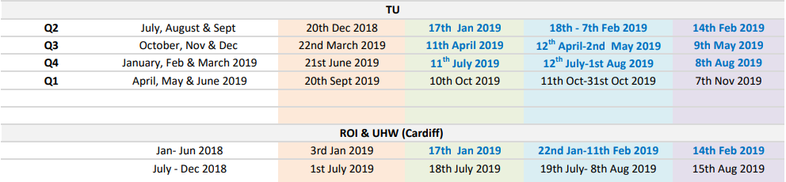
TU Dashboard timescales
Extended 12 week deadline between discharge & dispatch for Trauma units

Slide 18
The 2018
TARN database

Slide 19

TARN figures: 2018: Gender breakdown
44%
56%

Slide 20

TARN figures: 2018: Median Length of Stay
8 days

Slide 21

TARN figures: 2018: Age breakdown
<16 | 16-35 | 35-65 | 65-80 | >80
4% | 15% | 32% | 21% | 28%

Slide 22





TARN figures: 2018: Mechanism of injury
Vehicle incident
20%
Falls >2m
12%
Penetrating injury
2%
Falls <2m
58%
Other
2%
Blows
5%

Slide 23


TARN figures: 2018: Most severely injured body regions
Head
25%
Face
2%
Chest
16%
Abdomen
3%
Spine
13%
Limbs
33%

Slide 24
TARN figures: 2018: ED Admissions
Accident & Emergency
10% not admitted to ED

Slide 25

Contact us
Phone-line: 0161 206 4397 Email: support@tarn.ac.uk
tarn.supportstaff@nhs.net
Twitter account: @TARNaudit www.facebook.com/TARNaudit
Website: www.tarn.ac.uk

