Slide 1
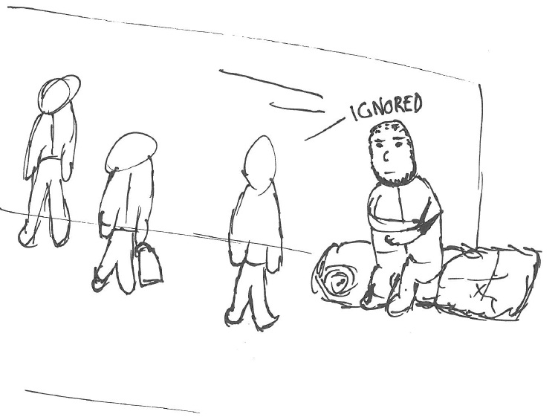
Homelessness
& Health
Lucy Wightman
Director of Public Health

Slide 2
Homelessness
‘Rough sleepers’
Anyone who does not have a home, including
  People whose accommodation is insecure
  Those facing eviction
  Living in temporary accommodation
  Squatters
  People at risk of violence
  People housed in property potentially damaging to their health
  People who cannot afford their current accommodation
SHELTER ENGLAND 
Website:
http://england.shelter.org.uk/get_advice/homelessness/homelessness_-_an_introduction/what_is_homelessness
CRISIS 
Website:
www.crisis.org.uk/ending-homelessness/about-homelessness/
GOV.UK 
Website:
www.gov.uk/emergency-housing-if-homeless
Notes:
Although the term ‘homeless’ is often applied in everyday language to people who sleep rough, there are much broader definitions covering anyone who does not have a home. This includes people whose accommodation is insecure; those facing eviction, living in temporary accommodation, squatting, people at risk of violence, those housed in property potentially damaging to their health, and those who cannot afford their current accommodation.

Slide 3
What causes homelessness?¹
Structural | Individual
Housing demand (linked to demographic trends) Lack of affordable housing (eviction/repossessions) | Family disputes / childhood disputes
Poverty | Physical & emotional abuse
Unemployment / welfare benefits | Poor physical health & mental health conditions
Ethnicity | Institutionalisation / offending behaviour (care, prison, armed forces)
Changing trends in family formation & fragmentation | Drug or alcohol misuse
 | Lack of qualifications & skills
 | Social networks
 | Debt

Slide 4
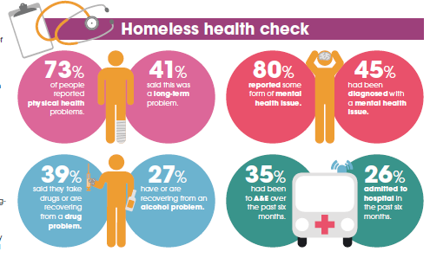
The unhealthy state of homelessness²

Slide 5
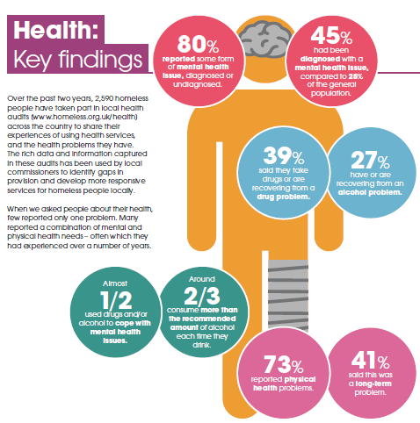

Slide 6
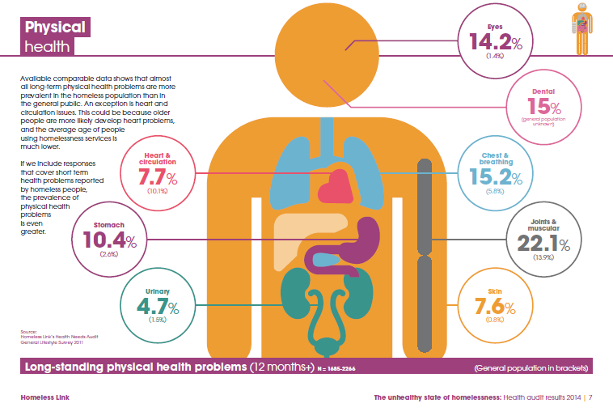

Slide 7
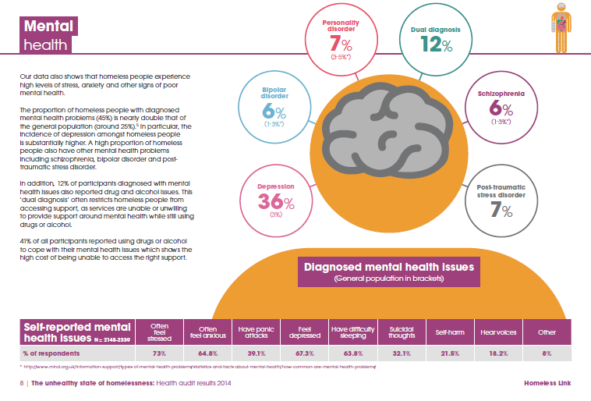

Slide 8
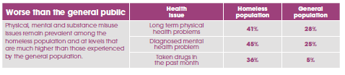
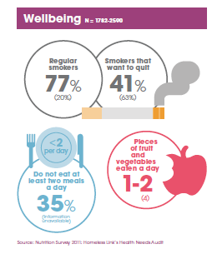
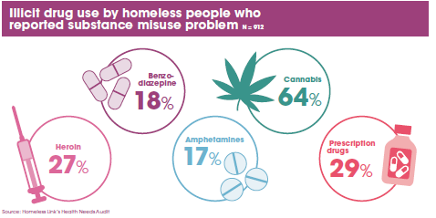

Slide 9
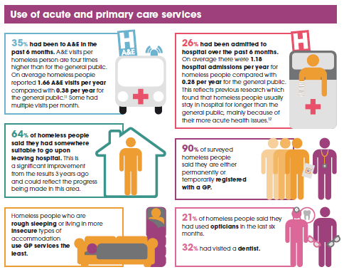

Slide 10
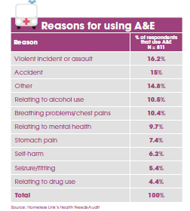

Slide 11
Age distribution of deaths, England³
General population
Homeless population
Notes:
Crisis Report, 2011 -homeless mortality in England for the period 2001-2009. For all homeless people the mean age of death is 47 and for homeless women it is even lower at only 43.

Slide 12
Health & wellbeing⁴
Notes:
Explore the information collected from 27 Health Needs Audits across England, conducted by Homeless Link in 2015.

Slide 13
Health & wellbeing

Slide 14
Health & wellbeing

Slide 15
Health & wellbeing

Slide 16
Comparative morbidity⁵
455 (77%) of 592 response rate - 80% males (365)
Average age range 16 - 44 years
61% born in the UK
72% registered with a local general practice
Overall gradual increase in risk of chronic disease across the quintiles of multiple deprivation
Adjusted OR for asthma was 2.46 (95% CI 1.78 – 3.39; p<0.0001)
Adjusted OR for heart disease was 5.87 (3.63 – 9.49; p<0.0001)
Adjusted OR for stroke was 4.93 (2.1 – 11.28; p<0.0001)
Adjusted OR for epilepsy was 12.40 (5.10 - 30.16; p<0.0001)
The adjusted OR for having two or more of these disorders was 5.12 (3.06 – 8.57; p<0.0001) - Quality of life measures showed similar disparities
Conversely, the likelihood of diagnosed diabetes was lower in the homeless than in those living in deprived areas (adjusted OR 0.59, 95% CI 0.35 – 0.99; p=0.046)
Notes:
Compared with housed people in the most deprived areas, homeless people had higher risks of asthma, heart disease, stroke & epilepsy

Slide 17
Impact measures⁶
Public Health Outcomes Framework (PHOF) which relate to statutory homelessness:
eligible homeless people not in priority need (1.15i)
households in temporary accommodation (1.15ii)
Evidence suggests there is also a relationship between homelessness and following PHOF
Indicators. Wider determinants of health includes:
school readiness (1.02)
pupil absence (1.03)
adults in contact with secondary mental health services who live in stable and
appropriate accommodation (1.06)
domestic abuse (1.11)
first time offenders and re-offending levels (1.13)

Slide 18
Impact measures
Health improvements includes:
smoking prevalence in adults (2.14)
successful treatment of drug treatment – opiate users (2.15i)
successful treatment of drug treatment – non-opiate users (2.15ii)
successful treatment of alcohol treatment (2.15iii)
cancer screening coverage – breast cancer (2.20i)
cancer screening coverage – cervical cancer (2.20ii)
cumulative % of the eligible population aged 40 to 74 offered an NHS health check (2.22iii)
cumulative % of the eligible population aged 40 to 74 offered an NHS health check who received an HNS health check (2.22iv)
cumulative % of the eligible population aged 40 to 74 who received an NHS health check (2.22v)
average Warwick-Edinburgh Mental Well-being Scale score (2.23v)

Slide 19
Impact measures
Health protection includes:
population vaccination coverage – Flu (at risk individuals) (3.03xv)
people presenting with HIV at late stage of infection (3.04)
treatment completion for TB (3.05i)
incidence of TB (3.05ii)
Healthcare and premature mortality includes:
mortality rate from causes considered preventable (persons) (4.03)
mortality from communicable diseases (4.08)
emergency readmissions within 30 days discharge from hospital (4.11)
excess winter deaths (4.15)

Slide 20
Impact measures
The NHS Outcomes Framework includes:
domain two: enhancing quality of life for people with long-term conditions
domain three: helping people to recover from episodes of ill health or following injury
domain four: Ensuring that people have a positive experience of care Improving people’s experience of outpatient care

Slide 21
References
Harding, J., Irving, A., & Whomwell, M. (2011) Homelessness, Pathways to Exclusion and Opportunities for Intervention. Newcastle Upon Tyne: Northumbria Graphics.
Homeless Link. (2014) The Unhealthy State of Homelessness [online]. Available at: http://www.homeless.org.uk/sites/default/files/site-attachments/The%20unhealthy%20state%20of%20homelessness%20FINAL.pdf. Accessed on: 27/11/2017.
Crisis. (2011) Homelessness. A silent killer [online]. Available at: https://www.crisis.org.uk/media/237321/crisis_homelessness_a_silent_killer_2011.pdf. Accessed on: 08/11/2017.
Homeless Link. (2015) Homeless Needs Audit [online]. Available at: http://www.homeless.org.uk/facts/homelessness-in-numbers/health-needs-audit-explore-data. Accessed on: 08/11/2017.
Story, A. (2013) Slopes and cliffs in health inequalities: comparative morbidity of housed and homeless people. The Lancet. 382: Special Issue 593; 29 November 2013.
Public Health England. (2016) Homelessness: applying All Our Health [online]. Available at: https://www.gov.uk/government/publications/homelessness-applying-all-our-health/homelessness-applying-all-our-health#facts-about-homelessness. Accessed on: 27/11/2017.

