Slide 1
Transforming care for people with learning disabilities and/or autism Building the right support - National Plan

Slide 2
The National Plan
Dialogue Events
December 2015

Slide 3


Transforming Care for people with a learning disability and / or autism
Building the Right Support
A national plan to develop community services and close inpatient facilities for people with a learning disability and/or autism who display behaviour that challenges, including those with a mental health condition

Slide 4
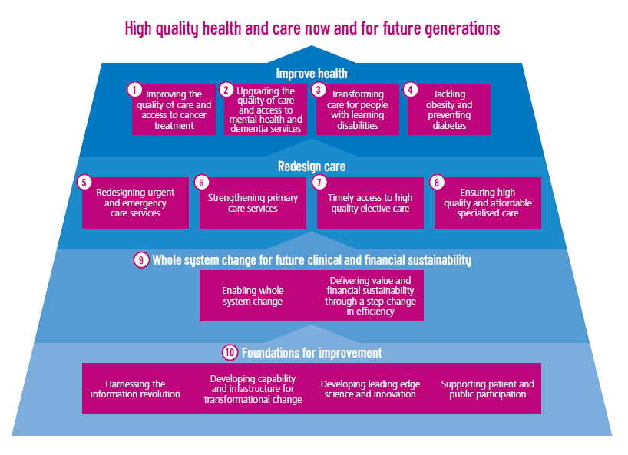

Making it happen
Notes:
Remains a high priority for NHS England and its partner organisations. Lots of changes already with the development of CTR reviews to look at individuals pathways through services, to really take a close look at how this could be done differently.

Slide 5

Implementing ‘Building the right support’
For a minority of people with a learning disability and/or autism, we remain too reliant on inpatient care. As good and necessary as some inpatient care can be, people are clear they want homes, not hospitals.
To implement this change on Friday 30th October NHS England, the Local Government Association (LGA), and the Association of Directors of Adult Social Services (ADASS) published Building the right support and a new service model.
Notes:
Here to talk about BRS – not able to talk to entirety of LD programme

Slide 6
The new services we need
The National Service Model sets out the range of services we will support local areas to put in place.
The model outlines what good support services should look like and has a number of ‘golden threads’ that run throughout:
Quality of life
Keeping people safe
Choice and control
Support and interventions
Equitable outcomes
Notes:
Quality equity choice control and safety

Slide 7
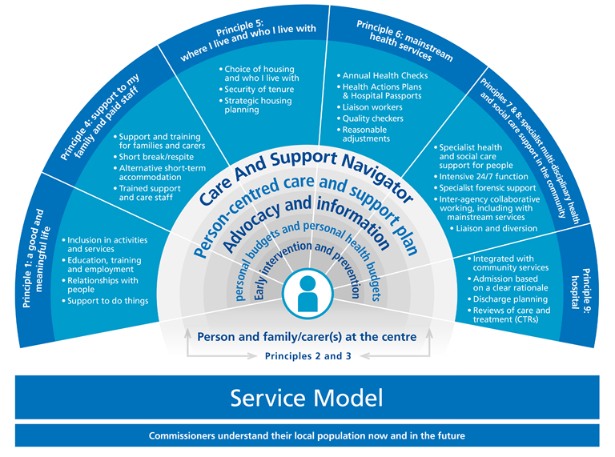
National Service Model
Notes:
People at the heart of the new model of care

Slide 8
The journey to date
significant reduction in reliance on institutional care, closing asylums, campuses and long-stay hospitals.
since Winterbourne View hundreds of people have been discharged – but still further to go
To make a lasting and transformational shift we need now to strengthen support in the community and close more inpatient provision.
Notes:
this is the journey and progress to date

Slide 9
New planning assumptions for inpatient capacity
Implementing this model of care will result in a significantly reduced need for hospital care.
In three years local areas should need hospital capacity to care for no more than:
10 – 15 inpatients in CCG-commissioned beds¹ per million adult population at any one time.
20 – 25 inpatients in NHS England commissioned beds² per million adult population at any one time.
These planning assumptions are based on what fast tracks told us was possible, sense-checked against current geographical variation in use of inpatient care.
Where an area’s current usage (or in the case of fast tracks, their projected usage) is already below these ranges, they would not be encouraged to increase their bed usage but to stay at their current rate or consider reducing it still further.
After three years we will take stock and consider going further.
i.e. primarily Assessment & Treatment beds and ‘locked rehab’
i.e. low, medium & high secure beds; CAMHS beds
Notes:
This is the overall bed reduction ambition

Slide 10
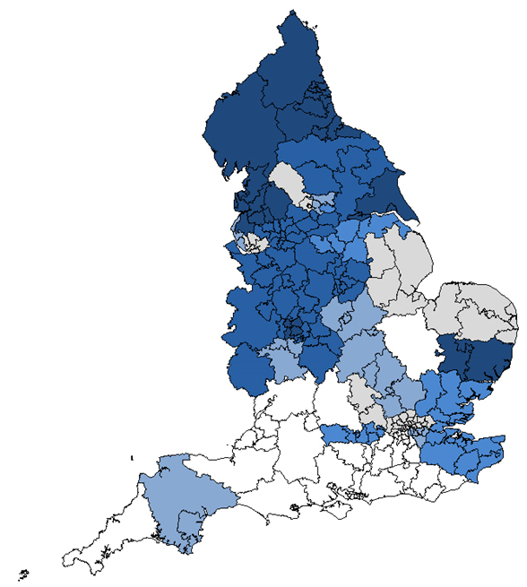
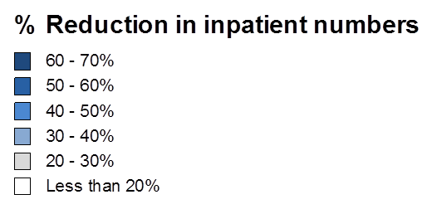
The planning assumptions imply bigger change in some parts of England
Notes:
Describe the transformation we expect to see nationally – variation means different issues and starting points for commissioners across country
Dark = over reliance on bed based services

Slide 11
6 Fast track areas – shaping the national approach to building the right support
Already making a difference on the ground
Together they are shifting money into community services and envisage reducing inpatient provision by approximately 50% over the coming 3 years
We will draw on our experience with fast tracks to support the rest of the country to build new community services
Notes:
Rapid learning from summer to publication of new national plan

Slide 12

Locally, delivery will be led by Transforming Care Partnerships
Building on learning from fast tracks, we are mobilising local Transforming Care Partnerships across England – collaborations of CCGs, local councils and NHS England specialised commissioning hubs. We expect CCGs to finalise these arrangements by December.
Partnerships of CCGs, local authorities and NHS England specialised commissioners will be supported to work with people with lived experience, families and carers, and key stakeholders to draw up and implement robust plans for transformation.
Specialised commissioning budgets for LD services will be aligned to these partnerships by April 2016, to enable investment to shift more easily from secure beds to community services.
Notes:
Describe plans for implementation – new partnerships now mobilising

Slide 13
Funding flows will be reformed to enable change
Local transforming care partnerships will be asked to consider the money they spend as a whole system on people with a learning disability and/or autism, and to use that total sum in a different way to achieve better results. This will entail shifting investment away from some services and into others.
NHS England’s specialised commissioning budget for learning disability and autism services will be aligned with the new transforming care partnerships.
CCGs will be encouraged to pool their budgets with local authorities, whilst recognising their ongoing responsibilities for CHC.
For people who have been in hospital >5 years at 1 April 2016, NHS-funded dowries will follow them as they are resettled in the community.
Up to £30 million transformation funding will be made available over 3 years to help with transition costs, conditional on match funding from CCGs
£15 million capital funding over 3 years
Who Pays guidance will be reformed to reduce financial barriers to swift discharge.
Significant expansion in personalised funding approaches
Notes:
Finance changes is key to transformation

Slide 14
National work and developments
Following on from stakeholder feedback, work is being undertaken at a National level to aid implementation of building the right support, including:
National Provider Forum progressing provider issues
Model service specifications are being developed to assist commissioners in implementing the Future Service Model.
Best practise guidance is being developed in relation to a new care pathway for children and young people
Notes:
Recognise that there is till more work and ore evidence required to underpin and support change at scale

Slide 15
Expectations of Transforming Care Partnerships
Dialogue Events
December 2015

Slide 16

What does this mean for individuals?
aAA new reality?
Notes:
So what doe s this actually mean for people? What should people expect? – something very different

Slide 17
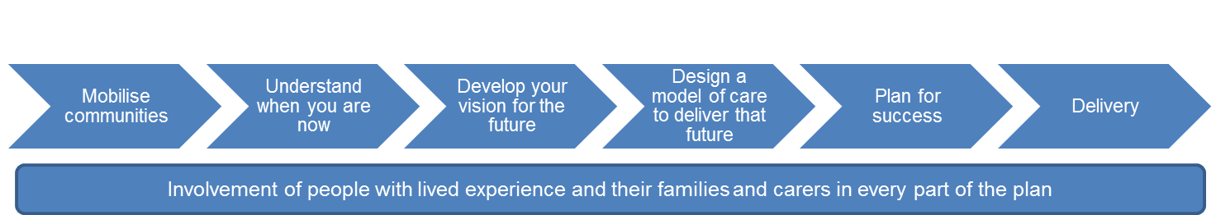
Transforming Care Partnerships
Notes:
Planning process steps

Slide 18
Timetable for Transforming Care Partnerships (TCP’s)
December 2015
Confirmation of arrangements for the partnerships will be in place by 15th December
Regional dialogue events to take place with the TCP’s and stakeholders to discuss expectations and clarify the next steps
NHS England to confirm assurance approach
January 2016
First TCP board meetings to take place
Support available to partnerships to help with planning
February 2016
Draft plans to be submitted by 8th February
NHS England and other stakeholders to undertake review and assurance of TCP plans locally
March 2016
TCP’s to revise plans according to local and regional feedback
April 2016
Final TCP plans submitted and implementation commences
Notes:
Timescale for delivery

Slide 19
Mobilise
Understand
Vision
Leadership
Governance
Organisations
Capacity
Population
Need
Finance
Baseline
Gaps
Model
Change
Outcomes
Alignment
Design
Plan
Delivery
People
Innovation
Evidence
Engagement
Scale of challenge
Priorities
Transition
Pace
Reconfiguration
consultation
Benefits
Monitoring progress
Support
Notes:
Reinforce need for partnerships to take all necessary steps to be ready to go – don’t underestimate scale of challenge

Slide 20
Local Engagement
Local stakeholders
Current and potential providers
Multiple commissioning organisations
People with lived experience
Families and carers
Advocacy
Notes:
Further reinforce that engagement early is the key to success

Slide 21
Strong stakeholder engagement:
providers of all types (inpatient and community-based; public, private and voluntary sector) should be involved in the development of the plan, and there should be one coherent plan across both providers and commissioners. Stakeholders beyond health and social care should be engaged in the process (e.g. public protection unit, probation, education, housing) including people with direct experience of using inpatient services.
Notes:
And again

Slide 22
Reconfiguration? Consultation?
Any reconfiguration programme must take into account the responsible organisations statutory responsibilities and will need to be reported through existing mechanisms to the Oversight Group for Service Change and Reconfiguration.
TCPs will need to factor in formal consultation with all relevant stakeholder and governance organisations
Notes:
Reinforce that they need to think of the formalities early

Slide 24
Enabling and Supporting
Dialogue Events
December 2015

Slide 25
Personal Health Budgets
Notes:
Separate slides for PHB and film

Slide 26
Support package during planning phase
Each TCP to get 2 independently facilitated workshops: one on building shared understanding of current system strengths/weaknesses; one on building shared future model of care
Potential for contribution towards costs of project management
Regional workshops on personal health budgets. Contact diane.domenico@nhs.net if you also want a PHB expert at your future model of care workshop (see above).
Be part of preparation of national “model service specifications” for key services to help aid your thinking. Contact kevin.elliott@nhs.net
Notes:
In planning and further information out to TCPS asap

Slide 27
Longer term service improvement
exploring the establishment of a national collaborative improvement programme (co-ordinating peer-learning and shared problem solving between local areas), and a national accelerated support team able to work intensively with local areas with the biggest challenges and/or struggling to make progress
Notes:
Reinforce need to use evidence and service improvement methodology to make sustainable change – bid in through programme budget to develop a change programme of support

Slide 28
Provider Development
To support and encourage the Provider community so they can develop innovative/creative approach to service delivery which meets the needs of the people with learning disabilities and the commissioners
Looking at
Innovative funding mechanisms
Options for accessing development support
Workforce development critical
process for using innovation fund to explore/ test new ways
Notes:
Acevo and mencap pilots
Providers want to help and willing to come alongside / secondments etc - make offer

Slide 29
FAQs
Working with Fast tracks and key stakeholders to refresh
Key questions
money
milestones
Further questions?
Contact alyson.taylor4@nhs.net
Notes:
Send in your questions

Slide 31
Planning and Assurance
Dialogue Events
DECEMBER 2015

Slide 32
Planning
Plans should be consistent with Building the right support and the national service model developed by NHS England, the LGA and ADASS, published on Friday 30th October 2015.
This is about a shift in power. People with a learning disability and/or autism are citizens with rights, who should expect to lead active lives in the community and live in their own homes just as other citizens expect to. We need to build the right community based services to support them to lead those lives, thereby enabling us to close all but the essential inpatient provision.
To do this people with a learning disability and/or autism and their families/carers should be supported to co-produce transformation plans, and plans should give people more choice as well as control over their own health and care services. An important part of this, is through the expansion of personal budgets, personal health budgets and integrated budgets
Strong stakeholder engagement: providers of all types (inpatient and community-based; public, private and voluntary sector) should be involved in the development of the plan, and there should be one coherent plan across both providers and commissioners. Stakeholders beyond health and social care should be engaged in the process (e.g. public protection unit, probation, education, housing) including people with direct experience of using inpatient services.
Notes:
Panning template in gateway
Main thing to complete is a narrative template and the finance and activity schedule

Slide 33

Assurance Principles
TCP Self assessment
Local assurance
Regional moderation
National escalation
Notes:
Main process

