Slide 1



10 things students should know about the UK graduate labour market
Charlie Ball (Prospects)
Tristram Hooley (Institute of Student Employers)

Slide 2
10 things about the UK graduate labour market
It doesn’t exist
It is quite stable (and recently stagnant)
It doesn’t look too bad (right now)
A new recession is possible
Place matters
Recruitment is as much art as science
Occupational shortages
Life isn’t fair
Graduate schemes aren’t everything
There is a lot we don’t know

Slide 3
1. It doesn’t exist
The UK graduate labour market is a series of discrete, sometimes (but not always) local and regional labour markets which usually influence the markets around them
It is also part a global market that influences what opportunities are available for graduates.
And don’t forget most people in the UK are not graduates, and most jobs are not graduate level
Notes:
Charlie
Eg London is very different to the rest of the country. Very business services oriented, and so it drags neighbouring labour markets toward business
services too, but still, most graduates who start their career in London are from London
And the other big UK urban labour markets are different as well
Manchester is more marketing/sales
Glasgow has loads of finance and law
Belfast is very, very VERY IT

Slide 4

2. It is quite stable
The past is an amazingly reliable guide to the future.
The jobs that graduates were doing last year, will probably be the jobs that they will be doing next year.
Notes:
Tristram

Slide 5
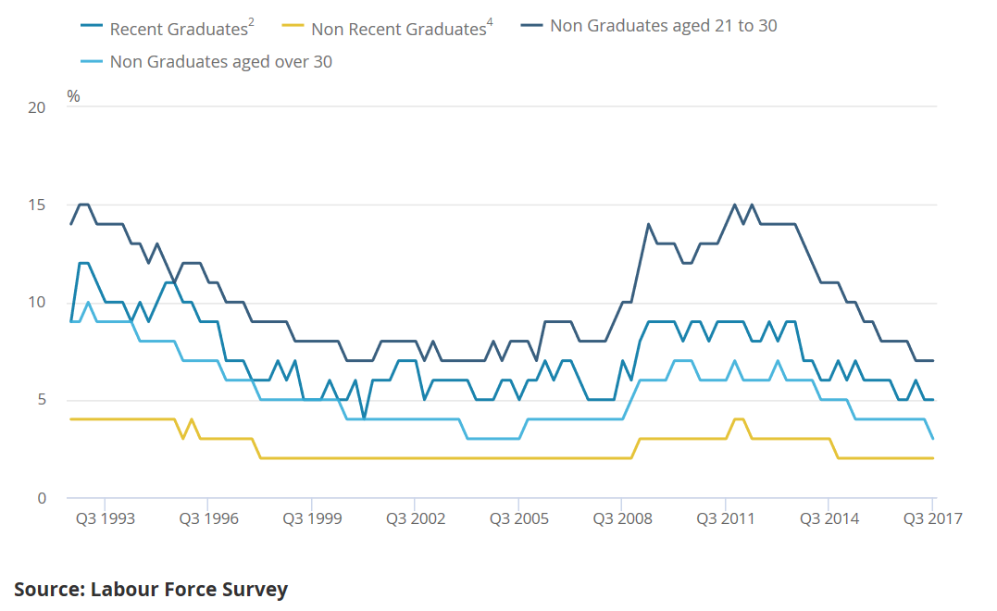
Graduate unemployment

Slide 6
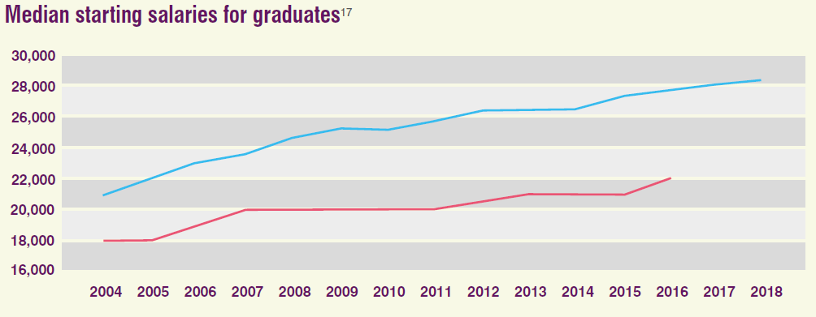
Salaries are increasing steadily

Slide 7
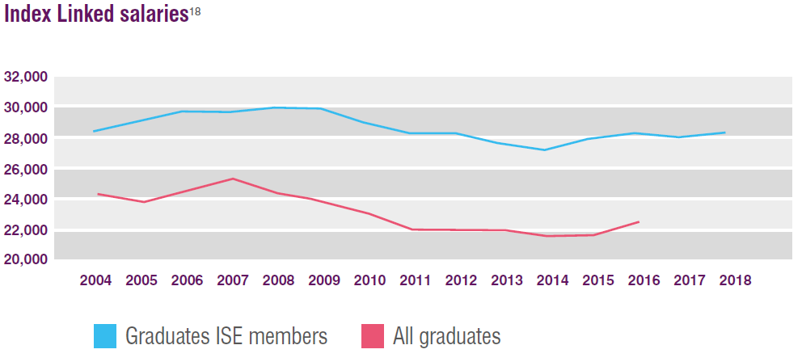
But they are barely keeping up with costs

Slide 8
3. It doesn’t look too bad
2017 graduates after six months
Data comes from HESA Destination of Leavers of Higher Education 2016/17
Notes:
Best outcomes figures since 2007

Slide 9
3. It doesn’t look too bad
Most common professional level occupations for new graduates from 2017
Nurses | 15830 | Specialist teaching and other educational professionals | 2135
Marketing | 5975 | Sales accounts and business development managers | 1960
Medical practitioners | 5710 | Social workers | 1900
Primary and nursery teaching | 5475 | Management consultants and business analysts | 1895
General and niche business professionals | 4055 | Legal associate professionals | 1860
Programmers and software developers | 3915 | Graphic designers | 1755
Finance analysts and advisers | 2895 | Photographers, audio-visual and broadcasting equipment operators | 1660
Human resources, recruitment industrial relations officers | 2805 | Midwives | 1640
Chartered and certified accountants | 2405 | Secondary education teaching professionals | 1600
Welfare and housing | 2290 | Sports coaches, instructors and officials | 1595
Business sales executives | 2170 | Events managers | 1540
Pharmacists | 2165 | Arts officers, producers and directors | 1510
Data comes from HESA Destination of Leavers of Higher Education 2016/17
Notes:
Best outcomes figures since 2007
Not really clear what point this slide is making

Slide 10
3. It doesn’t look too bad (right now)
14.47m people working in professional level jobs in the UK
Or 45.3% of the workforce
329,325 first degrees awarded to UK domiciled graduates last year. Rise of 12,635 on 2016 – up about 4%
The majority were working after six months – 74.3%
Unemployment was at 5.1% - lowest rate since 1988/89.
APS data also shows that the UK added 298,100 new professional level jobs last year
But warning signs now showing

Slide 11
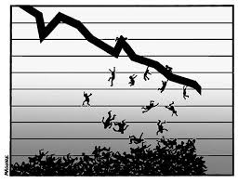
4. A new recession is possible

Slide 12

The B word

Slide 13
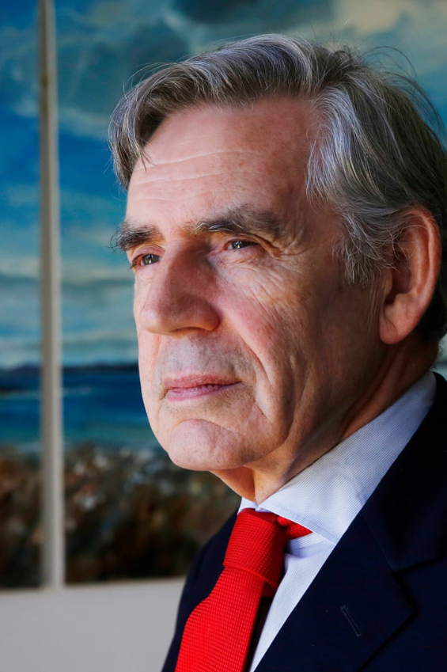
Economic vulnerability
“We are in danger of sleepwalking into a future crisis… There is going to have to be a severe awakening to the escalation of risks, but we are in a leaderless world… In an interconnected world there is an escalation of risks. We have had a decade of stagnation and we are now about to have a decade of vulnerability.”
Gordon Brown

Slide 14
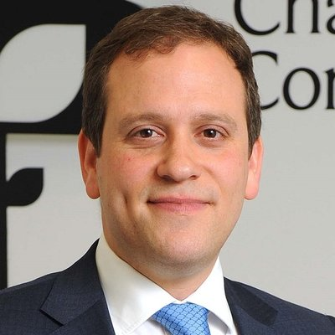
Signals from the labour market
“The sharp deterioration of the share of firms attempting to recruit is a concern and reflects both persistent hiring difficulties and heightened economic uncertainty - which if sustained could materially weaken jobs growth.”
Dr Adam Marshall, Director General, British Chambers of Commerce BCC Quarterly Economic Survey Q3 2018 – 8th October 2018

Slide 15
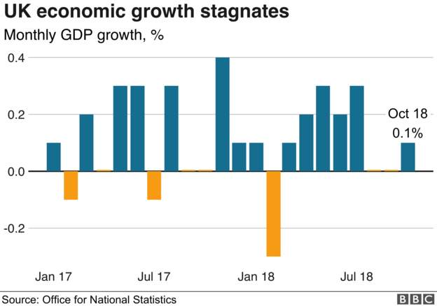
Stagnating growth
Data from Monday 10th December
Notes:
Best outcomes figures since 2007

Slide 16
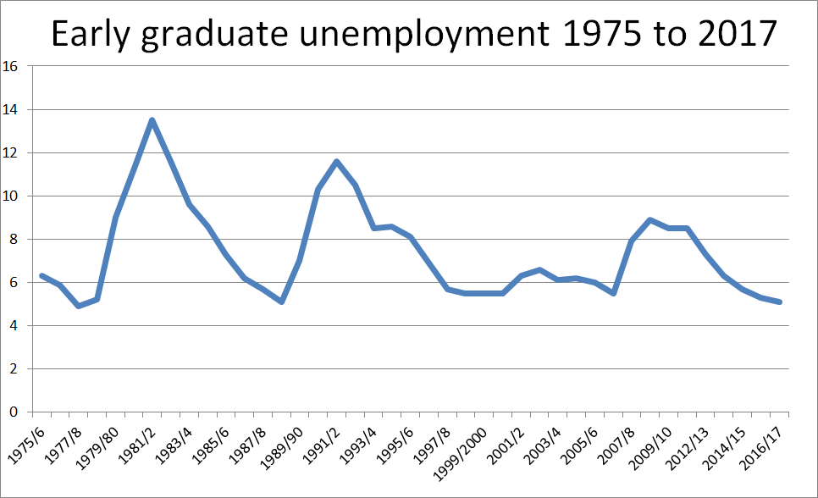
Impact on graduates
But if/when it comes, graduates will modestly, but not excessively, affected
Notes:
Best outcomes figures since 2007

Slide 17
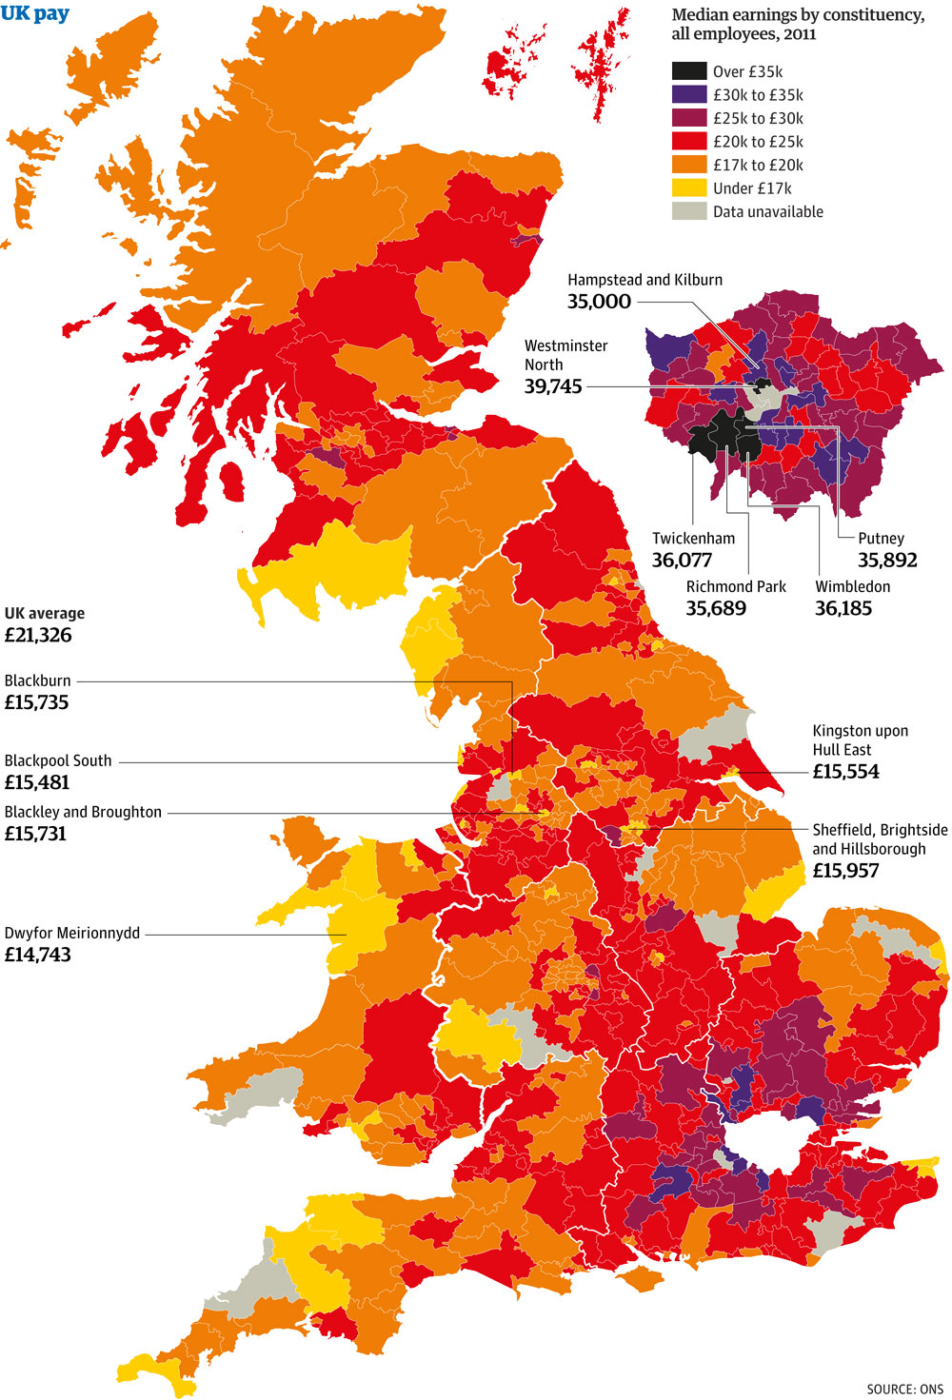
5. Place matters!

Slide 18
5. Place matters! London’s the most important graduate jobs market in the country
14.7% of the UK population lives in London
19.8% of UK graduates live in London
22.4% of 2016 graduates started their career in London. Many of those jobs were confined to a relatively small area of London.
Starting salary for graduates in London was £24,991 compared to £22,399 for UK as a whole

Slide 19
5. Place matters! But you don’t have to work in London, and most graduates don’t
Where 2017 graduates went to work
London 41,290 graduates
Birmingham 4670
Manchester 4420
Leeds 3625
Glasgow 3370
Edinburgh 2530
Liverpool 2445
Bristol 2390
Belfast 2385
Sheffield 2145
Cardiff 2115
Newcastle 1945
Nottingham 1790
Leicester 1545
Graduates are becoming more concentrated in large cities
Around a third of all graduates starting work in England last year were in one of 4 cities – London, Birmingham , Manchester or Leeds.
The periphery may be losing out on their share of graduates
Evidence that graduate mobility is stagnating or even falling
Notes:
This slide needs to be tidied up a bit.
It also needs to be analysed more e.g. grouping all of the London examples.

Slide 20
5. Place matters! Graduates may not be very mobile
58% of graduates from 2017 went to work in the region they studied in
69% went to work in the region they were originally domiciled
Only 18% of graduates went to work somewhere they were not already connected to
Because 45% never moved. They went to a local institution and got a job locally.
Cost of living issues are becoming more important, and are outrunning salary increases
These means that for many graduates, a move to London may not necessarily make financial sense

Slide 21
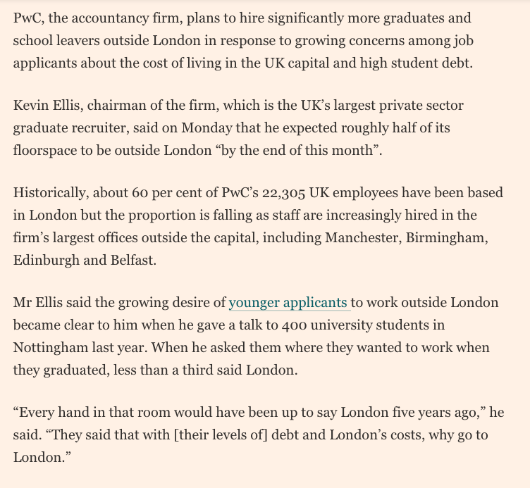
5. Place matters! But you don’t have to work there, and most graduates don’t
From the Financial Times,
September 17th 2018

Slide 22

6. Recruitment is as much an art as a science

Slide 23
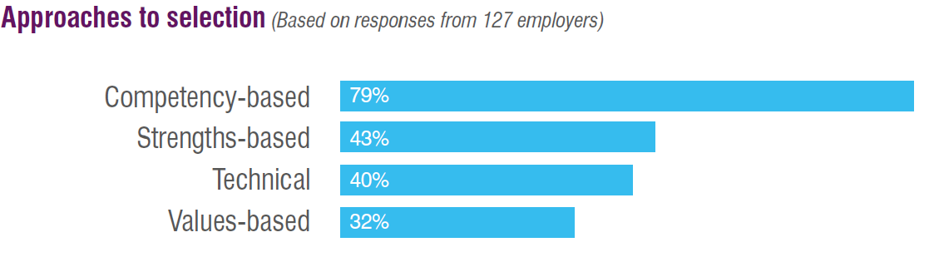
Employers are using a mix of approaches to recruitment and selection
A lot of evidence of pragmatism and hybrid approaches. E.g. 55% of employers say that they are doing two or more of the above.

Slide 24
What do different approaches predict?
Selection approach | % of ISE employers using it | % of performance it predicts
Assessment centres | 89% | 39%
Psychometric tests | 71% | General intelligence (65%) Integrity (46%) Conscientiousness (22%)
F2F interviews | 71% | 58%
CV screening | 66% | 35%
Degree | 58% | Years of education (10%) GPA (34%)
Phone interviews | 39% | 46%
Reference checks |  | 26%
https://www.testingtalent.net/wp-content/uploads/2017/04/2016-100-Yrs-Working-Paper-on-Selection-Methods-Schmit-Mar-17.pdf

Slide 25
7. There are currently significant shortages of graduates
Nurses
Programmers and software development professionals
HR and recruitment
Medical practitioners
Welfare and housing associate professionals
Business sales executives
IT user support technicians
Sales accounts and business development managers
Marketing associate professionals
General and specialist engineers
Managers and directors in retail and wholesale
Design and development engineers
Web design and development professionals
Veterinarians
Chartered and certified accountants
Have the largest numbers of vacancies employers report as ‘hard to fill’

Slide 26
7. There are currently significant shortages of graduates
Hardest graduate jobs to fill
Highest proportion of HTFs | Proportion of all vacancies that were HTF last year
Medical practitioners | 93.0%
Veterinarians | 86.8%
Draughtspersons | 72.6%
Nurses | 72.1%
Electronics engineers | 63.3%
Electrical engineers | 58.8%
Civil engineers | 57.9%
Quantity surveyors | 56.6%
Web design and development professionals | 54.1%
Design and development engineers | 53.9%
Environment professionals | 52.6%
Pharmacists | 52.5%
Estimators, valuers and assessors | 52.2%
Programmers and software development professionals | 50.0%

Slide 27

8. Life isn’t fair
Notes:
Tristram

Slide 28
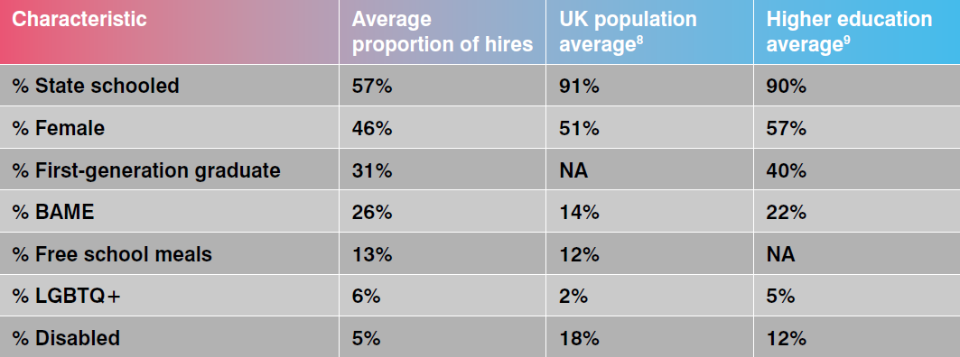
Hires by characteristic

Slide 29
Employers want to increase the diversity of their workforce
Current hires are not representative of the population. those who have attended state schools, women, first generation graduates and disabled people are the most under-represented groups.
Almost all employers are prioritising diversity. With some very focused on multiple diversity strands.
77% are changing attraction and marketing.
67% are changing recruitment and selection.

Slide 30
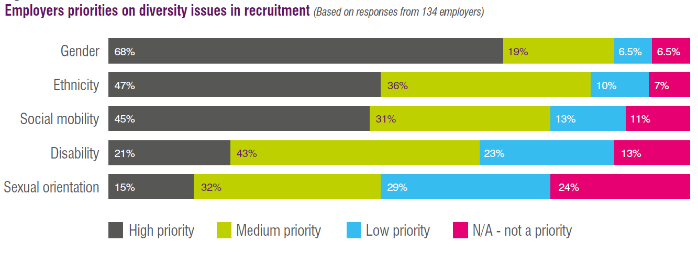
Priorities on diversity

Slide 31

9. Graduate schemes aren’t everything

Slide 32
Other options
Recruiting ‘direct to desk’ in larger companies
Large companies that aren’t big enough to have a graduate scheme
SMEs
Non-graduate roles
Self-employment

Slide 33
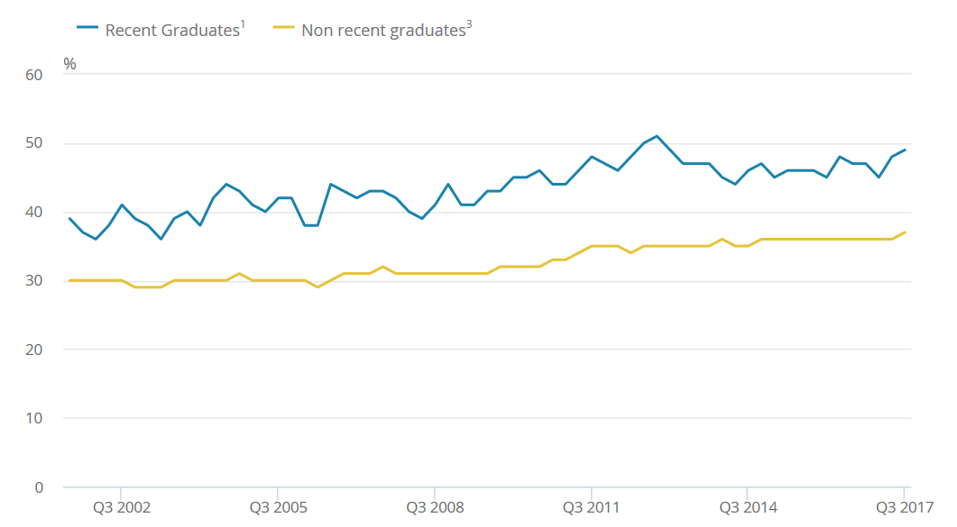
Grads in non-grad roles
https://www.ons.gov.uk/employmentandlabourmarket/peopleinwork/employmentandemployeetypes/articles/graduatesintheuklabourmarket/2017#graduates-and-non-graduates-in-work

Slide 34
Grads in SMEs
30% of graduates went to work for companies with fewer than 250 employees.
One in six graduates went to work for companies with fewer than 50 employees.
SMEs are important in the telecoms, arts, design, architecture, marketing/PR/advertising, sport/fitness, law, web design sectors.
SME graduate employment stronger (as a proportion of employment) in London and south of England, and in non-urban areas.
The proportion entering SMEs does seem to be falling, as many occupations in demand at SMEs are in shortage and SMEs are outcompeted.

Slide 35
10. There is a lot we don’t know
In particular, most of the most detailed data comes very early in graduate careers (less than a year) and even the data that comes furthest out is usually in the first decade of people’s careers
That means we don’t know an awful lot about graduate careers beyond the age of about 30
Which is a bit of a problem as most new graduates will be working well into their 60s
Or, to put that into perspective, someone graduating in 2018 will likely still be working in 2070.
And to put that into perspective, when graduates retiring this year started their A levels, Neil Armstrong hadn’t walked on the moon yet and England were the World Cup holders.

Slide 36
About us
Tristram Hooley
Charlie Ball
Chief Research Officer
Institute of Student Employers
tristram@ise.org.uk
@pigironjoe
Head of HE Intelligence
Graduate Prospects
c.ball@prospects.ac.uk
@lmicharlie

