Slide 1


Implementation of the South Marine Plan
Dorset Coastal Forum
Abby Haines
Notes:
Introductions
Ask about their existing knowledge of marine planning.

Slide 2
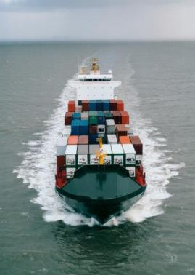
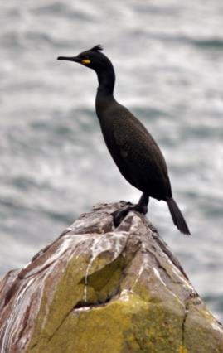
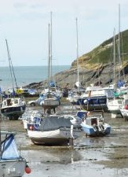
Benefits of marine planning
makes sure the right activities take place in the right place and in the right way placing sustainable development at the centre of all decisions
managing the increasing demands on space and resources
greater clarity and guidance on what activity should or should not take place
enables sustainable economic growth whilst protecting the environment
stronger understanding of the local marine resources and activities and their potential
providing local direction on how a marine area can be developed
better access to data

Slide 3
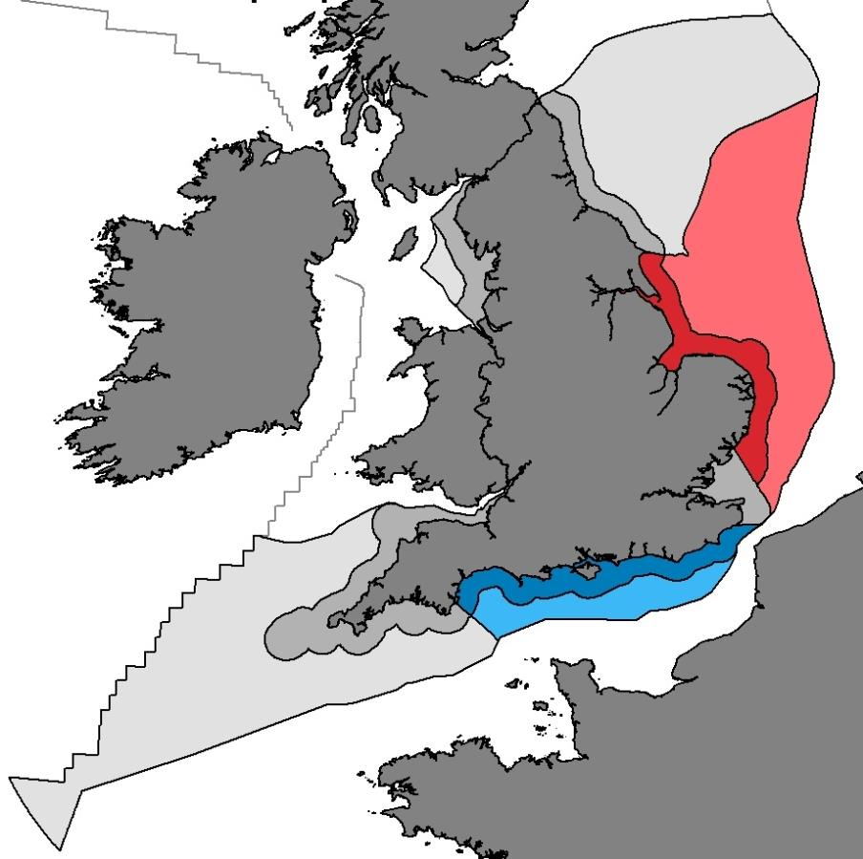
Progress to date
East Inshore and Offshore adopted April 2014
South Inshore and Offshore adopted July 2018
Notes:
There was a long period of time before the South Plan was adopted. The South plan was written and ready to go in 2016 however, due to a series of major political changes over the past couple of years, it’s taken a long time for the plan to actually get adopted.

Slide 4
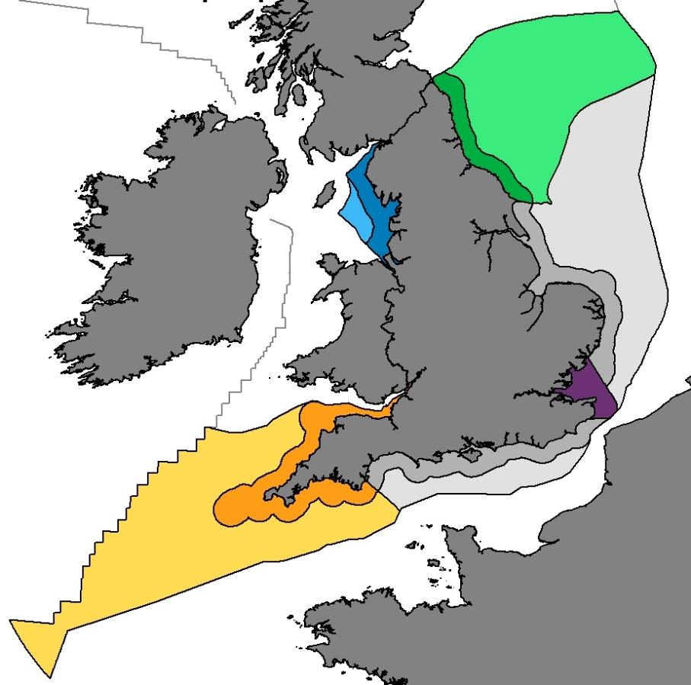
Developing new plan areas
NE, SE, SW, NW developed concurrently
Publish all by 2021*
Iterative approach- Iteration 3, Summer 2018 – Spring 2019
NE
* Adoption by 2021. Aim for June 2020 for contingency, or any Independent Investigation if required

Slide 5
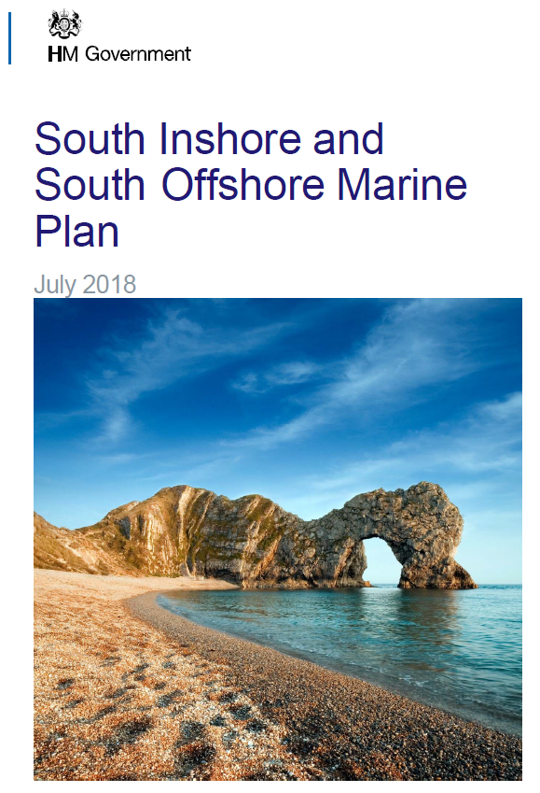
The South Marine Plan Documents
Documents
Marine Plan
Technical Annex
SA
HRA
Approach to Monitoring
Modifications report
Marine Plan Vision
Marine Plan Objectives
Marine Plan Policies
Folkstone in Kent to the River Dart in Devon. Up to mean high water spring mark. Out to French/Channel Island jurisdiction.
https://www.gov.uk/government/publications/the-south-marine-plans-documents
Notes:
SA- sustainability appraisal
HRA= Habitats regulation assessment

Slide 6
Implementing the marine plan
Why do I need to take account of marine plans?
It is a legal requirement for marine plans to be considered in all decisions that affect England's marine area, now and into the future.
Decisions that take account of marine plans:
have a reduced risk of legal challenge
are informed by the best available evidence
and are considered against wider context, both on land and at sea
This means that England's marine area is managed sustainably and time and money can be saved.

Slide 7
The value of implementation
Successful application of marine plans will help to:
shape the prosperity of the region for now and into the future
draw together the social, economic and environmental benefits across land and sea
strike a balance between local and national aspirations
understand how effective the plans and policies are once monitoring and review takes place
But what is the best way to do this and how can organisations make the most from the marine plans?

Slide 8
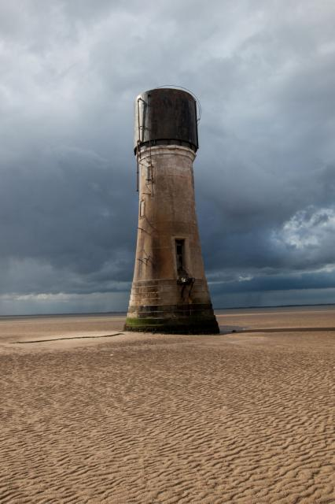
Application of marine plans (MCAA S.58)
Principally through decisions made by public authorities
Authorisation or enforcement decisions must be “in accordance with” the relevant marine planning documents S.58(1)
Decisions not taken in accordance with the marine plans, then the public authority must state its reasons (S.58(2))
A public authority must have regard to marine plans in taking any decision which relates to the exercise of any function capable of affecting the UK marine area (S.58(3))
Exception: decisions on NSIPs under the Planning Act 2008 which must have regard marine plans (S.58(3))

Slide 9
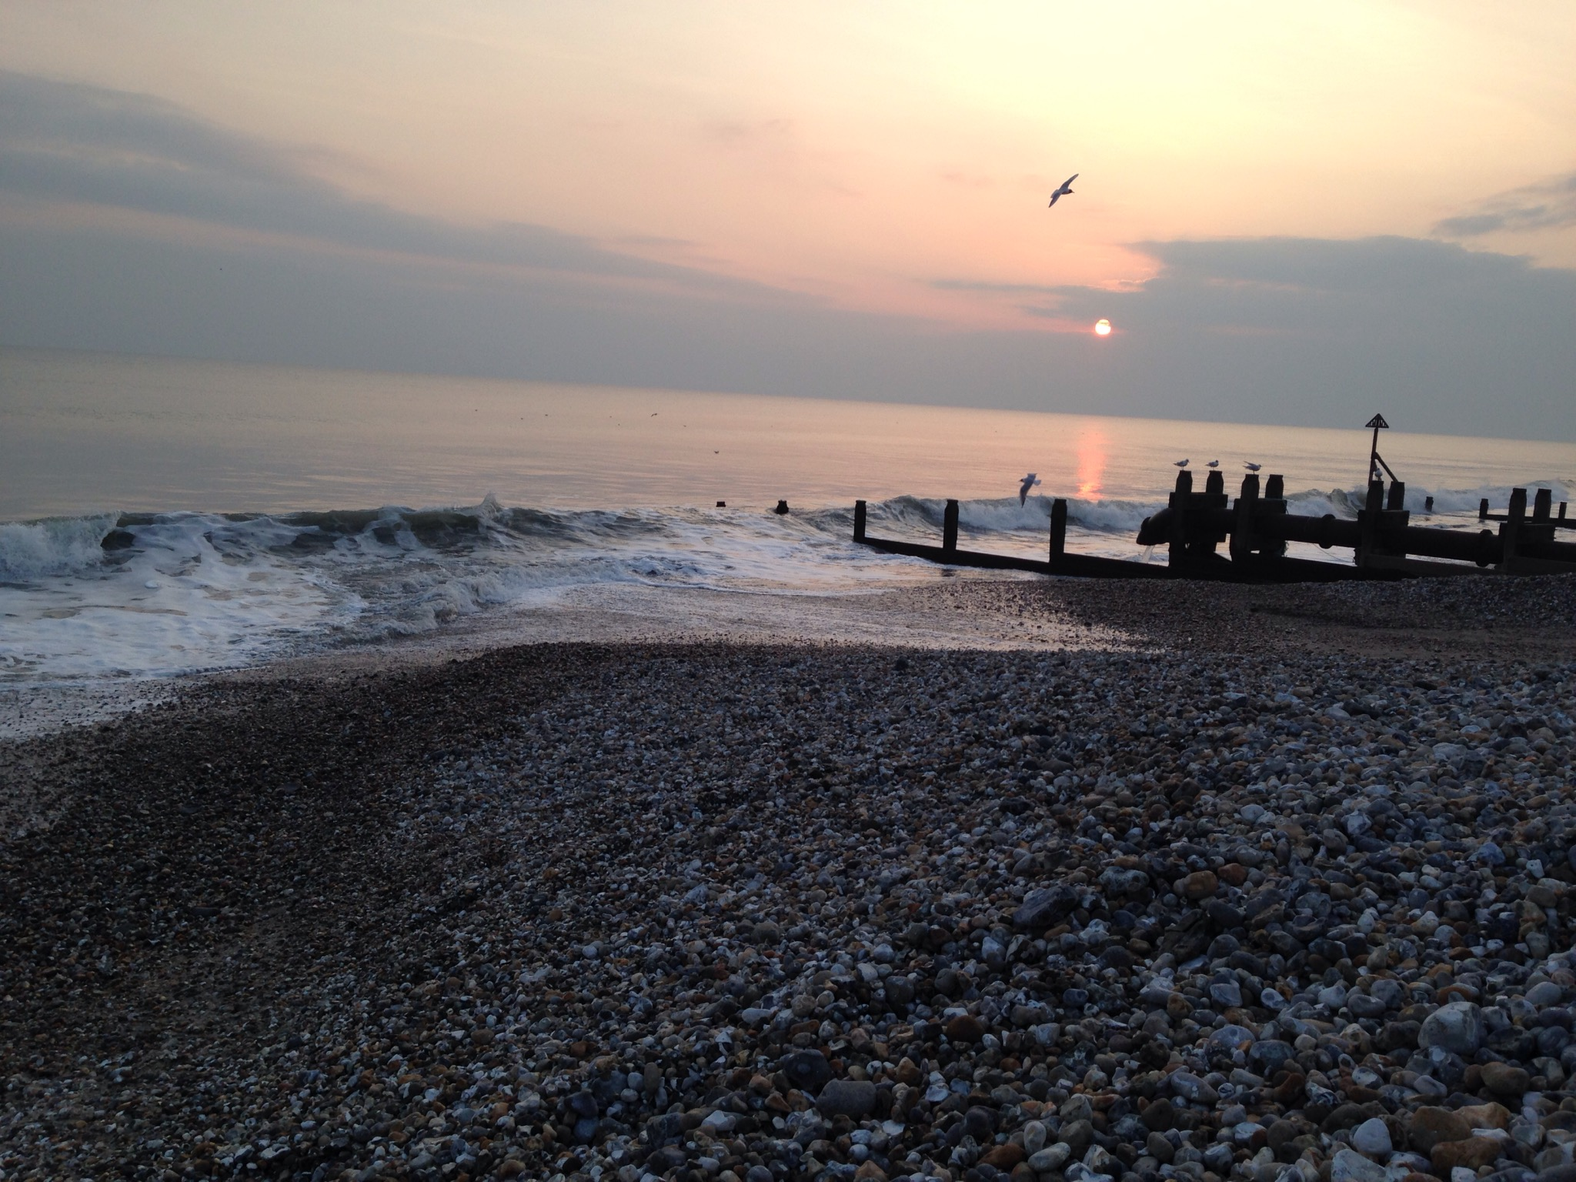
Implementation for applicants
While marine plans are new, use and application is broadly the same as land-based plans
Ideally, applications should consider marine plan policies at the pre-application stage
The need for consideration of the plans as a whole, as it is likely that several plan policies will be pertinent to any proposal
Incorporation of marine plan policy assessment into existing assessments currently completed by applicants

Slide 10

How do we monitor?
Cause and effect models provide the framework for assessing how marine plan policies bring about change
Indicators represent information used to understand this change. This information is drawn from:
Data: large range of topics which reflects the breadth of marine plans (e.g. sector performance economic data, habitat change data, risk status of heritage assets etc.)
Surveys: to gather stakeholders’ views
For more information, see the South Marine Plan Approach to Monitoring here: https://www.gov.uk/government/publications/the-south-marine-plans-documents
December 2018: next South plan monitoring survey is launched online. Please take part!
Notes:
The monitoring approach is published on the MMO website at: https://www.gov.uk/government/publications/the-south-marine-plans-documents
For information on the South plan monitoring survey, stakeholders can contact their local MO, or the Planning mailbox. Also, signing up to the Planning mailbox should ensure people receive a link once the survey is live.

Slide 11
How else can you get involved?
Iteration 3 of South West plans Spring 2019.
Newquay- 5th February
Totnes- 6th February
Bridgewater- 7th February
Dorset Coastal Forum- EMFF enhancing stakeholder engagement project
Yearly monitoring surveys https://www.gov.uk/government/publications/approaches-for-monitoring-the-impact-of-marine-plans
On-going MMO evidence projects: https://www.gov.uk/government/publications/evidence-and-the-marine-management-organisation-mmo/evidence-projects-register
Notes:
There is a list of on-going MMO evidence projects on the .gov website here. We are always looking for input. Some of the most relevant ones:
• The location, condition and features of significant sites for habitat restoration or creation (MMO1135) • The intensity and impacts of non-licensable activity on MPAs (MMO1136) • Social baseline data for marine planning (MMO1132) • Essential fish habitat validation (MMO1133)

Slide 12
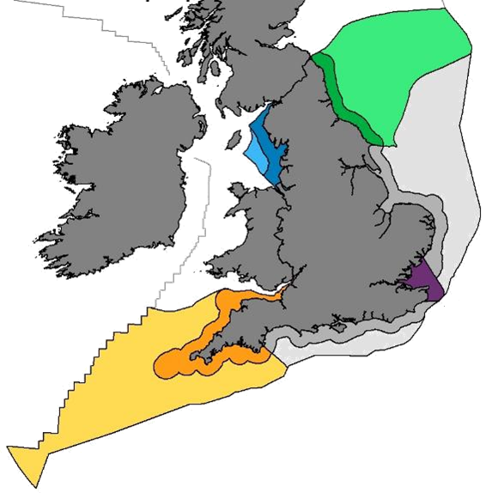
South east:
London
Tom Pavitt
02082 258 857
South west:
Plymouth
Alex Curd
02085 654 835
Bristol
Amy Willcocks
02078 955 620
South:
Poole
Abby Haines
02080 265 506
Shoreham
Mathilda Evans
02082 256 642
Notes:
As was mentioned by the Minister, we are working towards having all of England’s marine plans in place by 2021.
I will speak about the East and South plans later but current development work is focussed on the NW, NE, SE, and SW.
We have local planning officers in each area - if you would like to get involved with marine planning in your area I’d encourage you to get in touch with your local officer.
PRESS
Iterative approach.

Slide 13

Thank You
Abigail.Haines@marinemanagement.org.uk
Mathilda.Evans@marinemanagement.org.uk
Neal.Gray@marinemanagement.org.uk
Marine licencing Case manager for the South:
Lisa Southwood: lisa.southwood@marinemanagement.org.uk
www.gov.uk/MMO
@the_mmo #marineplanning

Slide 14

Questions?

