Slide 1

Guide to Admissions
School admissions Portal
School admissions Team
Deadline date for Secondary 31/10/2019
Deadline date for Infant 15/01/2020
Please note: Some screenshots used are from an older admission round. Nothing changes substantively except the date so this guide is still current.
0115 8415568
schooladmissions@nottinghamcity.gov.uk

Slide 2
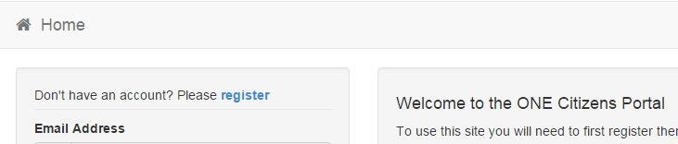
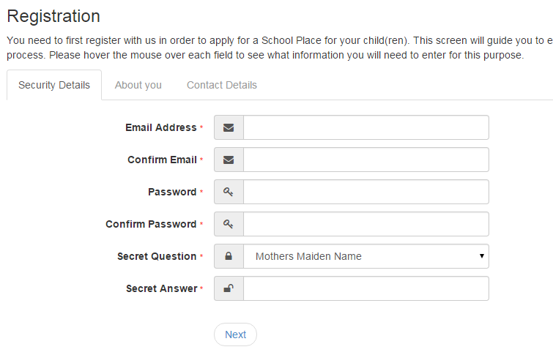
Registration www.nottinghamcity.gov.uk/e-admissions
Click register
Add your security details

Slide 3
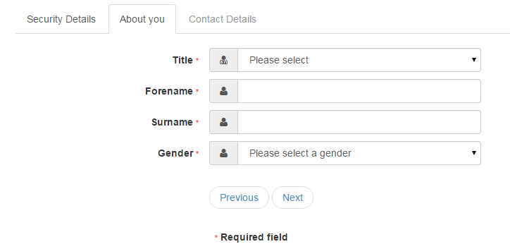
Who you are
Enter your details then click next

Slide 4
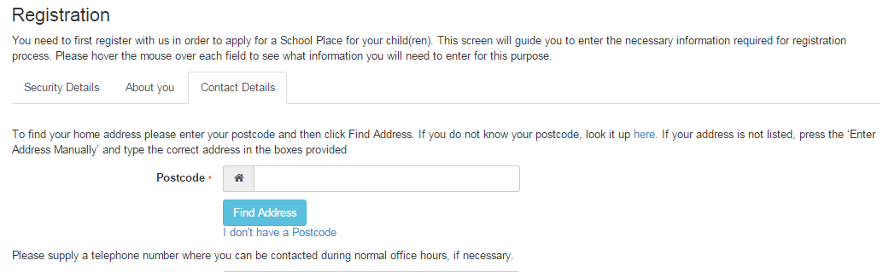
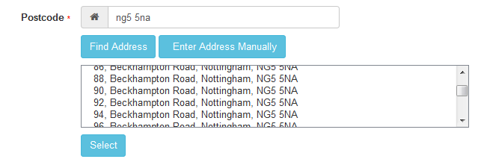
Where do you live
1. Enter your Post Code
2. Find Address
If you don’t find your address you can type it in Enter Address Manually
3. Click on Address
4. Select

Slide 5
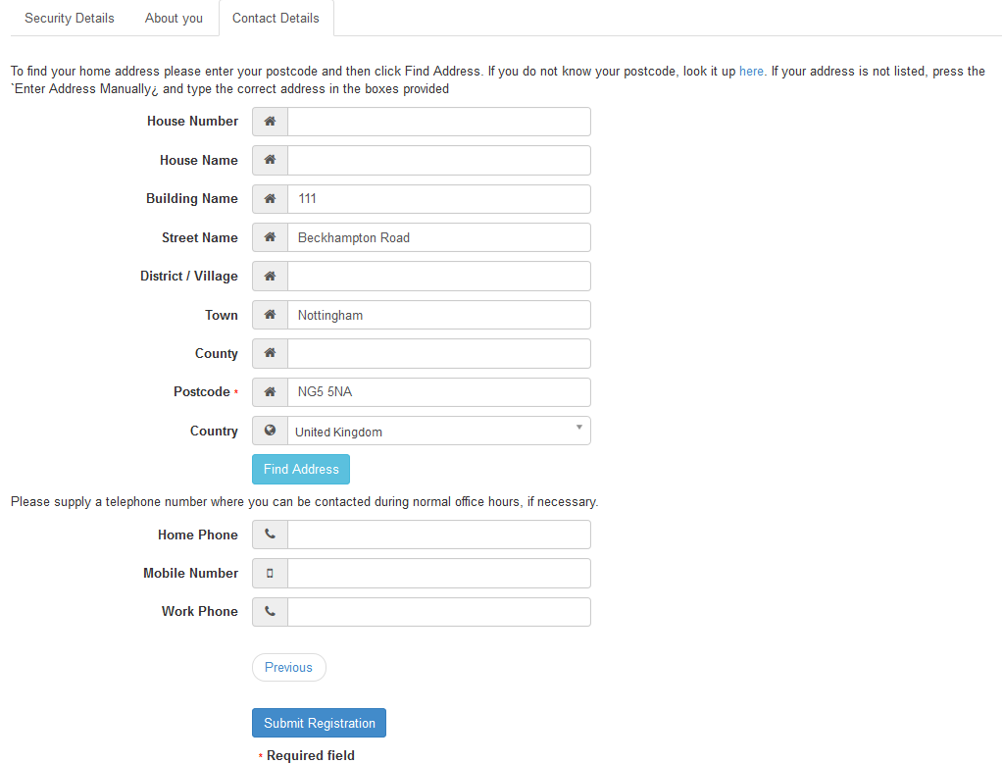
Give us your contact details
Enter your telephone Numbers
Submit Registration

Slide 6
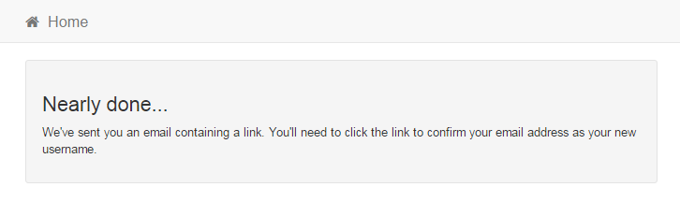
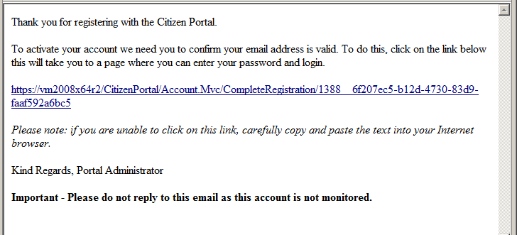
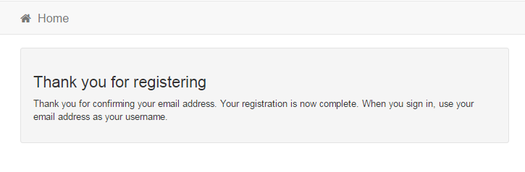
What happens Next
Click on the link
You get an Email
If the email is not in you inbox, check your Junk Mail folder
If the link is not highlighted copy and paste into your browser’s URL box

Slide 7
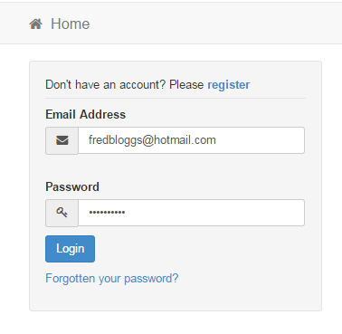
Log in
Email
Password
Login
If you have forgotten your password follow the ‘Forgotten your password?’ link

Slide 8
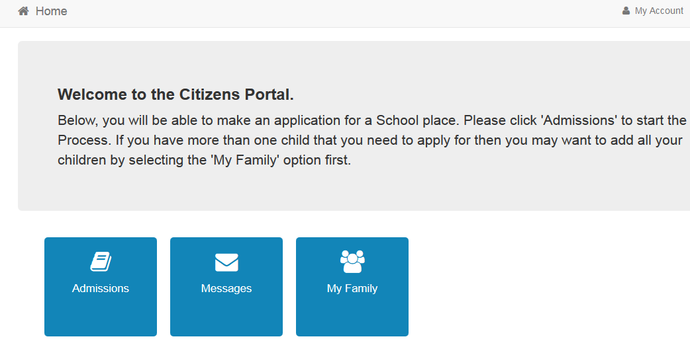
Your Home Page
Click Admissions
If you have more than one child you only need one account

Slide 9
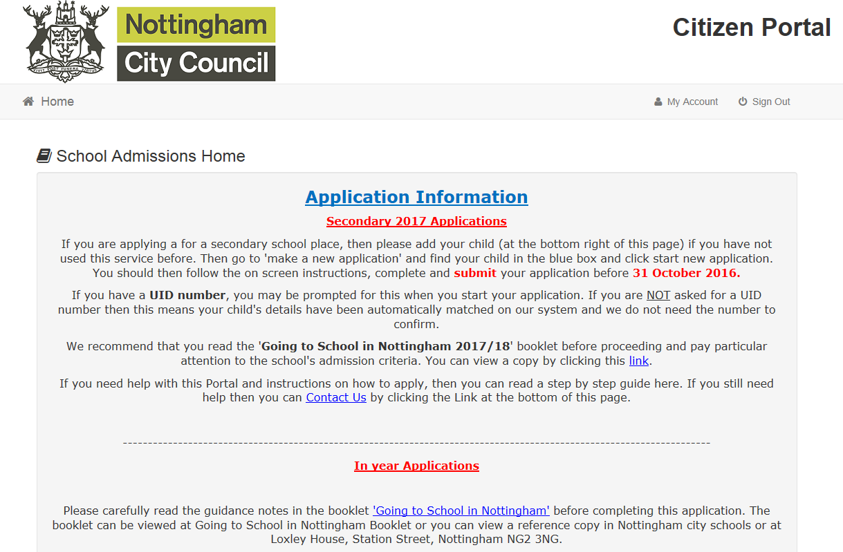
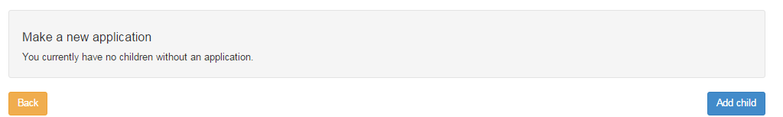
Adding an Application
This is the main landing page. Please read the instructions. At the bottom of the page you can add your child.
If you already have children added via another service or My Family they will be shown here
Click Add Child

Slide 10
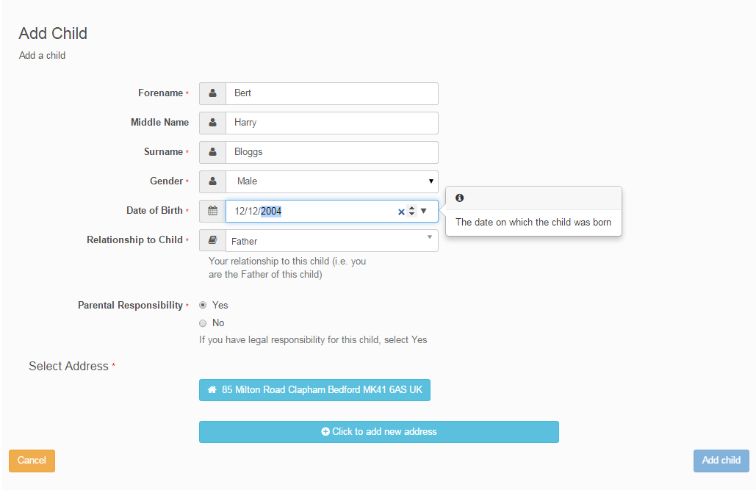
Add your child
Enter your child’s legal names, gender and Date of Birth
Relationship
Confirm they live with you or click in the box below to add their address

Slide 11
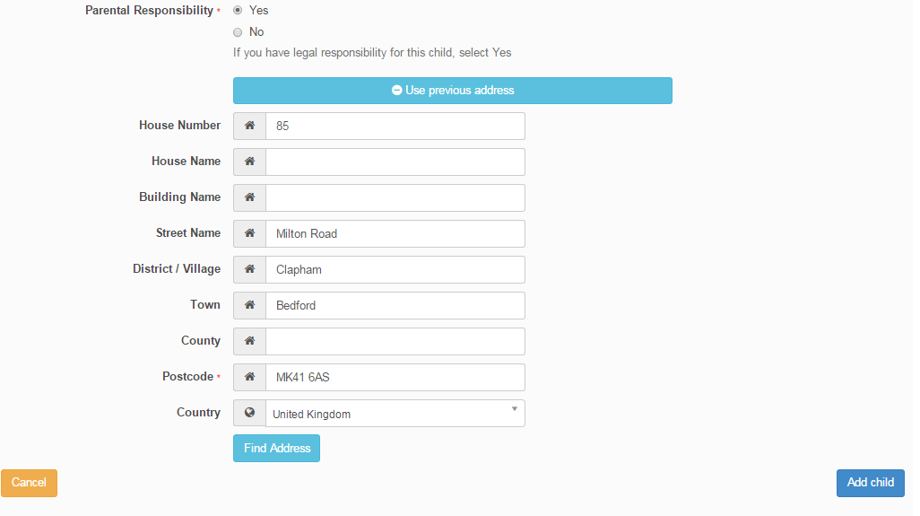
Add Child cont..
Click Add Child

Slide 12
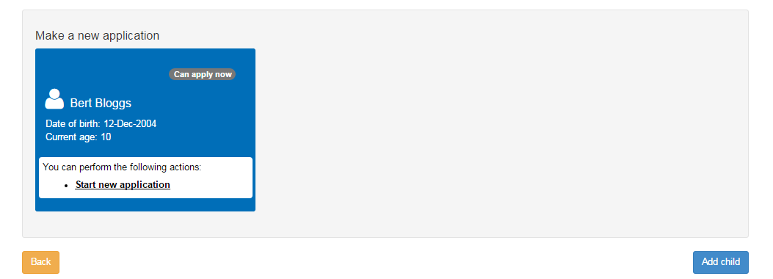
Start the application
Start new Application

Slide 13
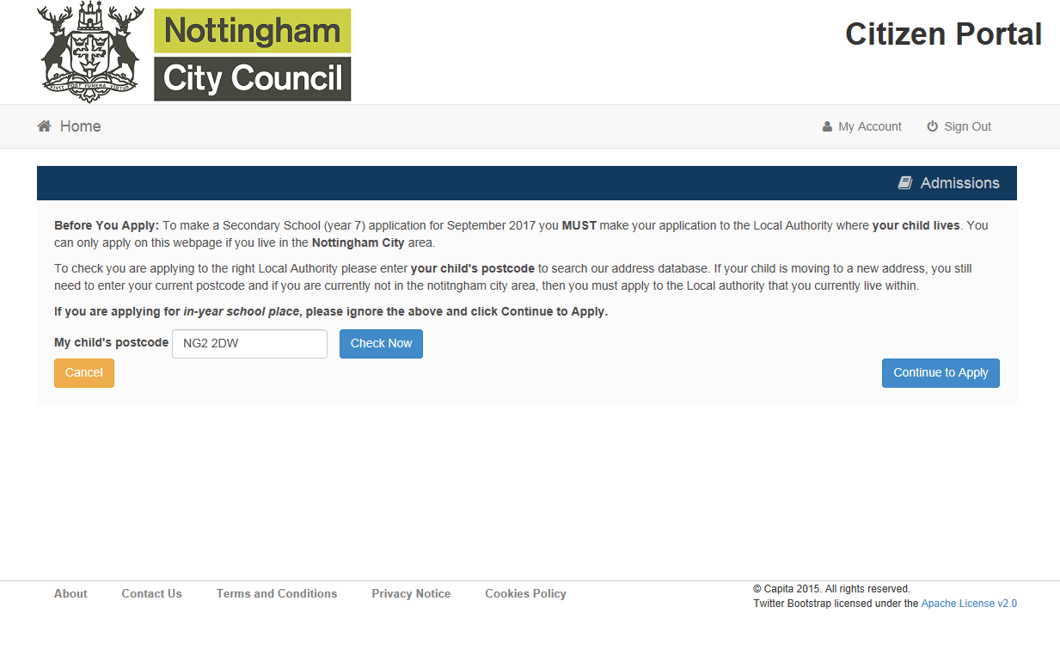
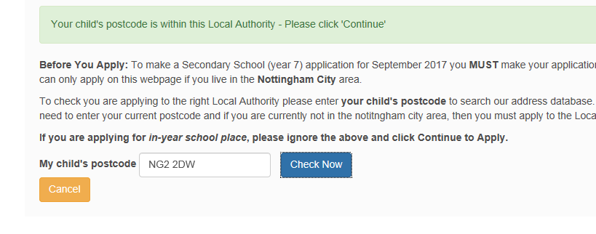

Which Local Authority do you live in?
You should check you are using the right website to apply for a school place. The postcode checker will determine whether you live in our local authority or not. This is very important!
It is the parent’s responsibility to apply on the correct website.
Click to continue

Slide 14
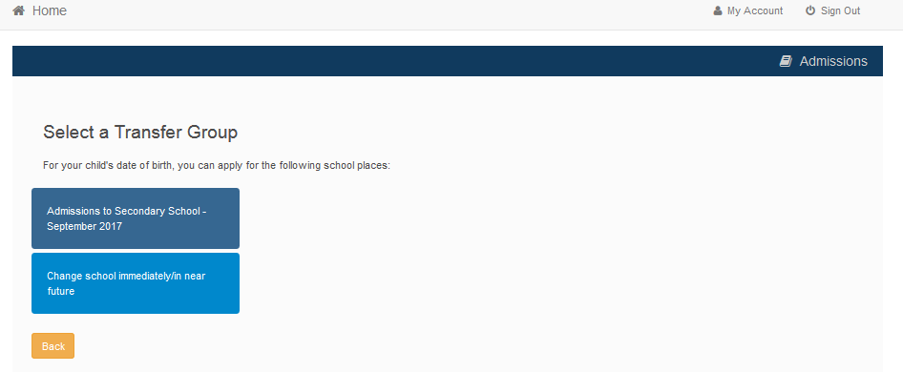
When is your child changing school?
Click this Box (e.g. Admission to Secondary School- September 2020)
2017
If you don’t get a Transfer Group appear (in a blue box), or you only get a box that says ‘Change school Immediately/in –near future’ you are maybe too late (past the deadline) or your child’s date of birth is out of range – either way please contact School Admissions

Slide 15
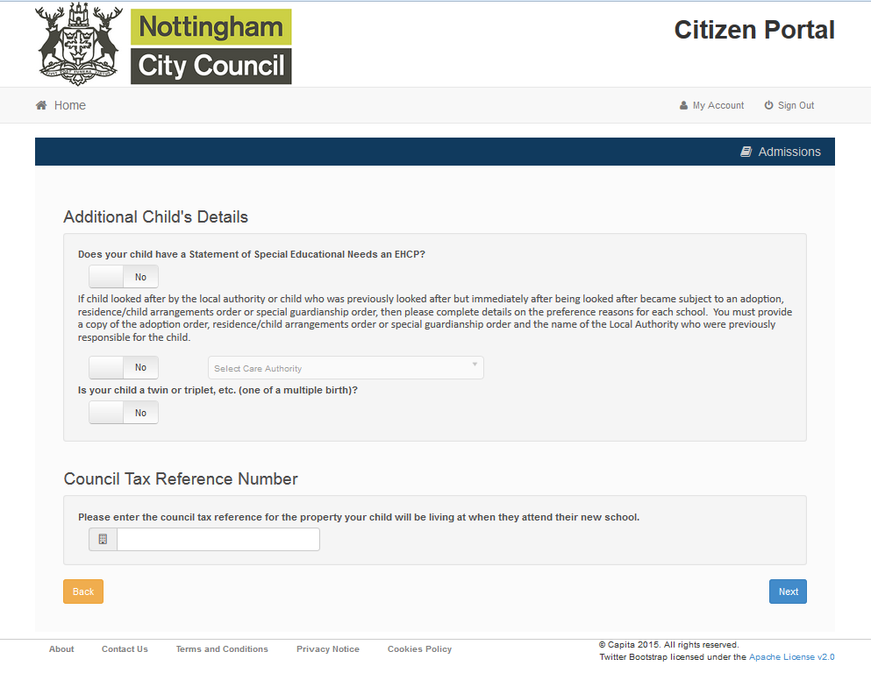
Your child’s details and Council Tax reference
Slide to select
Click Next to Continue
You can click next to continue without entering council tax details. However, please note that we may request this information from you at a later date.

Slide 16
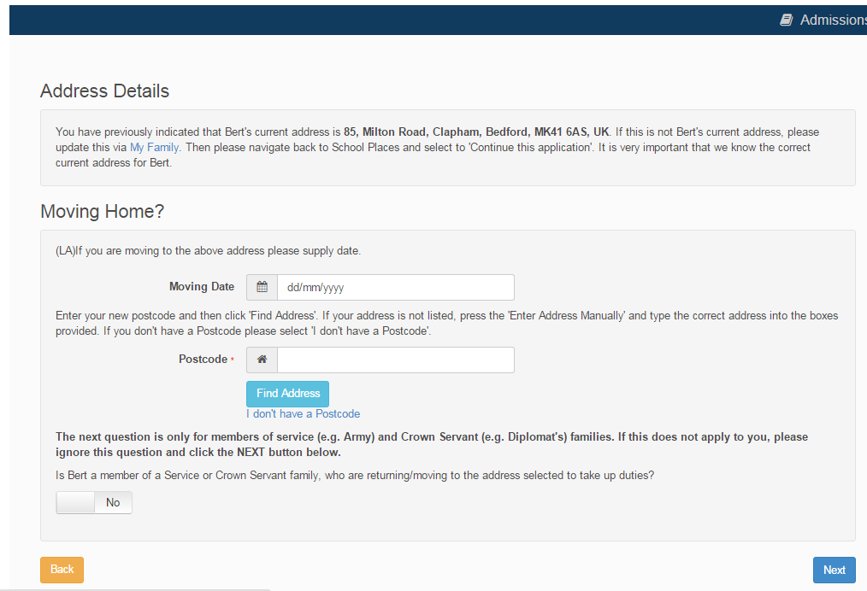
Moving Home?
Next

Slide 17
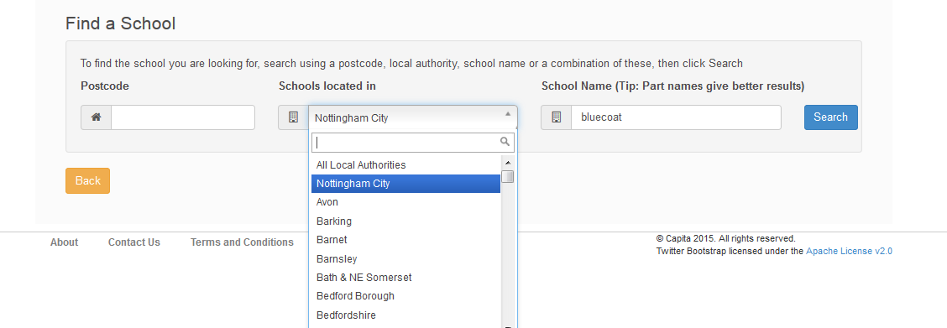
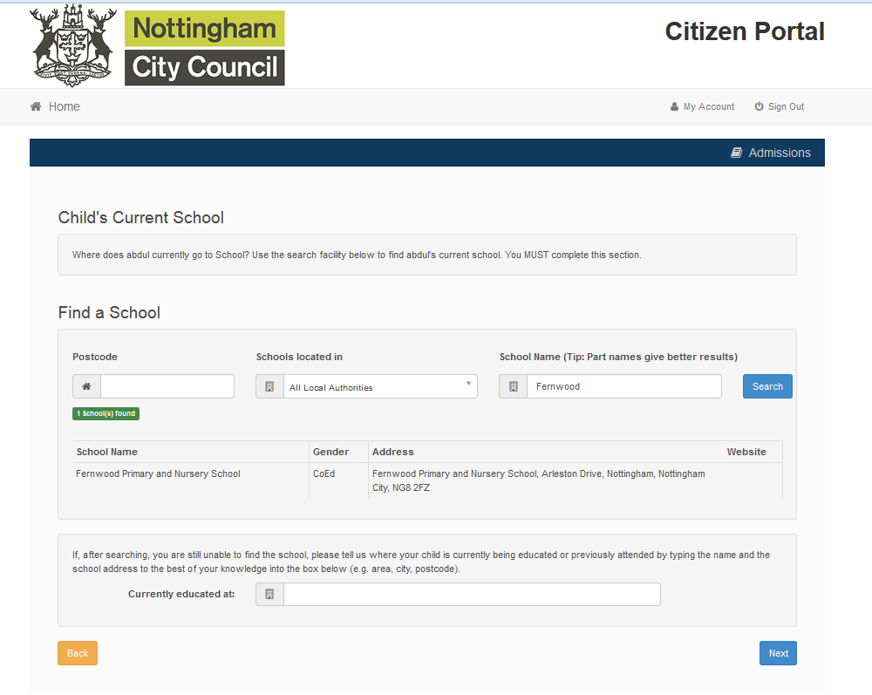
Current School
IMPORTANT – If your child is applying for a place in Reception you will skip this page. If you are applying for a Secondary School place (year 7) then you must complete this.
Select the local authority where your child’s current school is
Search for your child’s current school
Select
If your school is not listed remove the Postcode and change the Schools located in to your local authority

Slide 18
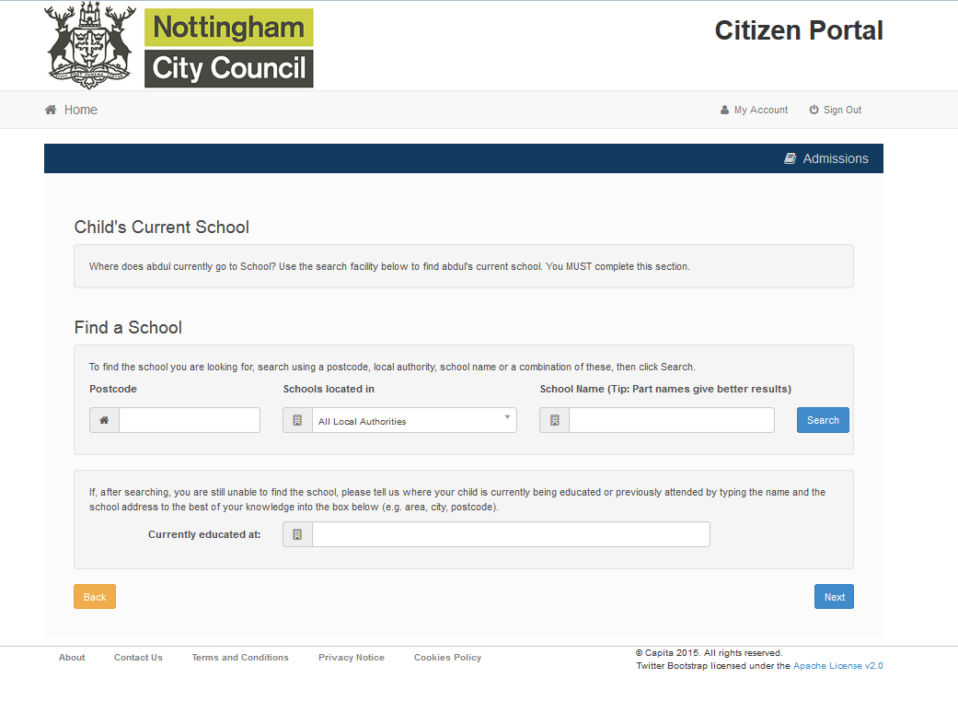
Confirm School
Next
If your child is not in school please tell us in the box at the bottom

Slide 19
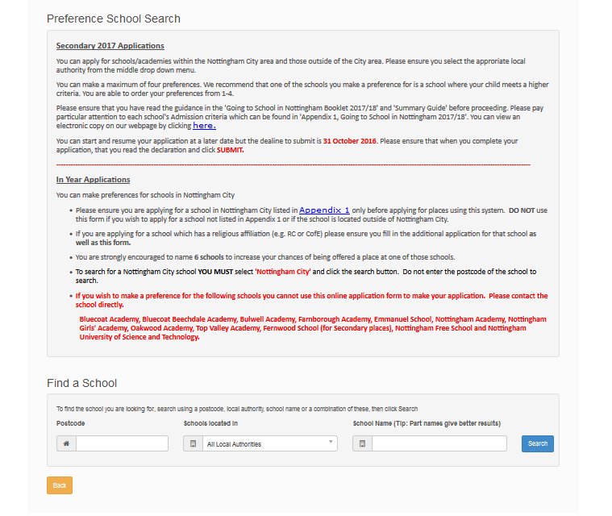
Your Preferences
Schools Located In.
YOU MUST SELECT NOTTINGHAM CITY for CITY SCHOOLS
Search for your school
IMPORTANT! If searching for schools by postcode, you must add the postcode of the school, not your own
If your school is not listed remove the Postcode and change the Schools located in to your local authority and enter part of the school name

Slide 20
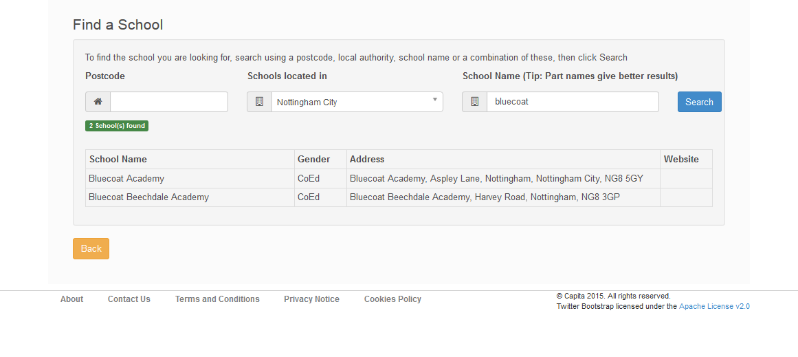
Selecting a school
Select the school which you wish to apply for

Slide 21
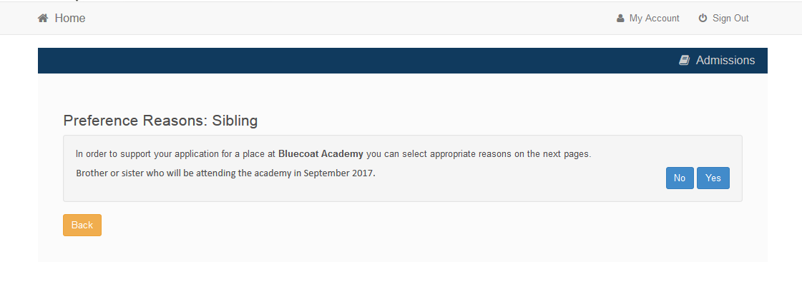
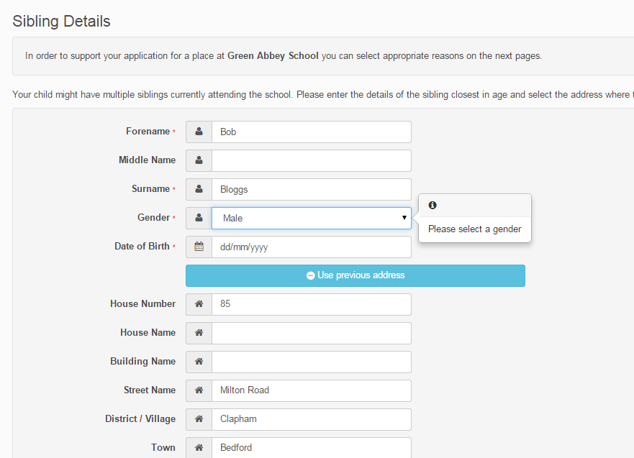
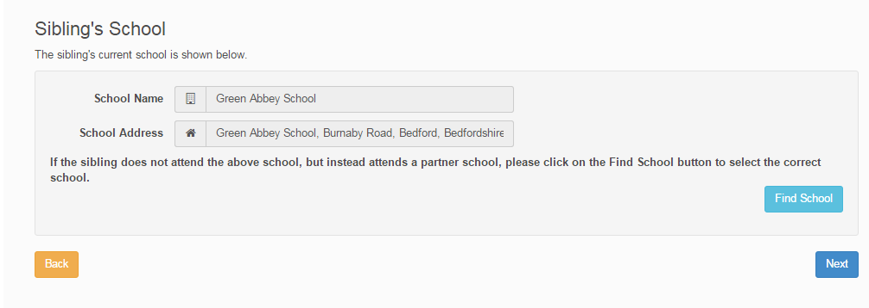
Sibling attending the school?
Click No or Yes
If Yes
Tell us about them

Slide 22
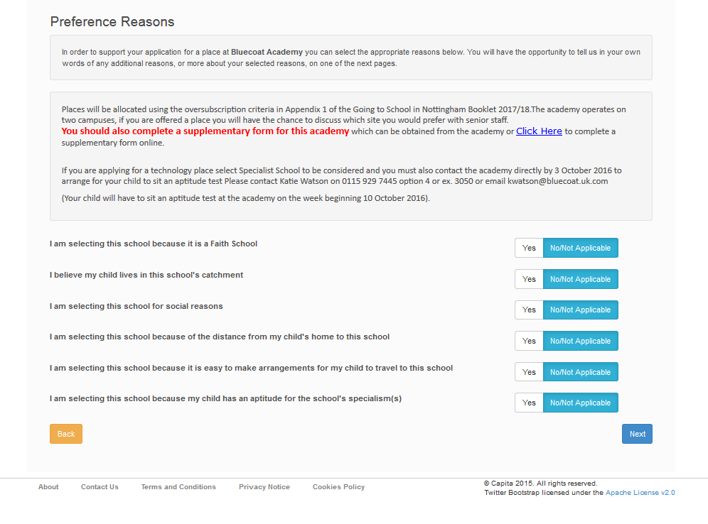

Tell us your Reasons
Some Schools will have Supplementary forms. If you wish to complete a form then please click and follow the link for more info/ or contact the school(s) directly for the form(s). From September 2019 and after we will no longer host supplementary forms on our website. It is the parents responsibility to contact the school and complete the form.
Slide to highlight Yes as Blue
Next
Depending on which school you apply for the reasons available to select will vary

Slide 23
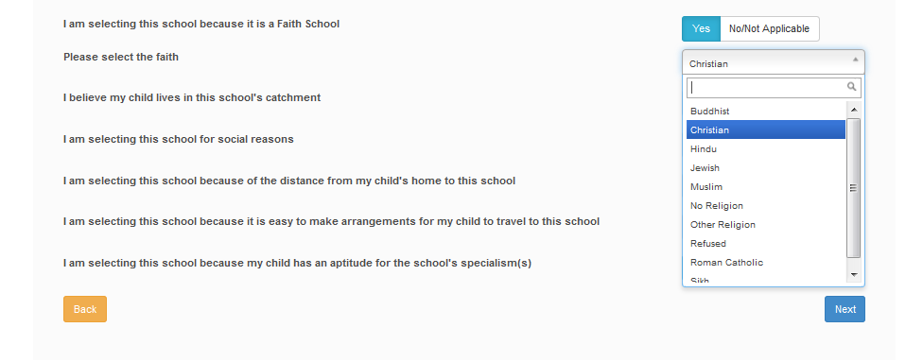
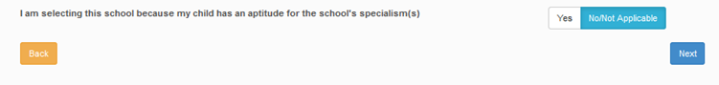
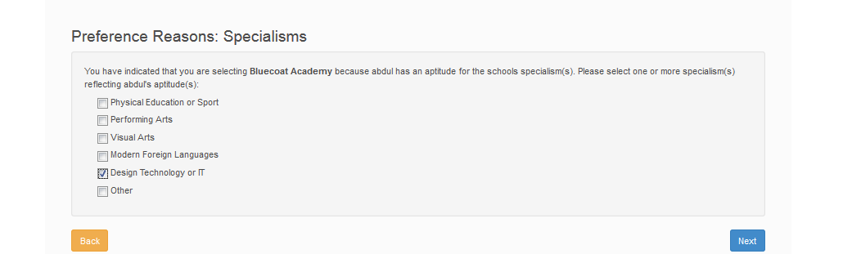
Special Reasons (select schools only)
You can enter your faith if you think it is applicable for this school
If you choose school specialism’s then you will be presented with the following options

Slide 24
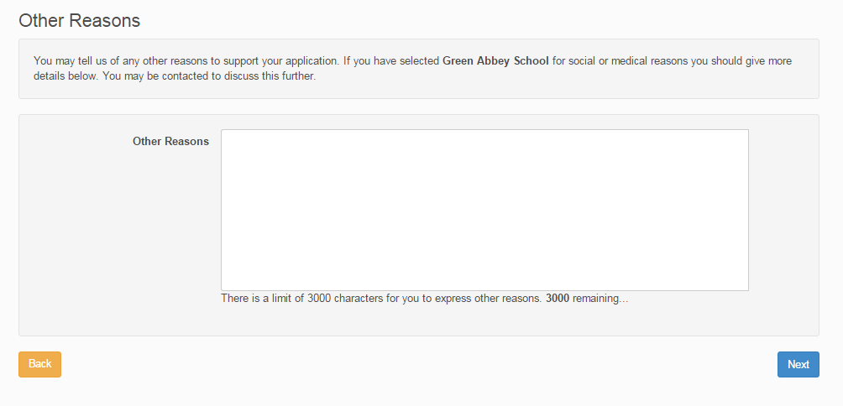
Anything else we should know?
Type in here
Next
Your reasons must be relevant to the schools admissions oversubscription criteria

Slide 25
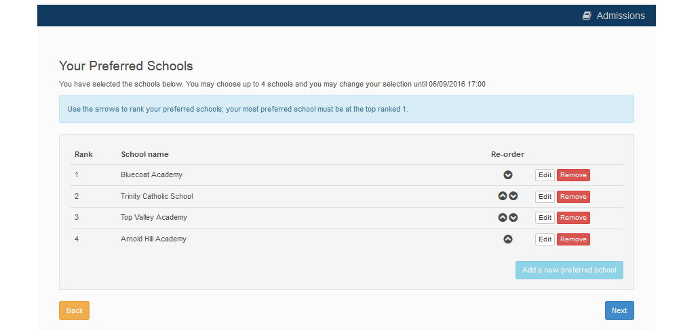
More Preferences
You can order your preferences in the priority you prefer
31/10/2016 23:59
Add more preferences (Max 4 for Secondary or 6 for Primary)
You can add up to the maximum number of four preferences, and we strongly recommend you add more than one.
Next

Slide 26

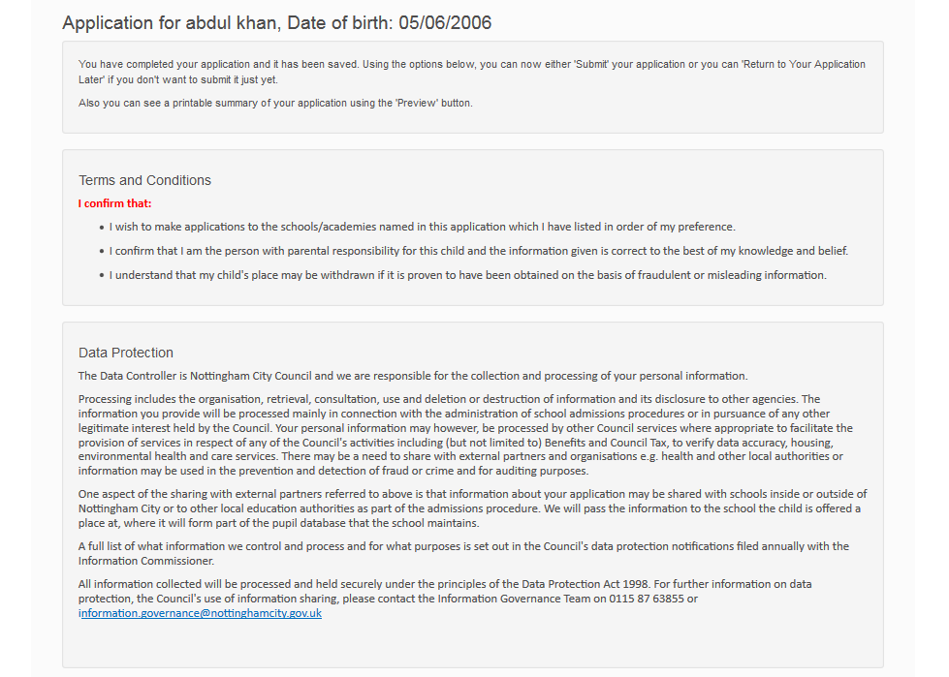
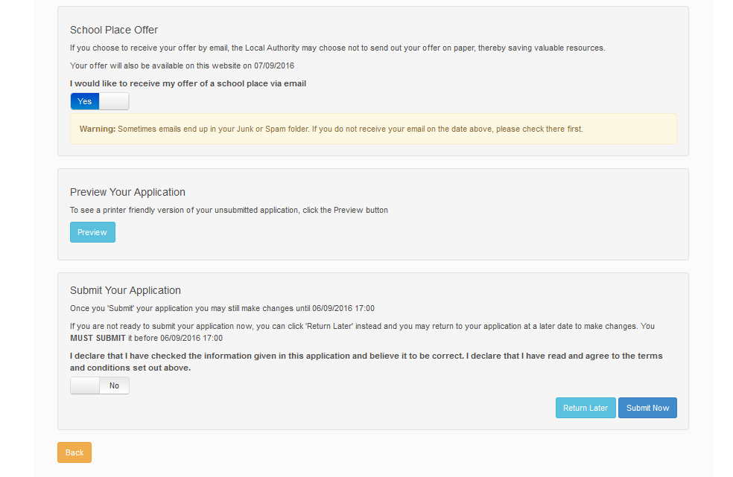
Submit Application
Read the Terms and conditions
Offer by Email? YOU MUST tick this to receive an offer by email
Preview and check your application
Finally – read the declaration, highlight yes and select Submit Now

Slide 27
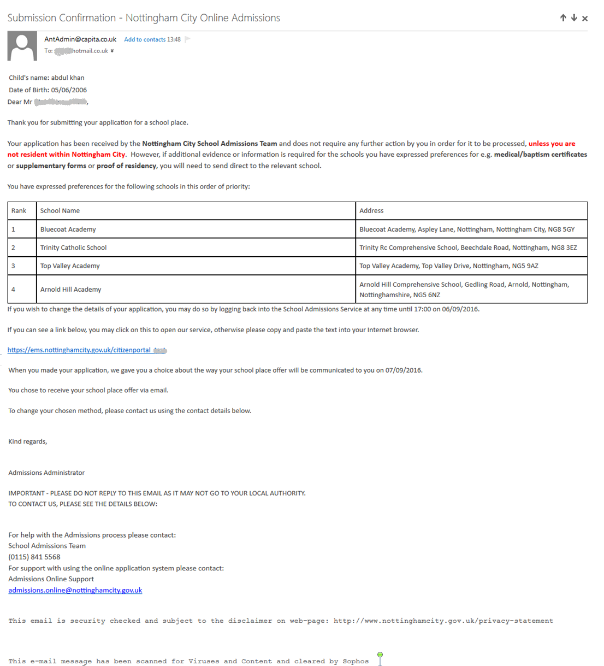
What next?
Confirmation Email
Our Contact info
The deadline date is 31 October 2019 for Secondary 2020 and 15 January 2020 for Infant 2020 You can return to your application before this date and make any changes. But please remember to SUBMIT your application again otherwise your application may NOT be considered.

Slide 28
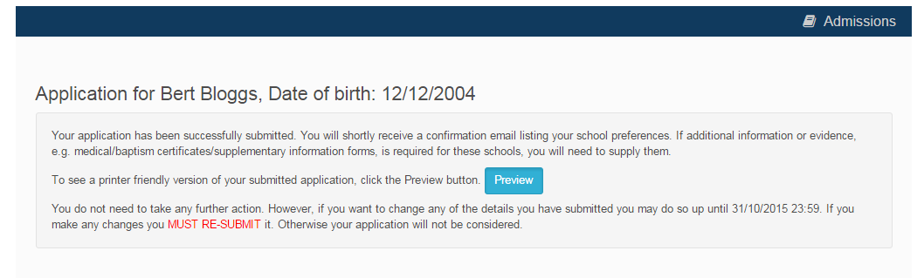

Portal on screen confirmation
Confirmation on Screen

Slide 29
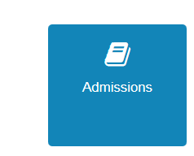
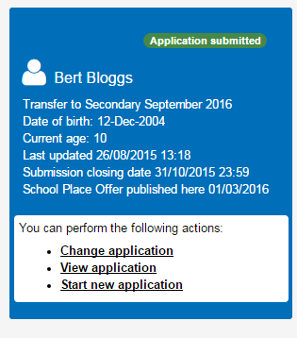
What next?
You can return to the Citizen Portal and at any time to change your application up until 31 October 2019 (the closing date) for Secondary 2020 and 15 January 2020 for Infant 2020.
2017
Decisions:
All Secondary applicants who apply online and tick to receive an email will receive a decision email on 2 March 2020 for Secondary 2020 and 16 April 2020 for Infant 2020. They will not receive a letter. They will also be able to view their decision on the Citizen Portal by logging back in on/after this date

Slide 30
FAQ’s
I have filled in the online form to register but have not yet received an email
It is possible that the email has been quarantined by anti-spam measures taken by your Internet Service Provider or by settings in your mail client. Check to make sure that, if you are an Outlook/Outlook Express user, the relevant email has not been misidentified as "junk" and deposited in the Junk folder. If the email has definitely not been delivered to you then contact your ISP to see whether the email can be tracked and its fate discovered. The service providers who suffer most from the problem of incorrectly identifying key emails as spam have proved to be aol.com, hotmail.com, hotmail.co.uk, yahoo.co.uk, yahoo.com and btinternet.com
I have forgotten my password
Visit the log in page, click on the link "Forgotten your password?" and enter your email address. A new email will be generated and sent to your registered email address with a link to reset the password details.
Or Please contact us. See next page for contact details.

Slide 31
FAQ’s
What if I change my email address?
Log in with your old address and select ‘My Account’
Or, contact us and we can help you update your account
I am unable to find my address on the dropdown address list
Just enter your address into the address boxes. Please note that House number and Postcode is required.
I am unable to find the school I wish to apply for
Please ensure you have selected the Correct Local authority (of where the schools is) from the MIDDLE box and ensure you have typed the name correctly. If you type in part of the school name, it will give you better search results.

Slide 32
FAQ’s
Can I use the same account to make more than one application (e.g. applications for twins or siblings in different year groups)
You are able to apply for twins, triplets etc. using the online admissions system but MUST ensure that you submit a separate application for each child.
More help?- Contact School Admissions on
0115 8415568
Or Email schooladmissions@nottinghamcity.gov.uk

