Slide 1
2019/20 Draft Budget
engagement
Worcestershire LEP
24th January 2019

Slide 2
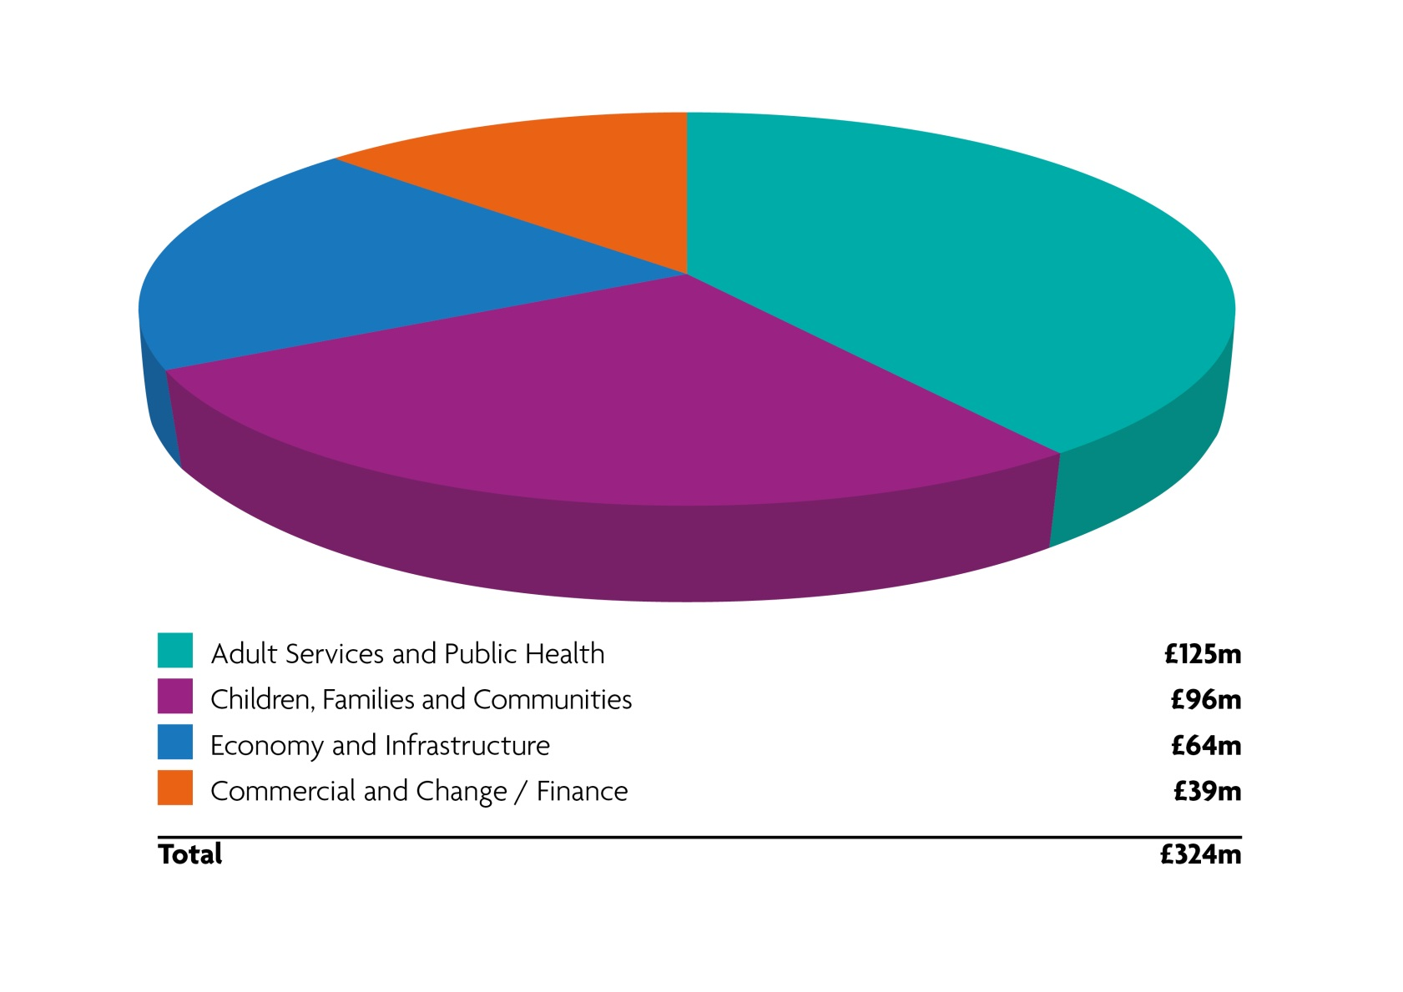
The Council’s Budget – 2018/19

Slide 3
Recap on the financial investments 2018/19
An extra £10.5m in 2018/19 to improve outcomes for our children and young people
An additional £7.2m invested into tackling the growing financial demands of an ageing population
£37.5m of capital investment over 3 years into improving the county's roads and pavements, reducing the risks of flooding and growing the local economy.
We increased Council Tax by 4.94% (3% ring fenced for adult social care and 1.94% to provide investment into the services that residents told us were most important to them)

Slide 4
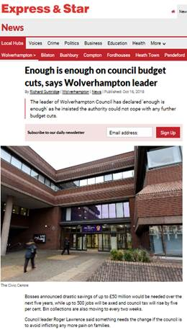
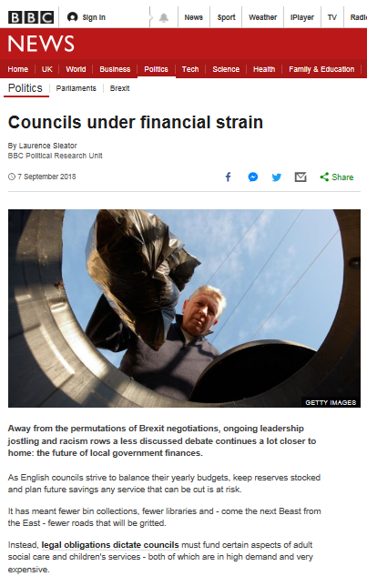

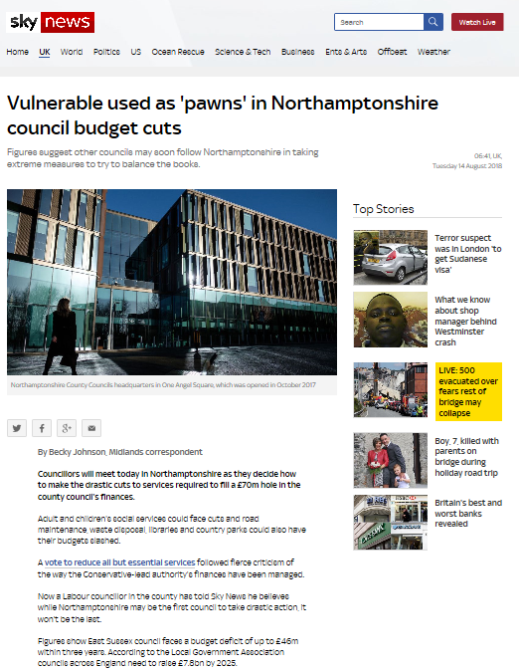
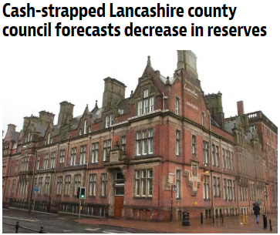
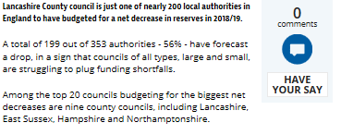



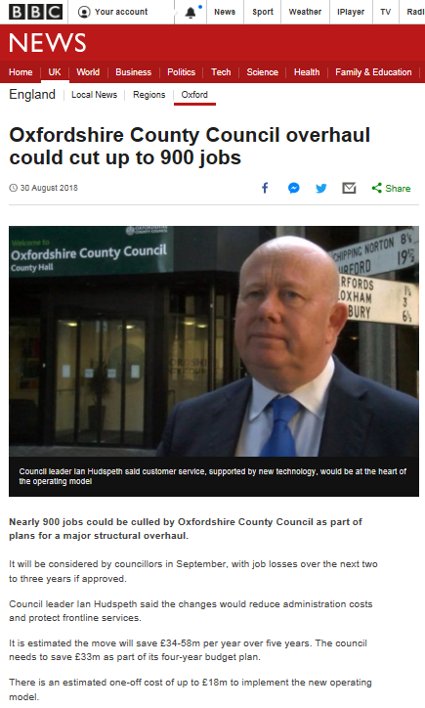
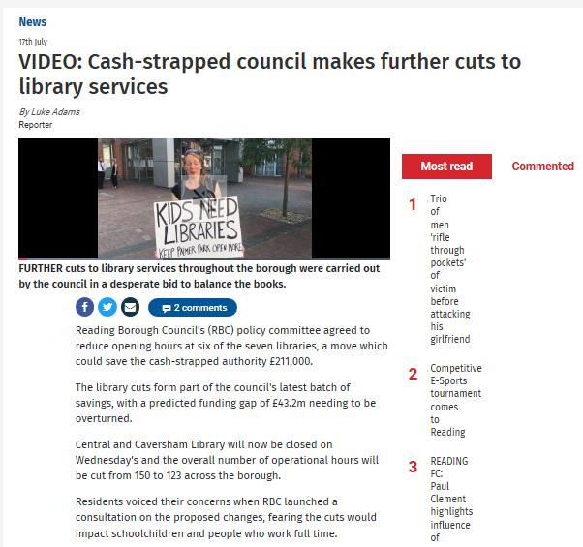
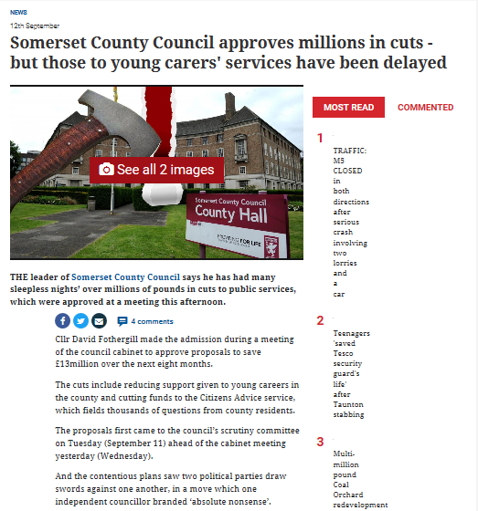
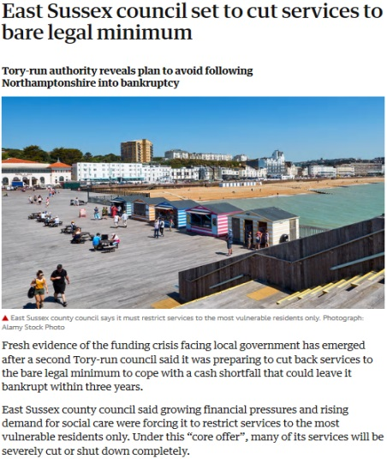
A challenging year for Local Government

Slide 5
Recap on our financial challenge
In September we reported a projected overspend of £17.9m for this financial year if we took no action
We identified £12.7m worth of management actions
At November Cabinet we reported that the projected overspend had been brought down to £5m
We are now projecting an overspend at the end of this financial year of £3m with an ambition to break even

Slide 6
The Autumn Budget
A one-off £240m grant for 2018/19 to ease winter pressures. Worcestershire has received £2.4m
A one-off £650m grant for English authorities for social care for 2019/20. Worcestershire is to receive £2.4m for winter health pressures and £4.1m for social care
An extra £420m nationally (one-off) to repair roads and potholes and to invest in bridges. It has been confirmed that Worcestershire will receive £6.6m in this financial year
School budgets increased by £400m nationally – a one off, in year bonus direct to schools for the purchase of technology
x

Slide 7
December Settlement Announcement
As expected reduction in grant
Council Tax cap at 3% excluding Social Care Levy
Awarded innovative 75% Business Rates Pilot to help reinvest a potential £4.9 million to prevent future social care costs
x

Slide 8
Budget pressure in 2019/20
The Council’s income is growing year on year due to an increase in the number of homes and an increase in business rates from a growing economy
However the pace of income growth is not keeping up with the increase in demand in social care.
There is a need for a national, long term solution to meet the increasing pressures in demand for social care
We await the Government’s Green Paper and annual Spending Review
In the meantime the Council will increase its spending to protect the most vulnerable in our society and will continue to invest in growing the local economy and improving the county’s infrastructure.
x

Slide 9
Investment proposals for 2019/20
An additional £14.1m for Adult Social Care (this includes a Government grant and a 1% adult social care levy on Council Tax bills)
An additional £7.7m into Children’s Social Care
An extra £3.0m for the Open For Business Reserve to support apprenticeships, skills development and business growth
£2.8m for regeneration and infrastructure projects. This is in addition to a £2.7m revolving investment fund

Slide 10
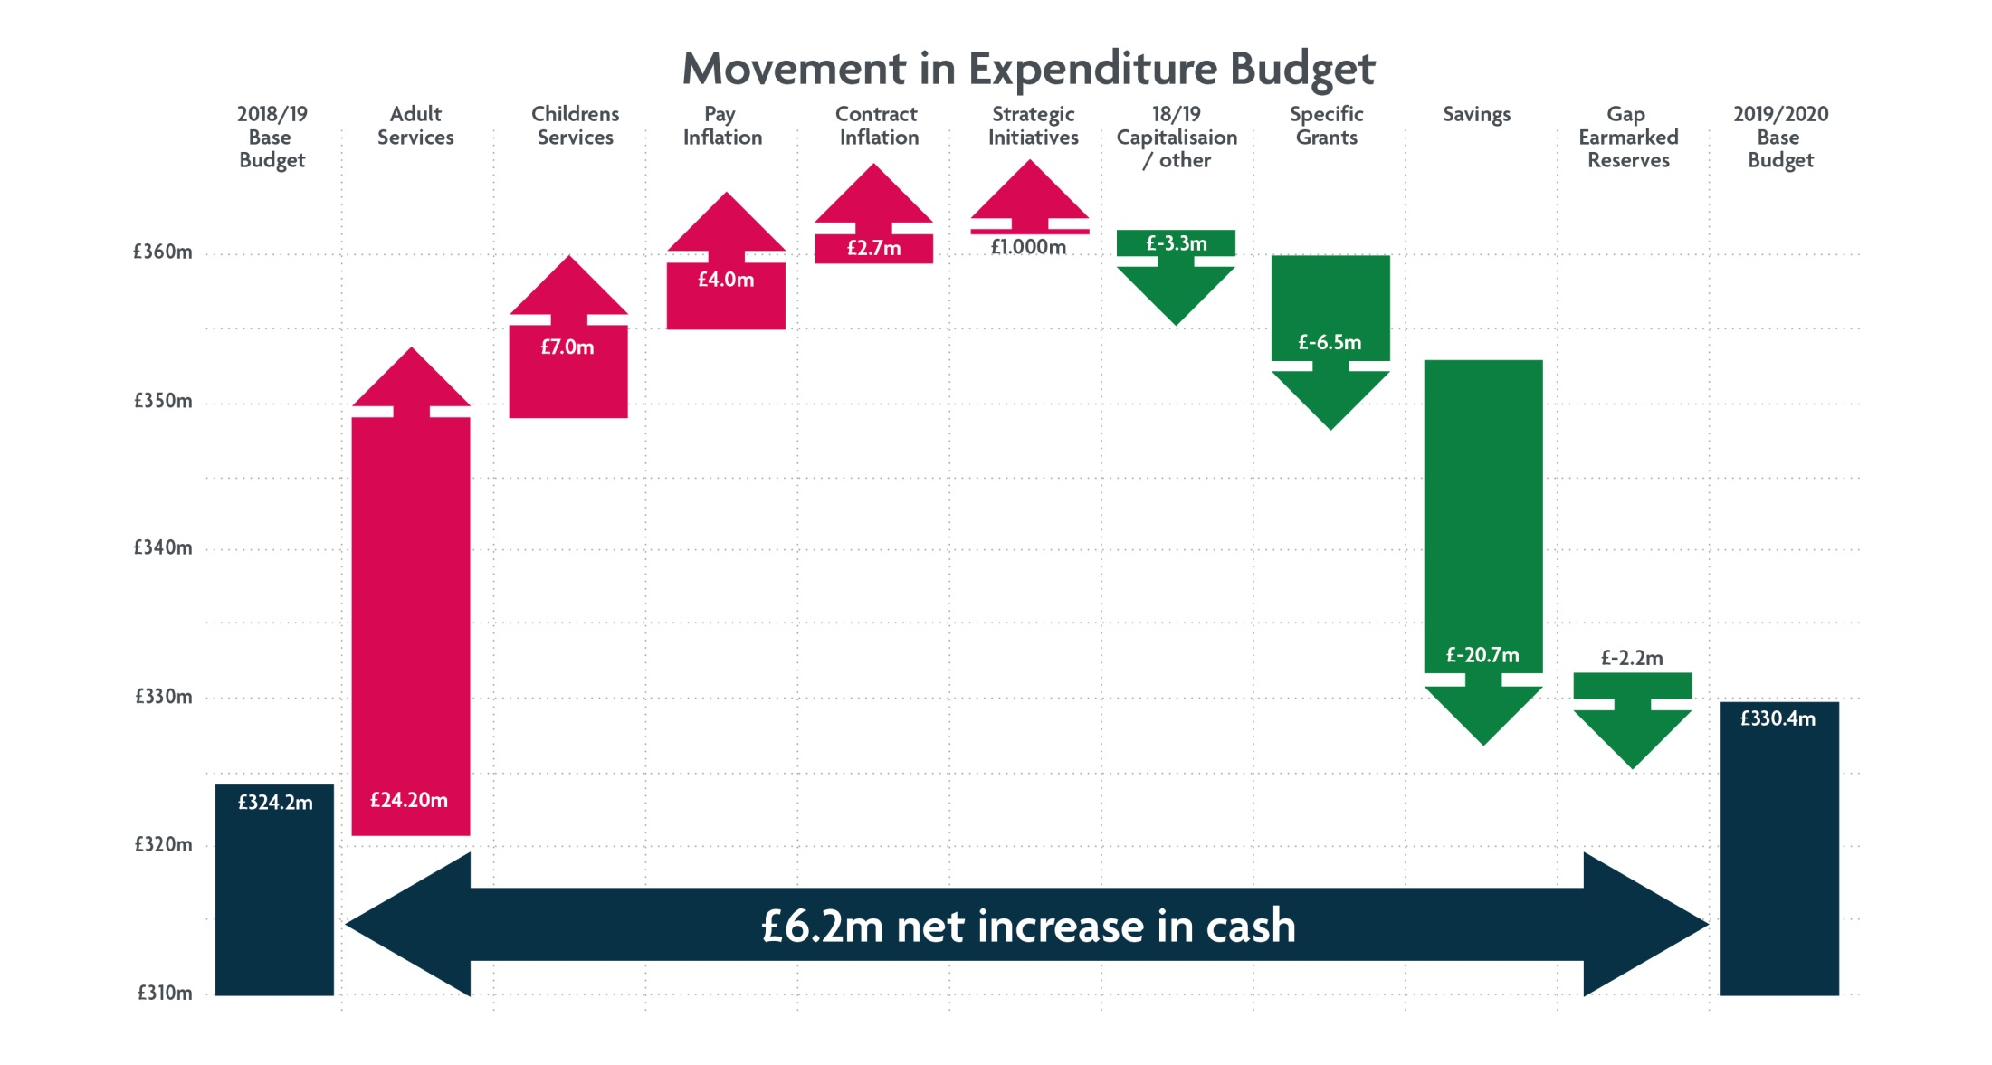
Draft 2019/20 Budget

Slide 11
Achieving a balanced budget in 2019/20
PROPOSALS INCLUDE:
Reshape and redesign the Council of the future £3.0m
Waste management £3.0m
Commercial contracts review £2.5m
Departmental restructures £1.6m
Debt management £1.5m
Agency spend £0.6m
Archives £0.4m
Full Analysis at Appendix 1C

Slide 12
Council Tax 2019/20
1% - ring-fenced for Adult Social Care services in order to contribute to existing cost pressures due to Worcestershire’s ageing population
2.99% - to provide financial support for the delivery of outcomes in the line with our plan for the County ‘Shaping Worcestershire’s Future’
An increase of 3.99% which is 93p per week for a Band D householder

Slide 13
Our Reserves
General Fund - £12.2 million
Appendix 3 Risk Assessment
No plans to add or reduce
Earmarked Reserves -
Redistributed to match Corporate Plan priorities
Reconciliation and audit trail at Appendix 2
Section 12 analysis and commentary – Table 17
Potential scope to use some

Slide 14
Capital spending proposals
£50m of capital funds over 3 years to be invested into the economy, infrastructure and to transform the organisation.
This includes:
£23m for regeneration
£3m to support Open for Business
£9m for digital investment
The Council is also to invest £13.7m to build, extend and maintain schools across the county.
Full analysis Appendix 1D

Slide 15
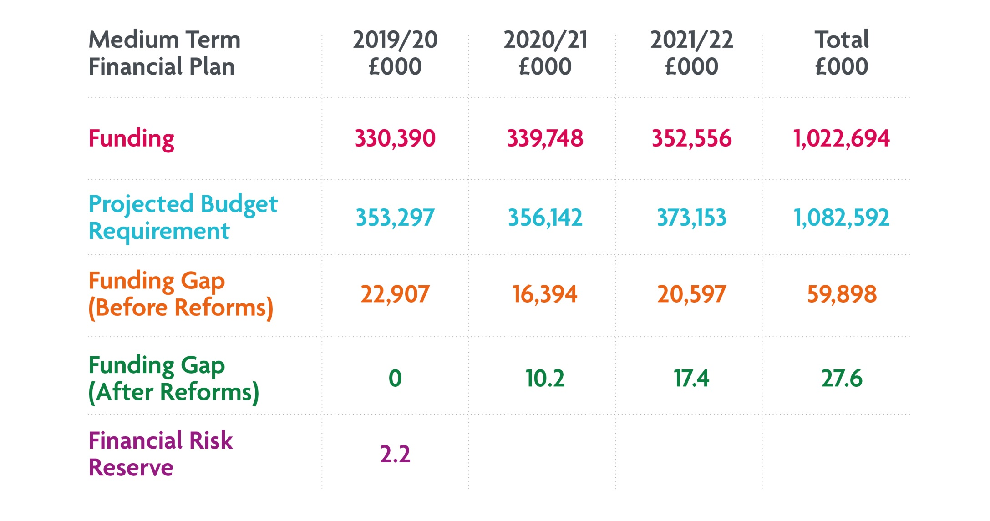
The next three years

Slide 16
Future year proposals 2020/22
PROPOSALS INCLUDE:
Delivery of Council redesign £2.9m
On street parking charges and enforcement £2.5m
Income and trading opportunities £2.2m
Commercial saving opportunities £2.0m
Review of transport spend £0.8m
Partnership working with the district councils £0.5m
Libraries £0.5m
Scientific Services £0.1m
Supporting the Arts Service to become self sufficient £0.1m

Slide 17
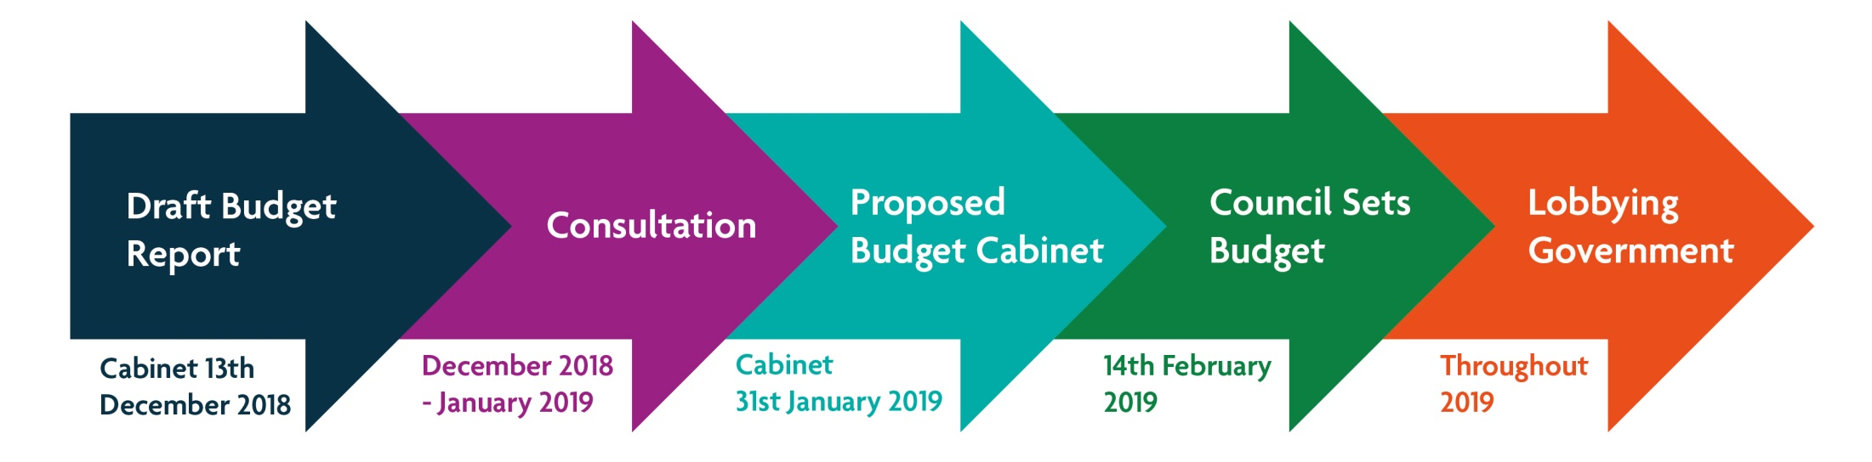
Budget Planning Timeline for 2019/20

