Slide 1
Making Infection Prevention and Control Easy
Dr Toyin Ejidokun
Consultant in Health Protection
SW Health Protection Team
Hot Topics event
14th November 2018

Slide 2

Organisational changes
Welcome to South West Public Health England Centre!!

Slide 3
Locality teams
Locality | Consultant | Practitioner
Cornwall and IOS | Jenny Taylor | Jonathan Plumb/Hannah Butcher
Plymouth | Chaamala Klinger | Pete Smith/Lesley Peters
Torbay | Nick Young | Georgina Fox
Devon | Nick Young | (Exeter) Gloria Osei Owusu (North Devon) Sharon Hilton
Somerset | Bayad Nozad | Penny Edwards
Bristol | Thara Raj | Julie Mann/Louisa Naylor
North Somerset | Chitra Arumugam | Shaun Adams/Jane Greenway
South Gloucestershire | Chitra Arumugam | Louise Dirks
Gloucestershire | Toyin Ejidokun | Stephanie Davis
Bath & NE Somerset | Charles Irish | Shaun Adams
Wiltshire | Mike Wade | Sarah King
Swindon | Charles Irish | Grace Magani
Dorset | Fiona Neely | Ben Sims/Joanna Randall

Slide 4
Overview
Infection Prevention & Control:
-Immunisation
-Infection Control
Outbreaks
Resources
How we can help

Slide 5
Immunisation
Protects individuals
Prevents transmission within health and social care
Herd immunity – protects unvaccinated
Avoids disruption to service provision
Residents – annual flu + pneumococcal
All care home residents
All risk groups
all >65 years
Staff – annual flu - all health and social care staff
Hepatitis B Vaccine – staff in contact with blood or body fluids
BCG – age <35 years

Slide 6
Infection Prevention Control
Standard precautions
Hand hygiene including use of soap & water/alcohol hand gel
PPE: apron, gloves. When to use masks, gowns, eye protection?
Cleaning & Decontamination
Waste disposal
Disposal of sharps
Laundry
Safe management of invasive devices where indicated
Food hygiene
Organisational
Policy development, implementation and review
Education and Training
Infection Control Link Person
Notes:
Use this space to get people active and washing hands- check technique/ video to show technique? Poster? Glow box
Advise that alcohol hand gel can be used on clean hands. It must NOT be used if hands are visibly dirty or when caring for clients with diarrhoea (the gel isn’t virucidal or sporicidal)
. When caring for clients with diarrhoea, alcohol hand gel can be used as well as soap and water but not as a substitute for it.
Masks and eye protection- various uses in acute healthcare setting but for care homes we would normally recommend surgical face masks during an influenza outbreak:
Use of surgical face mask when in close contact with the patient (within two metres). Eye protection is advisable where there is assessed to be a risk of eye exposure to infectious sprays. For example, when caring for patients with persistent cough or sneezing. (Found in PHE (2016): Infection control precautions to minimise transmission of acute respiratory tract infections in healthcare settings
Version 2 - October 2016
Cleaning and Decontamination
Usually detergent clean is sufficient. However during outbreaks or when caring for people with certain infections need to undertake enhanced cleaning- particularly horizontal surfaces/door knobs/taps/flushes etc. Should be after detergent clean using chlorine releasing agent at 1000 parts per million.
Waste disposal- as per local requirements. Larger homes may need dedicated waste services depending on the nature of the establishment.
Laundry- should be industrial washing machines not domestic to be fit for purpose if not outsourcing laundry.
Most homes won’t have a need for a lot of invasive devices but might need sharps boxes for dedicated clients (e.g. diabetics, those on end of life care needing syringe drivers etc). For most care homes the sharps bins will be issued via the patient needing it for sharps disposal. Care when using sharps to avoid needlestick injury- most devices now have a safety element to activate when withdrawing from patient to prevent accidents. However HCWs must be trained in this depending on role before they are used. The key thing to mention is minimal handling off sharps and disposal into a sharps bin to prevent neddlestick injuries

Slide 7
The Health and Social Care Act 2008: code of practice on the prevention and control of infections and related guidance
The Code sets out what registered providers of health and adult social care services need to do to ensure compliance with the Care Quality Commission registration requirements for cleanliness and infection control
https://www.gov.uk/government/publications/the-health-and-social-care-act-2008-code-of-practice-on-the-prevention-and-control-of-infections-and-related-guidance
Requirements

Slide 8
Recognition of Outbreaks
What is an Outbreak?
> 2 or more residents or staff with similar symptoms or disease linked in time, place and/or person
or observed number of cases greater than expected
E.g.
Flu-like illness
D&V
Norovirus
Food poisoning
Clostridium difficile
Scabies

Slide 9
Risk Assess
Notifiable disease
Cluster/outbreak to be notified
Risk to patients
Risk to staff
Seek advice on diagnosis
Immediate Control measures:
Isolation/exclusion
Enhanced Infection Control

Slide 10
Public Health / Health Protection advice
Contact:
Phone: 0300 303 8162 Option 1 Option 1
Email: swhpt@phe.gov.uk
For example: Reporting notifiable disease
Reporting outbreaks/clusters
Advice on outbreaks and infectious diseases

Slide 11
Reporting
PHE: SW HPT
Primary Care/ Care Homes
Environmental Health
Community IC
Food
Water
Legionnaires
CCG
CQC

Slide 12
Investigation and Control
Prevent Spread
Observe /
review
Isolate/Cohort
Restrict visitors/
Close home
Provide info:
Staff
Residents
Visitors
Other HC staff
Hospital transfers
?OB
Seek advice:
GP / PHE
Take specimens
Enhanced Infection Control including Standard Precautions
Inform others
?Vaccination/
Chemoprophylaxis
Line list

Slide 13
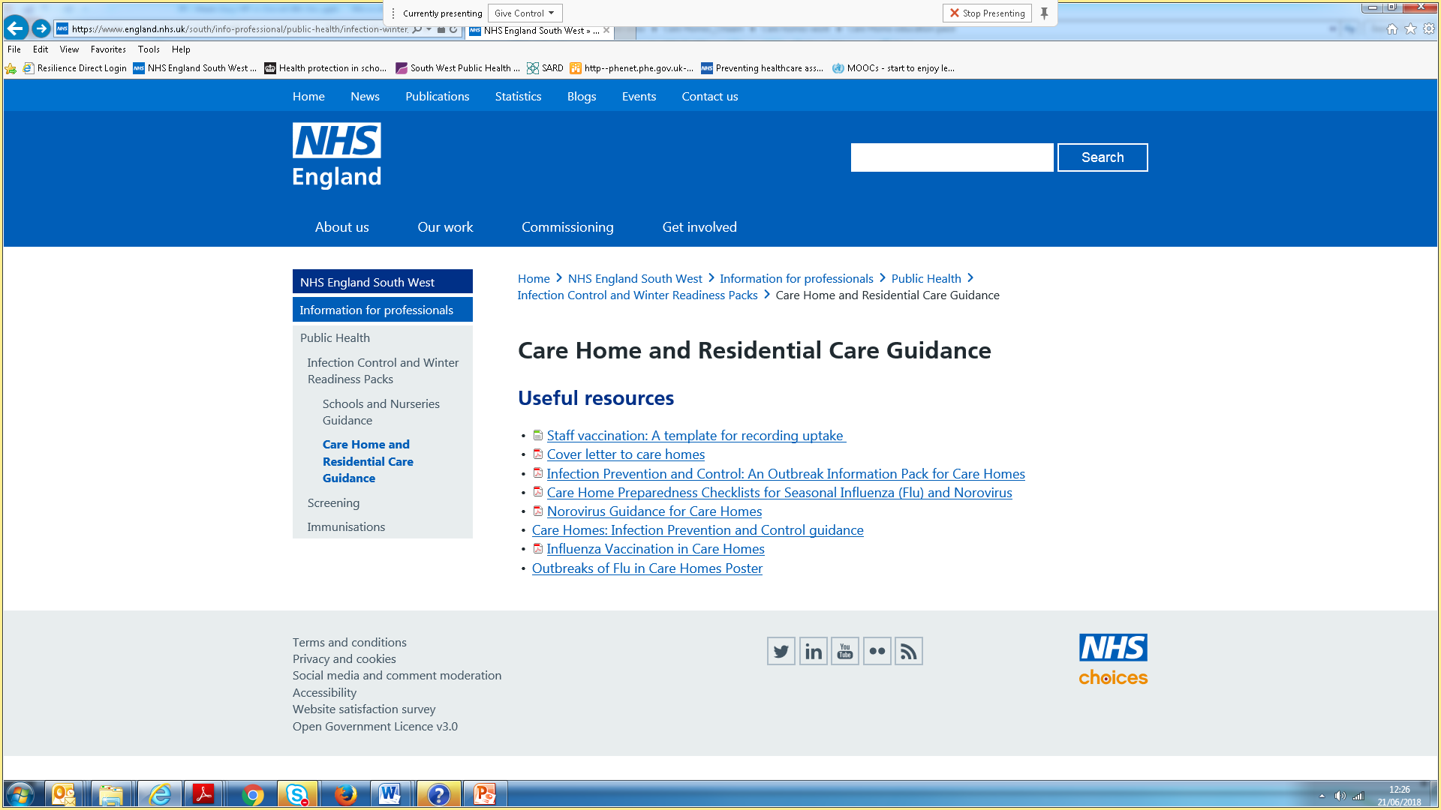
Resources

Slide 14
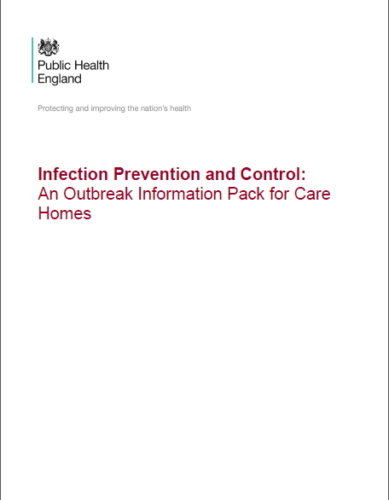
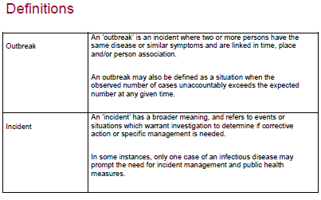
Outbreak information pack

Slide 15
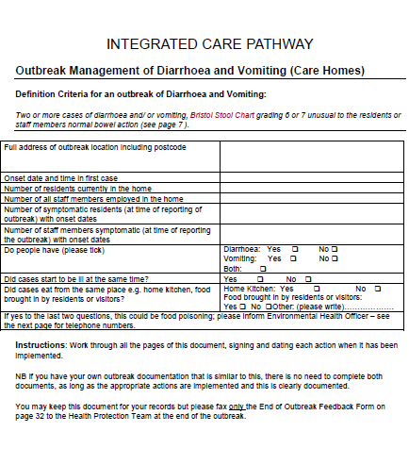
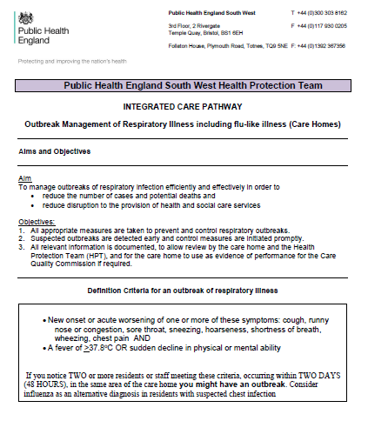

Slide 16
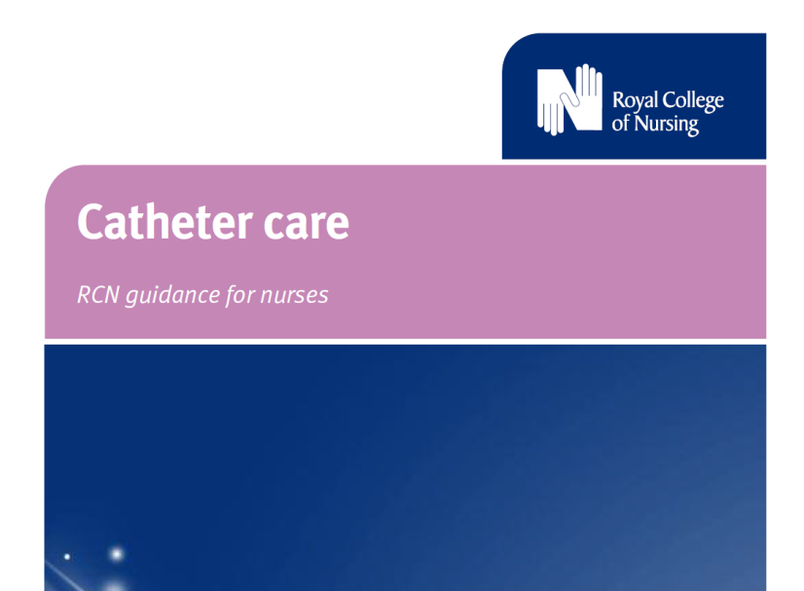
Other resources
https://www2.rcn.org.uk/__data/assets/pdf_file/0018/157410/003237.pdf
Notes:
Add some notes here

Slide 17
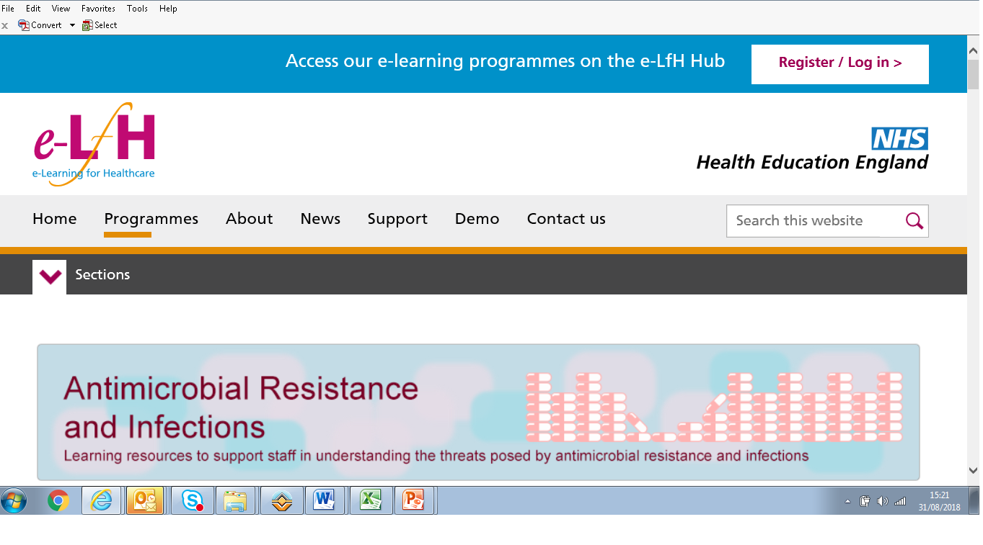
Antimicrobial resistance e-learning https://www.elfh.org.uk/programmes/antimicrobial-resistance-and-infections/

Slide 18
Scenario: Respiratory
Notes:
Flu
Gastro

Slide 19
Scenario
It is 8 am on a Monday morning and you are in charge of today’s shift after a week’s annual leave and during handover you are given the following information:
Maisie Middleton is 86 yrs old with a temperature of 38°C at 6am today. She has complained of generalised aches and pains and has a chesty cough. It is her great-great granddaughter’s 1 year old birthday and the family are due to visit today for a tea party.
Albert Mackie is 80 years old and is due to attend a physio appointment today at the local hospital, he has no temperature but has a sore throat, headache and a runny nose which started on Friday evening.
Rose Mehta is 92 years old and was taken to hospital yesterday with a chesty cough, generalised aches and pains. She has had a negative flu test and the hospital has phoned to say that she is ready to return.
One registered member of staff called in sick yesterday with a ‘head cold’ and an agency registered nurse has been booked to cover the shift and has just arrived for his shift.

Slide 20
Questions
1) What is your initial assessment of this scenario?
What guide will you use to help you collect the information you will need to report? Where will you find the information in the guide?
What are the key points set out in the guide that you must cover?
Who do you need to inform and how will they help you?
What actions do you need to take in the home to prevent the spread of flu?

