Slide 1
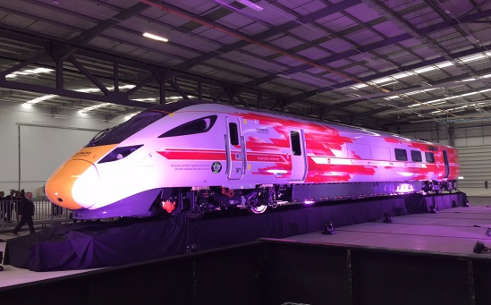

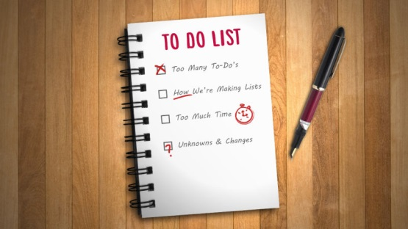
Major Projects – Getting ready for service
Major Projects:
IEP, Crossrail, Thameslink long term projects
Now planning – HS2 network interface, Crossrail 2
Top five stories IEP, Crossrail and Thameslink:
Think passenger – capacity, design, accessibility, performance, connectivity
Building on a live railway/living city
Supply chain and skills
Future – Innovations, green, growth
Cross industry effort to implement
What are we doing…..?
Infrastructure readiness
Train delivery and testing
Staff familiarisation
Systems integration and timetable planning
Communications

Slide 2
Dates
 | 2016 | 2017 | 2018 | 2019 | 2020
700s start | P
Full Thameslink |  |  | P
First IEPs GW |  | P
First IEPs EC |  |  | P
Full IEP |  |  |  |  | P
345s start |  | P
Central area Crossrail |  |  | P
Full Crossrail |  |  |  | P

Slide 3
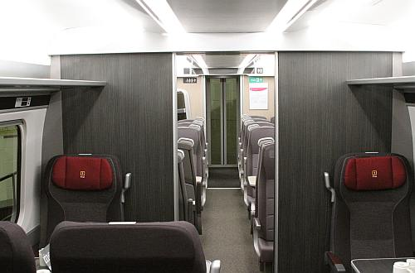
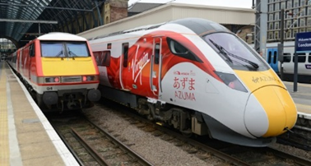
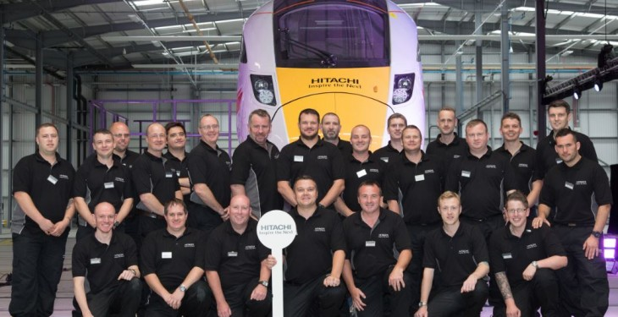
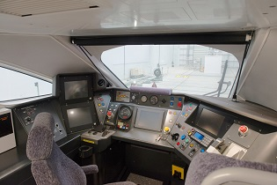
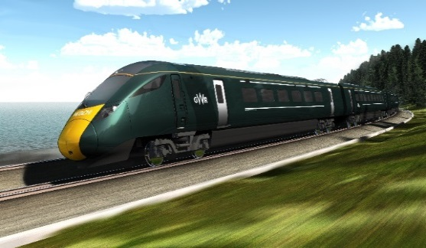
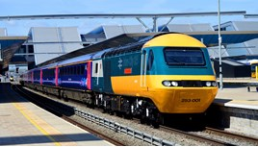
Renewing the High Speed fleet - IEP
Production:
Bodyshells from Japan
Newton Aycliffe assembly
UK suppliers
New depots
Passenger benefits:
More seats
Faster journeys
New services
More services
Better wifi
Photo – Rail Journal
Preparing for service:
Rigorous testing
Communications
Staff familiarisation
Transition
Infrastructure
Depot works
Acknowledging our heritage
Photo – Rail Magazine

Slide 4
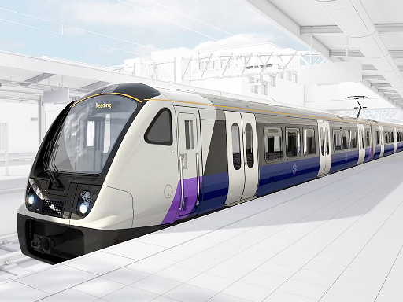
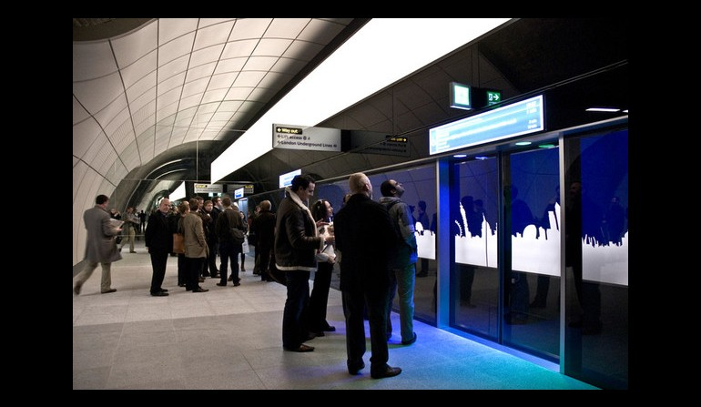
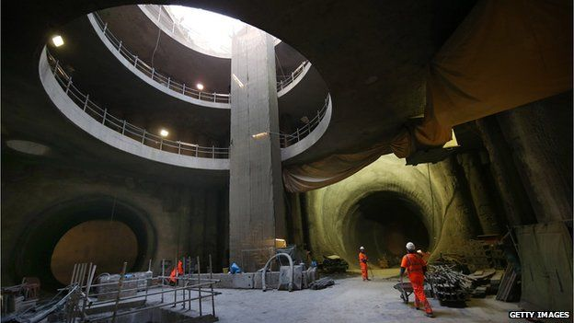
Crossrail
Passenger benefits:
New trains. More capacity, better accessibility
New routes. City and Canary Wharf to Heathrow; Abbey Wood to West End
24tph central area
Performance
Stations:
World class station design – major new Central London stations. 72k passengers per hour
Surface network station improvements
Life size mock up testing
Construction:
Surface works
Europe’s largest construction project – 26 miles of new tunnel
Building in a live city

Slide 5
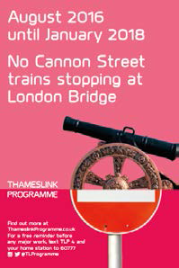
Thameslink
Passenger benefits:
New trains. More capacity, more luggage space, better accessibility
New routes. East Coast to Gatwick and Brighton
24tph central area – benefits the south east
Performance
Stations:
London Bridge, Blackfriars, Farringdon. More capacity, more space
More facilities – shops and amenities
Farrington Hub – North South and East West
Building it:
Significant challenges – constructing a new infrastructure on a crowded Victorian railway.
Communicating the major changes – disruption and other routes

