Slide 1
Bexley Mental Health and Wellbeing Provision in schools
Monday 11th July 2016
Pascale Berthellet
Public Health Advisor for Children & Young People
Notes:
What’s MH
Need to cover
SH
E-safety
Stress in secondary schools
Figures put dates of what is planned

Slide 2
Why mental health and wellbeing matters to schools
Research suggests that health & wellbeing and educational attainment are closely interlinked
Children with better emotional wellbeing make more progress in primary school and are more engaged in secondary school
References: Gutman, L. & Vorhaus, J., 2012. The Impact of Pupil Behaviour and Wellbeing on Educational Outcomes: research report DFE-RR253,
London: Department of Education.
Green, H. et al., 2005. The mental health of children and young people in Great Britain 2004, Basingstoke, Hampshire: Palgrave
Notes:
References: 1 and 2-Gutman, L. & Vorhaus, J., 2012. The Impact of Pupil Behaviour and Wellbeing on Educational Outcomes: research report DFE-RR253, London: Department of Education.
3- Green, H. et al., 2005. The mental health of children and young people in Great Britain 2004, Basingstoke, Hampshire: Palgrave
Most parents of a child with a diagnosable mental health problem seek advice
Only 1 in 4 children with a diagnosable problem get the help they need.
Early intervention with children with mental health conditions can often improve the prospects and quality of life of those children facing poor mental health
Reduce the burden of costs on schools, other agencies and society at large
Early intervention aims to counter risks for poor outcomes and to strengthen children’s assets
Half of those with lifetime menatl illness (excluding dementia) first experience symptoms by the age of 14 and three-quarters before their mid 20’s

Slide 3
Missed Opportunities- Report
There is an average delay of a decade in children receiving help
This delay sees their problems multiply and get progressively worse, eventually escalating into a crisis
3/4 of parents seek help, only 1/4 of children receive any support
Notes:
3/4 of parents whose children are experiencing mental ill-health seek help, only 1/4 of children receive any support

Slide 4
Mental Health on a Continuum
Circumstances
MH MI
Anxiety/Depression/Self-harming

Slide 5
Impact of a positive MHWB for young people
YP in better health achieve more academically
High quality reviews of the evidence suggest that both social & emotional skills education and mental health programmes in schools boost attainment
Well implemented SEAL programmes or equivalent have been noted to produce improvement in attainment levels
Notes:
Health implies physical and mental
What comes from a positive mental health? Resilience, self confidence, kindness, self regulation

Slide 6
In Bexley
Schools invite me to come in and deliver work around this agenda

Slide 7
Whole school community approach
Work with:
Children and young people
Teaching, non-teaching staff and governors
Parents
Notes:
To be successful, mental health promoting and anti-bullying approaches need to be owned by all school staff, threaded throughout the curriculum and embedded in school culture.
They should be backed up by policies, goodlinks with parents and outside agencies, swift action to support wellbeing and whole school staff training and commitment to promoting children’s mental health and wellbeing.
Faithful delivery of schoolbased programmes can be challenging for schools preoccupied with prioritising national curriculum targets, even if in the longer term
they promote educational attainment.

Slide 8
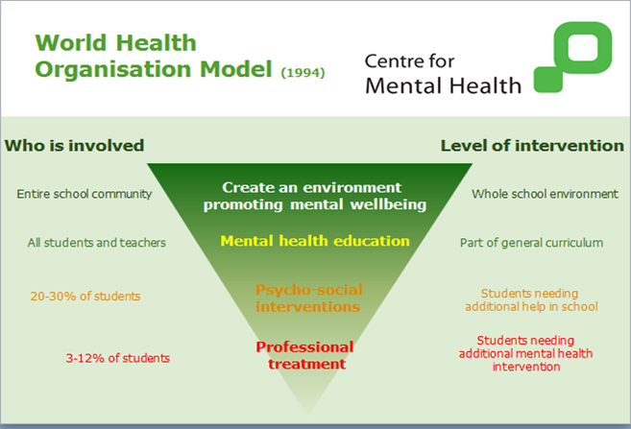
Notes:
European problems: too much tailoring- dilution, confusion, lack of impact hard to evaluate
If you get it right for teachers you will get it right for everybody –what are your doing for your own MH? Do you walk the talk
In schools you will have targeted initiative
High quality implementation
Right method for intervention
Clear and limited aims
Simple (less is more)
Staff training
Measurable and success monitored
Involve people
Allow time

Slide 9
Training for Bexley school staff
Twilight sessions organised on:
Raising understanding of MHWB
Self-harm/ Eating disorders
Resilience
Staff Wellbeing
Online-safety/ Cyberbullying
Staff development days on HBT Bullying
Promote any local/national training available
Mental Health First Aid for Youth/ Minded
Notes:
Promote any local training I am aware off
Young Minds

Slide 10

Programme to support MHWB in schools
Time to Change: to reduce stigma and prejudice
Training offer to secondary pupils to become MH Champions in their school

Slide 11
Bexley CYP’s voice
Primary Schools:
Work with school councils to embed the 5 ways to Wellbeing
Secondary Schools:
Young People Conference to hear their views

Slide 12





Five Ways to Wellbeing
Connect
Be Active
Take Notice
Keep Learning
Give
Notes:
For YP and Staff- Evidence based

Slide 13

Wheel of Well-being
SLAM designed the Wheel of Wellbeing (WoW) framework as a simple approach to promoting positive mental health and wellbeing
The WoW is a colourful graphic framework that represents six universal themes that contribute to health and happiness:
Body, Mind, Spirit, People, Place and Planet.
Each theme links to one of the five ways
DIY Happiness game

Slide 14
Assemblies
Wellbeing assemblies for primary & secondary
Transition from primary to secondary school
Exam stress
Mindfulness

Slide 15
Mindfulness
Involves learning therapeutic and meditative approaches to dealing with stress
has also been tested as a universal approach in schools

Slide 16

Mindfulness
Research on mindfulness and the young people
The Mindfulness in Schools Programme
Training for .b foundation programme
Mindfulness for school staff
Notes:
41+ studies/ 7 systematic reviews
The positives: it is promising, growing rapidly, popular (staff and students), cheap,
Impact of mindfulness happens in the classroom. It is not easy. You have to live it rather than know it
Be the change that you wish to see in the world.” ― Mahatma Gandhi
TEACHERS helps with teachers’ own wellbeing, stress, burnout, motivation- improves performance as teachers “teach mindfully” eg focus, prioritising, better relationships, attunement (harmony)- Role modelling/embodiment- essential for effective teaching of mindfulness (insider’s perspective)- enhance empathy (skills like patience, equanimity and non reactivity
Mindfulness can fit in PHSE/Tutorial time/SEAL/ subjects (RE, PE)/ Exam preparation- stress reduction- it does not need to take a huge amounts of time from the school day: a small amount could unlock all sorts of doors
Mindfulness helps C&YP to steady their attention and make it less reactive, with benefits for both MH and WB and the capacity to learn. There is some small but growing evidence on helping to manage impulsivity and anti-social behaviour, it also make people reassess their values
Universal programmes have a small but significant effect (and are much needed to avoid stigma)
How can schools build the case for this intervention “in the glare of Ofsted”: if Ofsted could be made to see the link between ability to pay attention and ability to learn and therefore to take an interest in emotional intelligence and mindfulness.

Slide 17

Headscape
http://headscapebexley.co.uk/

Slide 18
Online-safety
Social media
Cyberbullying
Child Sexual Exploitation
Radicalisation and Extremism
Notes:
Homophobic behaviour

Slide 19
Partnership work
Dove Self esteem project- Body image
Take Ten programme for schools
Using heart rate technology to improve concentration, reduce stress and manage emotions in the classroom

Slide 20
Work in the community
Wellbeing workshops for
LA staff
Community groups
Young carers

Slide 21

Royal Society Of Public Health Training
Level 2 Understanding Mental Wellbeing
Aim:
To provide participants with a knowledge and understanding of the principles of mental wellbeing, the effect of mental wellbeing on the individual and community, and how mental wellbeing can be maintained or improved
Notes:
It could be for learning mentors, teachers
The course focuses on building a baseline knowledge of MWB, it will also contribute to improve attitudes to MWB.
Outline the importance of MWB to the individual
Participants will know how MWB can be improved and maintained (through evidence base)

Slide 22

Thank you
Any questions?
pascale.berthellet@bexley.gov.uk
Tel: 0203 045 3831

