Slide 1
A new mindset: the Five Year Forward View for mental health
Jacqui Dyer
NHSE MH Equalities Expert by Experience Advisor

Slide 2

Five Year Forward View for Mental Health
The report in a nutshell:
20,000+ people engaged
Designed for and with the NHS Arms’ Length Bodies
All ages (building on Future in Mind)
Three key themes:
High quality 7-day services for people in crisis
Integration of physical and mental health care
Prevention
Plus ‘hard wiring the system’ to support good mental health care across the NHS wherever people need it
Focus on targeting inequalities
58 recommendations for the NHS and system partners
£1bn additional NHS investment by 2020/21 to help an extra 1 million people of all ages
Recommendations for NHS accepted in full and endorsed by government
Simon Stevens: “Putting mental and physical health on an equal footing will require major improvements in 7 day mental health crisis care, a large increase in psychological treatments, and a more integrated approach to how services are delivered. That’s what today's taskforce report calls for, and it's what the NHS is now committed to pursuing.”
Prime Minister: “The Taskforce has set out how we can work towards putting mental and physical healthcare on an equal footing and I am committed to making sure that happens.”

Slide 3
The current state of mental health
Mental health problems in the population:
One in ten children between the ages of 5 to 16 has a diagnosable mental health problem.
One in five mothers has depression, anxiety or in some cases psychosis during pregnancy or in the first year after childbirth.
One in four adults experiences at least one diagnosable mental health problem in any given year.
One in five older people living in the community and 40 per cent of older people living in care homes are affected by depression.
Experiences of mental health care:
It is estimated that up to three quarters of people with mental health problems receive no support at all.
People with severe mental illness are at risk of dying 15 - 20 years earlier than other people.
Suicide rates in England have increased steadily in recent years, peaking at 4,882 deaths in 2014.
In a crisis, only 14% of adults surveyed felt they were provided with the right response.
“The NHS needs a far more proactive and preventative approach to reduce the long term impact for people experiencing mental health problems and for their families, and to reduce costs for the NHS and emergency services”.

Slide 4
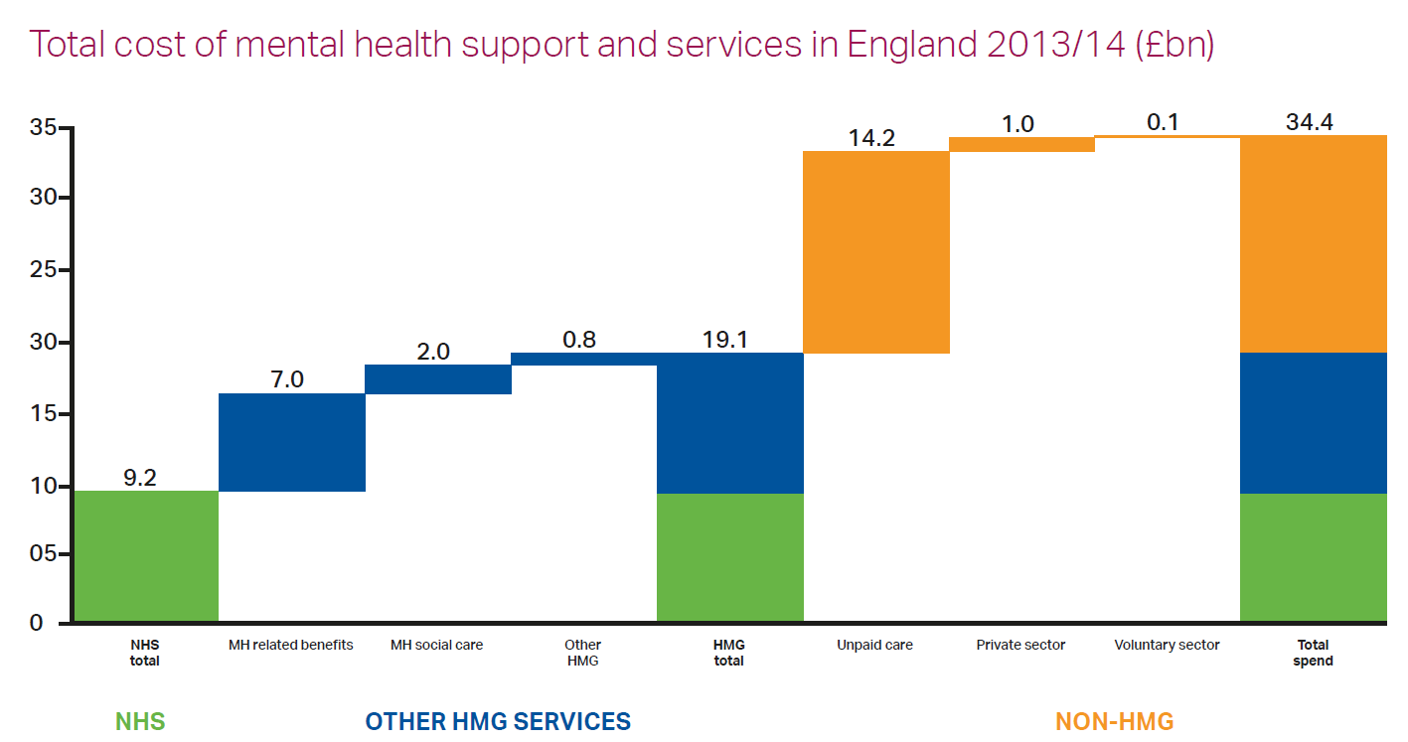
The costs of mental health care today
Poor mental health carries an economic and social cost of £105 billion a year in England.
Analysis commissioned by the Taskforce found that the national cost of dedicated mental health support and services across government departments in England totals £34 billion each year, excluding dementia and substance use.

Slide 5
Poor mental health can drive a 50% increase in physical care costs
Physical healthcare costs 50% higher for type 2 diabetics with poor MH
Additional costs due to increased hospital admissions and complications
Annual physical healthcare costs
per patient, 2014/15 (£)
Annual physical healthcare costs
per patient, 2014/15 (£)
+50%
3,430
2,290
Mostly healthy
Type 2 diabetes with good MH
Type 2 diabetes and poor MH
Type 2 diabetes & good MH
Type 2 diabetes & poor MH
Other Complications
Prescribing & OD
Excess inpatient
Primary care
Presence of poor mental health responsible for £1.8bn of spend on type 2 diabetes pathway
Note: Does not include spend on prescribing psychiatric drugs and other mental health services
Source: Hex et all, 2012; APHO Diabetes Prevalence Model for England 2012; Long-term conditions and mental health: The cost of co-morbidities, The King's Fund
Notes:
Tackling co-morbidities can release significant savings (with the right levers)
3.1m people currently have type 2 diabetes in England
NHS currently spends £8.8bn p.a. treating type 2 diabetes
Opportunity to reduce physical care spend through better integration of physical and psychological care
Less than 15% of type 2 diabetics have access to specialist diabetes psychological support
Integrated services that do exist demonstrate better patient outcomes and reduction in healthcare costs
Pilot schemes have successfully targeted different types of poor MH and varying severities of diabetes
Scaling up nationally would reduce physical care spend driven my poor MH by £160-200m (~25%)
Leading clinicians believe that benefits of MH integration are also applicable to other long term conditions

Slide 6




Opportunities for change
There is now a cross-party, cross-society consensus on what needs to change, with a real desire to shift towards prevention and transform care
Public attitudes towards people with mental health problems have improved by 6% in recent years
Mental health is a top priority for the NHS amongst young people
Over 1000 employers recognise the importance of mental health and are starting to act
There has been important progress e.g. through the development and implementation of NICE guidelines, the introduction of the first ever access and quality standards, & CYP transformation.

Slide 7
Aims and scope of the Taskforce
To develop a Mental Health Five Year Forward View for action by the NHS arms-length bodies, including:
Engaging experts by experience and carers to co-produce priorities for change
Focusing on people of all ages – taking a ‘life course approach’
Address equality and human rights
Enabling cross-system leadership
Making comprehensive recommendations on data and requirements to implement changes, monitor improvement and increase transparency
Assess priorities, costs and benefits as well as identifying and addressing key risks and issues

Slide 8
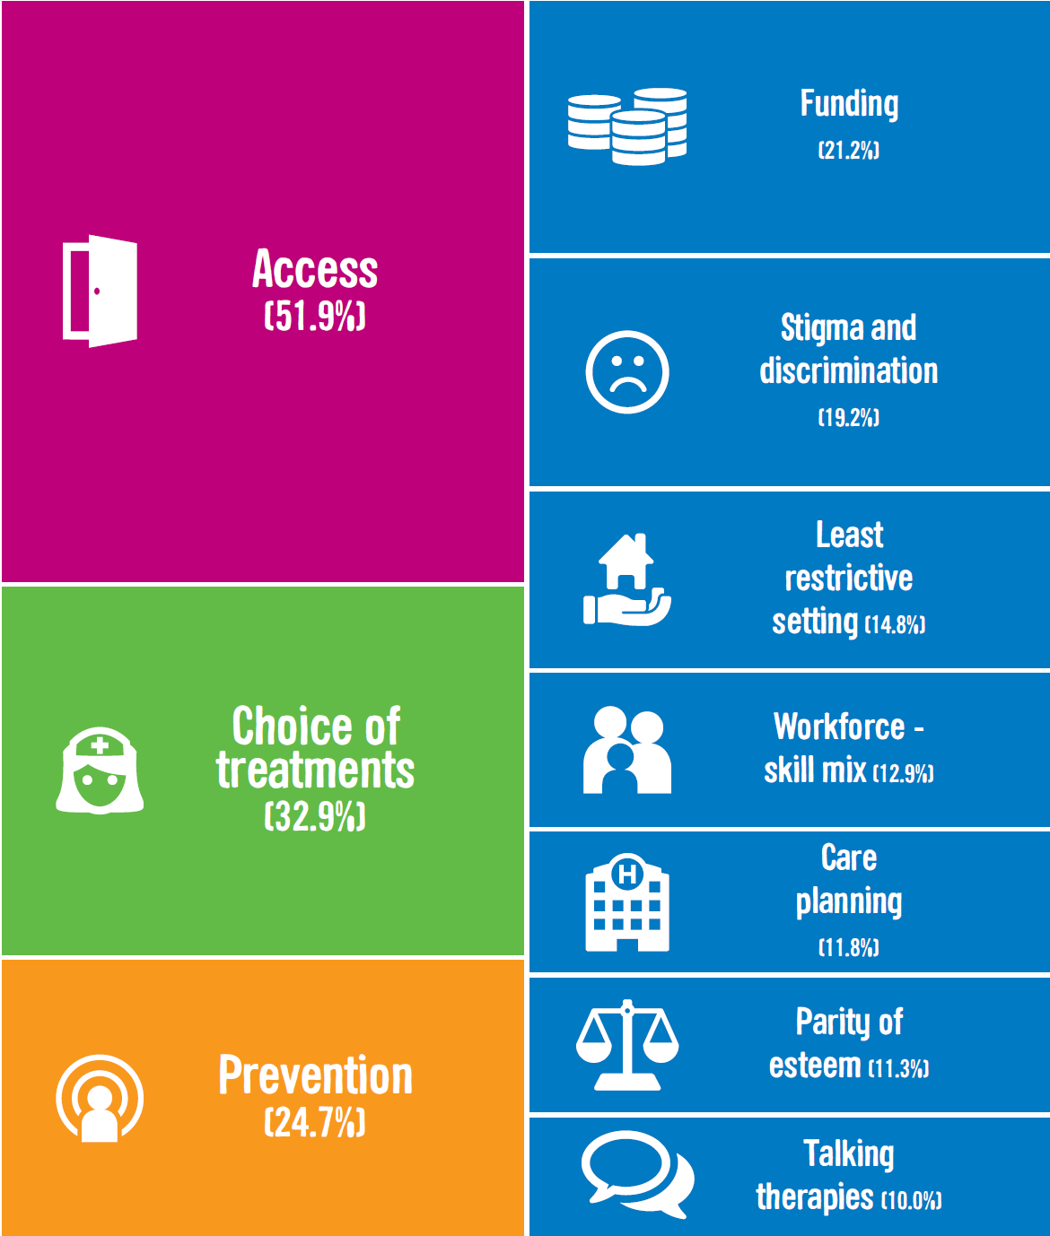
People’s priorities for change
20,000 responses to online survey
250 participants in engagement events hosted by Mind and Rethink Mental Illness
60 people engaged who were detained in secure mental health services
26 expert organisations submitted written responses
20 written submissions from individual members of the public
The themes identified through the engagement process informed the four priorities that shape the full set of recommendations…

Slide 9
Priority 1: A 7 day NHS – right care, right time, right quality
Selection of key recommendations for 2020/21:
No acute hospital should be without all-age mental health liaison services in emergency departments and inpatient wards, and at least 50 per cent of acute hospitals should be meeting the ‘core 24’ service standard as a minimum.
A 24/7 community-based mental health crisis response should be available in all areas across England and services should be adequately resourced to offer intensive home treatment as an alternative to an acute inpatient admission. For adults, NHS England should invest to expand Crisis Resolution and Home Treatment Teams (CRHTTs); for children and young people, an equivalent model of care should be developed within this expansion programme.
At least 10% fewer people should take their own lives through investment in local multi-agency suicide reduction plans.

Slide 10
Priority 2: An integrated approach to mental and physical health care
Selection of key recommendations for 2020/21:
30,000 additional women each year should have access to evidence-based specialist mental health care during the perinatal period.
There should be an increase in access to evidence-based psychological therapies to reach 25 per cent of need so that at least 600,000 more adults with anxiety and depression can access care (and 350,000 complete treatment) each year. There should be a focus on helping people who are living with long-term physical health conditions or who are unemployed. There must also be investment to increase access to psychological therapies for people with psychosis, bipolar disorder and personality disorder.
280,000 more people living with severe mental illness have their physical health needs met by increasing early detection and expanding access to evidence-based physical care assessment and intervention.

Slide 11
Selection of key recommendations for 2020/21:
The best start in life:
Implement the whole system approach described in Future in Mind, helping 70,000 more children and young people to access high quality care.
Employment:
Up to 29,000 per year more people should be supported to find or stay in work each year through increasing access to psychological therapies for common mental health problems (described above) and doubling the reach of Individual Placement and Support (IPS).
Ensure that qualified employment advisers are fully integrated into expanded psychological therapies services.
Identify how the £40 million innovation fund and other investment streams should be used to support devolved areas to jointly commission more services that have been proven to improve mental health and employment outcomes.
Priority 3: Promoting good mental health and preventing poor mental health

Slide 12
Selection of key recommendations for 2020/21:
Justice:
Establish a comprehensive health and justice pathway.
Expand Liaison and Diversion schemes nationally.
Housing:
Explore the case for using NHS land to make more supported housing available (DH, CLG, NHSE, HMT)
Use evidence to ensure that the right levels of protection are in place under the proposed Housing Benefit cap to Local Housing Allowance levels for people with mental health problems who require specialist supported housing
Priority 3: Promoting good mental health and preventing poor mental health (contd.)

Slide 13
Priority 4: ‘Hard-wiring’ mental health across the NHS
The Chief Scientist, working with all relevant parts of government, the NHS ALBs, independent experts, industry and experts-by-experience, should publish a report a year from now setting out a 10-year Government and ALB strategy for mental health research.
System transformation:
Promote equalities and reduce health inequalities in mental health through leadership and transparency
Integrate commissioning for prevention and quality
Establish comprehensive access pathways and standards for mental health (across conditions, ages and settings)
Promote a co-ordinated approach to innovation and research
Produce and deliver on a multi-disciplinary workforce plan
Improve data and transparency, including a MH FYFV dashboard
Reform payment and incentives to move away from unaccountable block contracts
Update the regulatory framework
Establish strong leadership (local, national and cross-Government) for a mentally health society
HEE should develop a multi-disciplinary workforce strategy for mental health to deliver the Taskforce report. To support the future of “Think Ahead”, DH should train more than 300 new Mental Health social workers and 5,000 CYP IAPT therapists over the next three years from the £1.4bn investment.
DH should establish a new independent system for conducting or monitoring investigations into all deaths in in-patient mental health settings, including individuals who are detained under the Mental Health Act, on a par with the way other deaths in state detention are investigated.

Slide 14
Funding and spend transparency
NHS England is investing additional funding in mental health - growing to £1 billion by 2020/21 - to deliver the priority recommendations for the NHS in the strategy.
CCGs should be increasing overall mental health spending over and above the growth in their total baseline allocation to improve the quality of mental health care in line with the strategy, and re-invest any resulting efficiencies in the provision of that care. .
This is additional to the £280m annual funding announced for children, young people, and perinatal care in 2014/15.
The funding will help an extra 1 million children, young people and adults to receive high-quality support when they need it by 2020/21.
Transparency: Through implementing the Taskforce recommendations, by 2020/21 we will be clearer about where money is spent on providing high quality mental health care across the NHS to facilitate improvement in outcomes and greater accountability, both locally and nationally.

Slide 15

Implementation and oversight
Planning Guidance & Mandate: the NHS should ensure measureable progress towards parity of esteem by implementing Taskforce priorities, including ‘must dos’ for 2016/17. Further guidance will be issued to support areas in developing their Sustainability and Transformation plans.
Trial and evaluation: Starting this year, NHS England and ALB partners will work with local areas to trial the implementation of proven and new models of care to identify how to target investment and realise savings locally to reinvest in mental health.
Transparency: The CCG Assessment and Performance Framework will include key mental health measures.
To complement this, a full mental health dashboard should be produced by the summer of 2016.
Governance and oversight: By no later than Summer 2016, NHS England, the Department of Health and the Cabinet Office should confirm what governance arrangements will be put in place to support the delivery of this strategy. This should include arrangements for reporting publicly on how progress is being made against recommendations for the rest of government and wider system partners, the appointment of a new equalities champion for mental health to drive change and creating an independent external advisory board to provide independent scrutiny and challenge to the programme.

Slide 16

For further information and to share your views
Visit: www.england.nhs.uk/mentalhealth/taskforce
Follow:@NHS England
@jahkey2u
Contact NHS England: england.mhtforce@nhs.net
Contact: Jacqui Dyer
Jacquidyer.jd@gmail.com

