Slide 1
Mental Health a priority at the local level – ADPH perspective
Dr Tamara Djuretic
tamara.djuretic@haringey.gov.uk
Assistant Director of Public Health, Haringey on behalf of London ADPH
Notes:
Overview of the context, some key statistics for London , describe work already taking place at the regional and local level

Slide 2
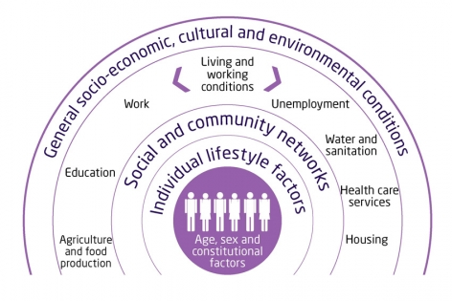
Regeneration
Poverty
“Zero-hours”
Aspiration
Self-esteem
HMOs
Migration
Refugees
Integrated care
Fast food outlets
Winterbourne
Temporary accommodation
Alcohol licenses
Isolation
Domestic and gender-based violence
Drug & alcohol recovery
Stigma
Determinants of health (1992) Dahlgren and Whitehead
Notes:
What are the opportunities in local government
Partnership working, community engagement

Slide 3
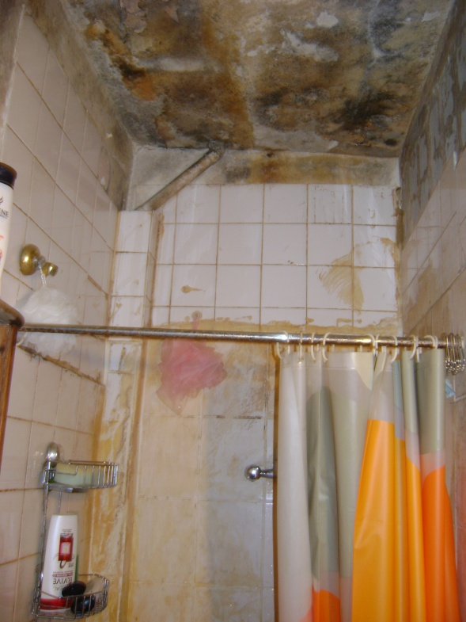
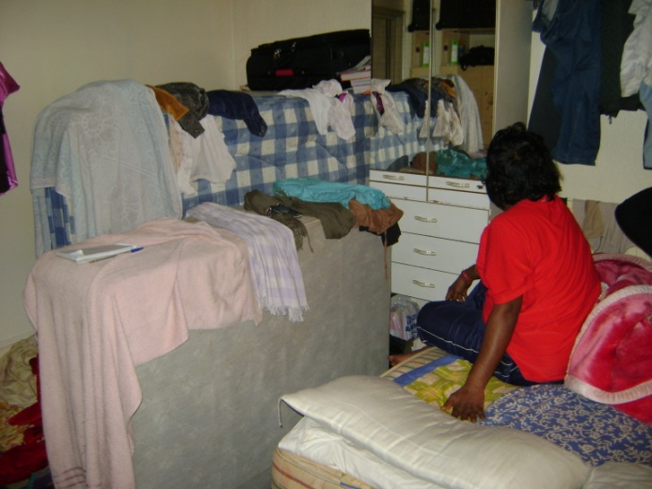

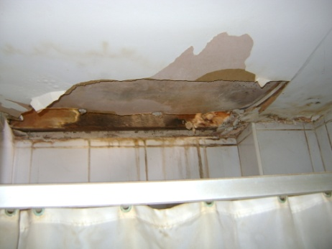
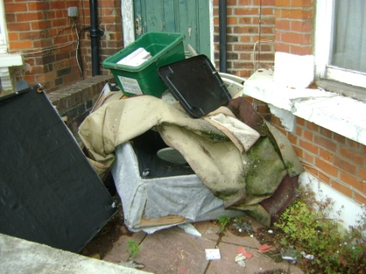

People’s lived experience
Noise
Anti-social behaviour
Lack of fire safety
Overcrowding
Poor construction
Small rooms
Insufficient local amenities
Poor
health
Notes:
Conditions that people live in in London in 21st Century impact on their health and wellbeing

Slide 4
Some key influencing factors – children and young people
Two in five children in London are not ‘school ready’ by the age of five (PHE Fingertips)
5.7% of households in London with dependant children have no adult in employment (Census 2011) – 186, 000 households
Notes:
School readiness - Department for Education (DfE), EYFS Profile: EYFS Profile statistical series
PHE Fingertips http://fingertips.phe.org.uk/profile/child-health-profiles/data#page/6/gid/1938132948/pat/6/par/E12000007/ati/102/are/E09000002/iid/90631/age/34/sex/4

Slide 5
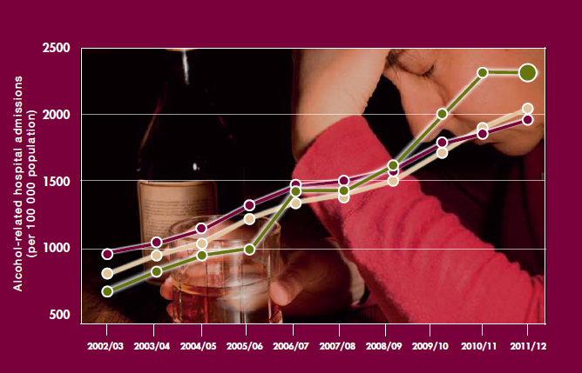
Key influencing factors - adults
Alcohol-related hospital admissions significantly increased over the last ten years in London and England (PHE Fingertips).
Crime in London is on increase with 36% of Londoners reporting being worried about crime in their local area (GLA).
Notes:
Alcohol-related hospital admissions – PHE Fingertips
Crime data – GLA paper

Slide 6
App. 150, 000 people in receipt of unemployment benefits have mental ill health, London, 2015 (46% of all claimants)
Data source: DWP, February 2015

Slide 7
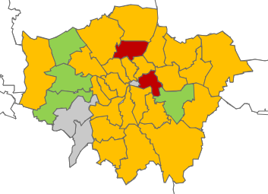
Suicide rates in London are decreasing but there is a great variation between the boroughs............
Suicide rates in London, compared
with England, 2001-03 to 2012-14
(age-standardised rate per
100,000 population)
Suicide rates in London, compared
with England, 2001-03 to 2012-14
(age-standardised rate per
100,000 population)
Data source: PHE Fingertips, 2015
Notes:
PHE Fingertips http://fingertips.phe.org.uk

Slide 8
Prioritising mental health at local level
1) Leadership
HWB Strategies across London have mental health and wellbeing as key priority and
JSNAs chapters
MH Champions in 13+ boroughs
2) Strategic shift to prevention and ‘early help’
Across the council – children and young people services, schools, employment, housing; a life-course approach
Tackling stigma - Mental Health First Aid
Smoking cessation services for people with SMIs
3) Working in partnership

Slide 9
Challenges and opportunities at the local level
High levels of need, and increasing; complexity of needs
Finite resources
Under-developed recovery models and models of care in the community
Shift from focusing on mental illness to wellbeing
Improving quality of primary care
Integrating health and social care and devolution pilots
Data and intelligence sharing across partnership
Adequate housing and employment opportunities
Established links with communities

