Slide 1

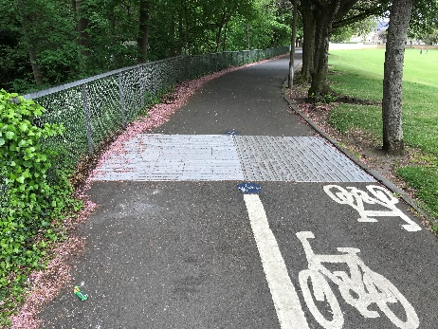
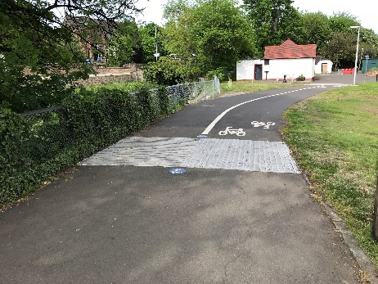
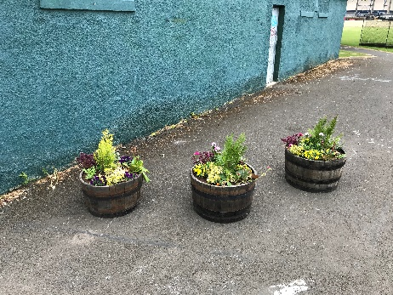
Proposed Path Improvements in Roseburn Park
Issue:
Roseburn Park currently has a number of paths designated as shared use for cycling and walking. Previous consultation exercises have shown that many path users would prefer cyclists and pedestrians to be segregated on these paths. In the centre of the park there are three buildings. Sightlines at these locations are poor which has led to conflict and collisions between different path users in the past.
Purpose and context:
The proposals include the segregation of cyclists and pedestrians along the paths in the park which form QuietRoute 8. The improvements aim to reduce conflicts between pedestrians and cyclists along these paths. The improvements are to QuietRoute 8, which is part of the QuietRoutes Network being implemented across the city.
The Council is developing a network of cycle routes across the city, called the ‘QuietRoutes’ network. We know that heavy or fast traffic is the most significant barrier preventing people who want to cycle from doing so. To address this, the QuietRoutes are designed so that people can cycle without having to be with heavy or fast traffic. QuietRoute 8 links Roseburn to Sighthill and Edinburgh Park. The lack of appropriate facilities through Roseburn Park is a key barrier which prevents the route meeting this required standard.
The improvements will help people on foot and by bike to reach key local destinations, such as Roseburn Primary School, Haymarket Station, Roseburn Park, Murrayfield Stadium and National Cycle Route 1.
Trial Layout:
In April 2018 the City of Edinburgh Council implemented trial changes to the path layout in Roseburn Park to reduce the potential for conflicts on the paths and main path junction. The results of the short term trial, as recorded by monitoring and feedback to this consultation, will inform the future permanent improvements to the path.
An online survey, inviting feedback on the current trial layout and its operation will be made available on the Council’s website:
https://consultationhub.edinburgh.gov.uk/sfc/design-cycle-walk-roseburn-park-trialdesign-cycle -walk-roseburn-park-trial

Slide 2
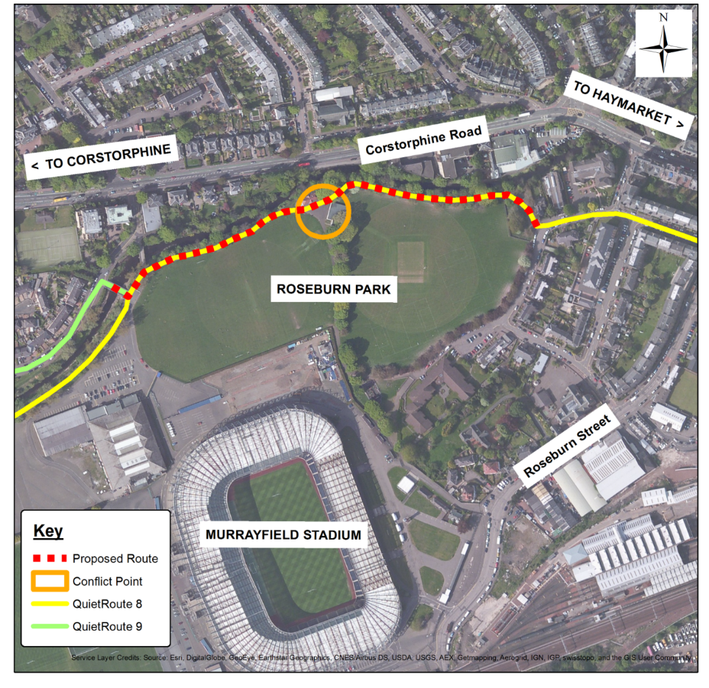
Proposed Path Improvements in Roseburn Park
Proposed scheme:
The Council is undertaking a short term trial to make to make it easier, safer and more convenient to walk and cycle through Roseburn Park. We would like your views on the operation of the trial improvements which include:
The segregation of pedestrians and cyclists along paths in Roseburn Park
Installation of planters to improve sightlines on approach to junction
Purpose: to provide segregation of pedestrians and cyclists along existing paths within Roseburn Park, reducing potential conflict between different users and creating a more pedestrian and cycle friendly environment within the park.
Next Steps: An update and information of the trial evaluation and its recommendations will be made available on the Council’s website following the trial period.

